Slide 1
Revisiting Transport Congestion Control
Jian He
UT Austin

Slide 2

Why is Congestion Control necessary?
Data
Packets
Congested
Link
ACK
Congested link vs. reliability: long queuing delay, packet loss
But, can delay or packet loss always well explain congestion?

Slide 3
Can we distinguish congestion reasons?
Congestion related signals:
- packet loss: duplicate ACKs, retransmission timeout
(TCP Reno, TCP Cubic)
- round-trip delay: TCP packet RTT
(TCP Vegas, FAST TCP, Compound TCP)
- queue size: explicit congestion notification(ECN)
(DCTCP)

Slide 4
Existing TCP Variants
TCP
Throughput-Latency Tradeoff Exploration
[Remy SIGCOMM’13]
Datacenter TCP
Tail performance[TIMELY SIGCOMM’15], New Architectures[R2C2 SIGCOMM’15] RDMA[DCQCN SIGCOMM’15]
Persistently High Performance
Large flows[PCC NSDI’15]
Highly-variant network condition
Cellular transport[Verus SIGCOMM’15, Sprout NSDI’13]
Reducing Start-up Delay
[Halfback CoNext’15], [RC3 NSDI’14]
Performance interference for competing flows
Application Heterogeneity[QJUMP NSDI’15]

Slide 5
TCP Evolution
Application
Application-Specific
Performance Requirements
Application Sensing Layer
TCP
Networking Sensing Layer
IP
Network Condition
Link
Hardware

Slide 6
Optimizing Datacenter Transport Tail Performance
Mittal, Radhika, et al. "TIMELY: RTT-based congestion control for the datacenter."
In ACM SIGCOMM 2015.

Slide 7

Why does tail performance matter?
…
TCP Incast: many servers reply the client simultaneously
All replies should meet their deadlines.
Datacenter transport must deliver high throughput(>>Gbps)
and utilization with low delay(<<msec).

Slide 8
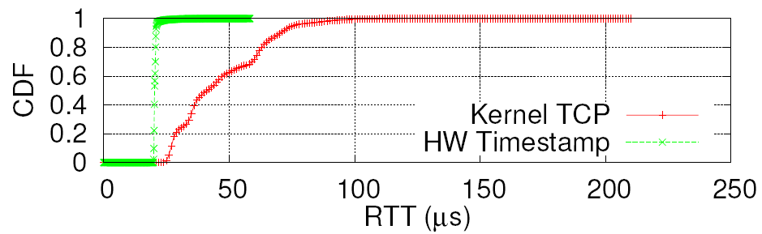
Hardware Assisted RTT Measurement
Why was RTT not widely used?
RTT-based congestion control performed poorly at WANs.
Highly noisy RTT estimation(system kernel scheduling, etc.)
Datacenter RTT measurement needs ms-level granularity.
Hardware timestamp and hardware acknowledgement
can significantly remove noise.

Slide 9
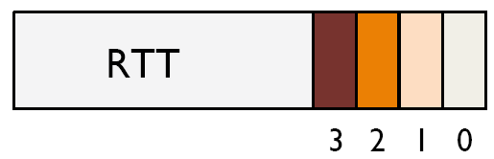
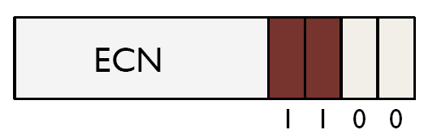
RTT As a Congestion Control Signal
Multi-bit signal
Single-bit signal
ECN can not reflect the extent of end-to-end latency
inflated by network queuing, due to traffic priorities,
multiple congested switches, etc.

Slide 10
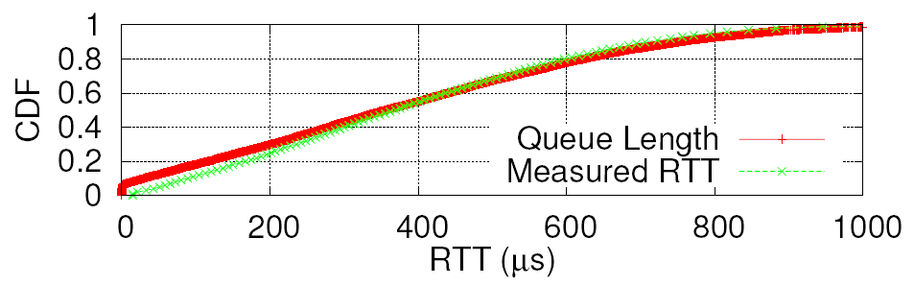
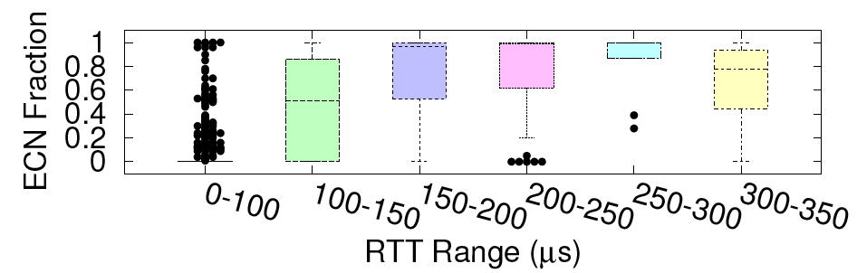
RTT Correlates with Queuing Delay

Slide 11
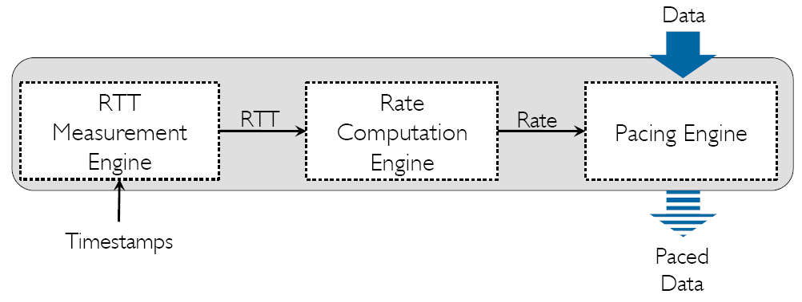
TIMELY Framework

Slide 12
RTT Measurement
tsend
Serialization Delay
RTT
tcompletion
Propagation &
Queuing Delay
ACK Turnaround Time
One RTT for one segment (NIC Offload)
Hardware ACKs make ACK turnaround time ignorable
RTT = Propagation + Queuing Delay
= tcompletion – tsend – segment_size/NIC_line_rate

Slide 13
Transmission Rate Control
Message to
be sent
Segments
RTT
Estimation
Rate Controller
Insert delay between
segments
Transmission
Queue
Target rate is determined by segment size and delay
between segments

Slide 14
Rate vs. Window
Segment size as high as 64KB.
(32us RTT x 10Gbps) = 40KB window size
40KB < 64KB: Window makes no sense

Slide 15
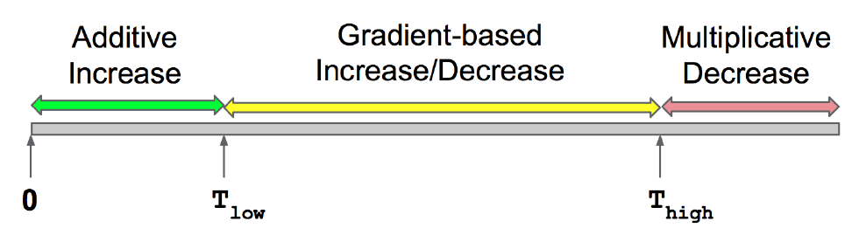
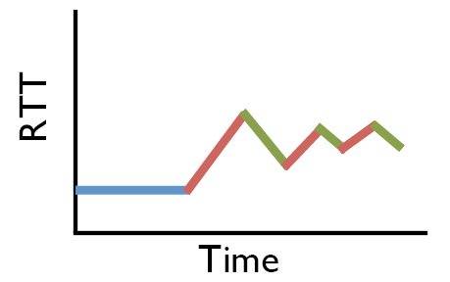
Rate Update

Slide 16
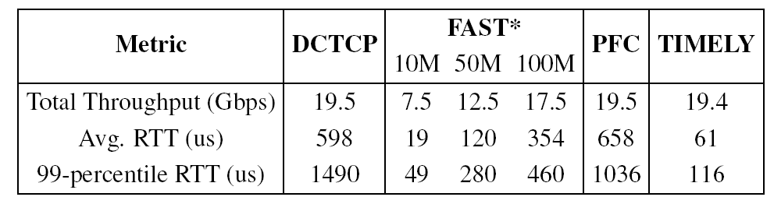
Evaluation

Slide 17
Datacenter Transport for Emerging Architectures
Costa, Paolo, et al. "R2C2: A Network Stack for Rack-scale Computers."
In ACM SIGCOMM 2015.

Slide 18
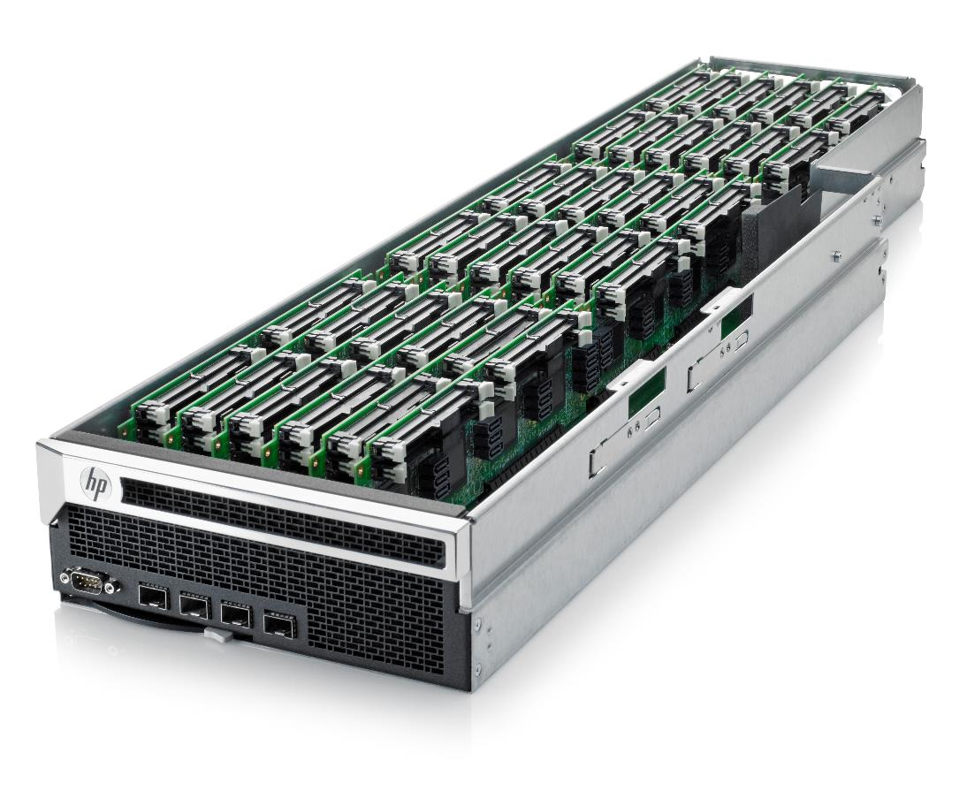
Rack-Scale Computing
Building Block for future datacenters
High BW low latency network
Direct-connected topology

Slide 19
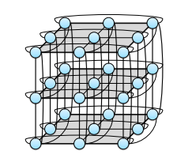
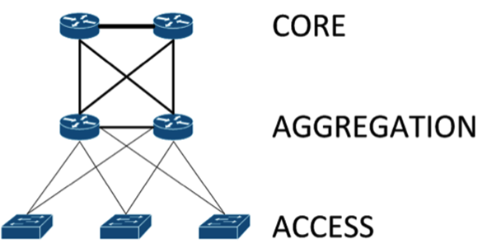
Rack-Scale Network Topology
Distributed switches(each node works as a switch)
High path diversities
3D Torus
Fat-tree Topology

Slide 20
Broadcasting-Assisted Rack Congestion Control
Broadcasting overhead is
low(around 1.3%).
Broadcast flow information(e.g., start time, finish time)
Each node has a global view of the network
Locally optimize flow rate with the global view

Slide 21
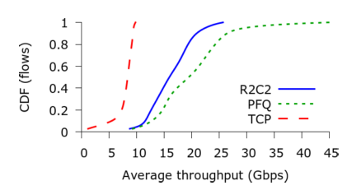
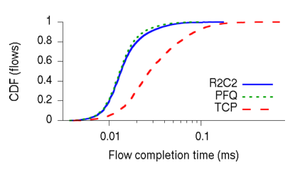
Evaluation

Slide 22
Congestion Control for
RDMA-enabled Datacenters
Zhu, Yibo, et al. "Congestion Control for Large-Scale RDMA Deployments.”
In ACM SIGCOMM, 2015.

Slide 23



Congestion Spreading in Lossless Networks
PAUSE
PAUSE
PAUSE
PAUSE
PAUSE
PAUSE
PAUSE
PAUSE
PAUSE
PAUSE
Port-based congestion control incurs congestion spreading
DCQCN: incorporating explicit congestion notification to
support flow-based congestion control

Slide 24
Wireless Congestion Control
Zaki, Yasir, et al. "Adaptive Congestion Control for
Unpredictable Cellular Networks.“ In SIGCOMM 2015.

Slide 25
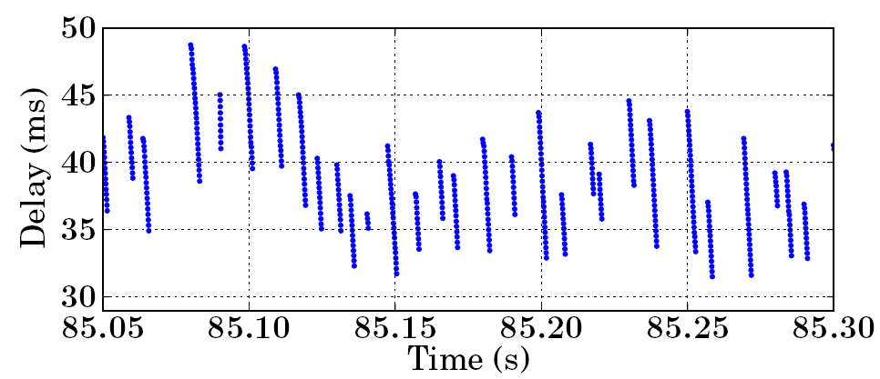
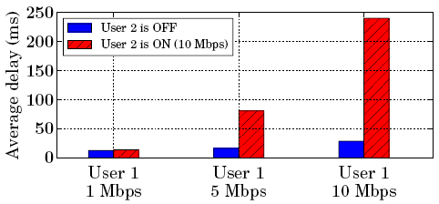
What do Cellular Traffic Look Like?
Burst Scheduling
Competing Traffic

Slide 26
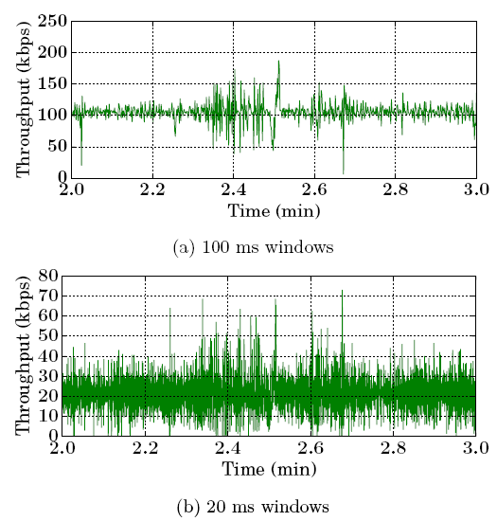
What do Cellular Traffic Look Like?
Channel Unpredictability

Slide 27
Verus Protocol
Epoch i
Epoch i+1
Sending window
Wi
Sending window
Wi+1
Epoch: a short period of time (e.g., 5 ms)
Sending window is updated at each epoch.
Sending window represents the number packets in flight.

Slide 28
Verus Overview
Delay Estimator: estimate delay in the
future based on the changes of delay
Delay Profiler: record the relationship of
delay-sending window
Go to
next epoch
Window Estimator: estimate the sending
window for the next epoch
Packet Scheduler: calculate the number
packets to be sent in the next epoch

Slide 29
Delay Estimation
Epoch i-1
Epoch i
Dmax,i =
alpha x
Dmax,i-1
+ (1-alpha) x
Dmax,i
∆Di = Dmax,i -Dmax,i-1
•
∆Di<=0
Dest,i+1
Estimated
Delay
Dest,i
•
∆Di>0
•
Time

Slide 30
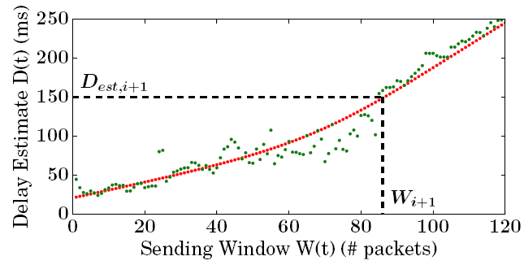
Window Update
Delay-Window Profile: updated based on historical data
Each epoch can contribute many points to the profile.
Profile is initialized using data in the slow-start phase.

Slide 31
Packet Scheduler
Epoch i
Epoch i+1
Sending window
Wi
Sending window
Wi+1
How many packets to be sent in current epoch?
Si+1 = max[0, (Wi+1 + ((2-n)/(n-1))*Wi)]
n is the number of epochs over the current estimated RTT

Slide 32
Loss Handling
Epoch i
Epoch i+1
Sending window
Wi
Multiplicative Decrease
Wi+1 = M * Wi
Stop updating delay profile during the loss recovery phase

Slide 33
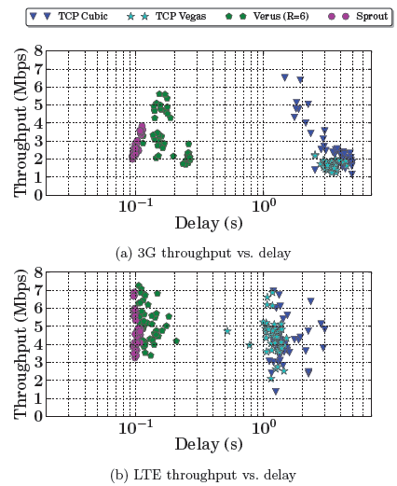
Evaluation

Slide 34
Thanks!

