Slide 1
RF-based Device-free Gesture recognition and Motion Tracking
Ghufran
Swadhin

Slide 2
Existing Techniques
Imaging based
Pros
Fine-grained tracking
Multi-object tracking
H/W abundant
Cons
Compute heavy
require LOS (Occlusion)
Privacy issues
Acoustic
Pros
Low on computation (Software based)
No external hardware
Good single object tracking
Cons
Limited bandwidth
Human Irritation
Specially modulated sound wave (FMCW)

Slide 3
Existing Techniques
60 GHz
Pros
Huge bandwidth
Higher resolution (~1.5cm in FMCW)
Opportunity of fine-grained tracking
Cons
Require specialized embedded chip
Restricted to LOS
Wi-Fi (2.4 GHz, 5 GHz, UWB)
Pros
NLOS
H/W availability more (SDR, USRP, NIC)
Allows both LOS/NLOS
Cons
No fine-grained tracking
Mostly identify coarse-grained gestures
Limited bandwidth

Slide 4
Existing RF based Systems
Name | Technique | Frequency (GHz) | Gesture/Tracking | Accuracy | Range | Hardware | Comments
WiTrack (NSDI ‘14) | FMCW | 5.4-7.25 | 2D Tracking | ~10cm | ~10m | USRP | Custom signal
WiTrack 2.0 (NSDI ‘15) | FMCW | 5.4-7.25 | 2D MU Tracking | ~10cm | ~10m | USRP | Custom signal
WiDeo (NSDI ‘15) | Channel Estimation | 2.4 | Limb Tracking | ~7cm | ~15m | WARP | Multiple APs
WiVi (SIGCOMM ‘13) | ISAR, MUSIC | 2.4 | Motion Tracking | 3 human: 90% | ~7m | USRP | Binary gestures
WiKey (MOBICOM ‘14) | CSI, HMM | 5 | Keystroke | ~85% | ~2m | Intel 5300 | ML based, 2500 pkts/s
WiDraw (MOBICOM ‘14) | CSI, MUSIC | 5 | Hand Tracking | 2D: ~6cm 3D: ~9cm | ~2m of device | Laptop and APs | Initial calibration, ~25 APs
Mudra (CoNext ‘16) | CSI, Nulling, DTW | 2.4 | 9 Finger Gestures | 96% | ~5m | SDR | SDR used, Training free
WiFinger (Mobihoc ‘16) | CSI, Wavelet, DTW | 2.4 | 8 Finger Gestures | 92% | ~4m | USRP | Restricted setup
WiHear (Mobicom ‘15) | MU-MIMO, CSI, Wavelet, DTW | 2.4 | 9 mouth gestures | ~75% | ~8m | USRP, Stepper motor | Restricted, stepper motor calib.

Slide 5
Things to look for in RF based schemes
Number of Transmitters and Number of Receiver Antennas.
SDR platform (Mudra and its predecessor) or COTS Wi-Fi (WiFinger, WiKey, WiDraw, WiDeo) or Custom setup (WiVi, WiTrack2.0).
Machine learning based or Training Free.
Fine-grained gesture (WiFinger, Mudra), Coarse-grained gesture (WiTrack2.0, WiVi, WiDeo) or 2D/3D tracking (WiDraw) or something else (WiHear - listening, WiKey).
Initial calibration step (WiDraw makes the user move the device for Azimuth and elevation, WiHear rotates the WiFi AP using a stepper motor).
Custom designed signal (FMCW in WiTrack, WiKey - 2500 packets/sec at max rate communication) or in parallel with the communication without hampering it (WiDraw, Mudra).

Slide 6
Mudra
Fine grained gesture recognition
CSI based MIMO nulling
WiDraw
Hand motion detection
AoA using CSI
Hand occlusion of AoA trajectory
WiFinger
Fine grained gesture recognition
Unique CSI pattern

Slide 7
Mudra: User-friendly Fine-grained Gesture Recognition using WiFi Signals
CoNEXT ‘16

Slide 8
Introduction
Fine grained finger gesture recognition
Utilizes regular WiFi signals
User and Environment Independent
Training-free
Used CSI to equalize signal utilizing nulling method in 2.4 GHz WiFi
Detects 9 gestures

Slide 9
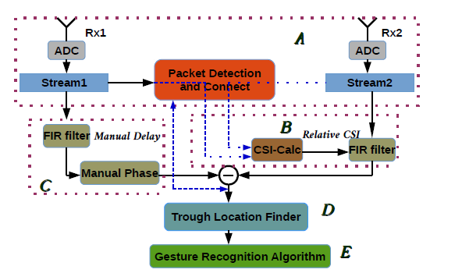
System Overview

Slide 10
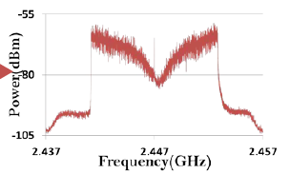
System Overview
Equalization
Manual delay addition
Finger movement causes delay mismatch
Subtraction yields troughs

Slide 11
Finger position sensitive indicator
Trough location
Trough depth and sensitivity to finger movement depends on Δt
More Δt : Deeper trough
More Δt : Less sensitivity

Slide 12
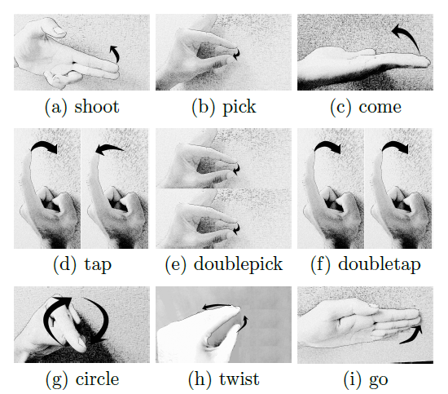
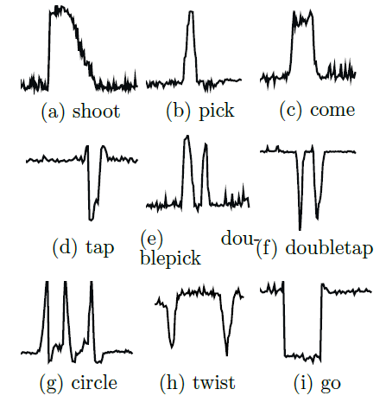
Gesture Grammar

Slide 13
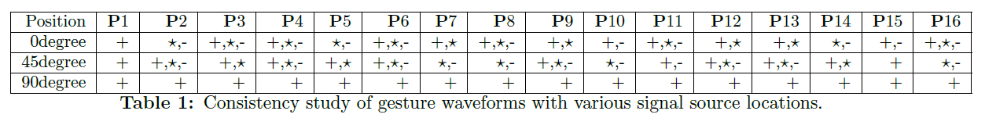
Gesture Recognition
Gesture waveforms remain consistent across users at different locations
Shape is preserved
universal waveform template for each gesture independent of specific user.
Use DTW to match waveform and template

Slide 14
Setup
NI-based SDR platform
Two antennas
Distances
2m LOS
5m NLOS
Δt is chosen to be 1 (skip one sample)
Gesture performed facing antennas
Metal plate between Tx and Rx to remove direct-path signals

Slide 15
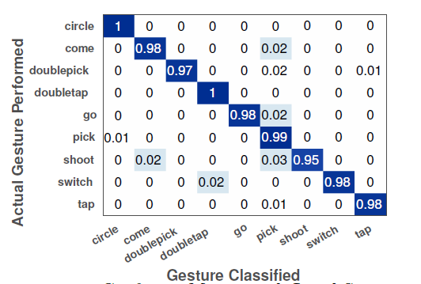
Results - LOS
Average recognition accuracy is 98%.

Slide 16
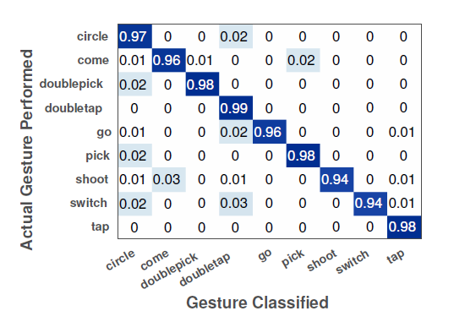
Results - NLOS
Average accuracy is 96%.

Slide 17
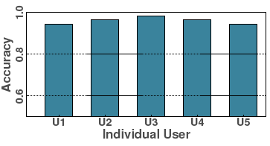
Accuracy is consistent across users
Three users performing simultaneous gestures
recognition accuracy 94%
Don’t mention if its for all users or just one

Slide 18
WiDraw: Enabling Hands-free Drawing in the Air on Commodity WiFi Devices
MobiCom ‘15

Slide 19
Introduction
Hand motion tracking system using commodity WiFi cards
WiDraw utilizes the
Channel State Information (CSI) from multiple antennas
Angle-of-Arrival (AoA)
Harnesses the effect of hand occlusions on the signal strength of incoming signal directions

Slide 20
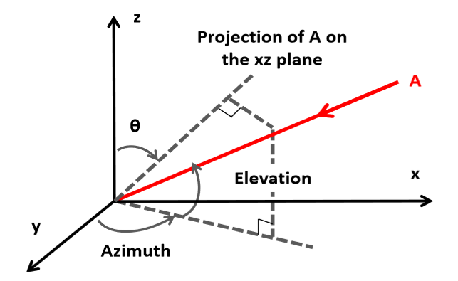

Multiple Aps at different locations
Multiple AoAs
MUSIC using CSI values
1-D AoA estimates
Notes:
we observe that if the user’s hand blocks the signal
arriving along a specific AoA, the AoA’s signal strength will experience
a sharp drop

Slide 21
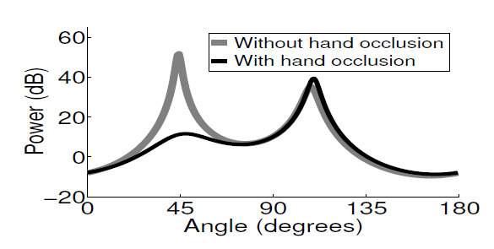
Observation:
If Blocked by hand, AoA’s signal strength experience sharp drop.
Stays constant otherwise

Slide 22
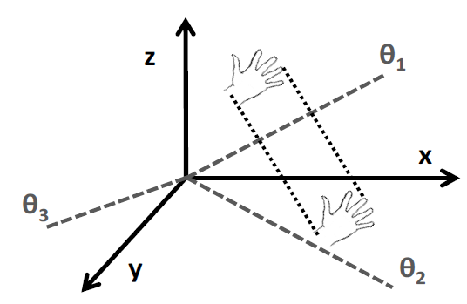
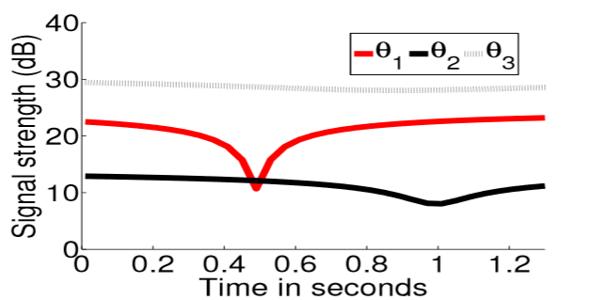
Observation:
Minima when hand is closest to AoA trajectory.
Drop proportional to hand proximity to the AoA trajectory

Slide 23
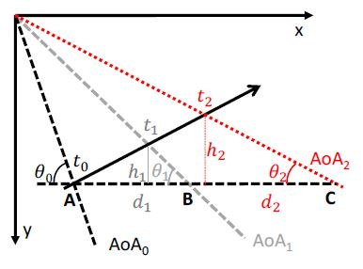

Estimating hand depth
Hand pepth
distance from hand to the line of Antenna array
Time of minima for each AoA
t0, t1, t2
α = (t1-t0)/(t2-t0)
Change in depth can be estimated as follows

Slide 24
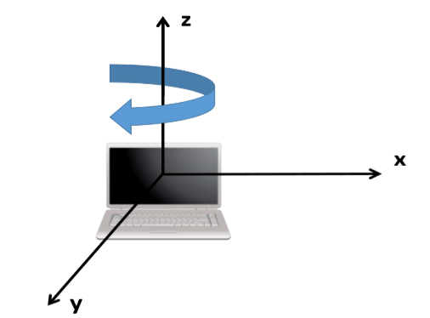
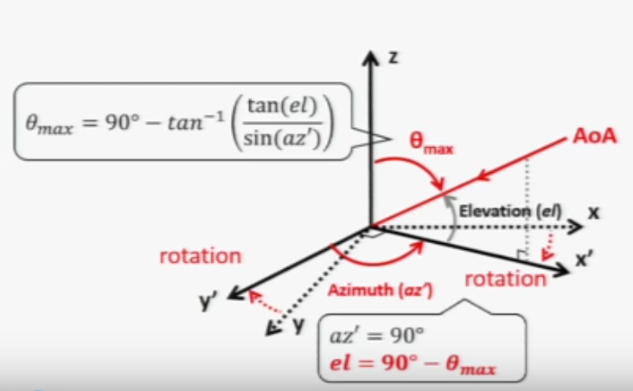
Estimate Az and El for each AoA
User rotates RX along Z axis
Tracks max angle for each AoA
Max angle used to compute ‘el’
‘az’ calculated from ‘el’

Slide 25

Hand Coordinate Estimation
Minima observed for AoA with azimuth (az) and elevation (el)
yi - hand’s depth from the receiver
Estimated coordinates

Slide 26
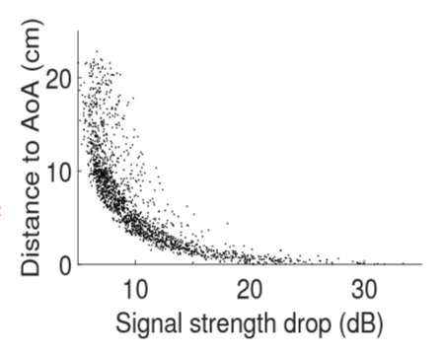
Calculated coordinates may not be exact
Hand does not occlude the AoA completely
Observation
RSSI drop proportional to Distance between hand and AoA trajectory
RSSI change
+ve moving away
-ve moving toward

Slide 27
Max RSSI drop for one AoA
Distance from estimated coordinated
Trend of change in RSSI from neighboring AoA
Resolve ambiguity
Gives true estimate for hand coordinates

Slide 28
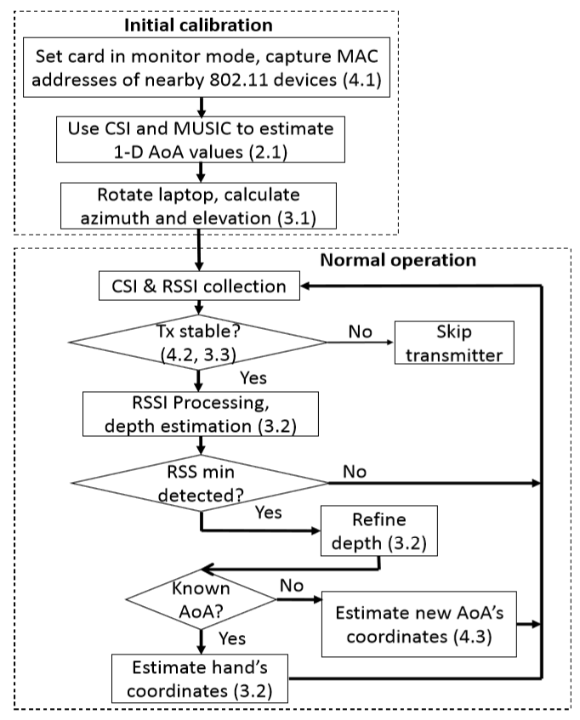
System Architecture

Slide 29
Setup
AoA values from 30 neighboring transmitters
Atheros 9590 chipset 3 antennas

Slide 30
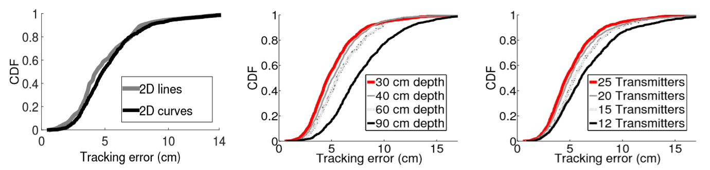
2D Tracking
median tracking error is 5.4 cm
No error accumulation over time

Slide 31
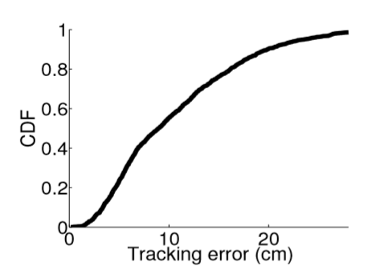
3D Tracking
Median tracking error 8.6 cm
Error proportional to depth estimation error

Slide 32
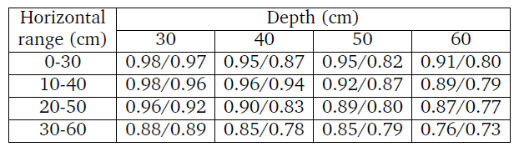
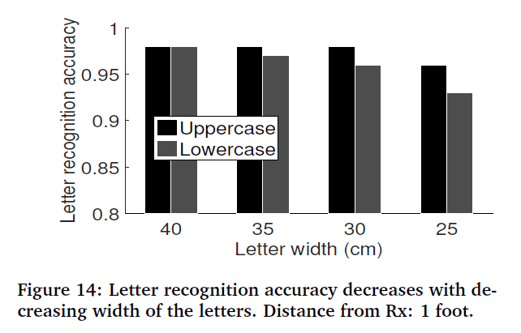
Results
Using the writing reorganization application - MyScript Stylus

Slide 33
WiFinger: Leveraging Commodity WiFi for Fine-grained Finger Gesture Recognition
MobiHoc ‘16

Slide 34
Introduction
Enables fine-grained gesture recognition
Train &Test CSI pattern across gestures
Resilient to individual diversity and gesture inconsistency
Once trained can be used for other users
Resilient to environment changes
Works for both LOS & NLOS scenarios
Detects 8 gestures

Slide 35
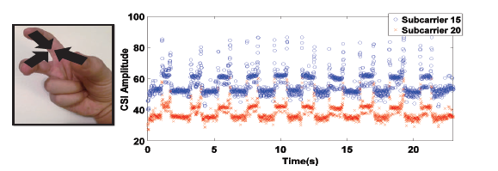
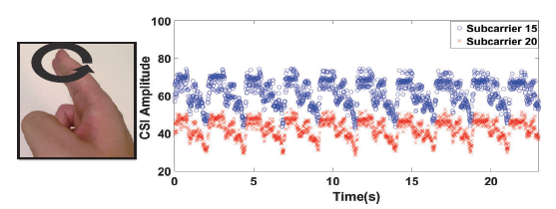
Observation
Each finger gesture has its unique CSI pattern
Gesture recognition
matching the CSI pattern against the gesture profiles.

Slide 36
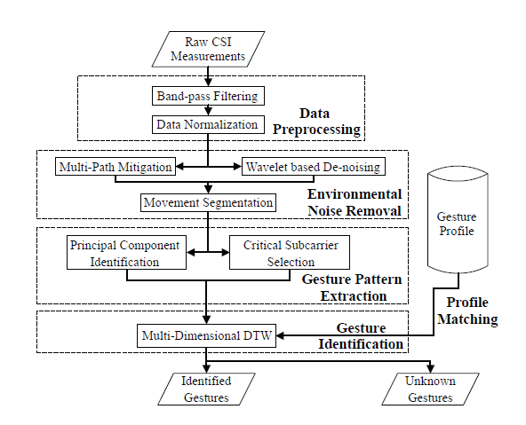
System Architecture

Slide 37
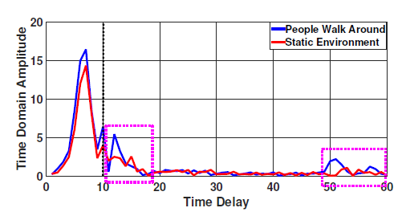
Multipath Mitigation
Signal components with large time delay removed
retains the CSI pattern of the finger gesture
mitigates effect of the changed multipath environment
Remove power delay profile coefficients with delay > 500ns

Slide 38
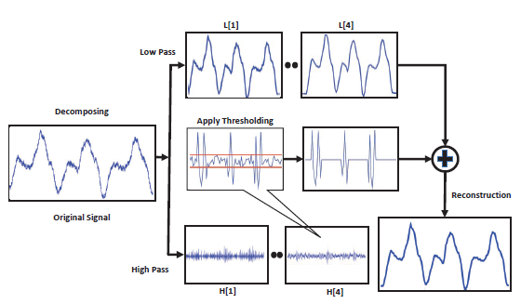
Noise Removal
Discrete Wavelet Transform (DWT)
approximation co-efficients - shape/trend of the signal which retain large scale characteristic
detail coefficients - high frequency noise and the fine details of the CSI pattern.
Noise removal
Symlet Wavelet Filter

Slide 39
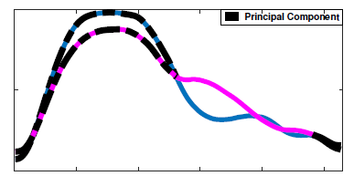
Principal Component Identification
Principal Component – invariant part of CSI waveform across the same set of finger gestures that one user performed.
Principal components assigned higher weights when building profiles

Slide 40
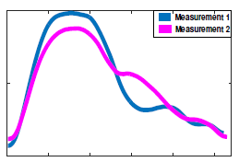
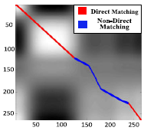
Principal Component Extraction
Extrapolate every sequence to same length
Direct matching samples in the coupling sequence generated by the DTW algorithm are considered as the principal component candidates which represent the consistent gesture segments between two CSI instances.

Slide 41
Gesture recognition
MD-DTW
align the CSI pattern to the gesture profiles in the library.
calculate the similarity between the testing CSI pattern and each of the known gesture profile in the profile library.
Highest and sufficient similarity to the CSI pattern is identified as recognized gesture

Slide 42
Setup
WiFi device
Dell LATITUDE E5540 Laptop)
Wireless Access Point
LINKSYS E2500 N600
10 instances of each gesture to build profiles
User always in between AP and device

Slide 43
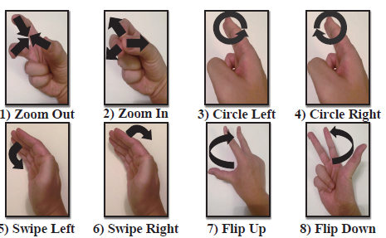
Gesture Grammar

Slide 44
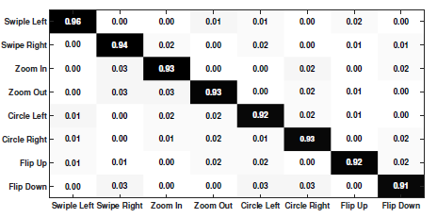
Recognition Accuracy
Overall recognition accuracy >93%

Slide 45
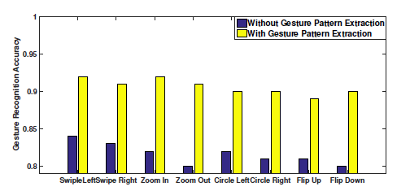
Individual Diversity
Trained using 1 user and tested by another
Principal component extraction improves accuracy by over 10%

Slide 46
Existing RF based Systems
Name | Technique | Frequency (GHz) | Gesture/Tracking | Accuracy | Range | Hardware | Comments
WiTrack (NSDI ‘14) | FMCW | 5.4-7.25 | 2D Tracking | ~10cm | ~10m | USRP | Custom signal
WiTrack 2.0 (NSDI ‘15) | FMCW | 5.4-7.25 | 2D MU Tracking | ~10cm | ~10m | USRP | Custom signal
WiDeo (NSDI ‘15) | Channel Estimation | 2.4 | Limb Tracking | ~7cm | ~15m | WARP | Multiple APs
WiVi (SIGCOMM ‘13) | ISAR, MUSIC | 2.4 | Motion Tracking | 3 human: 90% | ~7m | USRP | Binary gestures
WiKey (MOBICOM ‘14) | CSI, HMM | 5 | Keystroke | ~85% | ~2m | Intel 5300 | ML based, 2500 pkts/s
WiDraw (MOBICOM ‘14) | CSI, MUSIC | 5 | Hand Tracking | 2D: ~6cm 3D: ~9cm | ~2m of device | Laptop and APs | Initial calibration, ~25 APs
Mudra (CoNext ‘16) | CSI, Nulling, DTW | 2.4 | 9 Finger Gestures | 96% | ~5m | SDR | SDR used, Training free
WiFinger (Mobihoc ‘16) | CSI, Wavelet, DTW | 2.4 | 8 Finger Gestures | 92% | ~4m | USRP | Restricted setup
WiHear (Mobicom ‘15) | MU-MIMO, CSI, Wavelet, DTW | 2.4 | 9 mouth gestures | ~75% | ~8m | USRP, Stepper motor | Restricted, stepper motor calib.

