Slide 1
Hand Pose Estimation Using Computer Vision
Presenter:
Wenguang Mao

Slide 2
Outline
What is hand pose estimation
How to model a hand
How to estimate hand pose
Recent research about hand pose estimation
State-of-the-art performance

Slide 3

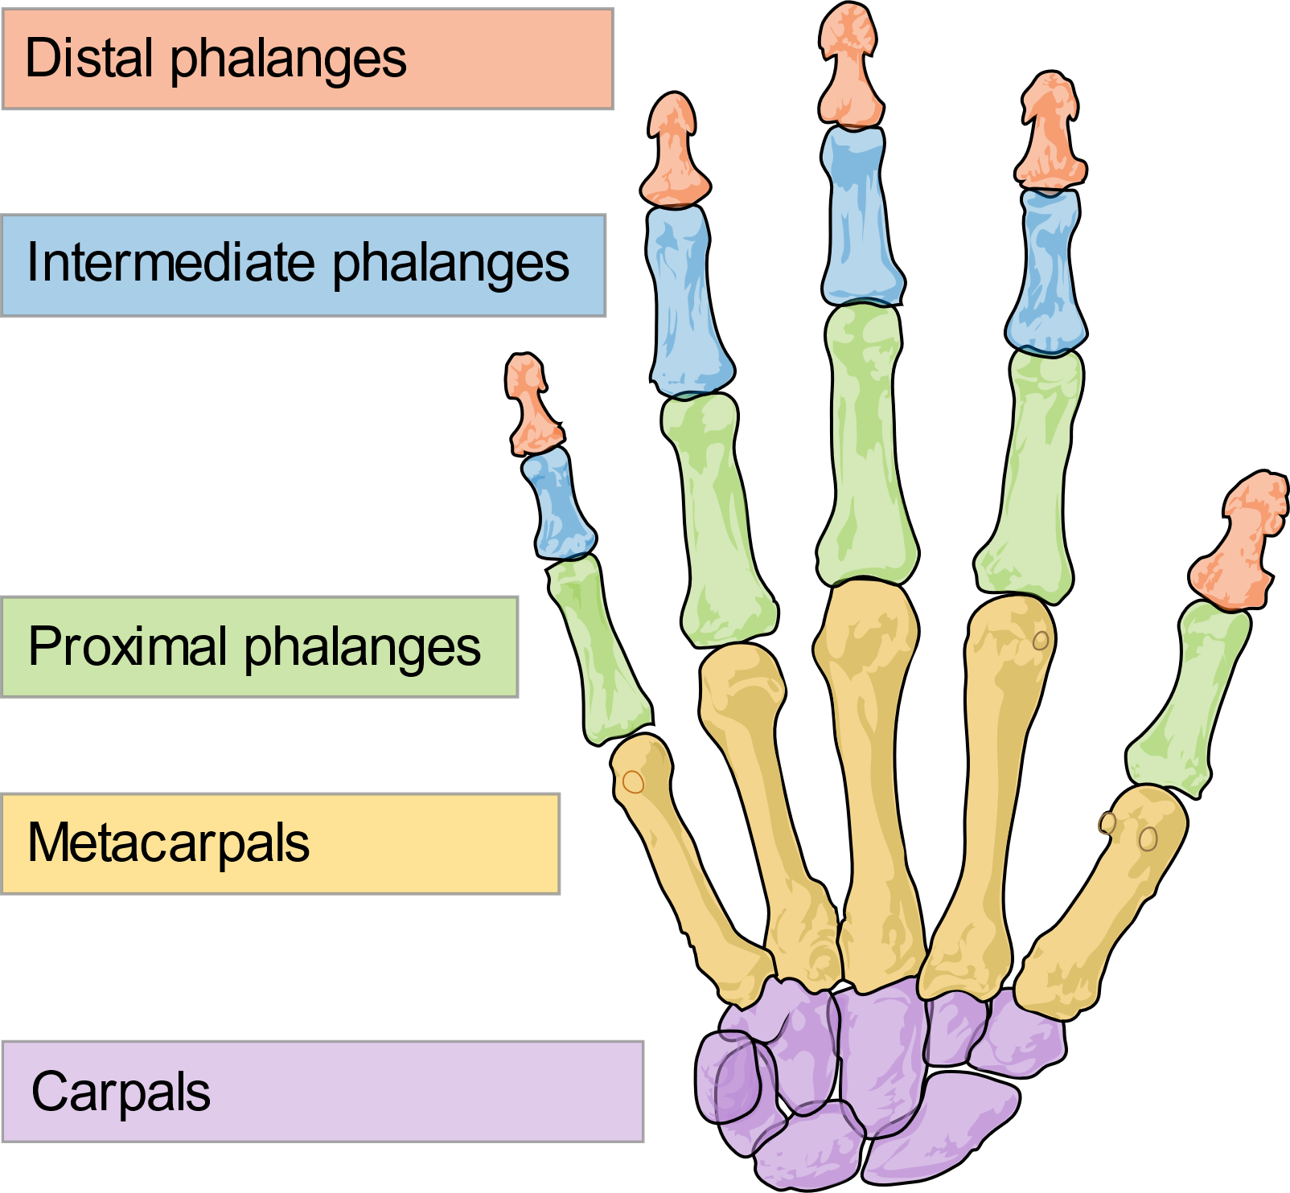
What is Hand Pose Estimation
Hand pose estimation
Determine 3D locations of hand joints
Require depth images
May also need RGB images
Hand tracking
Associate the same hand over consecutive video frames
Works on RGB image

Slide 4
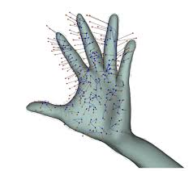
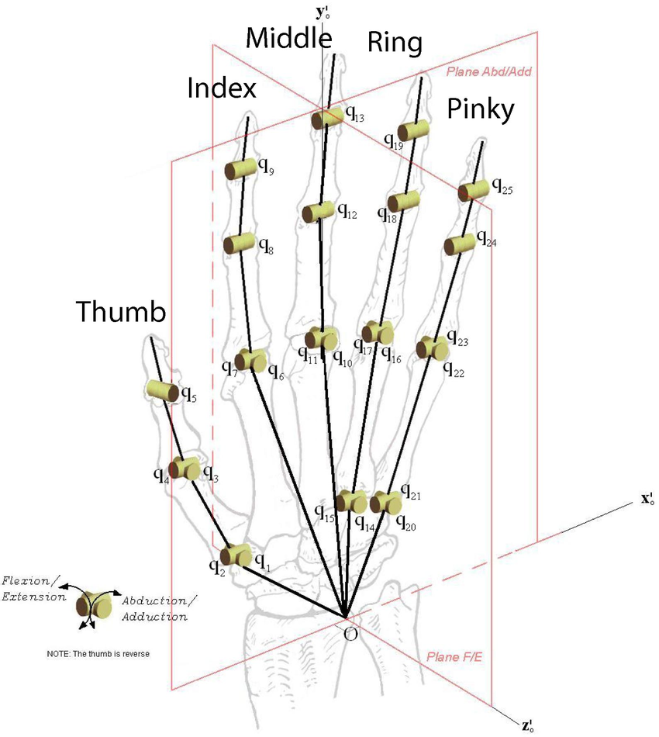
Modelling a Hand
Shape model
Describe the shape of a hand
Kinematic model
Describe DoF of hand joints

Slide 5
Steps for Hand Pose Estimation
Detection
Find the local region with the hand in the image and crop it
Mapping
Map the hand image to the locations of its joints
Refinement
Apply inverse kinematics to refine the estimation

Slide 6
Detection
Background subtraction
Template matching
Detecting using color or texture features
Using CNN to automatically detection hand region from an image

Slide 7
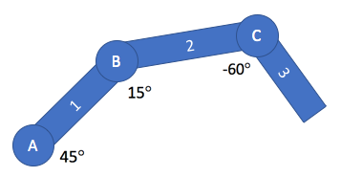
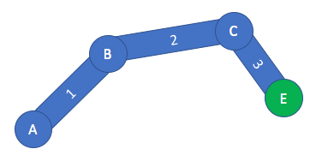
Inverse Kinematics
Kinematics
Know the pose of each joint
Estimate the end position
Inverse Kinematics
Know the end position
Infer the pose of each joint
Useful to refine the hand pose estimation

Slide 8
Estimating joint locations
Method 1: matching a template from database
For each pose, generate an synthetic image (template)
Derive the corresponding depth image
Given a real depth image of a hand, find the nearest neighbor in the database
Improve searching efficiency

Slide 9
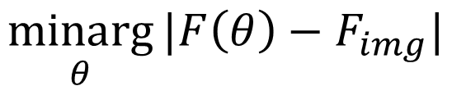
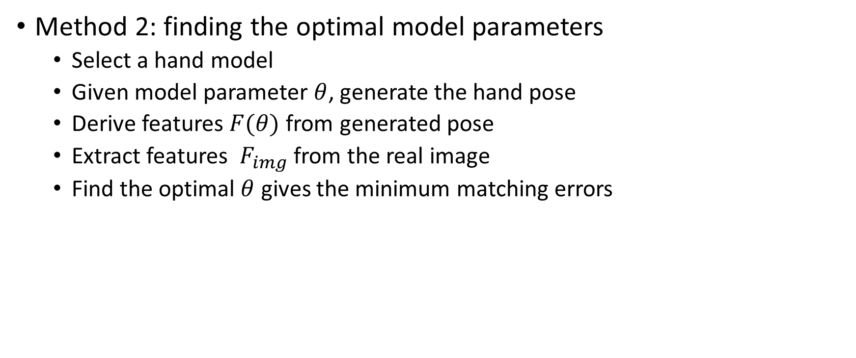
Estimating joint locations
Method 2: finding the optimal model parameters
Select a hand model
Given model parameter $θ$, generate the hand pose
Derive features $F(θ)$ from generated pose
Extract features $F_{img}$ from the real image
Find the optimal $θ$ gives the minimum matching errors
$$\underset{θ}{minarg}{|F\left(θ\right)−F_{img}|}$$

Slide 10

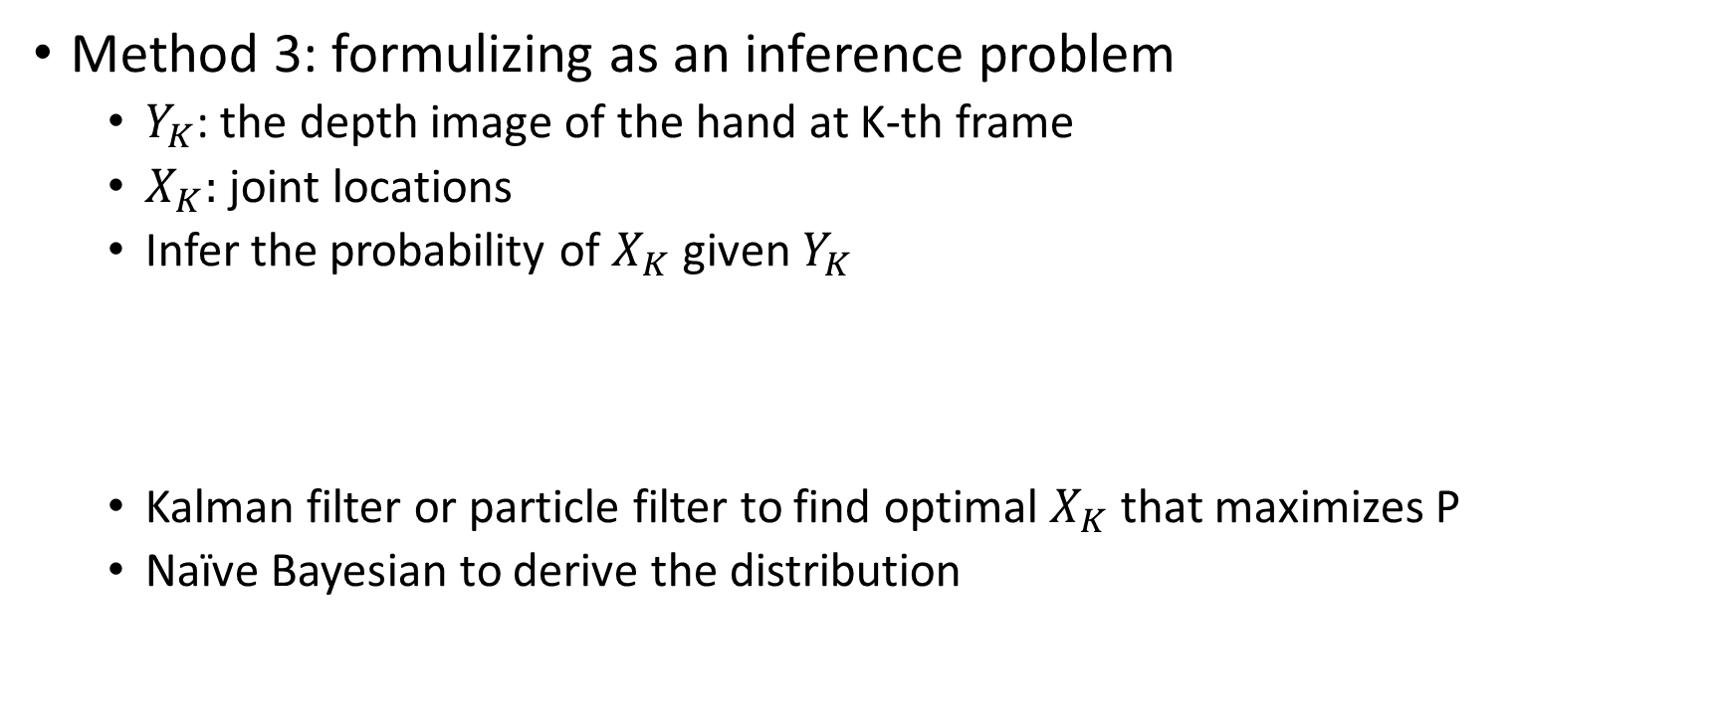
Estimating joint locations
Method 3: formulizing as an inference problem
$Y_{K}$: the depth image of the hand at K-th frame
$X_{K}:$ joint locations
Infer the probability of $X_{K}$ given $Y_{K}$
Kalman filter or particle filter to find optimal $X_{K}$ that maximizes P
Naïve Bayesian to derive the distribution
$$P(X_{K}|Y_{K})$$

Slide 11
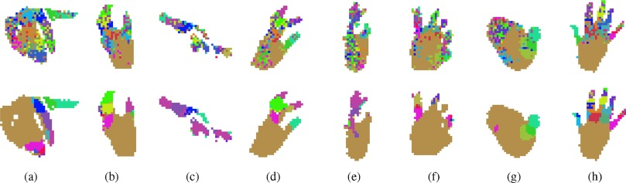
Estimating joint locations
Method 4: pixel labelling
Assign one label for each hand joint
For each pixel in the image, add a label if the pixel may be part of a certain joint
Perform clustering
Each cluster center gives the corresponding joint location

Slide 12
Estimating joint locations
Method 5: directly learning a map between the image and pose
CNN is the most dominate way
Can also learn parameters of the select hand model
Can also add constraints in the loss function
Machine learning
3D joint locations
(or model parameters)
Depth and/or RGB image

Slide 13
Recent Work
Hot area in computer vision
More than 60 papers published in 2017 – 2018
Introduce representative ones in the following slides

Slide 14
Recent work
Using 3D CNN

Slide 15
Recent work
Using point clouds

Slide 16
Recent work
Using GAN

Slide 17
Recent work
Using hierarchical approach

Slide 18
Recent work
Using a single RGB image

Slide 19
Recent work
Interacting with an object

Slide 20
State-of-the-Art Performance
HIM2017 challenge top 10 methods

