Slide 1
Introduction to RNN and LSTM
Presentor: Wenguang Mao

Slide 2
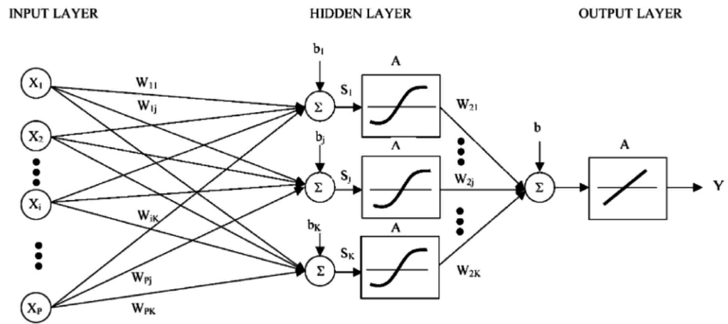
Traditional Neural Network
Input Layer
Hidden Layers
Output Layer
Activation
Notes:
Input, hidden, output layers,
The output of one layer is the linear combination of the output of previous layers followed by an activation func

Slide 3
Sequence Problems
The output depends on
Current Input
Previous Output
Traditional neural network cannot capture such relationship
Notes:
One class of classic classification problem is called

Slide 4
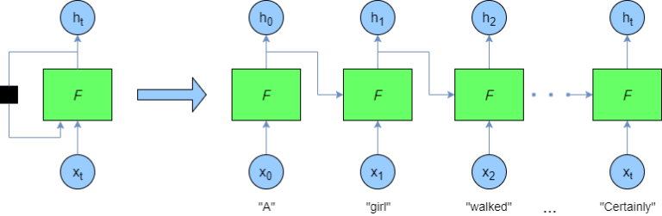
Recurrent Neural Network
Use the previous output as the input of current network
Notes:
The only difference from NN
Two ways to illustrate RNN, rolled and unrolled expression

Slide 5
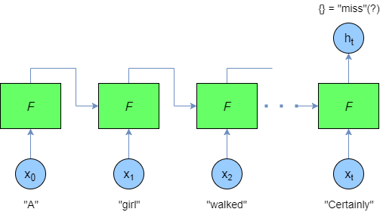
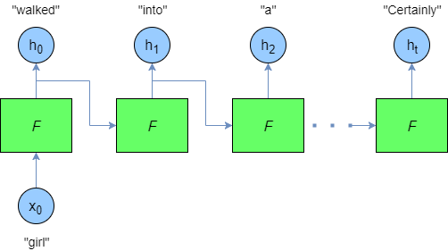
Different Configurations
Notes:
Many to one (only care about the last output)
One to Many (auto-completion)

Slide 6
Problem of RNN
The Concept of RNN is great
Having a practical problem for training RNN
Notes:
The motivation for RNN is to learn the dependency between the current output and previous inputs
When the separation between them is long
There will be gradient vanishing problem

Slide 7


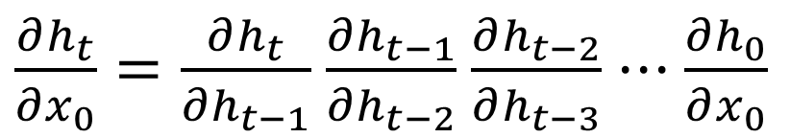
Gradient Vanishing
The dependency between $h_{t}$ and $x_{0}$ can be described by
It can be factorized into
$$\frac{∂h_{t}}{∂x_{0}}$$
$\frac{∂h_{t}}{∂x_{0}}=\frac{∂h_{t}}{∂h_{t−1}}$ $\frac{∂h_{t−1}}{∂h_{t−2}}$ $\frac{∂h_{t−2}}{∂h_{t−3}}$ $⋅⋅⋅\frac{∂h_{0}}{∂x_{0}}$

Slide 8
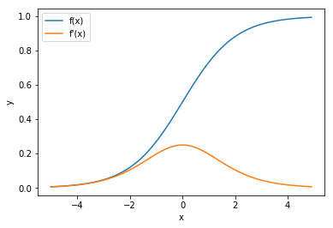
The Values of Derivative
Depending on the activation functions
Notes:
Common activation functions sigmoid
The final math op to derive the output is the activation

Slide 9
What’s the results
The partial derivative is close to zero
The output is not related to far pervious inputs
Long dependency is vanishing

Slide 10
Solutions
Change activation functions
The problem can be alleviated somewhat but not eliminated
May affect the learning performance
LSTM

Slide 11
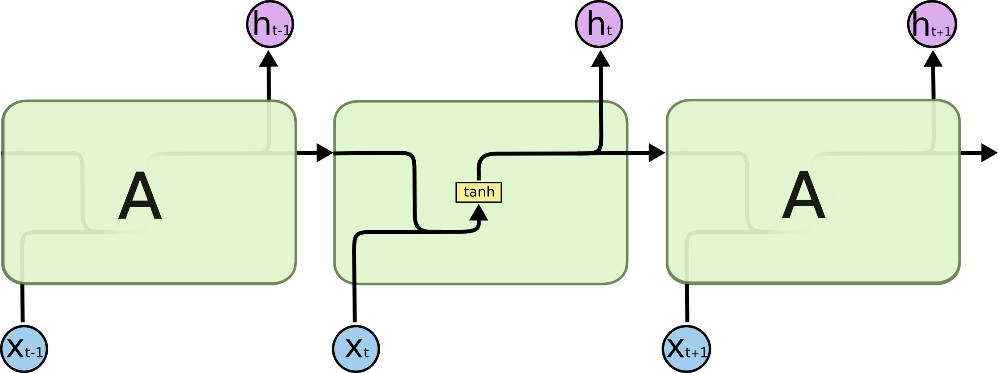

Long Short-Term Memory
Key insights: build a direct path from previous inputs to the current output

Slide 12
LSTM Breakdown
Hidden states
Input gates
Forget gates
Output gates

Slide 13
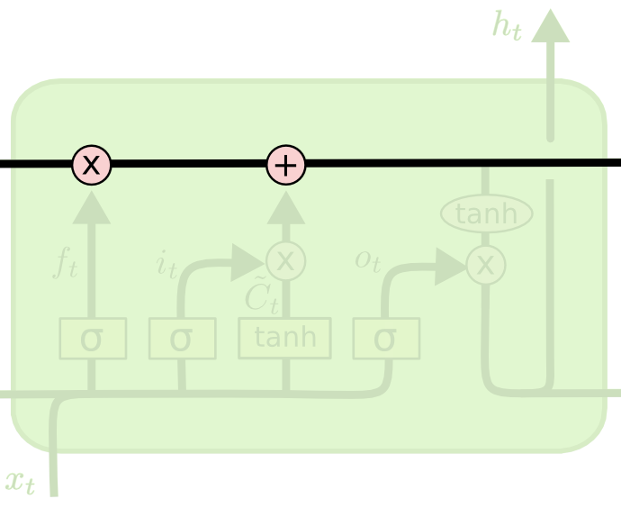
Hidden States
Carry previous information
Build a direct path

Slide 14
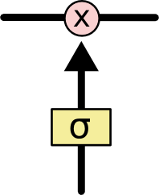

Gates
A neural network $σ$
Output range [0, 1]
Pointwise multiplication
Filtering function

Slide 15
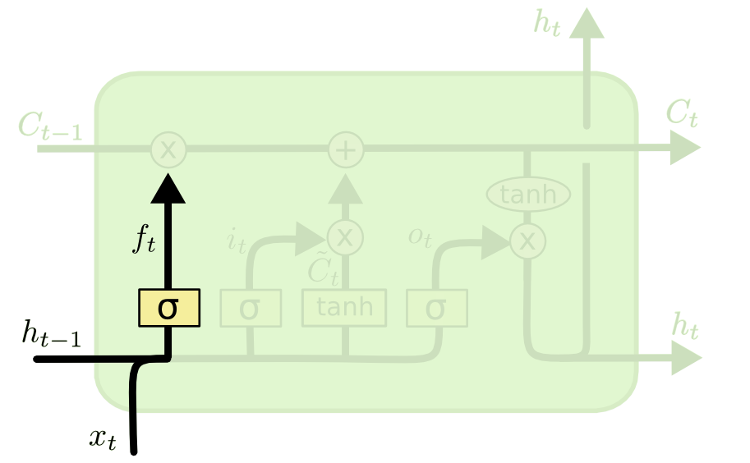
Input Gates
What is kept from previous states

Slide 16
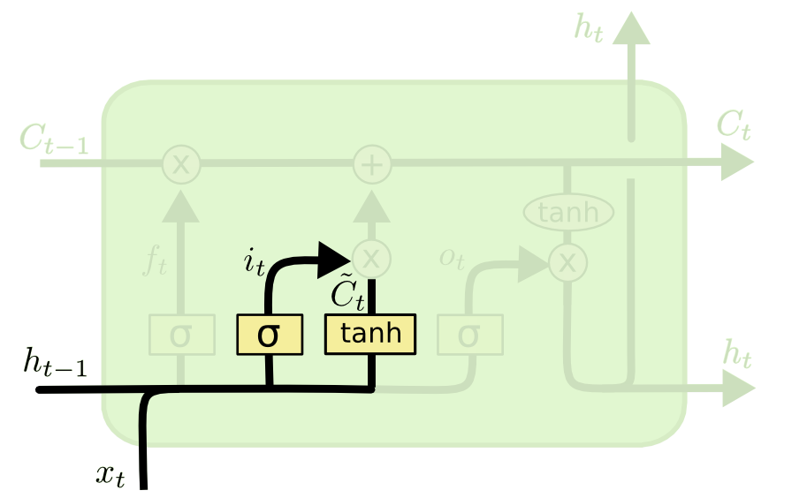
Forget Gate
What is added to the hidden state

Slide 17
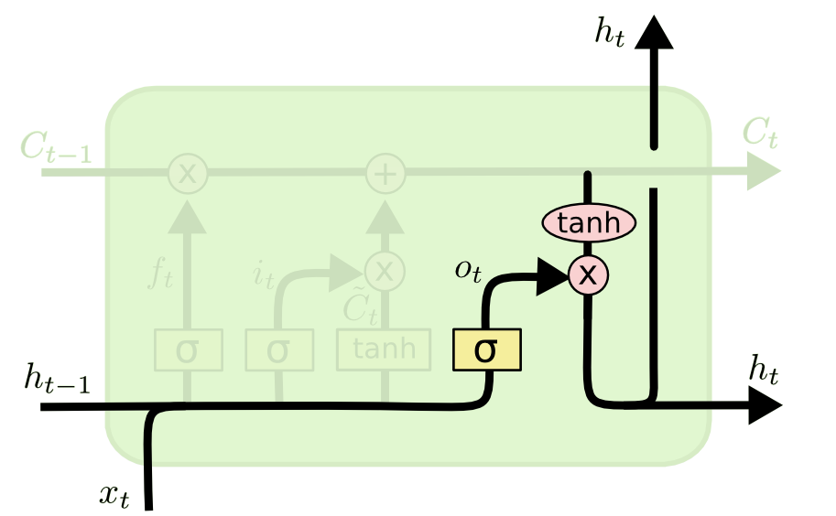
Output Gates
What is reported as output

Slide 18
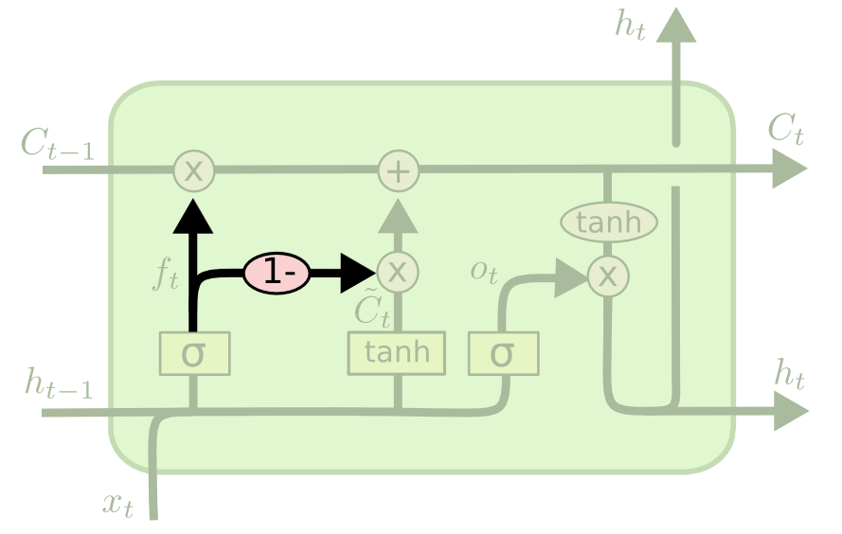
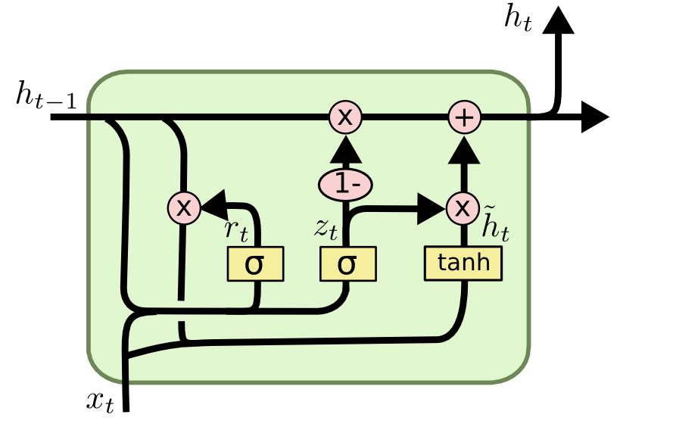
LSTM Variants

Slide 19
Conclusion
RNN is used for sequence / time-series problem
1
Gradient vanishing problem limits its effectiveness
2
LSTM cell to eliminate problem
3
Practically LSTM works much better than RNN
4

