Slide 1

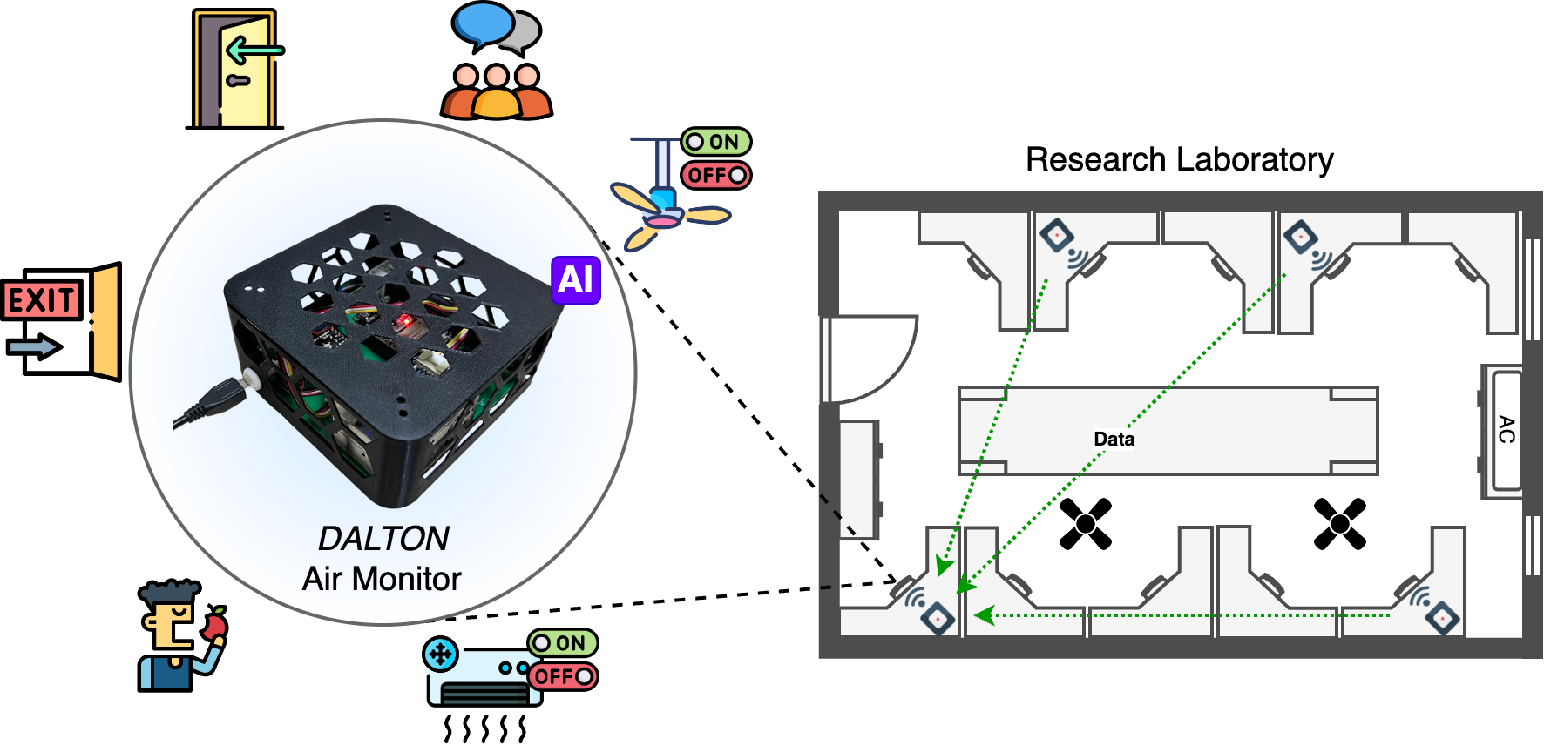


Exploiting Air Quality Monitors to Perform Indoor Surveillance: Academic Setting
Prasenjit Karmakar†, Swadhin Pradhan§, Sandip Chakraborty† †Indian Institute of Technology Kharagpur, India, §Cisco Systems, USA
UbiNet
ACM Compass 2024, July 8-11, India
24

Slide 2
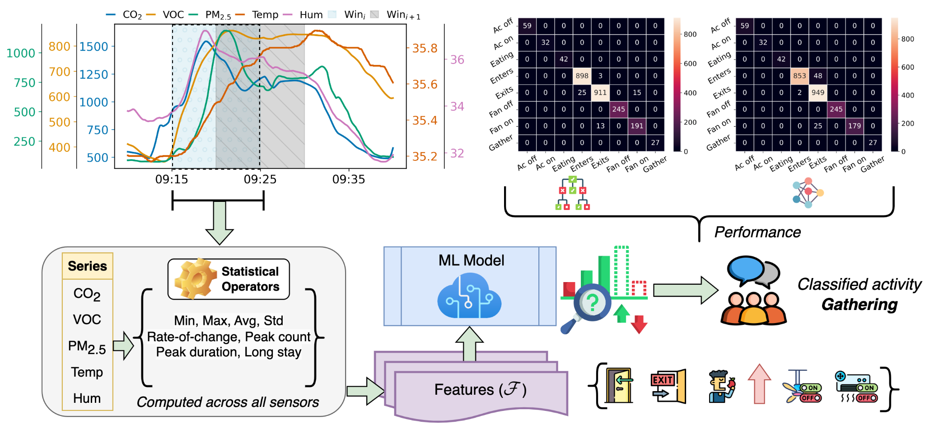

Overview of Our Approach
UbiNet
Contact Us
Email: prasenjitkarmakar52282@gmail.com
24

