Slide 1
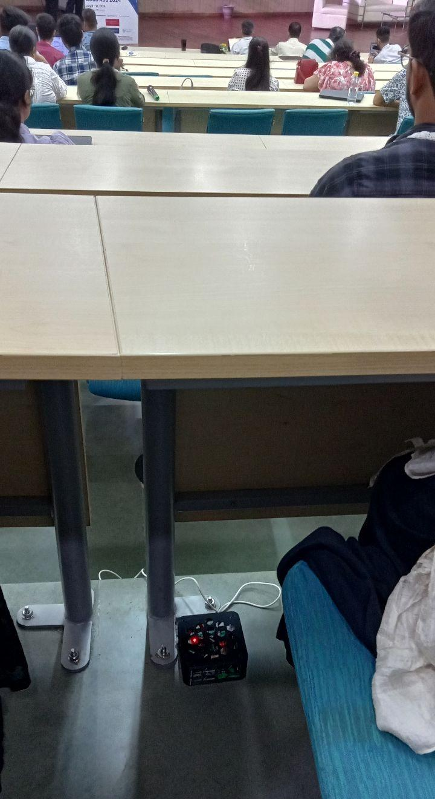
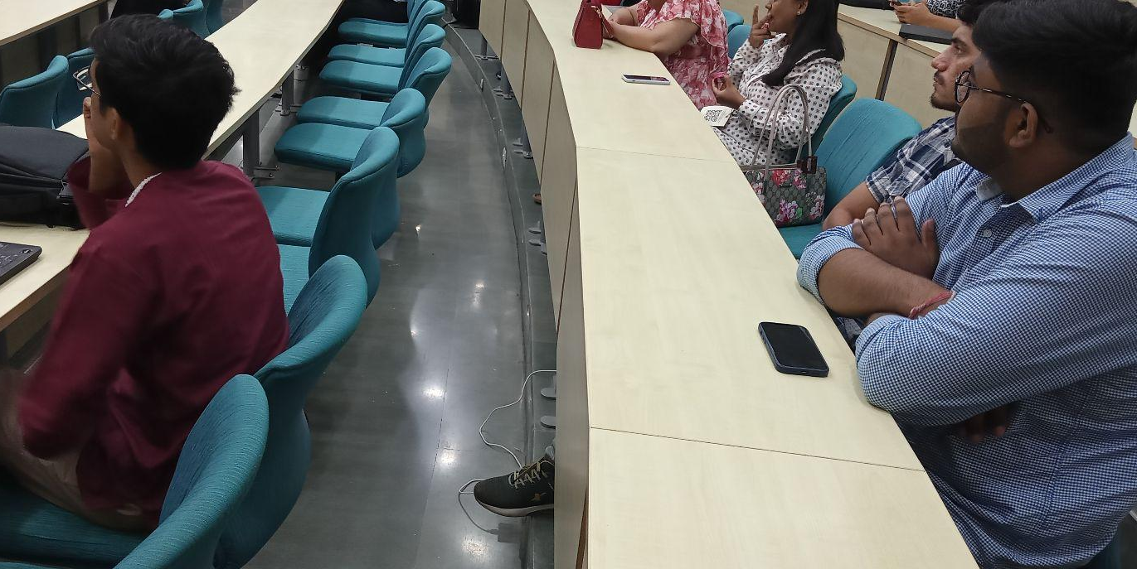
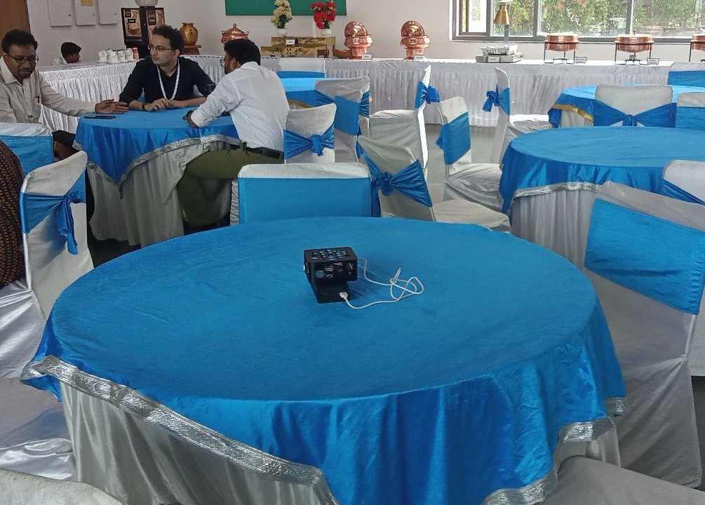
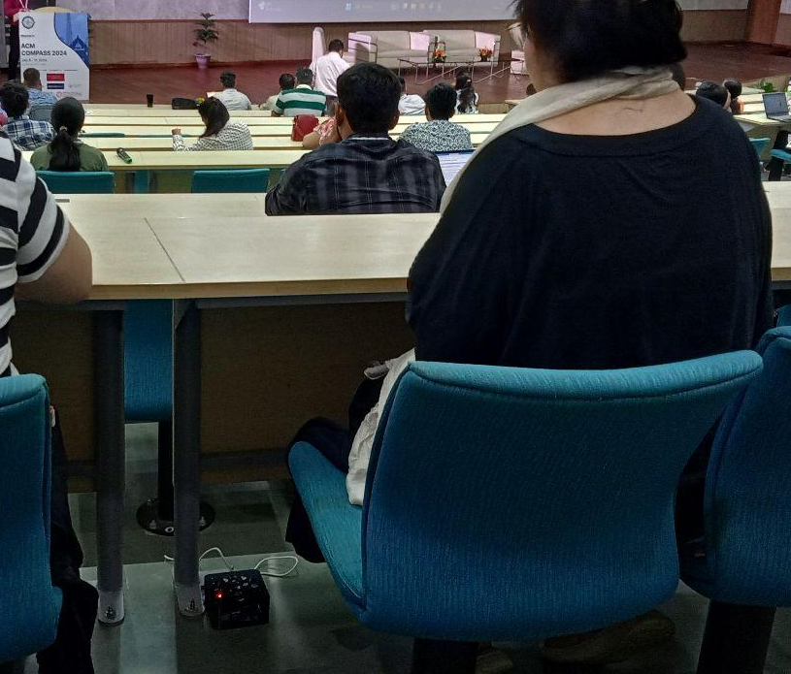
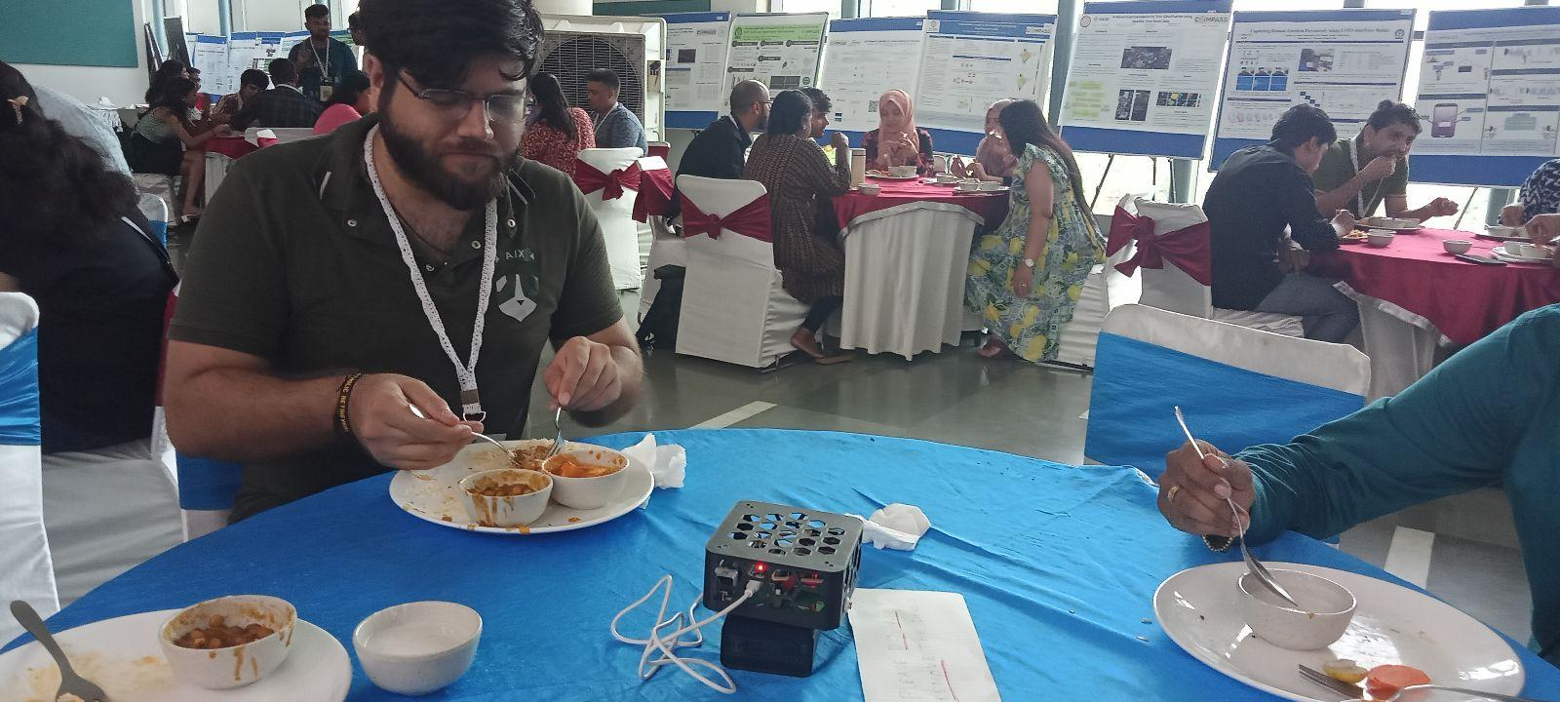
Indoor Pollution in COMPASS 2024

Slide 2
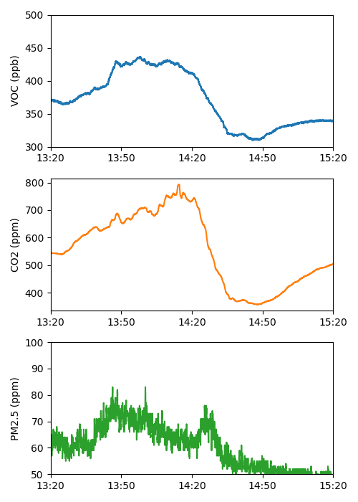
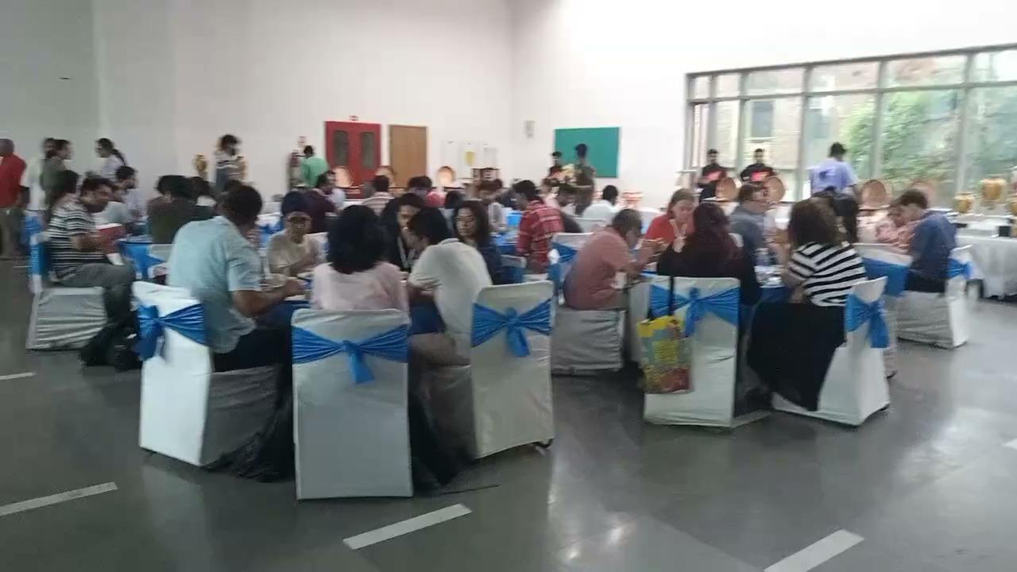
During Lunch
Increase in Pollutants during Lunch due to gathering and food

Slide 3
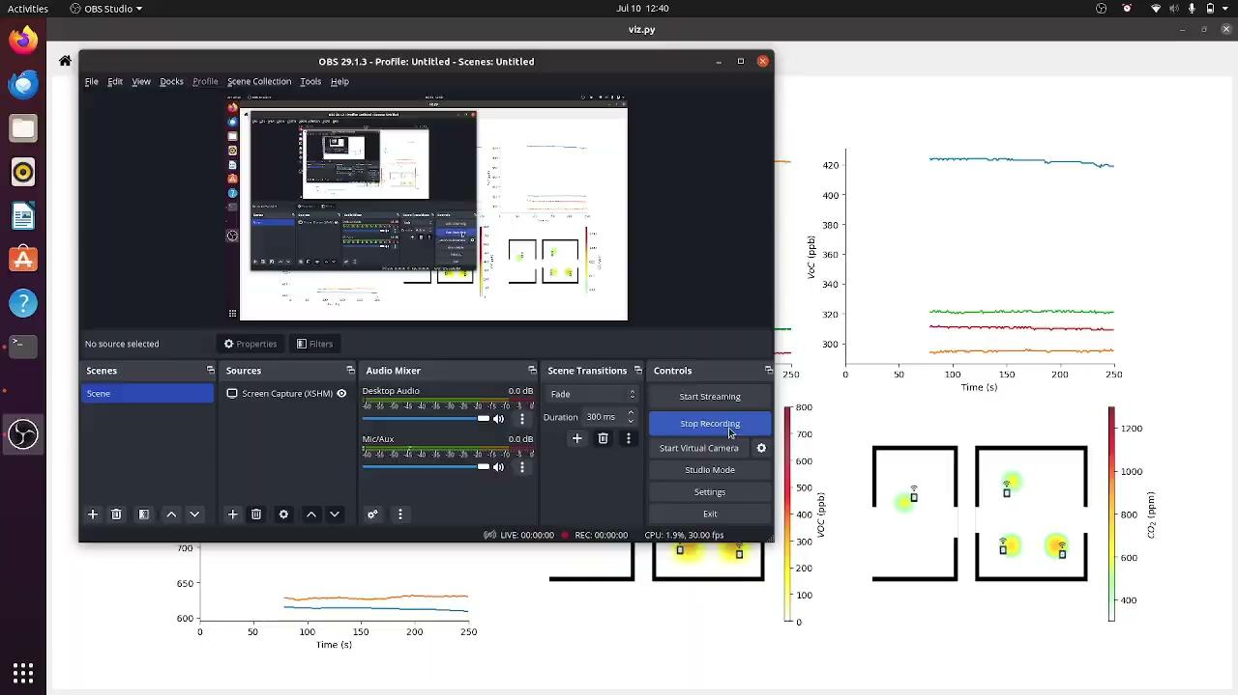
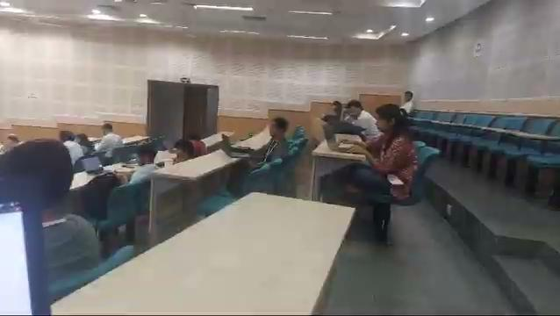
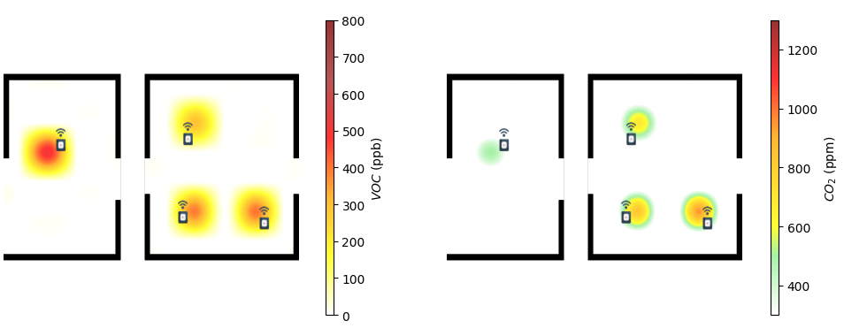
During Talks
The dining area has more VOC and PM2.5
Presentation room has more CO2, specially in the upper corners

Slide 4
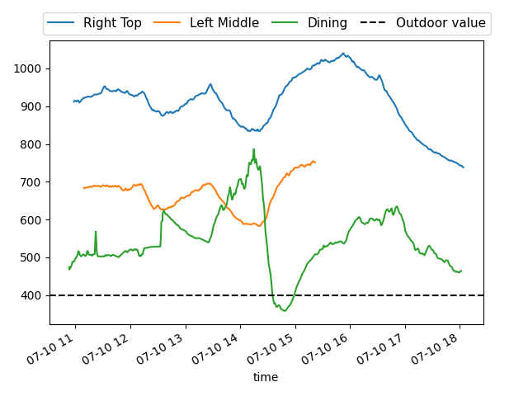
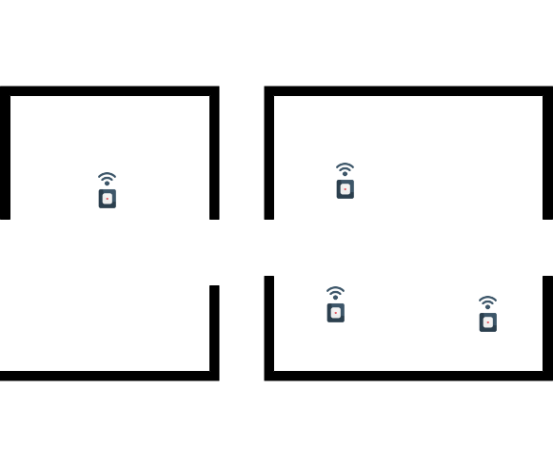
Concentration of CO2
Talks
Empty
Lunch
Disconn.
Poster
Tea Break

Slide 5
Thank You !!!
We will share more observations in our Lab page :P
https://cse.iitkgp.ac.in/resgrp/ubinet/

