Slide 1

Programming & Problem Solving
Code: CSE122
Lecturer: Rubel Sheikh

Slide 2
Team Members:
1. Jobaydul Islam » 222-15-6116
2. Tuhin Sheikh » 222-15-6288
3. Swadhin Biswas » 222-15-6259
4. Md Naimul Islam » 222-15-6299
5. Ismail Gazi » 222-15-6246
6. Fahim Abdullah » 222-15-6163

Slide 3
:::::::Problem:1::::::
​
​
​
A particle has initial velocity and constant acceleration. If its velocity after certain time is v then what will its displacement be in twice of that time?

Slide 4
Input​
The input will contain two integers in each line. Each line makes one set of input. These two integers denote the value of v (-100 ≤ v ≤ 100) and t(0 ≤ t ≤ 200) ( t means at the time the particle gains that velocity). The end of the input is determined by EOF.​
Output​
For each line of input print a single integer in one line denoting the displacement in double of that time.​
​
Input Sample | Output Sample
0 0 5 12 | 0 120

Slide 5
Algorithm: Step-1: Start Step-2: Declare 3 int variable v,t,s then Step-3: input v. if there is not !=EOF, input t. Step-4: calculate value of displacement s=v*(2*t); Step-5: print displacement . Step-6:End.

Slide 6
START
Flowchart
Int v,t,s
While
Input v
=EOF
!=EOF
Input t
Print displacement
S=v*(2*t)
END

Slide 7
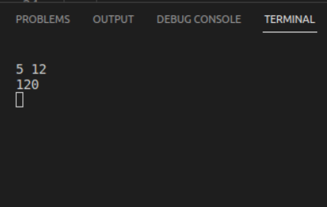
Solution code
#include <stdio.h>
int main(){
int v, t,s;
while(scanf("%d", &v) != EOF){
scanf("%d", &t);
s=v*2*t;
printf("%d\n", s);
}
return 0;
}
OUTPUT

Slide 8

::::::Problem:::::::
PPS Tracker: 216​
Jumping Frog​
​
In each stage of the Jumping Frog game you must safely get your amphibian through a sequence of pipes of different heights to the rightmost pipe. Nevertheless the frog just survives if the height difference of consecutive pipes is at most the frog jump height. If the next pipe height is too high, the frog hits the pipe and fall. If the next pipe height is too low, the frog does not survive the fall. The frog always starts on the top of the leftmost pipe.​
In this game the distance of pipes is irrelevant, which means that the frog always can reach the next pipe with a jump. You must write a program that, given the pipe heights and the frog jump height, show if the game stage can be beaten or not.

Slide 9
Input
The input is given in two lines. The first one has two positive integer numbers P and N, the frog jump height and the number of pipes (1 ≤ P ≤ 5 and 2 ≤ N ≤ 100). The second line has N positive integer numbers that indicate the pipes heights ordered from left to right. There are no height greater than 10.
Output
The output is given in a single line. If the frog can reach the rightmost pipe write "YOU WIN". If the frog fails, write "GAME OVER".
INPUT | OUTPUT
5 10 1 3 6 9 7 2 4 5 8 3 | YOU WIN
1 2 2 2 | YOU WIN
1 2 1 3 | GAME OVER

Slide 10
Algorithm: Step-1: Start Step-2: Take input value of height, num, count=0, step; Step-3: Input array and store num value as jump array input; Step-4: Read the array value by running a loop; (i) Run another for loop value to campare the (ii) if jump[i]>jump[i-1] is true store jump[i]-jump[i-1] in step (iii) else store jump[i-1]-jump[i-1] in step (iv) if step value equal or less then height then increase count value 1; Step-5: Now outside the loop check if step is equal num-1 then Step-6: print "YOU WIN" Step-7: Otherwise Print "GAME OVER". Step-8:End.

Slide 11
START
Flowchart
Input height,num,count=0,step
Read array jump
i=o
.i<num
Scan the array value
if(step==num-1)
step=jump[i-1]-jump[i];
if(step<=height){
count++;
(jump[i]>jump[i-1]
i=o
.i<num
step=jump[i]-jump[i-1];

Slide 12
Connect true OR false result
Print result
END

Slide 13
SOLUTION CODE
#include<stdio.h>
int main()
{
int height,num,count=0,step;//inputing total height,jump number of frog
scanf("%d %d",&height,&num);
int jump[num];
for(int i=0;i<num;i++)//for loop inputing jump number from user
{
scanf("%d",&jump[i]);
for(int i=0;i<num;i++)//for loop for calculate diffrent jump number from user .
{
if(jump[i]>jump[i-1])//compare elements index of jump number
{
step=jump[i]-jump[i-1];
}
else{
step=jump[i-1]-jump[i];
}
if(step<=height){
count++;
} //counting all true jump number

Slide 14
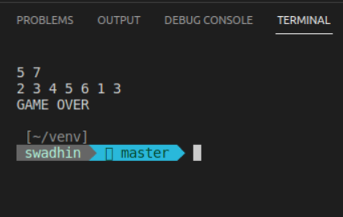
}
}
if(step==num-1)//if there is n time jump we can compare each element n-1 time
{
printf ("YOU WIN\n");
}
else{
printf ("GAME OVER\n");
}
return 0;
}
OUTPUT

Slide 15


