Slide 1
Doctor Machine
(A Disease Prediction System Using Machine Learning)

Slide 2
PROJECT SUPERVISOR Md.Abdus Salim Mollah DEPT. OF CSE, KUET
Software Development Project-II CSE 3200
DEVELOPED BY
Khandaker Tasnim Huq Md. Shakhawat Hossain Sajal
Roll: 1307002 Roll: 1307057

Slide 3
LAYOUTS
Introduction
Motivation
Objectives
Working procedure
Flow of Control
Windows
Advantages
Limitation & Future plan
Conclusion

Slide 4
Introduction
An interactive Disease prediction system
Based on basic Text Classification system
A supervised learning task using four Learning Algorithms
“Python 2.7” scripting language in windows 10 platform.

Slide 5
Motivation
Interested in “Machine Learning”
Inspired by a paper titled “Doctor Bayes” published on Machine Learning Summer project,2015 from Stanford University [1][2]

Slide 6
Objectives
To build an interactive disease classiﬁcation application.
To ease users finding out or predicting disease
To recommend tests and diagnosis
To prescribe medicines and treatments

Slide 7
Why We Used Python?
Simple, elegant, consistent, mathlike
Popular for applied data science and Machine learning
“scikit-learn” most enriched, easiest and most advanced library
NLTK (Natural Language Toolkit) & Matplotlib

Slide 8
Working Procedure
The whole project can be divided into two main period :
Training period
Test or Prediction period

Slide 9
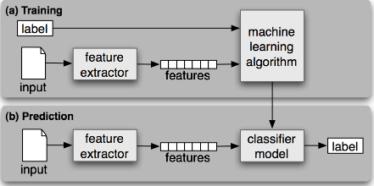
Flow of Control
Figure 1: Supervised Classification

Slide 10
Text Data
Stemming
Punctuation Removal
Feature
Extraction
Newline Removal
Stop Words Removal
Figure 2:
Function inside
Feature Extractor
Tf-Idf Weighting
Features

Slide 11
Each Row
Represents
“A Document”
rro
V11
V12
Each Cell Represents
Term Frequency-
Inverse Document
Frequency
Value
V21
V22
Each Column
Represents
“A Term”
Figure 3: Document-Term Matrix

Slide 12
Algorithms
Naive Bayes
Multinomial Naive Bayes
Logistic Regression
One Vs Rest Classifier on Linear SVC

Slide 13
System Design
Take_Input.py
(Input Processor)
input2.txt
(Input Data)
Main.py
(GUI)
Symptom
My_preprocess.py
(Feature extractor & Classifier)
my_file2.pkl
(Label Set)
Disease Name
my_file.pkl
(Training Data)
Ct_pkl.py
(Training Data Processor)
Figure 4: How System Be Designed

Slide 14
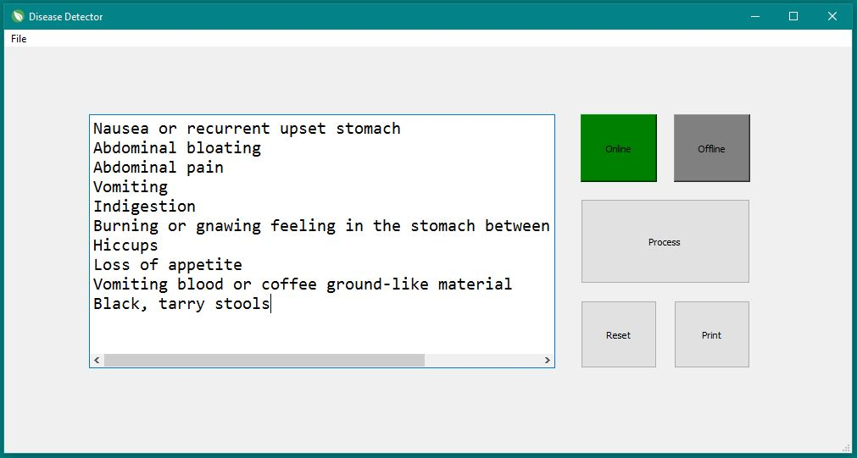
Project window

Slide 15
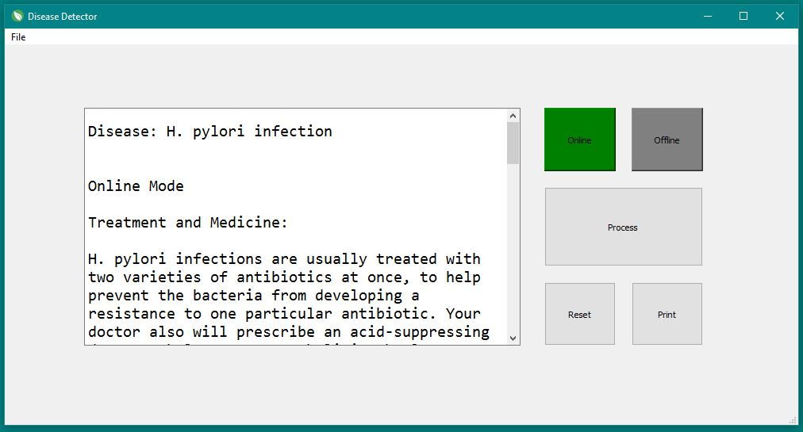
Project window

Slide 16
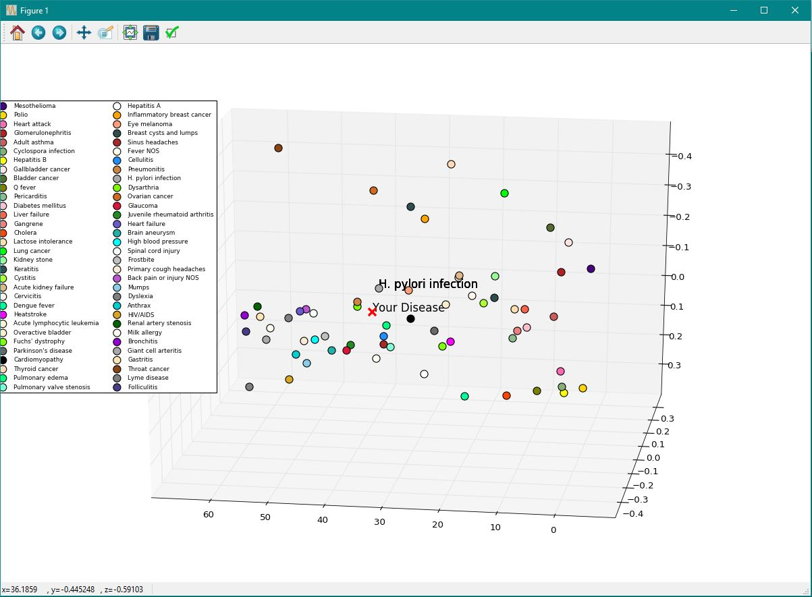
Project window

Slide 17
Advantages
Get idea about disease type.
Be acknowledged about level of risk of disease .
Serious diseases can be detected earlier
Works both online and offline

Slide 18
Limitations
Many disease dataset are not trained yet.
Can not detect invalid input.

Slide 19
Future Plan
Increasing the accuracy of the prediction .
Making it handy and more sophisticated for actual Doctors

Slide 20
Conclusion
Although doctors are irreplaceable, it would be beneﬁcial to the healthcare system to have a way to reliably get an assessment of health without human interaction.

Slide 21
References
“CS Project: Doctor Bayes” by Brandon Beckhardt, Leonid Keselman, Anthony Perez in Machine Learning Summer project,2015 from Stanford University. ( Link: [cs229.stanford.edu/proj2015/271_report.pdf] )
CS 229 Machine Learning Final Projects, Autumn 2015 (Link: [http://cs229.stanford.edu/projects2015.html])
“Intro to Machine Learning Course” by Udacity.(Link: [https://www.udacity.com/course/intro-to-machine-learning--ud120])
“Your First Machine Learning Project in Python Step-By-Step” by Jason Brownlee. (Link: [http://machinelearningmastery.com/machine-learning-in-python-step-by-step/])
Stackoverflow.com

Slide 22
Thanks To All

