Slide 1
Different Movie Shots
FHNW Film Studies, Simon Wächter

Slide 2
References
For the different movie shot types, the following article was used (I was unable to find the course material presentation): http://www.elementsofcinema.com/cinematography/framing-shot-sizes/
The movie «Bowling for Columbine» (2002) can be found here: https://www.youtube.com/watch?v=YtnX1fq8Zl0

Slide 3
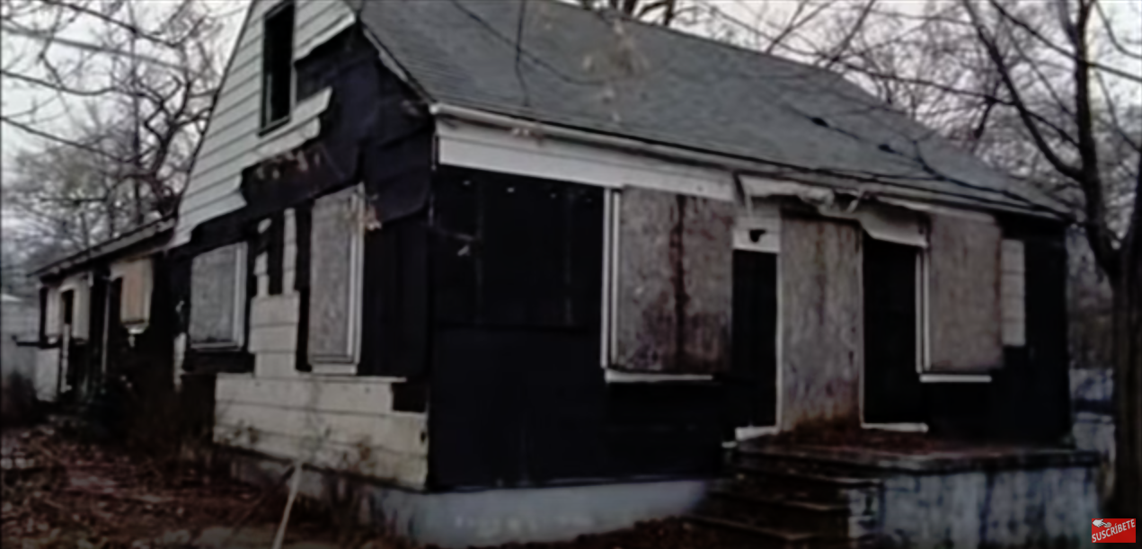
Long shot (1:27:09 – 1:27:50)

Slide 4
Long shot
It’s hard to find a proper long shot, but the scene serves as a follow up to the shooting of 6 year old Kayla Rolland in Mount Morris and tries to find some answers for the shooting
The scene emphasizes the lack of perspective and the high rate of poverty around Flint → A series of long shots, e.g. left buildings, are used
Thus the scene is used to show the lack of alternatives young people have around the town → E.g. number one cause of death is homicide (Robberies?)

Slide 5
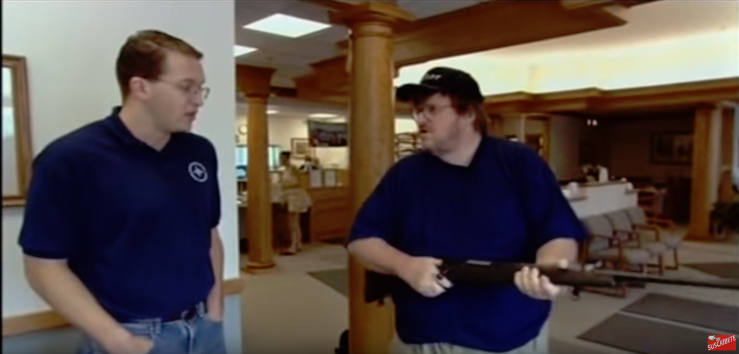
Medium shot (3:10 – 3:16)

Slide 6
Medium shot
The medium shot (Hip to head) shows the gun hand over (A few seconds before) and the resulting smalltalk between a bank employee and Michael
The scene tries to show how ridiculous it is to issue a rifle in a bank (A few seconds after) – because it’s a bank and not a gun store → Question pops up in my head: Are Americans insane?
In addition, the smalltalk of the bank employee increases the ridiculousness of this scene (I have one personally / It’s a straight shooter) → You are employed to handle my money, not my rifles

Slide 7
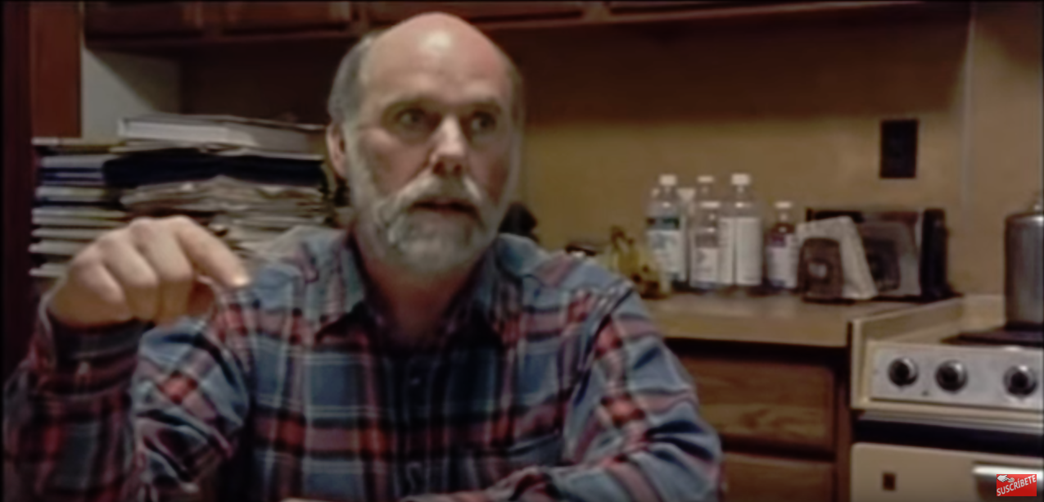
Close-up shot (13:19 – 13:51)

Slide 8
Close-up shot
The shot is targeting James Nichols, the brother of Terry Nichols who co-comitted the Oklahoma City bombing
The shot is used to show how upset and angry James is about the fact that people [his ex wife] thought he is a radicalist and that he might start a second Waco → Personal emotions, eye movement and hand gestures
The shot is used to create a link to the next scene where he even becomes more angry & insecure → We start to think that James is a strange person or maybe even a bit insane

