Slide 1
Bowling for Columbine
Simon Wächter, efst HS18 FHNW

Slide 2
Introduction
Background
Plot
Film elements
Mise en scéne & theme
Conclusion
Questions

Slide 3
Background
Michael Moore, documentary filmmaker, born in Michigan
It’s the year 1999, after a series of terror attacks
Waco siege (76 + 4 victims) + Oklahoma City Bombing (168 victims)
First World Trade Center bombing
Army of God
Beginning of digitalization and urbanization

Slide 4
Plot
Final fight
Outro: Elixir
Inmost Cave
NRA meets NRA
First threshold
Meeting the enemy
Kayla
Rolland & Mark
Kosovo &
Columbine
Ordinary World
Enemy NRA and Charlton Heston
Question: What does bowling for Columbine stands for?
Intro
Bank scene
Daily life in the US

Slide 5
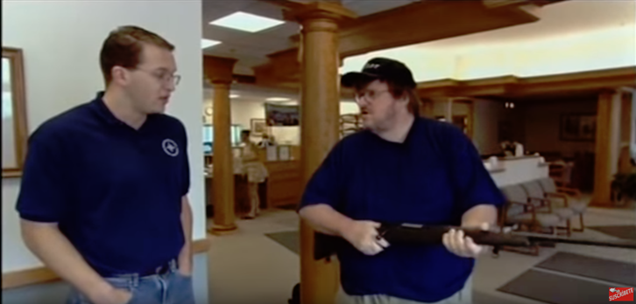
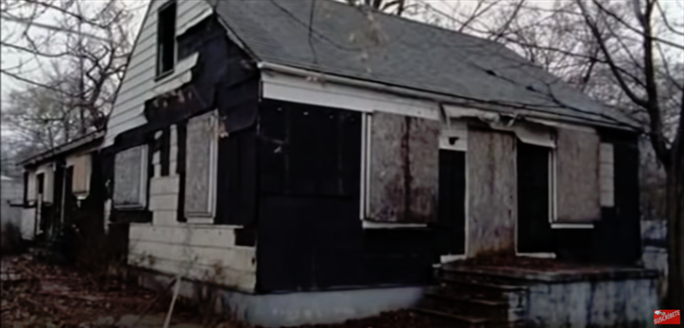
Film elements
Medium shoots
Be part of the documentary as third person
Look over Michael’s shoulder
Long shoots
Show the surroundings
Follow him as photographer

Slide 6
Mise en scéne & theme
Documentary-style - we follow as a third person
Lightning: Often typical 90 VHS movie quality - “the past”
Acting and music:
Depressing, lot of dark colors
Satirical and cynical elements
Same themes

Slide 7
Conclusion
Lead in question: Bowling before the attacks
Question: Are we a nation of gun nuts or are we just nuts?
Show the fear and surrealism
Keep in mind it’s a streamlined documentary
What is real?
What was staged?
Still: It’s a great insight t US culture and shows that gun laws are not the root cause - culture is!

Slide 8
Question A:
Gun control & Getting a rifle from the local bank
Why is it "normal" to issue a rifle for opening a bank account?
Is the second amendment in the constitution a good idea (Right to keep and bear arms)?
Argument: The more guns you have, the less violence you have → According to gun statistics, wouldn’t the US be the safest place on earth (Hint: It's not)? Why does this not work?
Should this be possible in Switzerland? Should the Swiss gun law be more liberal?

Slide 9
Question B:
Youngest school shooting in the US
How should a society react to such a tragedy? How handle it?
How should law enforcement/courts or a judge react?
Can we/should we punish & sentence a six-year-old offender? Does it do more harm than good?

Slide 10
Question C:
Changing the world
What does/did Michael Moore change?
Do you think there will be change [to the society], e.g changes to the second amendment (Think about racial segregation or same sex marriage)?
Did he over dramatize the movie? Was this his/the right choice?

Slide 11
Thank you!

