Slide 1
MOTIVATION

Slide 2

Introduction
Visionary Idea (1883) – Engineer John Roebling proposed a first-of-its-kind suspension bridge linking Manhattan and Brooklyn. Visionary Idea (1883) – Engineer John Roebling proposed a first-of-its-kind suspension bridge linking Manhattan and Brooklyn. Experts dismissed it as "impossible."
Visionary Idea (1883) – Engineer John Roebling proposed a first-of-its-kind suspension bridge linking Manhattan and Brooklyn. Experts dismissed it as "impossible."
Tragedy Strikes – John died early in construction. His son, Washington Roebling, took over but suffered a crippling injury, leaving him paralyzed and mute.

Slide 3
4.Against All Odds – From his sickbed, Washington directed construction for 14 years using only finger taps to communicate with his wife, Emily.
5.Emily’s Critical Role – She decoded his instructions, relayed them to engineers, and became the bridge’s unofficial chief engineer.
6.Completion (1883) – Despite 20 worker deaths, financial struggles, and public doubt, the iconic bridge opened, becoming the world’s longest suspension bridge.
7.Legacy – A triumph of perseverance, innovation, and teamwork, proving even the "impossible" can be achieved.

Slide 4
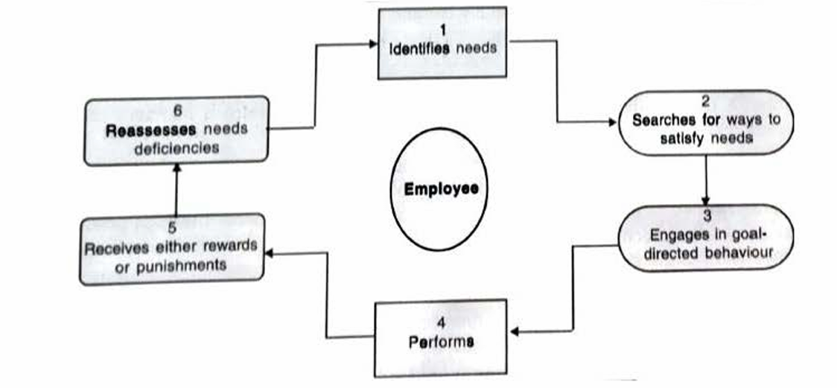
Framework of motivation

Slide 5
Definition
"Motivation is the result of processes, internal or external to the individual, that arouses enthusiasm and persistence to pursue a certain course of action."
"How behavior gets started, is energized, is sustained, is directed, is stopped, and what kind of subjective reaction is present in the organization while all this is going on."

Slide 6
Importance of motivation
Performance and Innovation
Motivation, coupled with ability, drives performance.
Employees seek innovative ways to complete tasks, improving efficiency.
Quality Orientation
Motivated employees prioritize quality (e.g., meticulous data analysis or careful documentation).
Higher Productivity
Motivated workers outperform apathetic ones (e.g., Japanese productivity in
manufacturing).
Behavioral Dimensions
Organizations must:
Attract and retain talent.
Ensure employees perform tasks dependably.
Encourage creativity and innovation.

Slide 7
Importance of motivation
Understanding Organizational Behavior
Motivation explains why employees behave the way they do, impacting leadership, job design, and satisfaction.
Technological Adaptation
Advanced technology requires motivated employees (e.g., ISRO’s success due to skilled and willing workers).
Long-Term Human Resource Development
Organizations invest in training, job rotation, and talent management to build a "talent bank" for future growth.
Employee Well-Being
Satisfied employees contribute to a positive workplace culture and organizational reputation.
Global Competitiveness
Effective motivation strategies align with cultural values (e.g., recognition, material rewards, or group harmony).

Slide 8
Challenges in motivation
Diverse Workforce Needs
Employees join organizations with different values, beliefs, backgrounds, and expectations.
Many organizations fail to understand or address these differences.
Organizational Restructuring
Downsizing, rightsizing, and flattening hierarchies reduce trust and commitment.
Strategies like "hire-and-fire" or pay-for-performance may demotivate employees.
Inferred Motives
Motives cannot be directly observed (e.g., two employees with identical qualifications may perform differently for unclear reasons).
Dynamic and Conflicting Needs
Employees’ needs and expectations evolve over time.
Work demands (e.g., overtime) may conflict with personal needs (e.g., family time).

Slide 9
Challenges in motivation
Non-Work Fulfillment
Higher-level needs (e.g., social belonging) may be satisfied outside work.
Managers must understand employees’ personal lives, not just work behaviors.
Cultural and Individual Differences
Needs vary across cultures and individuals (e.g., Japanese prioritize group harmony, Americans value independence).
Complexity of Motivation
Motivation is influenced by leadership styles, job design, salary systems, and technology.

