Slide 1
MOTIVATION

Slide 2

Introduction
Visionary Idea (1883) – Engineer John Roebling proposed a first-of-its-kind suspension bridge linking Manhattan and Brooklyn. Visionary Idea (1883) – Engineer John Roebling proposed a first-of-its-kind suspension bridge linking Manhattan and Brooklyn. Experts dismissed it as "impossible."
Visionary Idea (1883) – Engineer John Roebling proposed a first-of-its-kind suspension bridge linking Manhattan and Brooklyn. Experts dismissed it as "impossible."
Tragedy Strikes – John died early in construction. His son, Washington Roebling, took over but suffered a crippling injury, leaving him paralyzed and mute.

Slide 3
4.Against All Odds – From his sickbed, Washington directed construction for 14 years using only finger taps to communicate with his wife, Emily.
5.Emily’s Critical Role – She decoded his instructions, relayed them to engineers, and became the bridge’s unofficial chief engineer.
6.Completion (1883) – Despite 20 worker deaths, financial struggles, and public doubt, the iconic bridge opened, becoming the world’s longest suspension bridge.
7.Legacy – A triumph of perseverance, innovation, and teamwork, proving even the "impossible" can be achieved.

Slide 4
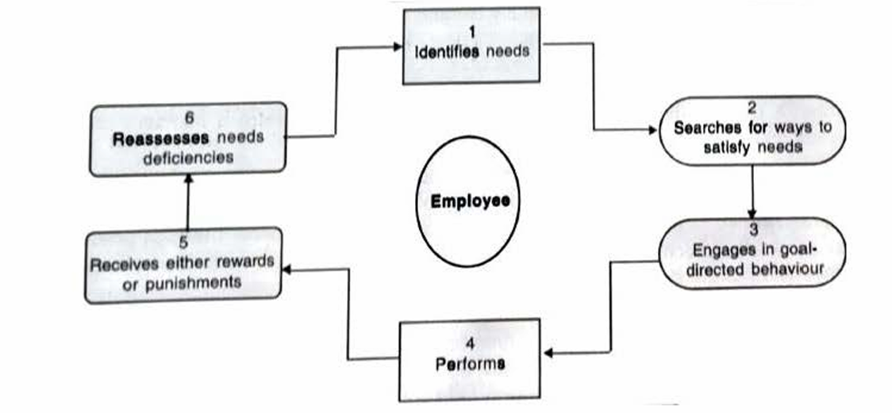
Framework of motivation

Slide 5
Step 1: Identifies Needs
Definition: Needs are "felt deprivations" that act as energizers.
Types of Needs:
Psychological (e.g., need for recognition).
Physiological (e.g., need for water, air, food).
Social (e.g., need for friendship).
Step 2: Searches for Ways to Satisfy Needs
Employees seek actions to reduce or eliminate deprivations.
Example: An employee works overtime on high-visibility projects to address the need for advancement.

Slide 6
Step 3: Goal-Directed Behavior
Definition: Goals are specific results individuals aim to achieve.
Employee goals drive actions (e.g., pursuing promotions or influence).
Example: A salesperson sets a target to close 20 deals/month to gain recognition.
Step 4: Performance
Employees engage in behaviors to achieve goals (e.g., solving major organizational problems).
Example: Working on critical projects to gain visibility with senior managers.

Slide 7
Step 5: Receives Rewards/Punishments
Feedback Mechanism: Organizations reward desirable behaviors (e.g., promotions, raises) or punish undesirable ones.
Example: A promotion signals approval of an employee’s efforts and alignment with organizational goals.
Step 6: Reassesses Needs
Employees reevaluate needs based on outcomes (rewards or punishments).
Example: After a raise, an employee may shift focus from financial needs to career growth needs.

Slide 8
Definition
"Motivation is the result of processes, internal or external to the individual, that arouses enthusiasm and persistence to pursue a certain course of action."
"How behavior gets started, is energized, is sustained, is directed, is stopped, and what kind of subjective reaction is present in the organization while all this is going on."

Slide 9
Importance of motivation
1.Motivation Drives Performance and Innovation
Explanation: Motivation, combined with ability, leads to higher performance. Employees seek better ways to do their jobs, fostering innovation.
Examples:
A production worker in an automobile factory suggests a streamlined assembly process, reducing time and costs.
A teacher creates interactive digital lessons to boost student engagement and learning outcomes.
2.Motivation Enhances Quality Orientation
Explanation: Motivated employees prioritize quality, improving organizational reputation.
Examples:
A marketing manager meticulously verifies data in a client report, ensuring accuracy.
A baker taste-tests every batch of cookies to maintain consistent flavor and texture.

Slide 10
Importance of motivation
3.High Motivation Boosts Productivity
Explanation: Motivated teams achieve more with fewer resources.
Examples:
Toyota’s "Kaizen" philosophy empowers workers to suggest efficiency improvements.
A retail employee restocks shelves twice as fast during peak hours to ensure customers find what they need quickly.
4.Human Resource Sustainability
Explanation: Organizations need motivated employees to attract talent, ensure reliability, and foster creativity.
Examples:
Tech companies like Google offer "20% time" for personal projects, leading to innovations like Gmail.
A small café owner provides mentorship programs to retain skilled baristas and encourage loyalty.

Slide 11
Importance of motivation
5. Motivation is Interlinked with Organizational Dynamics
Explanation: Motivation interacts with leadership, job design, and rewards, impacting overall performance.
Examples:
A company using performance-based bonuses sees higher sales team productivity.
A team improves collaboration after managers introduce weekly brainstorming sessions.
6. Motivation is Critical for Advanced Technology Adoption
Explanation: Complex technologies require skilled and willing employees.
Examples:
ISRO’s engineers master cutting-edge rocket technology for the PSLV launch.
A farmer learns to use a weather-tracking app to optimize irrigation, improving crop yields with minimal training.

Slide 12
Importance of motivation
7.Long-Term Human Resource Investment
Explanation: Organizations prioritize developing employees as future assets.
Examples:
IBM’s "SkillsBuild" program offers continuous training and job rotations.
A local gym sponsors fitness certifications for trainers to stay updated on health trends.

Slide 13
Challenges in motivation
1. Motives Are Inferred, Not Directly Observable
Motivation is internal and cannot be seen; it must be deduced from behavior.
Example: Two employees with identical qualifications and roles show different performance levels, indicating varying underlying motivations.
2. Dynamic and Conflicting Needs
Employees have multiple, evolving needs (e.g., achievement, affiliation, family time) that may conflict.
Example: Working overtime to fulfill career goals may clash with the desire to spend time with family.
3.Needs Extend Beyond the Workplace
Higher-level needs (e.g., self-actualization) are often satisfied through personal life, not just work.
Implication: Managers must understand employees’ personal lives and social contexts to motivate effectively.

Slide 14
4.Challenges in Modern Workforce Motivation
Complexities:
Diverse workforce with differing values, backgrounds, and expectations.
Organizational changes (e.g., downsizing, flattened hierarchies) erode trust and commitment.
Ineffective Strategies:
Hire-and-fire or pay-for-performance tactics fail to inspire employees to exceed minimum requirements.
Example: A company relying solely on bonuses sees short-term gains but loses long-term employee loyalty.

Slide 15
Role of a Successful Manager
Key Responsibilities:
Inspire employees to "overreach" and achieve the seemingly impossible.
Cultivate commitment, quality consciousness, and productivity.
Encourage aspirations beyond basic needs (e.g., career growth, personal development).
Example: A manager mentors an employee to aim for leadership roles instead of settling for routine tasks.

