Slide 1
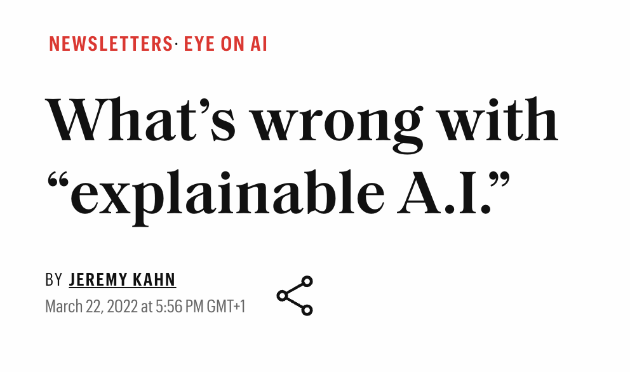
The Disagreement Problem in Explainable Machine Learning: A Practitioner’s Perspective Authors: Satyapriya Krishna, Tessa Han, Alex Gu, Javin Pombra, Shahin Jabbari, Zhiwei Steven Wu, and Himabindu Lakkaraju (Harvard, MIT, Drexel, CMU) Feb, 2022 (170+ citations!)
Presenter: Swagatam Haldar
Explainable Machine Learning Seminar
Summer 2024, University of Tübingen
Notes:
- came out in 2022, and interestingly not published in any conference to the best of my knowledge
- but it has hit the right spot on a very important issue in explainable AI I would say, and that’s why it already has 170+ citations
- also this article got some press attention in popular media

Slide 2
The Disagreement Problem in Explainable Machine Learning: A Practitioner’s Perspective Authors: Satyapriya Krishna, Tessa Han, Alex Gu, Javin Pombra, Shahin Jabbari, Zhiwei Steven Wu, and Himabindu Lakkaraju (Harvard, MIT, Drexel, CMU) Feb, 2022 (170+ citations!)
Presenter: Swagatam Haldar
Explainable Machine Learning Seminar
Summer 2024, University of Tübingen
Notes:
- came out in 2022, and interestingly not published in any conference to the best of my knowledge
- but it has hit the right spot on a very important issue in explainable AI I would say, and that’s why it already has 170+ citations
- also this article got some press attention in popular media

Slide 3
Problem addressed
Motivation: Often explanations for the same prediction disagree across ML algorithms, what can we do about this, if anything?
Notes:
- practical information

Slide 4
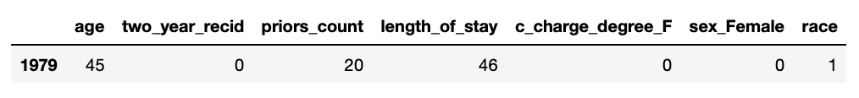
Problem addressed
Motivation: Often explanations for the same prediction disagree across ML algorithms, what can we do about this, if anything?
Example: COMPAS, RF
Notes:
- practical information

Slide 5
Problem addressed
Motivation: Often explanations for the same prediction disagree across ML algorithms, what can we do about this, if anything?
Example: COMPAS, RF
Notes:
- practical information
- explain how disagreement can manifest itself in many ways

Slide 6
Problem addressed
Motivation: Often explanations for the same prediction disagree across ML algorithms, what can we do about this, if anything?
Example: CIFAR10, VGG19
Notes:
Model prediction for this image was bird. Why? LIME shows a big superpixel cluster as the explanation, SHAP is more localized.

Slide 7
Problem addressed
Motivation: Often explanations for the same prediction disagree across ML algorithms, what can we do about this, if anything?
Example: CIFAR10, VGG19
Notes:
Model prediction for this image was bird. Why? LIME shows a big superpixel cluster as the explanation, SHAP is more localized.

Slide 8
Problem addressed
Motivation: Often explanations for the same prediction disagree across ML algorithms, what can we do about this, if anything?
> Practitioner’s perspective:
interviews with 25 data scientists/practitioners to understand what constitutes disagreement between explanations
Then online study with 25 participants to observe how they resolve that in practice
> Contributions:
Identify/point out that this problem exists through interviews and online study
Develop principled evaluation metrics to compare explanations quantitatively
Notes:
- practical information

Slide 9
But what is an explanation?
Most overloaded term currently in use in this seminar! Local vs. global, feature attribution, counterfactuals, training data attributions etc.
Scope of this paper: local, feature attribution based
Explanation: an ordered/ranked list of <feature, importance> pairs
<feature, importance> or <pixel, importance> or <superpixel, importance> or <word/token, importance> pairs
Complications might arise in defining “what is a feature” with discretization of continuous features, segmentation, tokenization etc., I will not get into that.
Notes:
So whenever I say explanation for the rest of the talk, imagine a list of tuples with (feature, imp) pairs.

Slide 10
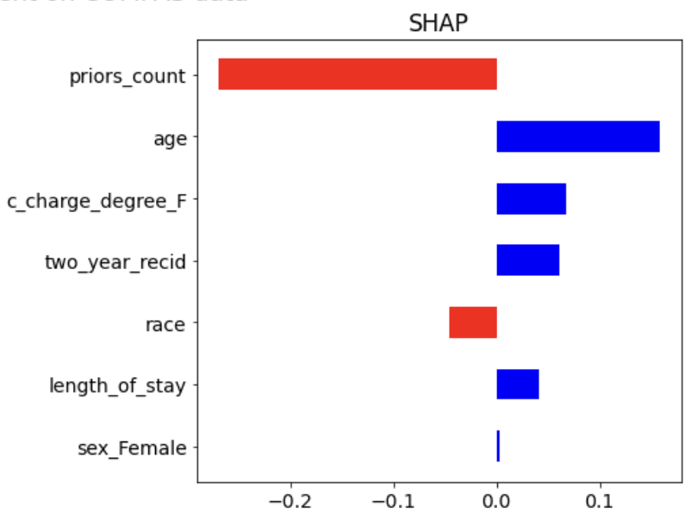
Insights from interview with practitioners
The paper uses these insights to formalize the notion of explanation disagreement:
> What people looked at to determine disagreement?
Top features are different
Ordering among top features is different
Direction/influence of contribution of top feature is different
Relative ordering of meaningful features are different
> What they did not look at to determine disagreement?
The actual values of feature importance – they have wildly different scales across explanations
{
Notes:
- illustration of some of these
- put same figure in this slide

Slide 11
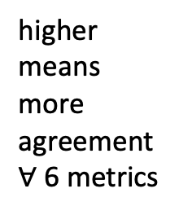
How to compare explanations quantitatively?
The authors propose to use six metrics to measure how similar (or dissimilar) are feature attribution-based explanations:
(Dis)agreement w.r.t top-k features
- (FA) how many features (fraction) within the topk are same?
- (RA) Is the order of top-k features same?
- (SA) Are the signs of top-k features identical in both explanations?
- (SRA) another metric combining both signs and ranks of top-k features (strictest)
(Dis)agreement w.r.t user-provided features of interest
Here we can take any set of features
- (RC) rank correlation (viewing explanations as ordered rank lists)
- (PRA) pairwise rank agreement: checks relative ordering of every pair of features
higher
means
more
agreement
$∀$6 metrics
Notes:
- explain the abbreviations (use in figures later, write full forms)
Note: They are not evaluating how good an explanation is wrt a model, for that we have metrics like stability, fidelity etc.
They are measuring the “difference” between two explanations, i.e., how similar or dissimilar are they.
And there is another one that combines both sign and rank agreement
Add metric definitions

Slide 12
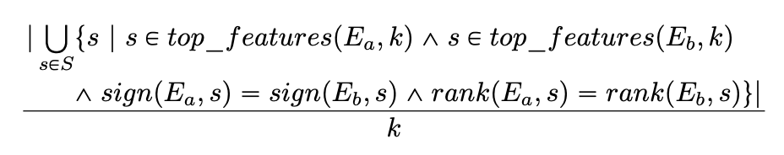

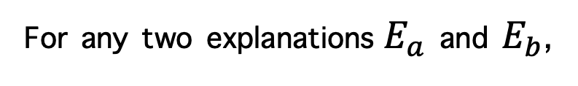
Metric definition: Signed rank agreement (SRA)
For any two explanations $E_{a}$ and $E_{b}$,
SRA =
For a given set of features $F=\{f_{1},f_{2}, …, f_{n}\}$, and $r_{s}$ is the Spearman rank correlation coefficient
Rank correlation (RC) =
Notes:
- explain the abbreviations (use in figures later, write full forms)
Note: They are not evaluating how good an explanation is wrt a model, for that we have metrics like stability, fidelity etc.
They are measuring the “difference” between two explanations, i.e., how similar or dissimilar are they.
And there is another one that combines both sign and rank agreement
Add metric definitions

Slide 13
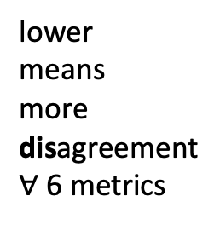
How to compare explanations quantitatively?
The authors propose to use six metrics to measure how similar (or dissimilar) are feature attribution-based explanations:
(Dis)agreement w.r.t top-k features
- (FA) how many features (fraction) within the topk are same?
- (RA) Is the order of top-k features same?
- (SA) Are the signs of top-k features identical in both explanations?
- (SRA) another metric combining both signs and ranks of top-k features (strictest)
(Dis)agreement w.r.t user-provided features of interest
Here we can take any set of features
- (RC) rank correlation (viewing explanations as ordered rank lists)
- (PRA) pairwise rank agreement: checks relative ordering of every pair of features
lower
means
more
disagreement
$∀$6 metrics
Notes:
- explain the abbreviations (use in figures later, write full forms)
Note: They are not evaluating how good an explanation is wrt a model, for that we have metrics like stability, fidelity etc.
They are measuring the “difference” between two explanations, i.e., how similar or dissimilar are they.
And there is another one that combines both sign and rank agreement
Add metric definitions

Slide 14
Empirical verification of disagreement: Ingredients
Datasets:
> Tabular (COMPAS, German credit)
> Image (Imagenet-1000)
> Text (news category prediction)
Models:
> Tabular (LR, MLP, RF, GBDT)
> Image (ResNet18)
> Text (LSTM based classifier)
Explanation methods:
> Perturbation based:
LIME, KernelSHAP
> Gradient based:
Vanilla gradient (VG),
Gradient * Input (G*I),
Integrated Gradients (IG),
SmoothGrad (SG)
- All models were trained to a reasonable accuracy
- For RF & GBDT, they only used LIME and KernelSHAP.
- Metrics as defined in last slide.
Notes:
- one example of signed rank agreement calculation

Slide 15
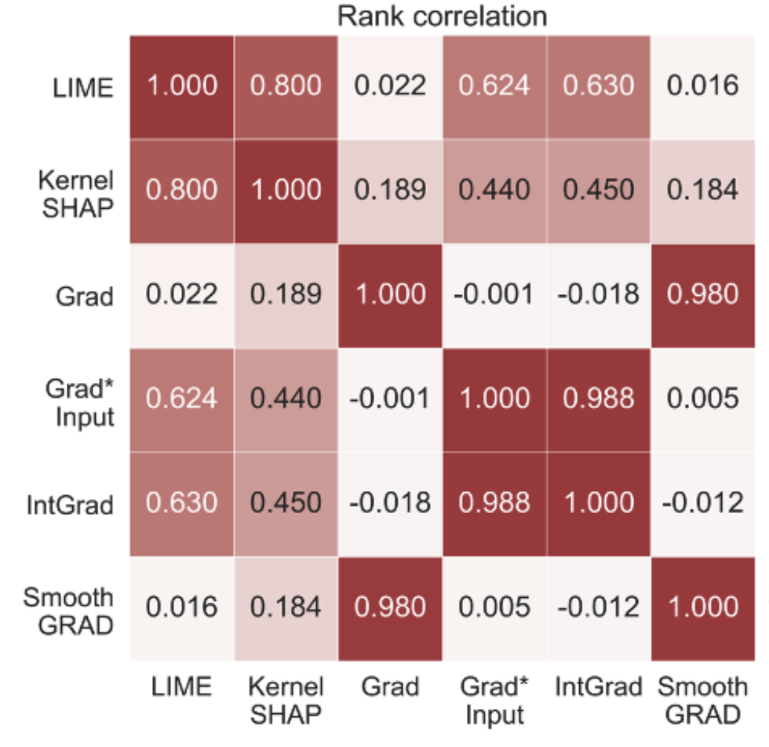
Result computation
1. Take a test data point
2. Compute explanation E_a and E_b for it
3. Calculate metric(E_a, E_b)
4. Average over all test points
Notes:
- explain the abbreviations (use in figures later, write full forms)
Note: They are not evaluating how good an explanation is wrt a model, for that we have metrics like stability, fidelity etc.
They are measuring the “difference” between two explanations, i.e., how similar or dissimilar are they.
And there is another one that combines both sign and rank agreement
Add metric definitions

Slide 16
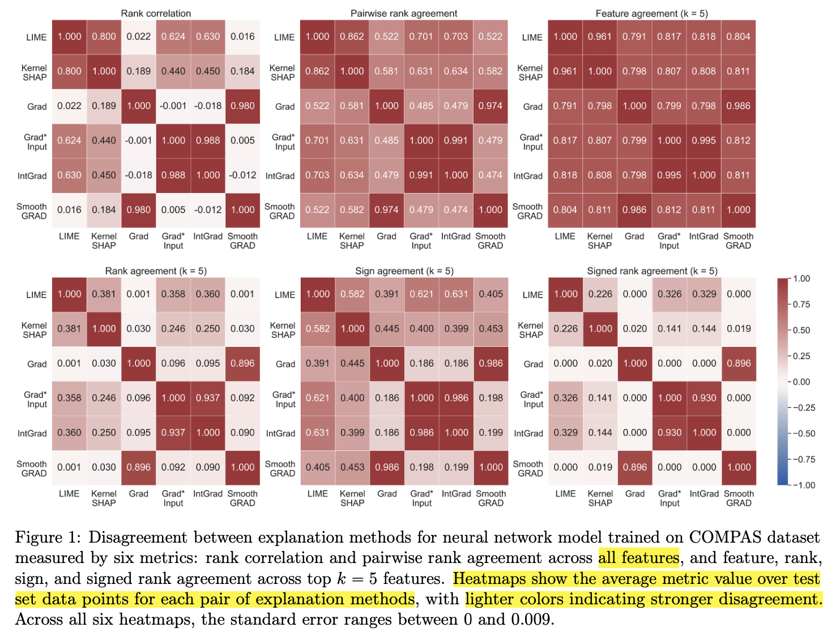
Main results: tabular modality
> high FA (k=5) for all explanations
(caveat: only 7 features!)
> RC: higher for (VG, SG), and (G*I, IG) pairs
> More features lead to more disagreement
> More complex models (hard to approximate) lead to less agreement
COMPAS,
NN
Notes:
One such result on tabular dataset, may be I will start with the most dark one.
FA
Now may be let’s come to this box of rank correlation that considers all features.
The way they generated this sort of metrics is for each test data, they generated all such explanations, and then averaged over the entire dataset

Slide 17
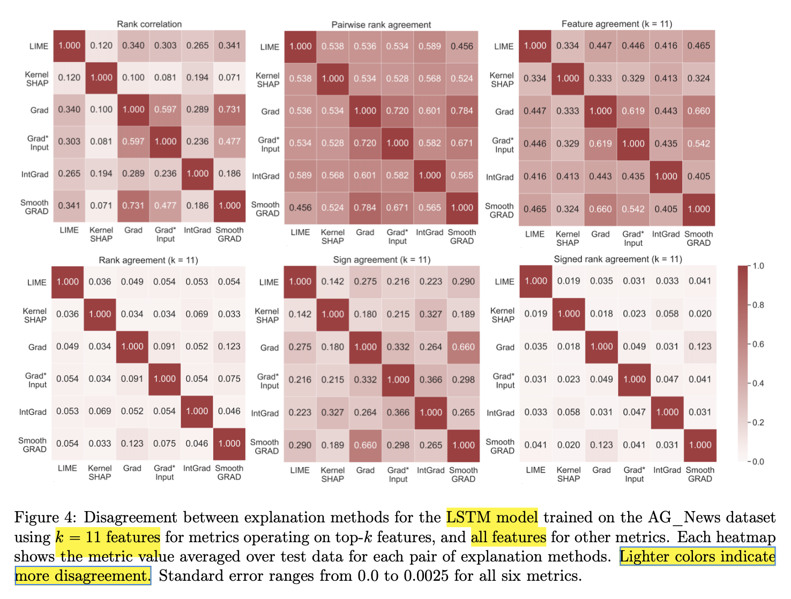
Main results: text modality
> more features so all plots look lighter!
>very low agreement between methods here
> LIME agrees more with other explanations than KernelSHAP (look at first 2 rows top)
Text clf,
LSTM
Notes:
Main goal: identify/point out

Slide 18
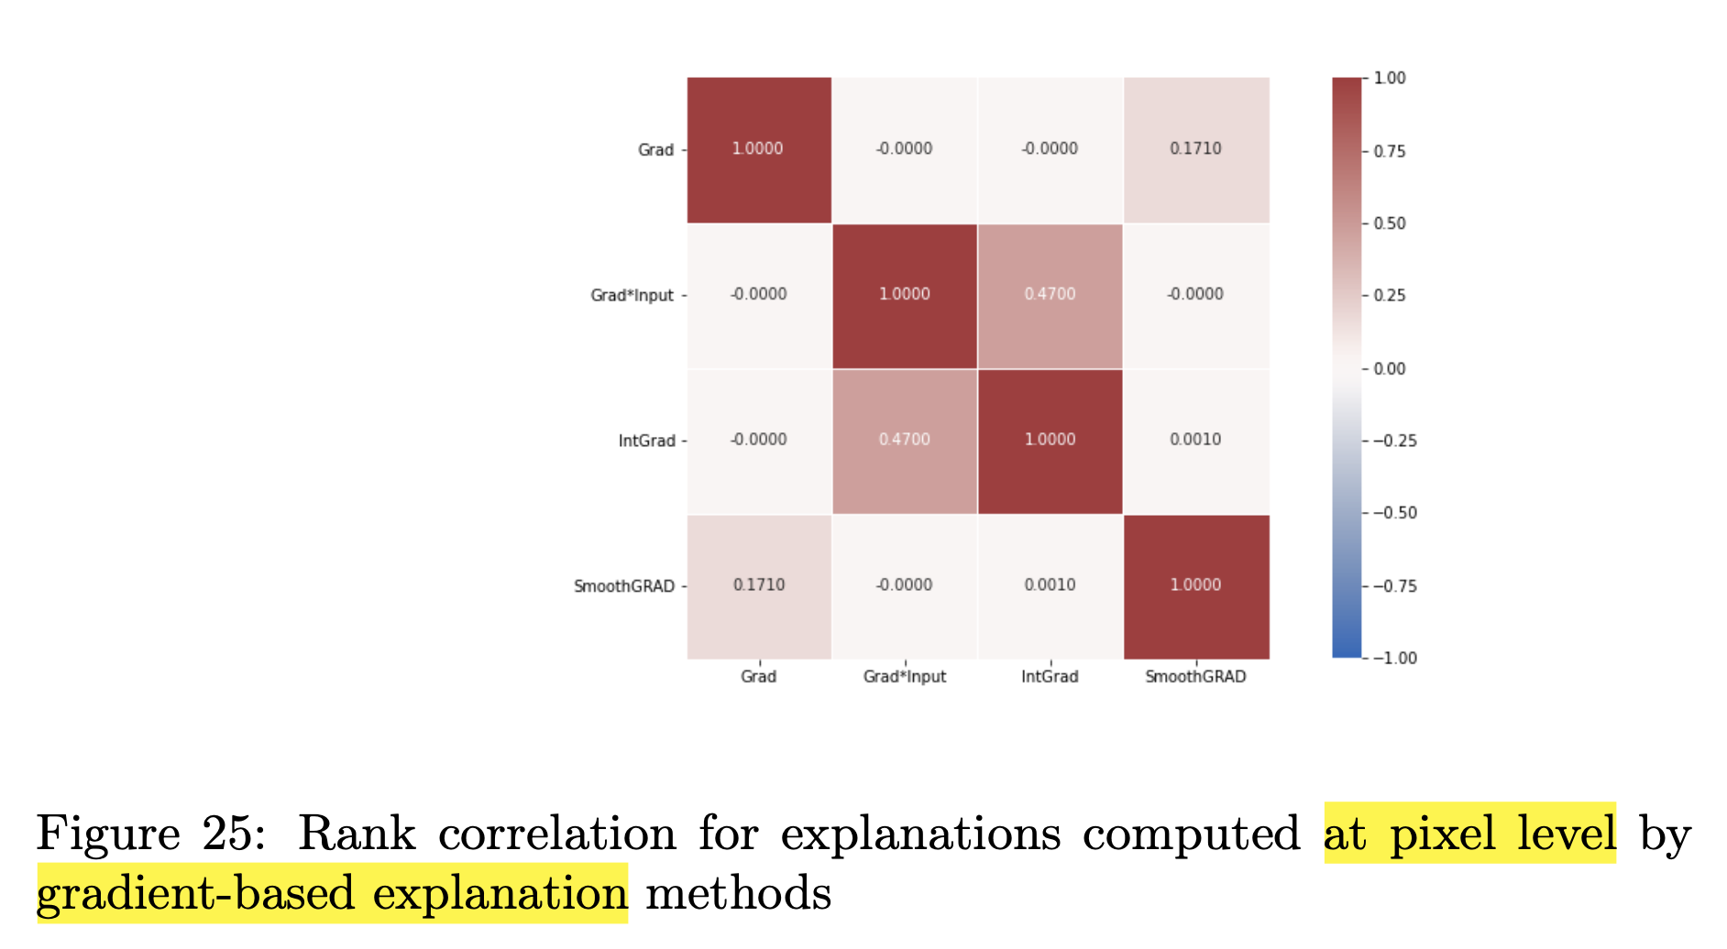
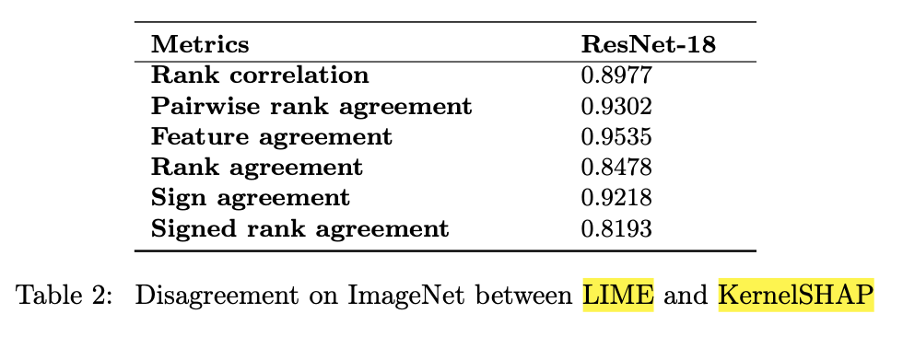
Main results: image modality
> Gradient based explanations show high disagreement (likely because too granular)
> unlike tabular & text, here more agreement between LIME and SHAP (probably because they used the same superpixels, too coarse)
pixel level explanations
superpixel level
Notes:
- the notion of top-k features and the metrics we define on top-k features are not semantically meaningful when we consider pixels as features.
-

Slide 19
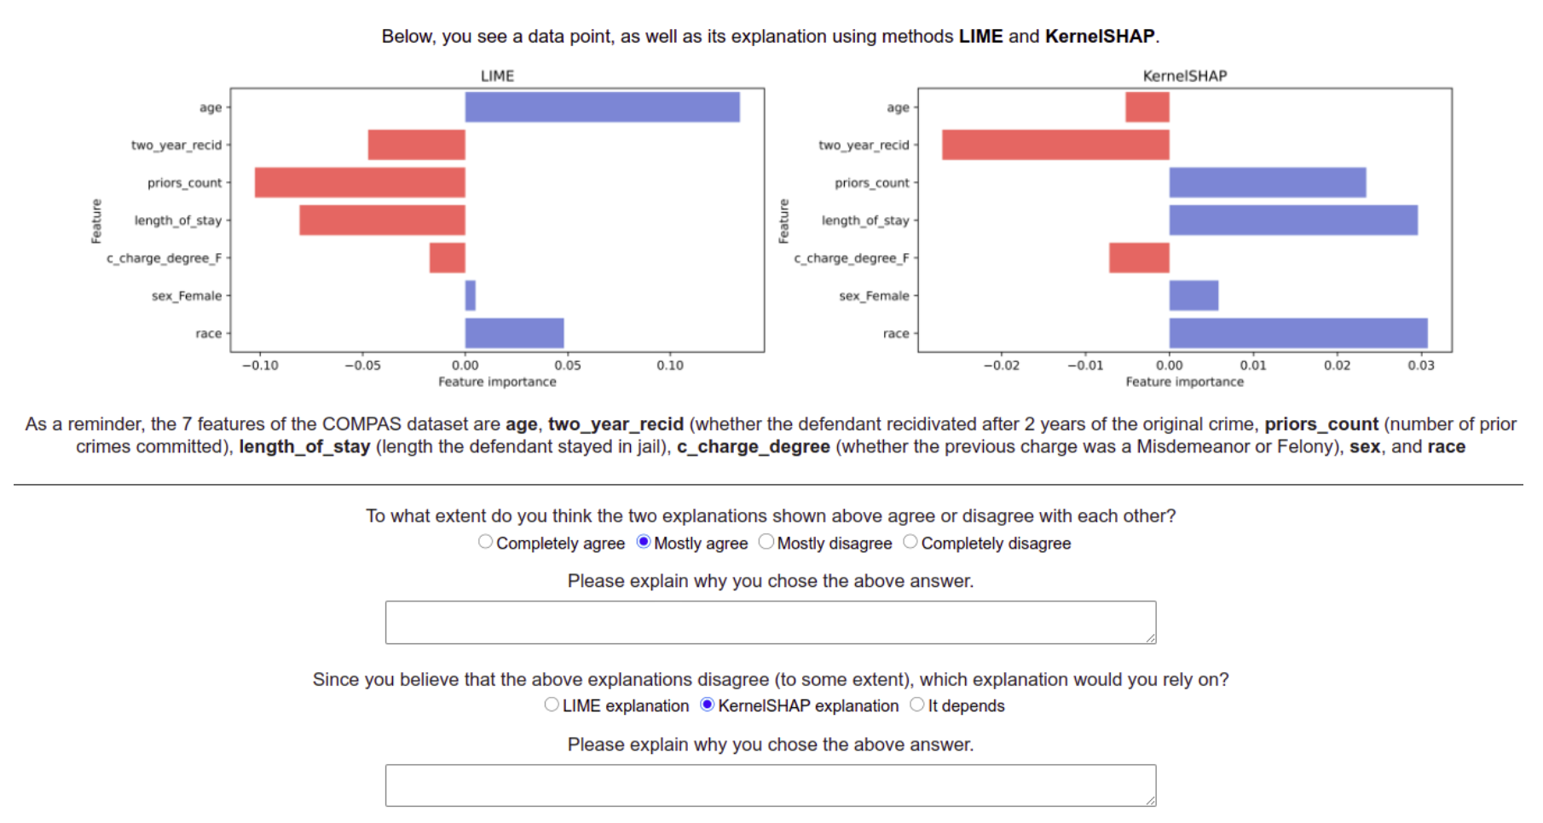
Qualitative online study
Goal of the study: To understand how people resolve or choose between two disagreeing explanations
One example prompt from the study →
Notes:
Now that we have established and verified that disagreement exists, what can we do about it?

Slide 20
Insights from the online study
> Majority of respondents observed and acknowledged disagreement
> Often certain explanations are favoured over others:
SHAP is the most popular while (Gradient*Input) is least chosen
SmoothGrad is often favoured over VanillaGrad (probably because of less noise)
> How do they resolve disagreements in practice?
Rely on heuristics such as “lime/shap is better for tabular data”
Choosing the explanation that matches their intuition better
Using other metrics (fidelity, stability) that quantify the “goodness of fit” of the explanation to the model
Other things also matter like ease of implementation, groundedness of theory, recency of publication, documentation of packages

Slide 21
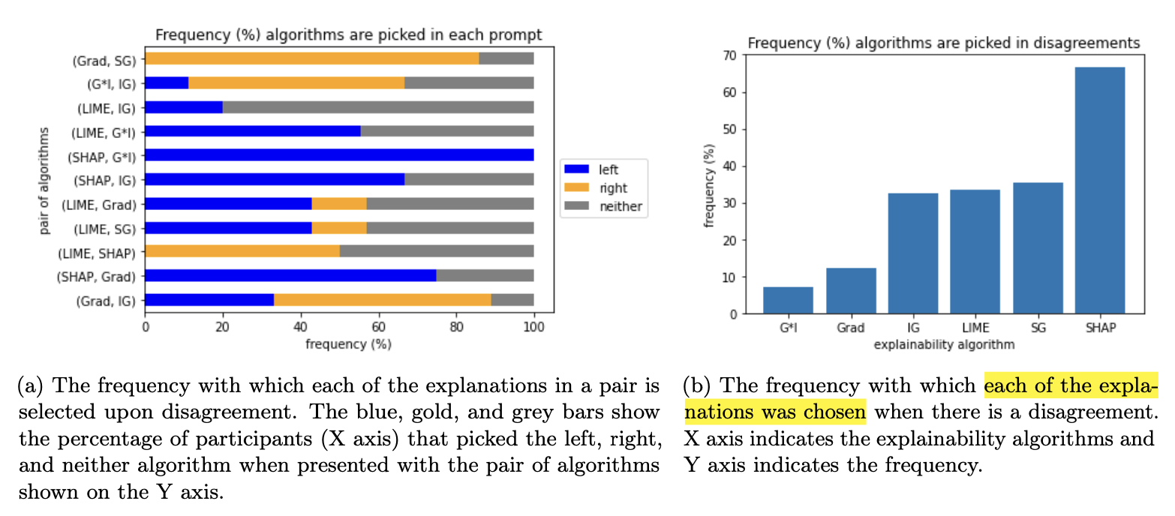
Insights from the online study

Slide 22
Thoughts
> This paper is more of a practitioners’ perspective on explanation disagreement which motivates the metrics
Interview to understand what exactly is disagreement
Online study to find out how people resolve such disagreements
> They do not investigate further on the reasons behind why explanations disagree
> Their studies also find out that people mostly rely on heuristics, intuitions when they use explainability methods
> No mention of other explanation methods
> This paper raises more questions than answers it provides
Notes:
Q freddy: What has happened since 2022?
- Who are these people interviewed? What are the consequences of observing disagreements in explanations?
-
- Counterfactual explanations?

Slide 23
Thank you for your attention! Questions?

Slide 24
Thoughts
This paper is more of a practitioners’ perspective on explanation disagreement which motivate the metrics
Interview to understand what exactly is disagreement
Online study to find out how people resolve such disagreements
They do not investigate further on the reasons behind why explanations disagree
Their studies also find out that people mostly rely on heuristics, intuitions when they use explainability methods
Some explanations are proven to be equivalent (under certain conditions) in the literature (e.g., LIME and gradients), how does this relate to the disagreement problem? [include a source]
No mention of other explanation methods
This paper raises more questions than answers it provides
Notes:
Q freddy: What has happened since 2022?
- Who are these people interviewed? What are the consequences of observing disagreements in explanations?
-
- Counterfactual explanations?

Slide 25
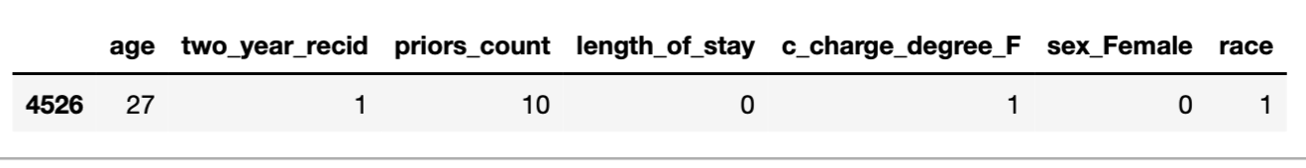
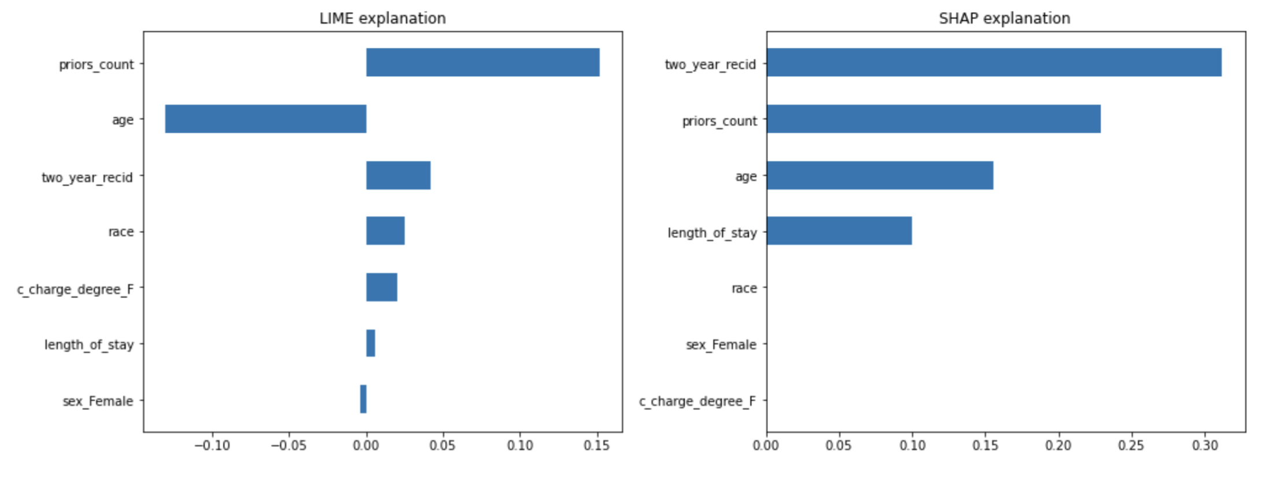
Example of the disagreement problem
same data instance:
two different explanations (while the model predicts same class label risk=0):

Slide 26
Example of disagreement
Notes:
Main goal: identify/point out

Slide 27
Example of disagreement
Notes:
Main goal: identify/point out

Slide 28
Empirical verification of disagreement
Ingredients:
Datasets: Tabular (COMPAS, German credit), Image (1000 image classes), Text (news category prediction)
Models: LR, GBDT, RF, MLP (tabular), LSTM based text classifiers (text), ResNet18 (image)
Explainability methods: LIME, KernelSHAP, VanillaGradients, IntegratedGradients, Gradient*Input, SmoothGrad (feature attribution)
Metrics: (as defined in the last slide)
Notes:
- one example of signed rank agreement calculation

Slide 29
Main results from experiments
Tabular data
They mainly discuss results on COMPAS dataset (only 7 features) --- how it affects the agreement
All explanations for tabular typically agree most for topk (5) feature agreement and pairwise rank agreement (agreement reduces as topk increases 1, 4, 7)
Grad-SmoothGrad, Grad*Input-IntGrad exhibit high agreement, while Grad-IntGrad, SmoothGrad-Grad*Input show disagreement: dichotomy among gradient based explanations!
Text data
Words are used as features with topk=11 (25% of avg input text length)
All explanation methods mostly disagree! – high variance of explanations due to increase in no. of features in text data
LIME explanations are more aligned to other explanations than anything else (figure 3 in paper)
Image data
LIME and KernelSHAP (superpixels) mostly agree on all metrics when features are superpixels
But for gradient based explanations (pixels), disagreement is high for all metrics (granularity matters for images) – explain it further (more pixels – high variance)
Notes:
- “Grad-SmoothGrad, Grad*Input-IntGrad exhibit high agreement, while Grad-IntGrad, SmoothGrad-Grad*Input show disagreement: dichotomy among gradient based explanations!” --- make an illustration
- for text, explanations are not easy to visualize for text and images
for Image, superpixel
“different for different modalities” message should come up!
Make different slides
Mention metrics that agree on
ad

Slide 30
Tabular example

Slide 31
Text explanation example

Slide 32
Image explanation example

Slide 33
Todo
Discuss more results from the experiments, for example, how did they evaluate for each modality: tabular, text, image etc.?
Separate gradient based methods into separate buckets (i.e., grad-smoothgrad vs. intgrad-grad*input)
Do all the metrics make sense? Example: for images, how do they decide features? (superpixels)
Decide which figures are more informative from the paper and add to slides

