Slide 1
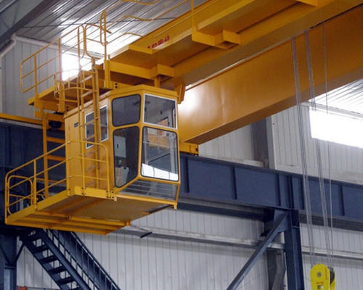
Crane Operator's Fatigue detection
Overhead crane operators control the lifting, moving and positioning of loads on the crane.
They observe and make sure that the load is safely attached and within the lifting weight limits.
During lifting operation if the operator is exhausted or tired then accident may happen, so it is essential to ensure that the operator is alert throughout the entire operation shift.
A primary objective to ensure safety of lifting operations by monitoring the facial fatigue signs of the crane operator , using computer vision and AI model based alert trigger.
EOT Crane operator's cabin

Slide 2
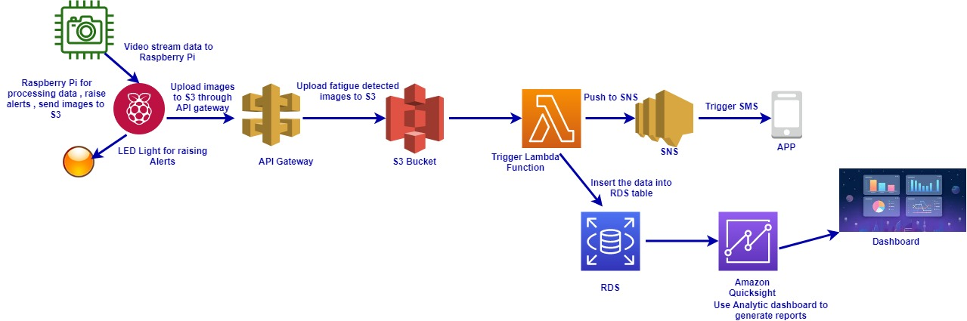
The Architecture flow
Raspberry pi will be used as a edge computing.
A camera will be integrate with Raspberry Pi.
Alert LED bulb will be integrate with Raspberry pi.
AWS cloud components like S3 , lambda function , SNS , RDS and Quicksight e.tc. will be used
Programming language is python , OpenCV for video reading and parsing.

Slide 3
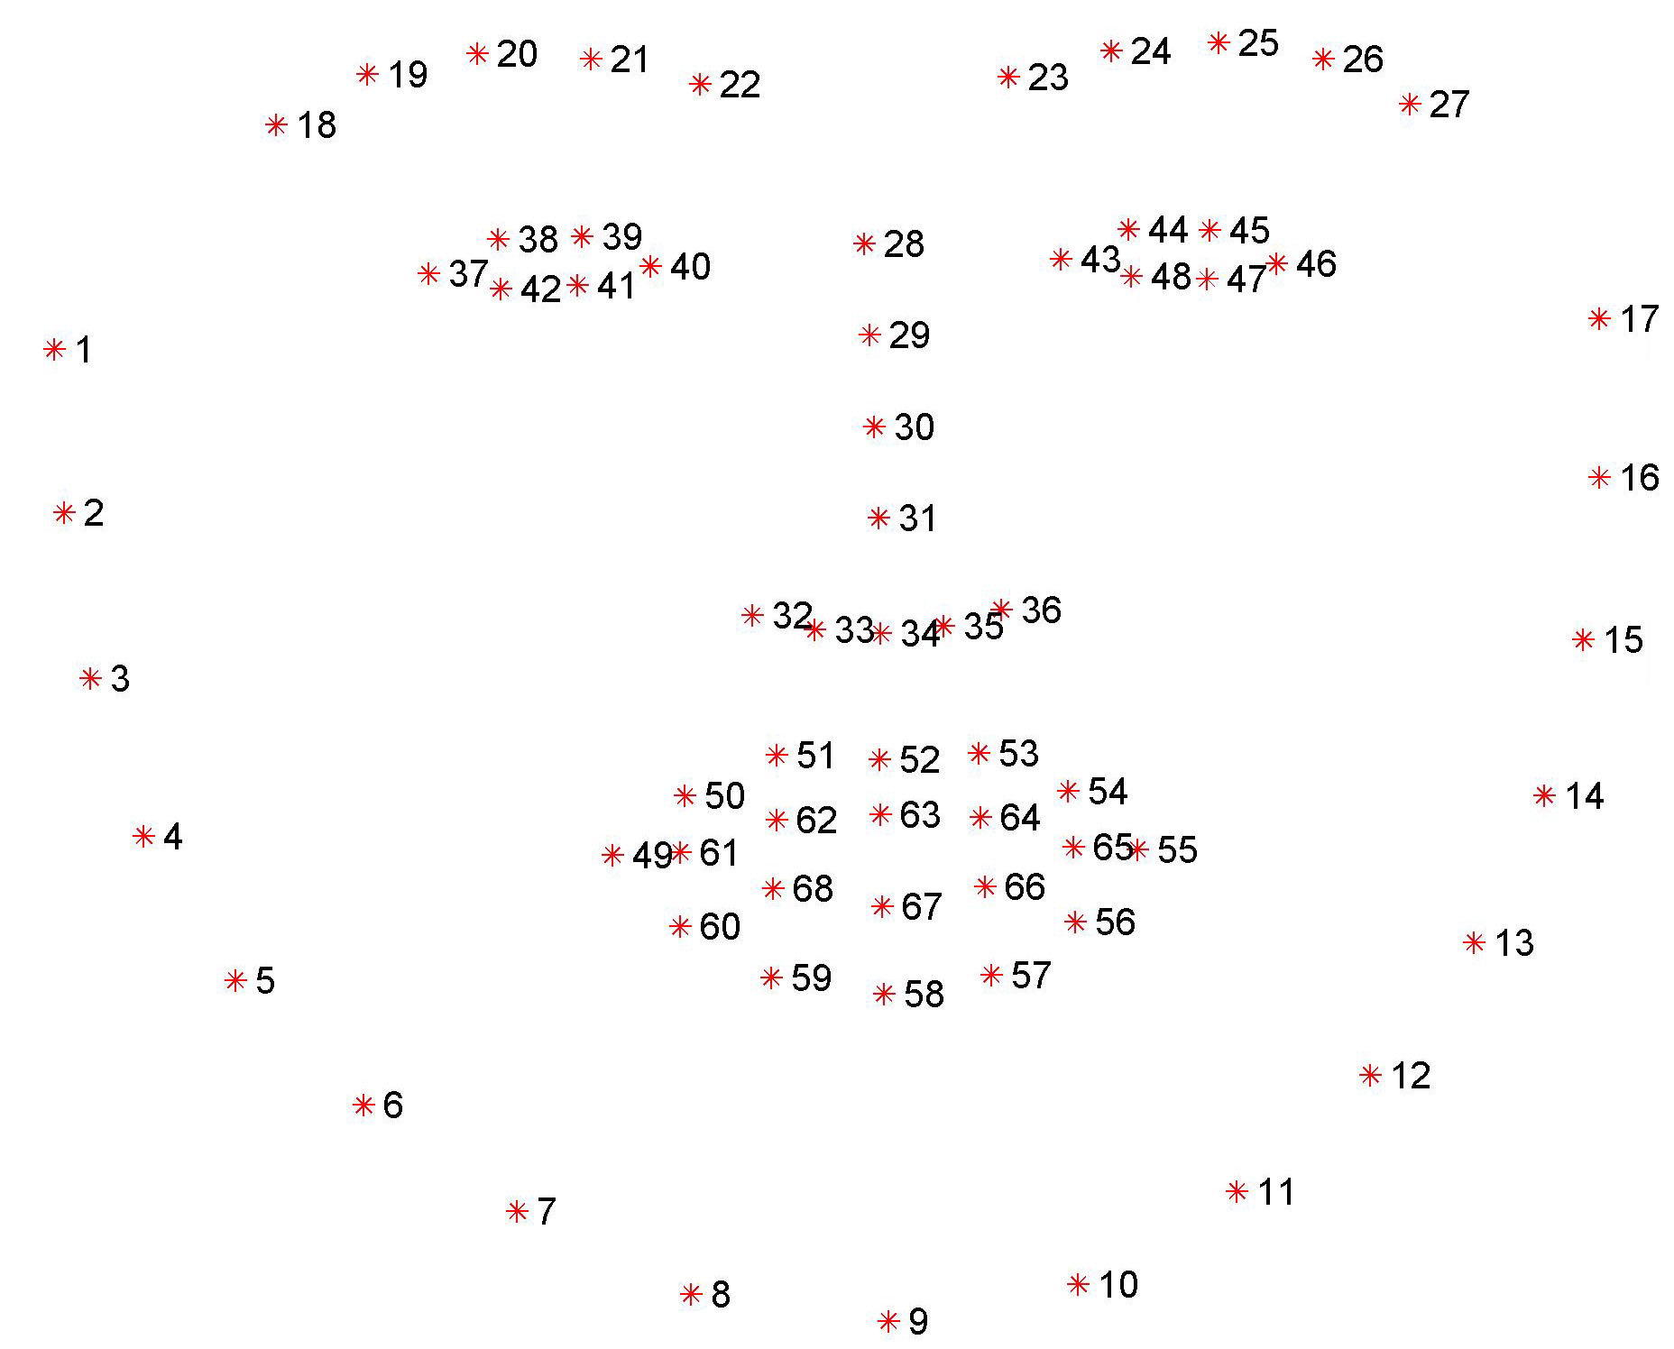
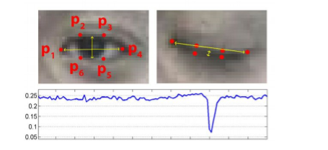
Process Flow
The camera , raspberry pi and alert LED bulb will be installed inside the cabin where camera can take good videos of crane operator’s face.
The camera will capture crane operator’s video and video stream data will be passed to raspberry pi.
The raspberry pi will read video data and parse it into frames.
The frames will then pass into AI pretrained model which will detect the face.
Once the model confirmed that the face is detected it will then pass to another AI pretrained model which will detect the facial landmark.
Facial landmarks are used to localize and represent salient regions of the face, such as:
Eyes
Eyebrows
Nose
Mouth
Jawline
The pre-trained facial landmark is used to estimate the location of 68 (x, y)-coordinates that map to facial structures on the face.

Slide 4
Process Flow Cont.….
Extract the eye ROI(region of interest) and mouth ROI.
Calculate the eye aspect ratio and mouth aspect ratio.
If mouth aspect ratio is > threshold then trigger warning (yellow light) that crane operator is tired.
Similarly if eye aspect ratio is < threshold then trigger alert (red light) that crane operator is in fatigue / drowsiness state. The eye is open if Eye Aspect ratio is greater than threshold.
Raspberry pi will trigger LED bulb (on/off) based on the alerts / warning raised .
Use AWS IAM to setup bucket policy and configured the credential in raspberry pi to haver access to S3 bucket to send images.
Send the frame image where the warning or alert is detected to AWS S3.
Create a Lambda function in AWS. Lambda is the flagship AWS serverless computing service. A Lambda is a piece of code that will run once it's invoked by some trigger, like when images arriving at S3 buckets.
Create Simple Notification Service (SNS) topic , lambda will post a message to the SNS topic using SNS API.
Subscribe to this SNS topic and shopfloor / sites supervisor will be notified via SMS texts regarding crane operator’s fatigue state.
Lambda will send the crane operator’s fatigue details to AWS RDS .
The RDS data can be used by amazon Quicksight to generate various dashboard for end user to do further analysis.

Slide 5
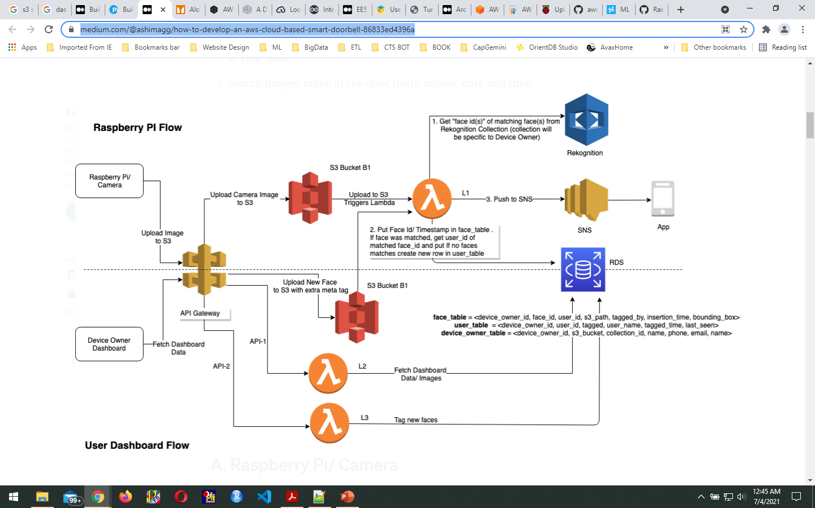

Slide 6
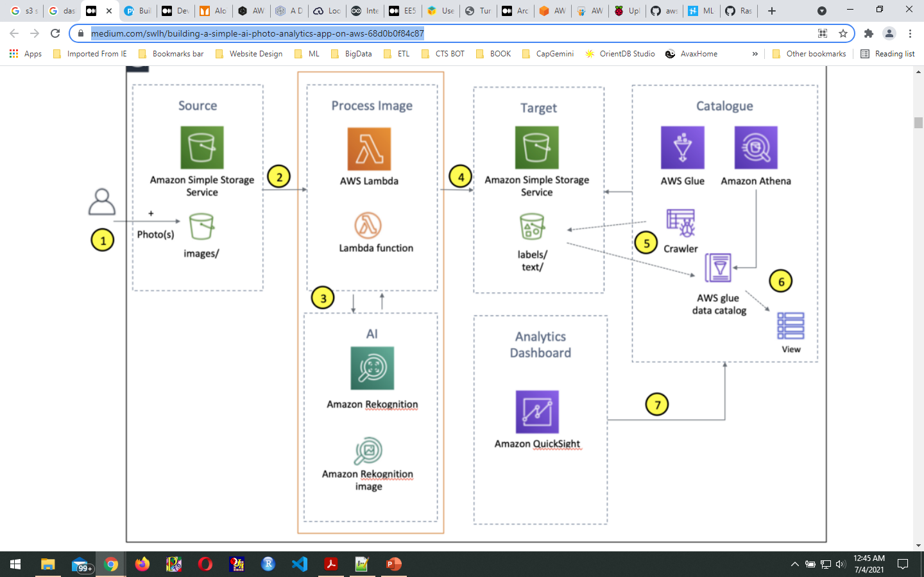

Slide 7
My Notes –
Every 5 seconds a human blink in normal condition.
If for continuously 30seconds the eye is closed that means the person is in fatigue state .
If you take 5pfs then if counter will be 150. if eye close for continuously 150 frames then
Fatigue state.
If 10fs then counter will be 300
Jaw Points = 1–17
Right Brow Points = 18–22
Left Brow Points = 23–27
Nose Points = 28–36
Right Eye Points = 37–42
Left Eye Points = 43–48
Mouth Points = 49–61
Lips Points = 62–68
The dlib library provides two functions that can be used for face detection:
HOG + Linear SVM: dlib.get_frontal_face_detector()
MMOD CNN: dlib.cnn_face_detection_model_v1(modelPath)

