Slide 1
Beer Data Analysis Summary
By :- Swagatika Panda
Date – 2022-09-20

Slide 2
Purpose
To analyze beer data to see what makes the best beer
What factors influence consumers ratings on beer?
Consumer reviews data
Consumer over all rating
Any particular test/flavor

Slide 3
Question to Address
Rank top 3 Breweries which produce the strongest beers?
Which year did beers enjoy the highest ratings?
Based on the user’s ratings which factors are important among taste, aroma, appearance, and palette?
If you were to recommend 3 beers to your friends based on this data which ones will you recommend?
Which Beer style seems to be the favorite based on reviews written by users?
How does written review compare to overall review score for the beer styles?
How do find similar beer drinkers by using written reviews only?

Slide 4
Source Data
Data Set: – 0.52887 million reviews
Data source link - https://drive.google.com/open?id=1e-kyoB97a5tnE7X4T4Es4FHi4g6Trefq
Rates common attributes of beers and provides their overall ratings.
Few observations from source data
There are total 528870 beer name and beer_style data.
There are unique 18339 beer name
There are 104 unique beer style
There are unique 22800 review profiler name
Most common beer name is Sierra Nevada Celebration Ale
Most common beer style is American IPA
Most Common review profiler name is northyorksammy
Total 3 features has missing values. These are beer_ABV , review_profileName and review_text.

Slide 5
Data, Cleanup, Exploration
Out of total records 3.8% missing values is from beer_ABV, where as review profile Name and review text contribute only 0.02%
Fill the missing profiler name with most occurrence profiler name (mode value)
Fille the review text with most occurrence review text (mode value)
For Alcohol beer value(beer ABV) , fill the missing values based on beer name , as beer name has fixed alcohol beer value. After filling missing alcohol beer value still we got 17920 missing ABV value , so we dropped these records.
Beer style , beer name , review profiler name and review text are the categorical features.
The number of unique beer ABV is 283
The number of unique beer name is 18339
We do not have any over all negative reviews.
We got review time in unix time so convert unix time to date time format for review time .
As per feature processing create new 'year' column and extract year from review time

Slide 6
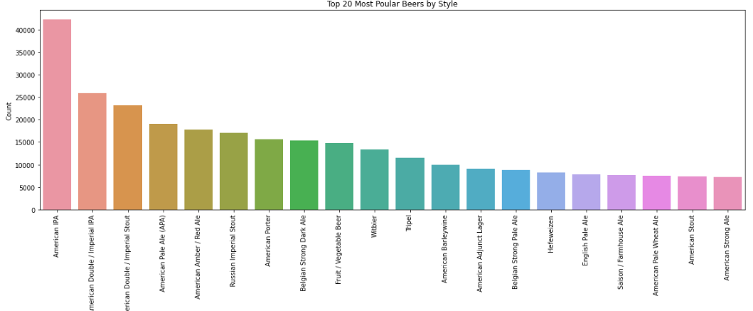
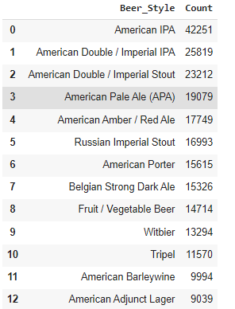
Data Analysis
Which beer style has maximum count in entire data set.
Let’s check top 20 most common beer style based on count.
American IPA beer style is having maximum count in entire data sets. The beer drinker bought maximum this beer style .

Slide 7
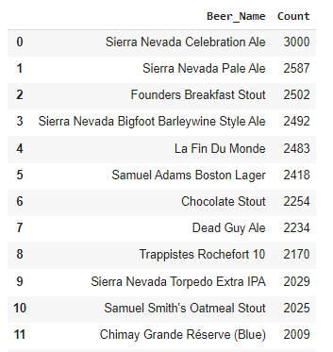
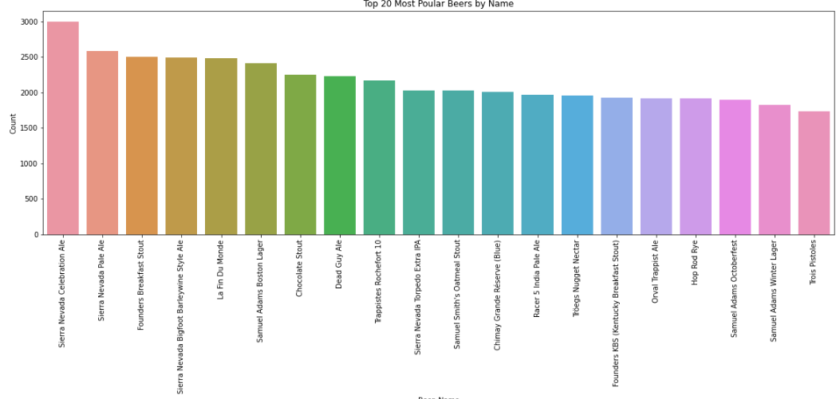
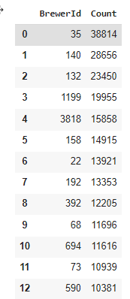
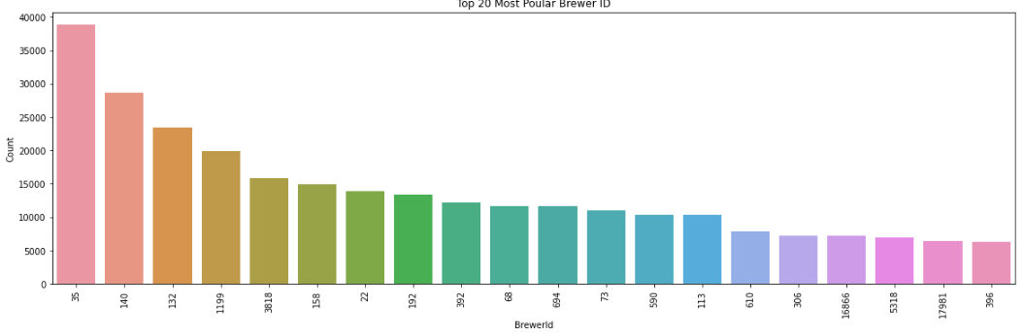
What is the maximum beer by name the user bought.
Which brewer is most popular that sell maximum beers in entire data set. Since we don’t have brewer name in the data set , we will check with brewer id.
Sierra Nevada Celebration Ale is maximum bought in entire data set
Brewer ID 35 is the top selling beers

Slide 8
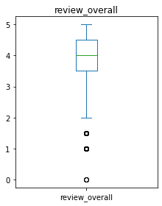
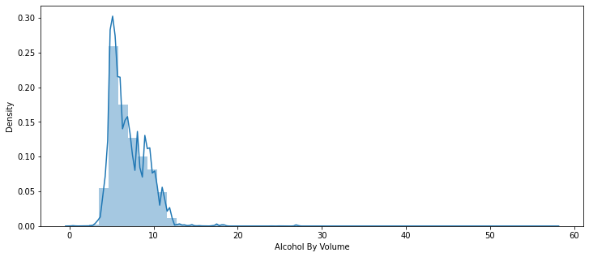
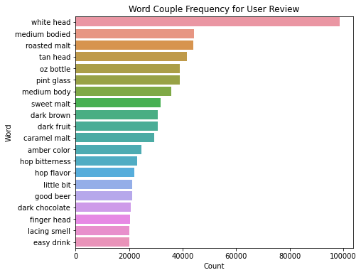
Let’s check the data distribution for Alcohol beer value
Almost all of the majority data in the distribution of 'beer_ABV' is between 5-10 with long tail towards right.
Data is not perfectly normally distributed.
The IQR for the overall review feature is between 3.5-4.5.
Let’s check the most frequency word used in user review comments.
The most frequency word used is white head, oz bottle , roasted malt, amber color etc.

Slide 9
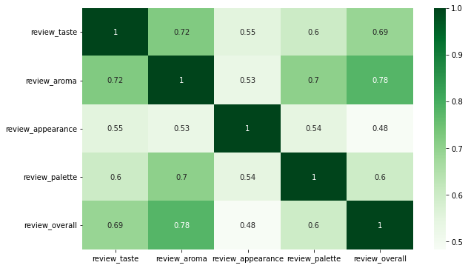
Q1.Rank top 3 Breweries which produce the strongest beers?
Based on the alcohol volume of a beer (i.e. 'beer_ABV'), we can determine how strong it is. We have beer_brewerId for finding the breweries which produce the strongest beer.
The top 3 breweries which produce the strongest beer is listed below based on brewery ids is.
6513
736
24215
Though Brewer ID 35 is the top selling beers but didn’t make the top 3 breweries which produce the strongest beer.
Q2. Which year did beers enjoy the highest ratings?
Use the overall rating we can find which year it got highest rating. Beers enjoyed the highest ratings in the year 2000.
Q3.Based on the user’s ratings which factors are important among taste, aroma, appearance, and palette?
• Looking at the data:
– Aroma has the highest highest correlation on overall beer rating
– Appearance has the lowest correlation to overall beer rating

Slide 10
Q4. If you were to recommend 3 beers to your friends based on this data which ones will you recommend?
if you are going to recommend beer then it should have a good rating , good taste and also have good alcohol value.
The top 3 beers which can be considered for recommendation based on the overall ratings ,test and the alcohol value is
AleSmith Speedway Stout - Oak Aged
Love Child Belgiweizen
Edsten Triple-Wit / Honey Badger
Though Sierra Nevada Celebration Ale is maximum bought in entire data set but it did not make it top 3 based on over all rating , test and alcohol value.
Q5. Which Beer style seems to be the favorite based on reviews written by users?
Used two different methods to find the Beer style seems to be the favorite based on reviews written by users. Used some text cleaning features like remove stop words, white space ,tokenization , lemmatization etc. Calculate the average polarity score for each beer style found that :-
Using textblob the most favourite beer style is Vienna Lager
Using NLTK SentimentIntensityAnalyzer the most favourite beer style is Bière de Champagne / Bière Brut
Though American IPA beer style is having maximum count in entire data sets but as per user review comment it is not the most favored one.

Slide 11
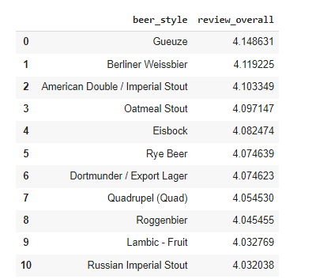
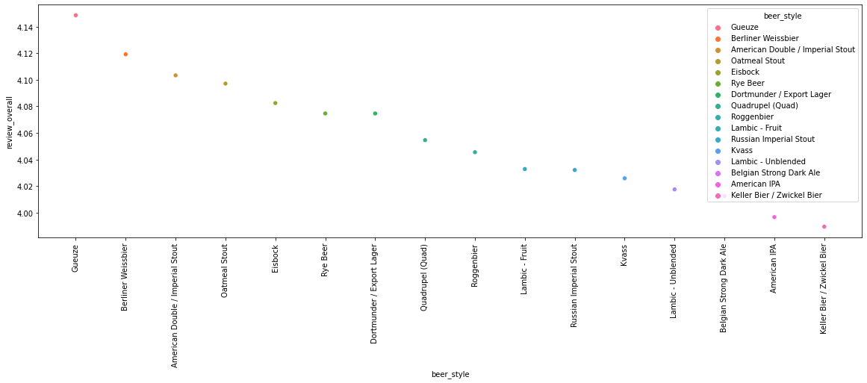
Q6. How does written review compare to overall review score for the beer styles?
Let's compare over all review with review comments for each beer style.
The favourite beer style based on review is listed below .American Adjunct Lager is having two different review scores 16.5 and 11.5. So let's consider it as one
American Adjunct Lager
Märzen / Oktoberfes
English Porter
Fruit / Vegetable Beer
American Double / Imperial Stout
Though American IPA beer style is having maximum count in entire data sets but as per user review comment and review scope it did not make it to top.
Based on over all review rating the top beer style is Gueuze.

Slide 12

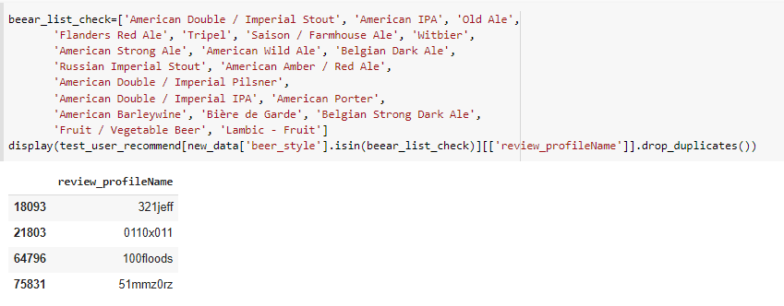
Q7. How do find similar beer drinkers by using written reviews only?
let’s build a recommendation system which will recommend user based on review comments. I have used memory based collaborative filtering using cosine similarity concepts.
It has total 22594 user profile in this data set.
Created a dataset with unique combination of user and corresponding user reviews
Used sample 200 user’s record to build a recommendation engine due to memory constraint ( build in google colab free version).
Used TF-IDF concept to retrieve word that are more weightage value in review comments.
Use NLTK pair wise cosine similarity to create a sparse matrix for recommendation.
Since I have used only 200 sample data to build recommendation , it can be build with entire data sets when we have memory to process the data . A threshold can be given to recommend user based on threshold value.
Example – I passed index value 0 which is user 0110x011
Based on above user written reviews we can recommend below top 3 users
['0110x011', '100floods', '321jeff', '51mmz0rz']
Cross check if same beer style is used by recommended user or not

Slide 13
Thank You

