Slide 1


APEX INSTITUTE OF MANAGEMENT, CHANDIGARH UNIVERSITY
Programme: MBA - Data Science and AI (3rd Semester)
Summer Internship (1st June - 12th July)
Submitted by: Swagata Das | UID: [TO BE FILLED]
Under the guidance of: Kuldeep Dubey
Internship Organization: Tutorsuite Technologies LLP, Kolkata
Academic Year: MBA 2023-25
CUSTOMER REVENUE INTELLIGENCE
An Interactive Data Science Platform for Customer Segmentation, Revenue Prediction and Business Growth
DISCOVER . LEARN . EMPOWER
Notes:
Good morning. I am Swagata Das, MBA Data Science and AI at Apex Institute of Management, Chandigarh University. This is my summer internship project, carried out at Tutorsuite Technologies LLP, Kolkata, under the guidance of Kuldeep Dubey. The project builds one platform that takes customer transaction data through segmentation, value analysis, prediction and forecasting to a business decision.

Slide 2
Introduction
Retail and e-commerce businesses record transaction data far faster than they convert it into decisions.
Revenue is reported in aggregate - by month, category and region - but the questions that drive growth are customer-level: who matters most, who is going quiet, what will they spend next.
Customer value is concentrated, so identifying and protecting high-value customers is more economical than acquiring new ones.
Planning needs a forward view: predicted customer revenue and a forecast of company revenue with an honest error range.
An integrated analytics platform is needed so segmentation, value analysis, prediction and forecasting all use one validated dataset and one definition of revenue.
This project implements that platform on 18,670 validated order lines covering 1,984 customers over 36 months.
Notes:
Frame the business problem first. Aggregate reporting cannot tell a month carried by a few large customers from one built on a broad base, so it cannot guide retention spend. Likely viva question: why customer-level analytics rather than reporting? Answer: because the decisions - who to retain, who to grow - are taken at customer level.

Slide 3
About the Organization
Internship organization: Tutorsuite Technologies LLP, Kolkata.
Internship period: 1st June - 12th July, under the guidance of Kuldeep Dubey.
Academic project based on a synthetic e-commerce transaction dataset.
The dataset was generated programmatically for academic demonstration. It does not describe any real company, customer or transaction, including the internship organization.
It is reproducible from a fixed seed (42), which allows every result in this presentation to be regenerated and checked.
No company history, revenue, client or operational information is presented, because none is documented for this project.
Notes:
Be explicit and unembarrassed about this: the data is synthetic. Say why it is a strength for an academic project - no confidentiality constraint, a known ground truth to audit the cleaning against, and full reproducibility. The methods are exactly those you would apply to real data. Viva question: would your results hold on real data? Answer: the method transfers, the specific numbers do not.

Slide 4
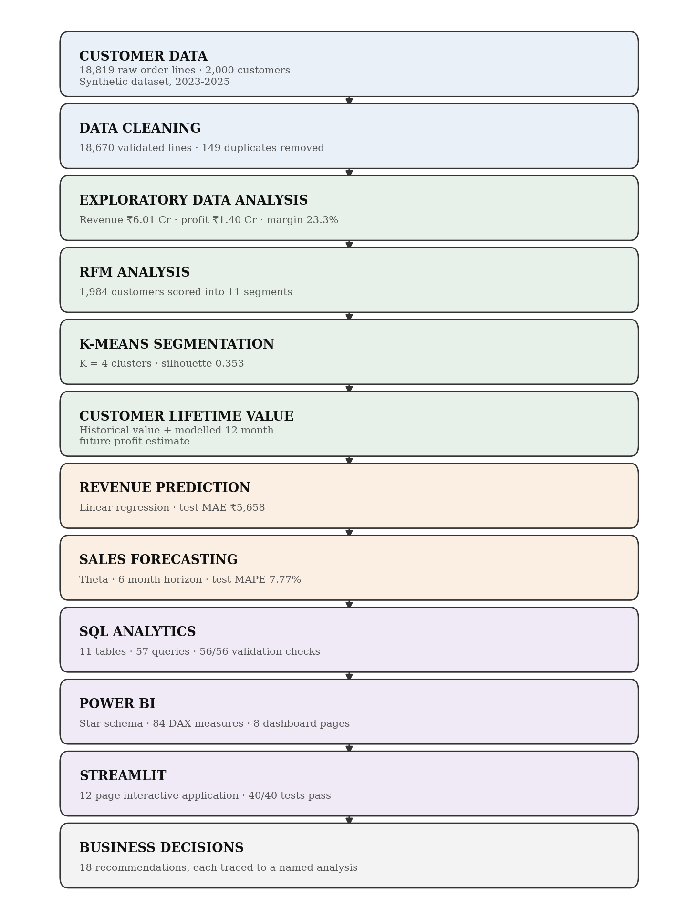
About Customer Revenue Intelligence
Customer revenue intelligence turns raw transactions into decisions by moving up a chain: who the customer is, what they are worth, and what they will do next.
Each stage consumes the validated output of the one before it, so one revenue definition holds end to end.
Notes:
Walk the chain out loud: customer data, customer understanding, segmentation, value analysis, prediction, forecasting, business decision. The point to make is that each arrow is a real module in the project, not a concept - the diagram is generated from the actual pipeline.

Slide 5
Review of Related Literature
Six strands of published work inform the design. Full APA citations are on the References slide.
Area | Key work | Method | Relevance to this project
RFM analysis | Hughes (1994); Fader et al. (2005) | Quintile customer scoring | Rule-based customer value segments
Segmentation | MacQueen (1967); Rousseeuw (1987) | K-Means; silhouette | Unsupervised customer groups
Customer value | Gupta et al. (2006); Fader et al. (2005) | CLV modelling | Historical vs estimated forward value
Prediction | Hastie et al. (2009); Breiman (2001) | Regression and ensembles | Next-quarter customer revenue
Forecasting | Hyndman & Athanasopoulos (2021); Theta (2000) | ETS, ARIMA, Theta | Monthly revenue planning
BI delivery | Kimball & Ross (2013); Few (2006) | Star schema; dashboard design | Power BI model and application
Notes:
Do not claim novelty in any single technique - all six are established. What the literature gives you is the discipline: Rousseeuw for choosing K, Hyndman for insisting a forecast beat a naive benchmark, Gupta for separating measured historical value from estimated forward value. Viva question: which paper justified your K? Answer: silhouette from Rousseeuw, applied only after stability rules fixed in advance.

Slide 6
Research Gap & Significance
The practical gap
  Transaction data -> traditional reporting -> limited customer intelligence -> limited predictive capability.
  These techniques are well established individually, and prior research has combined several of them. What is rarely available in one reproducible workflow is all of them on one validated dataset with a single revenue definition.
The integrated solution implemented here
  RFM + K-Means + Customer value + Revenue prediction + Forecasting + SQL + Power BI + Streamlit.
  Significance: every stage is re-runnable from a fixed seed, every metric is reconciled against an independent SQL implementation, and the whole project passes an audit of 135 checks (134 pass, 0 fail).
Notes:
State the gap carefully - integration and traceability, not novelty of method. If asked what is new: one dataset and one revenue definition flowing through every stage, reconciled across Python, SQL and DAX, with an audit that tests the integration rather than asserting it.

Slide 7
Objectives of the Study
1. Generate and validate the dataset, and clean it against explicit business rules
2. Characterise the revenue base through exploratory data analysis
3. Score every purchasing customer on Recency, Frequency and Monetary value
4. Segment customers independently using K-Means clustering
5. Quantify historical customer value and estimate forward twelve-month value
6. Predict customer revenue for the following quarter
7. Forecast company-level monthly revenue with prediction intervals
8. Reproduce the principal metrics independently in SQL and reconcile them
9. Build a Power BI semantic model and dashboard specification
10. Develop an interactive Streamlit application
11. Derive evidence-linked business recommendations
Notes:
All eleven objectives were implemented; none is aspirational. If asked which objective was hardest: objective 6, revenue prediction, because the target is zero-inflated - and that result is reported honestly rather than dressed up.

Slide 8
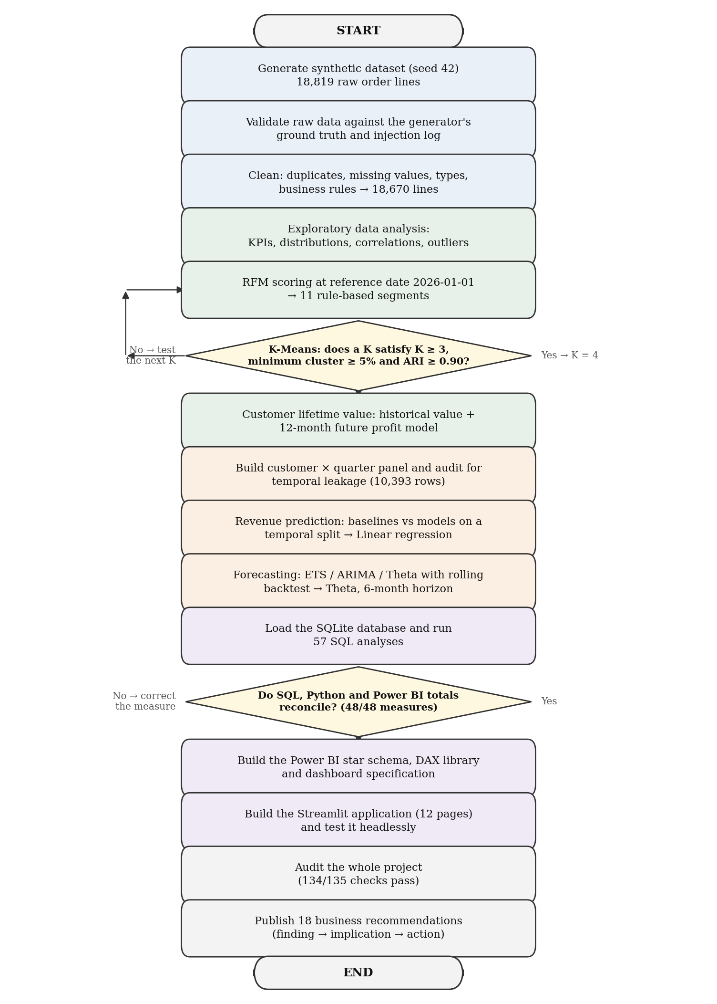
Research Methodology
Applied data science on quantitative transaction data: machine learning for segmentation and prediction, time-series analysis for forecasting, business intelligence for delivery.
Three validation gates let a stage reject its own output: business rules, K-selection and the forecasting baseline test.
Notes:
Emphasise the gates - they are what makes this a methodology rather than a sequence of scripts. Gate 1: no analysis until every business rule returns zero failing rows. Gate 2: K must satisfy rules fixed before the results were seen. Gate 3: a forecast model must beat both naive baselines or it is rejected.

Slide 9
Dataset & Data Preprocessing
Raw data -> missing values -> duplicates -> data types -> business rules -> outliers -> clean dataset -> feature engineering.
Dataset property | Value | Cleaning rule | Rows failing before / after
Raw extract | 18,819 lines, 23 columns | Missing value | 941 / 0
Cleaned dataset | 18,670 lines, 51 columns | Invalid or non-ISO date | 566 / 0
Duplicates removed | 149 | Non-numeric value | 93 / 0
Customers | 2,000 registered, 1,984 purchasing | Discount out of range | 38 / 0
Products | 61 in 6 categories | Revenue mismatch | 56 / 0
Geography | 35 cities, 21 states, 5 regions | Invalid category value | 794 / 0
Period | 01 January 2023 to 31 December 2025 (36 months) | Age out of range | 19 / 0
Orders | 13,251 across all statuses | Quantity not positive | 9 / 0
Notes:
Revenue is computed on delivered order lines only; returned and cancelled lines are kept and analysed separately as lost value. That single rule, applied identically in Python, SQL and DAX, is what makes the three implementations reconcilable. Every cleaning rule returns zero failing rows after treatment - a rule that does not is treated as a failure of the cleaning stage, not an acceptable residue.

Slide 10
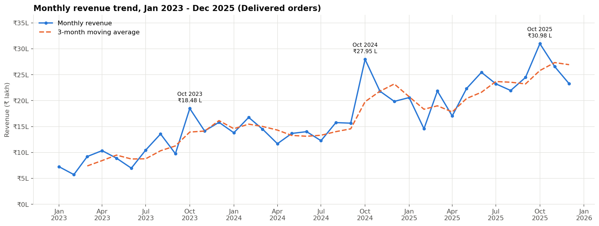
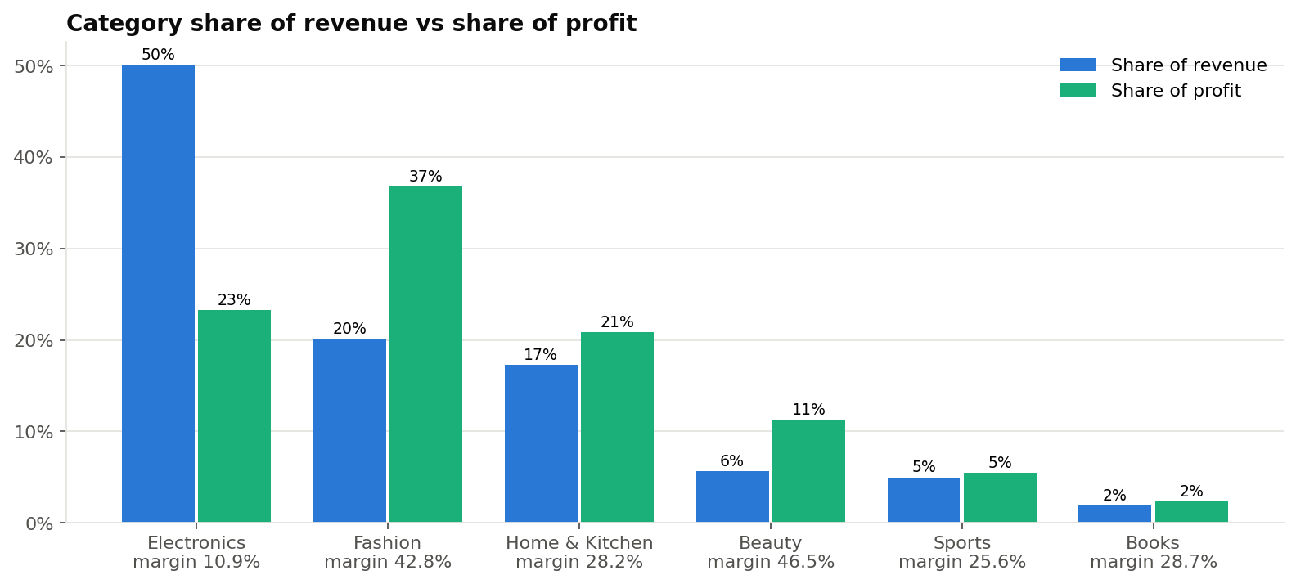
Exploratory Data Analysis
Delivered revenue Rs 6.01 Cr at 23.35% margin, 12,212 orders, AOV Rs 4,918.
Revenue grew 51.4% then 37.7% while margin rose to 23.90% - growth is not bought with margin.
The top 20% of customers produce 64.33% of revenue.
Notes:
Each chart answers a business question. This one answers 'is the business growing, and is it buying that growth with margin?' - the answer is yes and no respectively. October is the strongest month in all three years, which is the clearest seasonal signal the series carries, but with 36 observations the formal seasonality test does not confirm a stable pattern.

Slide 11
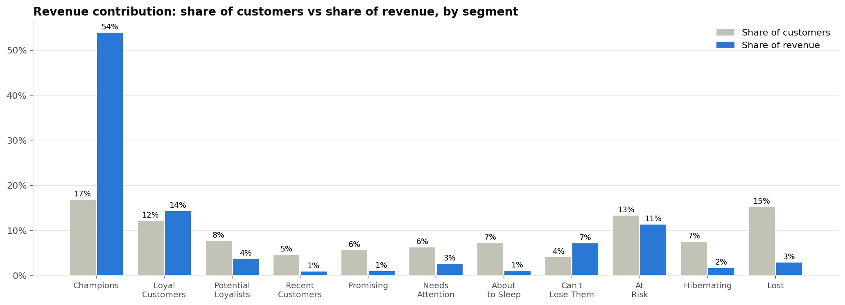
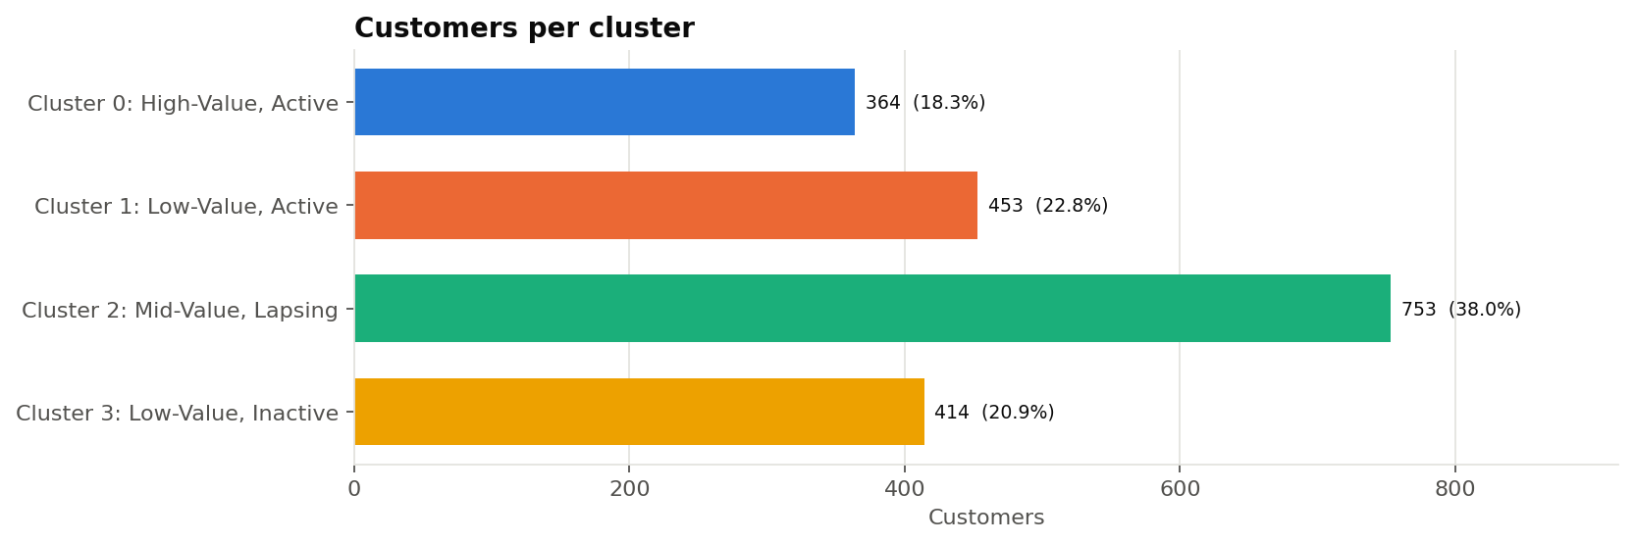
Customer Intelligence - RFM & K-Means
RFM scores 1,984 customers on recency, frequency and monetary value into 11 rule-based segments. Champions: 16.8% of customers, 53.8% of revenue.
K-Means on the same features selected K = 4 (silhouette 0.353). Cluster 0 is 18.3% of customers and 55.7% of revenue.
Agreement between the two schemes: ARI 0.3952.
Notes:
The two schemes are independent: RFM is rules, K-Means is unsupervised. They agree substantially on the high-value group and diverge in the middle of the base, which is itself a finding - it shows where the rule boundaries are arbitrary. Viva question: why K = 4? Answer: three rules were fixed before seeing results - K at least 3, no cluster below 5% of the base, bootstrap stability ARI at least 0.90 - and among the eligible values K = 4 had the highest silhouette.

Slide 12
Customer Lifetime Value
Historical value (measured): Rs 1.40 Cr of delivered profit on Rs 6.01 Cr of revenue; mean Rs 7,068 against median Rs 3,893 per customer.
Estimated forward value (predicted): a random forest trained out of time on eight behavioural features, predicting delivered profit over the next twelve months. The two are reported separately and are never added together.
Forward-value model | MAE | RMSE | R2 | Spearman | Selected
Ridge regression (baseline) | Rs 2,853 | Rs 4,469 | 0.2007 | 0.4779
Random forest | Rs 2,793 | Rs 4,269 | 0.2705 | 0.4869 | Yes
Gradient boosting | Rs 2,982 | Rs 4,323 | 0.2520 | 0.4960
Naive: last-12-month profit repeats | Rs 2,947 | Rs 4,648 | 0.1354 | 0.4402
Simplified formula (AOV x F x margin x P(repeat)) | Rs 2,859 | Rs 4,606 | 0.1509 | 0.4641
BG/NBD orders x avg profit per order | Rs 2,693 | Rs 4,356 | 0.2405 | 0.4899
Value drivers by permutation importance: Frequency, Avg_Discount, Recency_Days, AOV.
1,716 customers scored by the model, 268 by group average. 52 high-value customers are inactive for 180+ days, holding Rs 26.51 L of historical revenue.
Notes:
Be precise about the distinction the examiner will probe: historical value is measured from delivered profit already earned; forward value is an estimate with error. The model's R-squared of 0.2705 with a Spearman of 0.4869 means it ranks customers considerably better than it predicts their exact value - so it is used as a prioritisation instrument, not as a promise of any individual customer's spend.

Slide 13
Revenue Prediction
Target: each customer's delivered revenue in the next quarter. Panel of 10,393 customer-quarter rows with 24 features computed strictly before the target quarter began.
Out-of-time split (not random): 4,788 train / 2,692 validation / 2,913 test rows.
Model tested | Type | MAE | RMSE | R2 | WAPE | Selected
Baseline: previous quarter (naive) | Baseline | Rs 6,423 | Rs 14,483 | -0.5700 | 145.1%
Baseline: same quarter last year (seasonal naive) | Baseline | Rs 5,880 | Rs 13,557 | -0.3756 | 132.9%
Baseline: 12-month quarterly mean | Baseline | Rs 5,436 | Rs 11,466 | 0.0160 | 122.8%
Linear regression | ML model | Rs 5,658 | Rs 11,232 | 0.0557 | 127.8% | Yes
Random forest | ML model | Rs 5,762 | Rs 11,265 | 0.0502 | 130.2%
Gradient boosting | ML model | Rs 5,845 | Rs 11,383 | 0.0302 | 132.1%
Random forest (tuned) | ML model | Rs 5,554 | Rs 11,148 | 0.0698 | 125.5%
Selected: Linear regression by the rule fixed in advance - simplest model within 2% of the best validation RMSE (fixed in advance).
Most important features (permutation): Orders_12M, Main_Category, Share_Books, AOV_12M.
Honest reading: the model beats every baseline but is weak in absolute terms (R2 0.0557), because 53.0% of customer-quarters have a zero actual value. Total bias 1.12%, so it is usable at portfolio level, not for one customer.
Notes:
Do not oversell this slide - the examiner will respect the honesty more than a high number. The model is better than the naive previous-quarter baseline on every metric, but explains only about 5.6% of the variance in individual outcomes. The reason is structural zero-inflation: more than half of customer-quarters have no order at all. The correct fix, stated in future scope, is a two-stage model: will the customer order, and if so how much.

Slide 14
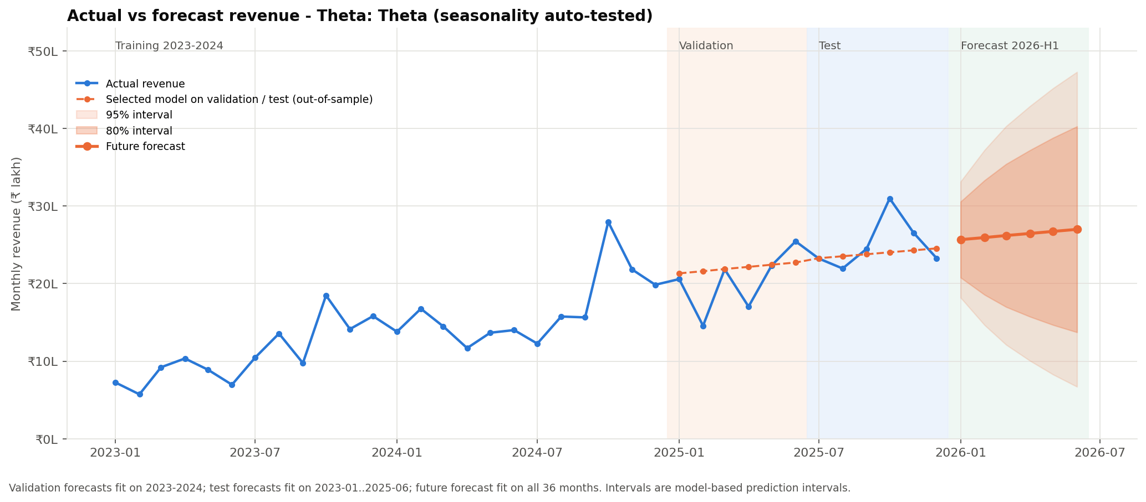
Sales Forecasting
Forecasting is company-level monthly revenue; prediction is per customer per quarter. They are different tasks.
Naive, seasonal naive, ETS, ARIMA/SARIMA and Theta were tested on 36 months. Selected: Theta: Theta (seasonality auto-tested), backtest mean MAPE 14.56%.
6-month horizon: Rs 1.58 Cr, 80% interval Rs 1.00 Cr to Rs 2.16 Cr.
Notes:
Make the distinction between prediction and forecasting explicitly - it is a standard viva question. Then defend the model choice: Theta was selected because it had the lowest mean backtest error and beat both naive baselines on test MAE, which was a rule set before the results were seen. Quote the backtest MAPE, not the flattering single-split test MAPE. The interval is wide because the history is short and the model is univariate - it uses no price, promotion or holiday input.

Slide 15
SQL-Based Business Analytics
A normalised SQLite database of 11 tables and 2 views, with 57 analytical queries (37 analysis, 20 business). All 56/56 validation checks and 20 data-quality checks pass.
Techniques used: JOIN, GROUP BY, common table expressions, window functions, self-joins, conditional aggregation and ranking.
Business question answered in SQL | Result computed | Source query
Revenue | Delivered revenue ₹6.01 Cr, profit ₹1.40 Cr (23.35% margin), 12,212 orders, 1,984 customers, AOV ₹4,918. | rev_kpi_summary
Growth | Revenue growth 2024: +51.4%, 2025: +37.7%; margin 22.65% -> 23.05% -> 23.90%. | rev_by_year
Customer concentration | Top 20% of customers = 64.33% of revenue; top 1% = 9.05%. | cust_concentration_summary
Repeat purchasing | Repeat customers are 89.4% of customers and 98.6% of revenue. | BQ12
Retention | Retained / active last year: 2024: 73.0%, 2025: 93.3%; new customers per year 2023: 1,137, 2024: 498, 2025: 349. | BQ15
RFM segments | Champions: 16.8% of customers, 53.8% of revenue; At Risk + Can't Lose Them: 18.4% of revenue. | seg_rfm_summary
This layer is an independent implementation: written against the same definitions in a different language, so agreement with the Python pipeline is evidence rather than a tautology.
Notes:
The purpose of the SQL layer is reconciliation, not duplication. Revenue, profit, margin, order count, customer count and AOV are recomputed here from the normalised tables and agree with the Python pipeline to the paisa - which is what allows the dashboard and the application to quote the same figures. Be ready to name the window functions used: ROW_NUMBER and RANK for top-N customers and products, and cumulative sums for the concentration curve.

Slide 16
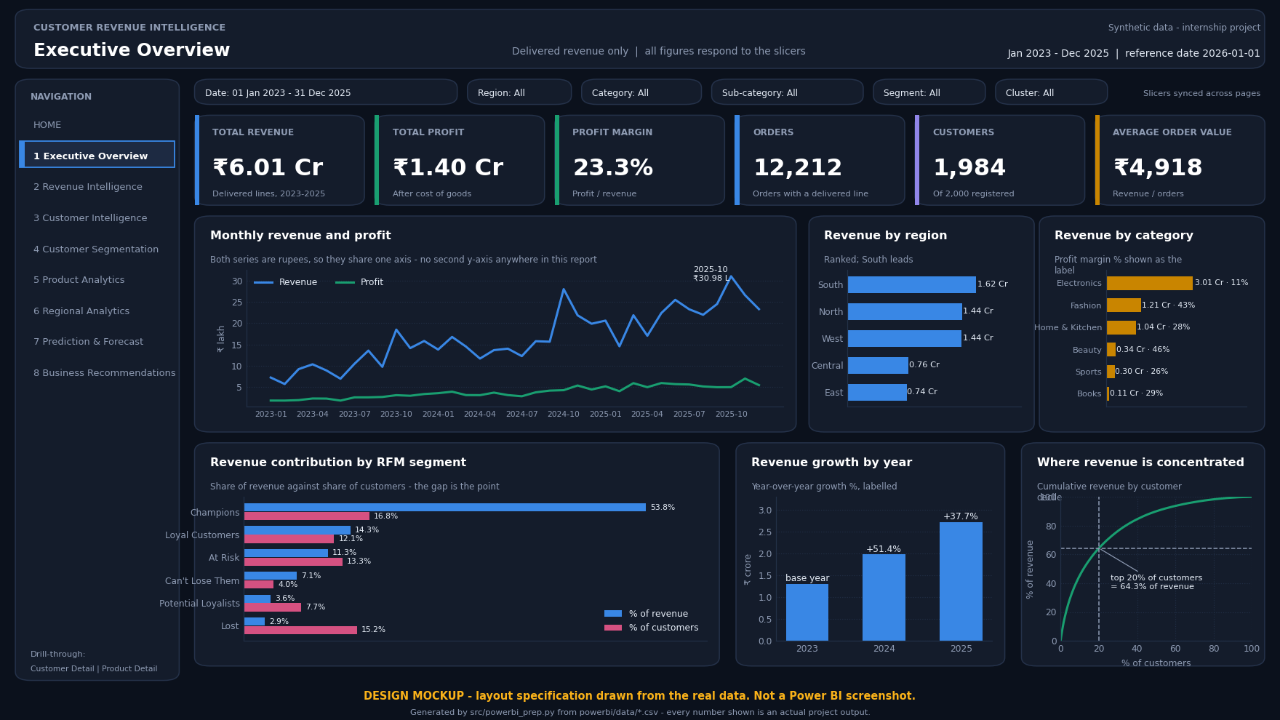
Power BI Executive Dashboard
Star schema: 13 tables, 9 relationships, 84 DAX measures in 10 folders, nine pages specified.
All 48/48 measure validations match SQL; all 32 consistency checks pass.
Power BI Desktop is Windows-only and was unavailable, so the page shown is a design mockup rendered from the real data - not a screenshot.
Notes:
Say plainly that this is a design mockup, not a screenshot, and why - Power BI Desktop is Windows-only and the project was built on Linux. Then say what IS complete: the semantic model, the 84 DAX measures every one of which was validated against its SQL equivalent, the Power Query scripts, the theme and a build guide. Anyone with Power BI Desktop can build the report from those artefacts in an afternoon. Claiming a screenshot you do not have is the one thing that would undermine the whole deck.

Slide 17
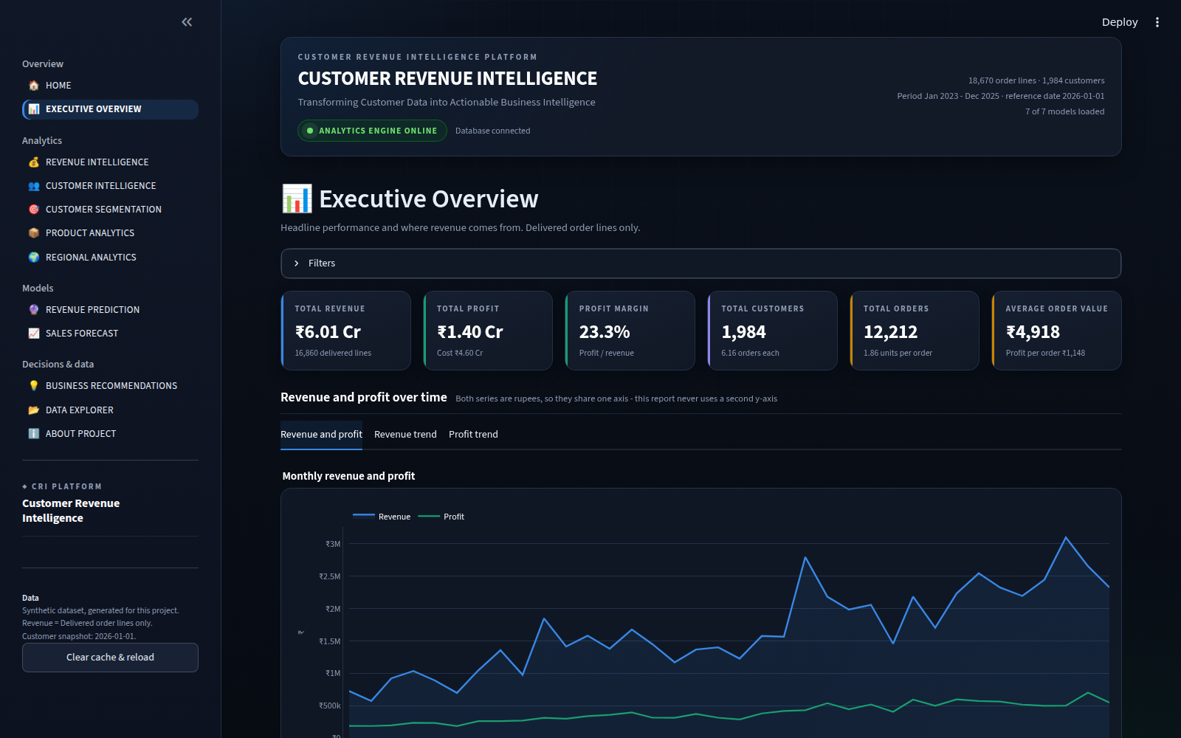
Interactive Streamlit Data Science Platform
A working 12-page application with interactive filters, Plotly charts, CSV download on every table and a data explorer.
It loads the persisted models rather than refitting, and computes no metric of its own - every number comes from the pipeline's outputs.
Tested headlessly: 40/40 checks pass. The image is a real screenshot.
Notes:
This is a real running application, and the image is a real screenshot of it - offer to demonstrate it live if the examiner wants. Emphasise the architectural point: the app is a presentation layer only. It loads the same persisted models and the same outputs the pipeline wrote, so a number on screen cannot drift from the number in the report.

Slide 18
Findings and Suggestions
Key findings, and the recommendation each one supports:
Finding (from project output) | Business implication | Recommendation
Top 10% of customers produce 45.39% of revenue; top 20% produce 64.33% | Losing a few large customers costs more than a month of acquisition | Give the top decile a named owner and review it monthly
52 high-value customers inactive 180+ days, holding Rs 26.51 L of revenue | Value already earned is quietly at risk | Work the list as a contact campaign; record the outcome
Champions are 16.8% of customers but 53.8% of revenue | A small group carries the business | Protect and grow Champions before chasing new customers
Repeat customers are 89.4% of the base and 98.6% of revenue | The second order is where value is created | Target the first-to-second order conversion
Electronics is 50.10% of revenue at 10.85% margin; Beauty earns 46.49% | Volume leader and margin leader are different assets | Manage category mix rather than a single revenue target
Zero-discount band returns the best margin in 6 of 6 categories | Discounting is costing margin (association, not proven cause) | Run a controlled discount experiment before changing policy
Notes:
Every row here is traceable to an output file and is reproduced in the application's recommendations page - eighteen recommendations in total, six shown here. The one to be careful about in viva is the discount row: the relationship is an association measured on observed orders, not a causal claim, which is exactly why the recommendation is to run an experiment rather than to cut discounts.

Slide 19
Future scope of the study
Validate the pipeline on a real transaction dataset under an appropriate data-protection agreement, and compare the segment structure that emerges with the one reported here.
Define an operational inactivity label with the business, and convert the present recency flag into a supervised model that can be evaluated against it.
Reframe next-quarter prediction as a two-stage problem - will the customer order at all, and if so how much - to address the zero-inflation that limits the present model.
Extend the forecast with external regressors: promotion calendar, price index and holiday effects, benchmarked against the current univariate backtest.
Run a controlled discount experiment to establish whether the observed discount-margin association is causal.
Operationalise the pipeline with scheduled re-runs, drift monitoring on the input distributions and model-performance tracking against realised outcomes.
Complete the Power BI build on a Windows machine from the supplied semantic model, measures and build guide.
Notes:
Frame future scope as the honest continuation of the limitations, not as a wish list. Each item answers a specific weakness named in the report: synthetic data, no churn label, zero-inflation, a univariate forecast, association without causation, no monitoring, and Power BI not rendered in Desktop.

Slide 20
Conclusion
The project converts 18,670 validated transaction lines into an integrated decision-support platform, carrying one dataset and one revenue definition through cleaning, exploratory analysis, dual segmentation, customer value analysis, prediction, forecasting, SQL analytics and two delivery surfaces.
Value is concentrated: the top 20% of customers hold 64.33% of Rs 6.01 Cr in delivered revenue, and two independent methods - RFM rules and K = 4 clustering - identify substantially the same high-value group.
Reliability differs by horizon and is reported as such: monthly company revenue forecasts to a backtest MAPE of 14.56%, while individual customer revenue predicts weakly.
The integration is tested, not asserted: an audit of 135 checks returns 134 passes and 0 failures across 39 Python modules, 4 SQL files and 9 executed notebooks.
Every figure presented is read from the project's own output files, so the presentation, the report and the application cannot disagree.
Notes:
Close on the through-line: raw transactions in, business decisions out, with every step reproducible and every number traceable. If you are asked for the single most valuable outcome, say the concentration finding - it changes where the business spends effort - and note that two independent methods found it, which is why it can be trusted.

Slide 21
BIBLIOGRAPHY / REFERENCES
Books and Journal Articles (APA)
  Breiman, L. (2001). Random forests. Machine Learning, 45(1), 5-32.
  Fader, P. S., Hardie, B. G. S., & Lee, K. L. (2005). RFM and CLV: Using iso-value curves for customer base analysis. Journal of Marketing Research, 42(4), 415-430.
  Gupta, S., Hanssens, D., Hardie, B., Kahn, W., Kumar, V., Lin, N., Ravishanker, N., & Sriram, S. (2006). Modeling customer lifetime value. Journal of Service Research, 9(2), 139-155.
  Hastie, T., Tibshirani, R., & Friedman, J. (2009). The elements of statistical learning (2nd ed.). Springer.
  Hughes, A. M. (1994). Strategic database marketing. Probus Publishing.
  Hyndman, R. J., & Athanasopoulos, G. (2021). Forecasting: Principles and practice (3rd ed.). OTexts.
  Kimball, R., & Ross, M. (2013). The data warehouse toolkit (3rd ed.). Wiley.
  Rousseeuw, P. J. (1987). Silhouettes: A graphical aid to the interpretation and validation of cluster analysis. Journal of Computational and Applied Mathematics, 20, 53-65.
Websites and Software Documentation
  Microsoft. (n.d.). Data Analysis Expressions (DAX) reference. https://learn.microsoft.com/en-us/dax/
  Streamlit Inc. (n.d.). Streamlit documentation. https://docs.streamlit.io/
The complete reference list of 38 entries appears in the project report.
Notes:
These are the eleven most load-bearing of the 38 references in the report. Every one is a real, verifiable publication or official documentation - none was invented. If asked for the reference behind a specific choice, name it: Rousseeuw for silhouette, Hyndman for the naive-baseline rule, Gupta for separating historical from predicted value.

Slide 22
THANK YOU
Questions & Discussion
Swagata Das | MBA - Data Science and AI (3rd Semester)
CUSTOMER REVENUE INTELLIGENCE: An Interactive Data Science Platform for Customer Segmentation, Revenue Prediction and Business Growth
Notes:
Invite questions, and offer to run the Streamlit application live if the examiner would like to see the platform working.

