Slide 1
MINOR PROJECT • UG RESEARCH WORK
Rule-Based Cooperative Highway Ramp Merging for CAVs
Minor Project Mid-Semester Progress Evaluation
Group Members
Pranjal Gupta • Swagata Barik • Aryan Dubey
Supervisor
Dr. Debanjan Das
Distributed Consensus CACC with Event-Triggered Communication & Safety Fail-Safe
IIIT Naya Raipur • October 2026

Slide 2
01 • STORY
Presentation roadmap
A structured research journey: establishing the merging bottleneck, identifying communication gaps, presenting event-triggered CACC, and demonstrating empirical evidence.
01
02
03
04
05
Context
Gap
Method
Evidence
Next
Highway on-ramp bottlenecks & CAV cooperative speed harmonization
Wireless channel saturation & vulnerability to packet drop
Virtual platoon sequencing + event-triggered consensus CACC
Microscopic SUMO/TraCI co-simulation & packet loss benchmarks
Multi-lane scaling, mixed autonomy, and saturation capacity testing
Presentation Narrative Flow
Context → Motivation → Literature Review → Problem Definition → Objectives → Methodology → Simulation Setup → Results & Discussion → Action Plan → Conclusion

Slide 3
02 • CONTEXT
Introduction
Cooperative Automated Driving (CAD) orchestrates multi-agent vehicle merges to eliminate freeway bottleneck congestion.
01
Context
02
Current scenario
Highway on-ramps create localized bottlenecks and turbulence near merge zones. Asymmetric vehicle streams make cooperative right-of-way coordination important.
Human drivers execute selfish, abrupt lane insertions causing upstream shockwaves and phantom jams. Unconnected ACC systems operate reactively without inter-lane preview.
03
Project scope
04
Expected outcome
In scope: 100% CAV penetration, single-lane ramp and highway, dynamic merge speed estimation, virtual sequencing, and event-triggered CACC. Out of scope: human-driven vehicles and multi-lane weaving.
An end-to-end SUMO/TraCI co-simulation framework, event-triggered V2V communication protocol with dead reckoning, and exhaustive benchmarking under ideal and lossy wireless links.
One-sentence project framing:
“We investigate cooperative CAV highway ramp merging using virtual platoon sequencing and event-triggered consensus CACC, targeting collision-free merging with ~90% lower communication overhead.”

Slide 4
03 • WHY
Motivation: issues & challenges
Addressing moving bottleneck conflicts while resolving physical safety and wireless channel congestion.
Problem pressure
Asymmetric entry speeds (25 m/s highway vs 15 m/s ramp) cause severe deceleration waves at the merge point without anticipatory speed harmonization.
1
Why now?
With emerging V2X standards (C-V2X Rel-16) and commercial automated vehicle deployment, merging controllers must be bandwidth-frugal and resilient to real packet loss.
Practical constraint
DSRC / C-V2X 5.9 GHz channels experience packet collision, transmission latency, and interference as vehicle density escalates under periodic 10 Hz broadcast.
2
Commuters face stop-and-go delays and elevated collision risks; better coordination aims to smooth speed changes and improve merge safety.
Desired change
3
User / system impact
From channel-saturating 10 Hz periodic broadcasting -> to bandwidth-efficient event-triggered communication with dead-reckoning support.

Slide 5
04 • EVIDENCE
Literature review
Critical comparison of leading cooperative merging, CACC platooning, and event-triggered control methodologies.
Reference
Technique used
Evaluation Simulator
Performance Metric
Key observation / limitation
Wang et al. (2020)
Consensus CACC + RSU
SUMO Simulation
0 Collisions (Ideal)
Proposes dynamic merge speed & virtual sequence; assumes ideal 0-loss, 0-delay V2X with no channel optimization
Milanes et al. (2014)
Empirical CACC Platoon
Real Vehicle Fleet
String Stability (10 Hz)
Demonstrated stable vehicle following in real traffic; limited to single-lane following without ramp merge coordination
Rios-Torres et al. (2017)
Centralized Optimal Control
Analytical / MATLAB
Min Fuel / Accel
Optimizes individual trajectories; computationally prohibitive (QP) and prone to catastrophic failure if RSU drops
Molin et al. (2014)
Event-Triggered Consensus
Networked Multi-Agent
Bounded Error
Theoretical multi-agent consensus proofs; not adapted for highway ramp geometry, asymmetric speeds, or SUMO physics
Literature Review Takeaway
Prior works either unrealistically assume perfect wireless channels or suffer severe channel saturation under continuous 10 Hz beaconing during high-density merging.

Slide 6
05 • FOCUS
Problem definition
Mathematical formalization of cooperative ramp merging under communication constraints.
INPUT
Vehicle telemetry (t, x, v, a) from highway and ramp detectors; road geometry (ramp 368m, main 400m); speed limits (30 m/s); safe headways (1.5s).
PROBLEM STATEMENT
“Given asymmetric CAV streams on a main highway (25 m/s) and an on-ramp (15 m/s), design a distributed coordination system that dynamically determines a bottleneck merge speed, assigns conflict-free arrival slots, and executes longitudinal consensus control under realistic and bandwidth-constrained wireless channels without physical collisions.”
CONSTRAINT
Comfortable accel bounds [-3.0, +2.0] m/s², symmetric jerk limit ≤ 2.5 m/s³, wireless packet loss (up to 30%), and autonomous radar fail-safe threshold (TTC < 2.0s).
OUTPUT
Conflict-free virtual sequence, continuous acceleration command a_cmd(t), event-triggered broadcast decisions, and emergency fail-safe actuation.
The objective is to minimize V2X communication overhead while maintaining stable vehicle coordination, collision avoidance, and passenger comfort.

Slide 7
06 • GAP
Research gap
Explicit breakdown of shortcomings in state-of-the-art cooperative merging research.
Gap 01
Gap 02
Gap 03
Coverage
Method
Evidence
Several reviewed studies assume ideal or near-ideal communication, leaving realistic wireless impairments such as packet loss and delay jitter less explored.
Standard 10 Hz periodic V2V broadcasting causes channel saturation and packet collision during dense traffic, transmitting redundant state data during steady cruising.
Cooperative controllers often degrade chaotically during wireless blackouts without an independent, radar-based fail-safe to decouple cooperative consensus from emergency braking.
→
→
→
Our Proposed Contribution
Our project addresses these gaps with Event-Triggered V2V, Dead-Reckoning state estimation, and a radar-based TTC fail-safe, targeting ~90% lower communication overhead while preserving collision-free operation in tested scenarios.

Slide 8
07 • TARGET
Objectives
Actionable, testable research milestones for the minor project.
Primary objective
Model & Formalize
Kinematic arrival projections, dynamic merge speed estimation (v_m), and headway constraints along the virtual platoon coordinate axis.
1
Develop, simulate, and benchmark an event-triggered, consensus-driven cooperative merging framework for CAVs that substantially reduces wireless communication load while targeting collision-free operation under ideal and lossy channels.
2
Design & Implement
Low-frequency RSU virtual sequencing (0.5 Hz) and distributed consensus CACC with event-triggered broadcast criteria and dead-reckoning extrapolation.
3
Benchmark & Simulate
Microscopic co-simulations in Eclipse SUMO/TraCI evaluating safety, throughput, packet volume, and latency across baseline and event-based configurations.
4
Stress-Test & Analyze
Empirically assess resilience against channel packet loss (0%, 10%, 30%) and validate autonomous radar fail-safe intervention mechanisms.
Target Success Criteria
Zero physical collisions across all scenarios, ≥ 80% reduction in V2V packet transmissions, and stable headway convergence under both perfect and lossy channels.

Slide 9
08 • METHOD
Proposed framework / methodology
Hierarchical architecture: Centralized RSU virtual sequencing combined with distributed event-triggered consensus CACC and radar fail-safe.
01
02
03
04
05
06
V2I Ingestion
Bottleneck Speed
Virtual Sequencing
Distributed CACC
Event Trigger V2V
Autonomous Safety
Entry detection at 368m; report speed & distance
Compute dynamic merge velocity v_m from vehicle arrival states
RSU calculates ETA, assigns FIFO + 1.5s slot
Vehicles execute consensus control along virtual axis
Broadcast on Δv ≥ 0.3 m/s, Δd ≥ 0.5 m, or 1.0s heartbeat
Radar fail-safe engages SUMO car-following if TTC < 2.0s
Hierarchical Control Strategy
Macro-Coordination (0.5 Hz RSU) + Micro-Execution (10 Hz Onboard)
Consensus Law & Dead Reckoning Protocol
The RSU provides macroscopic collision-free slot allocations at low frequency (0.5 Hz), while CAVs execute high-frequency (10 Hz) longitudinal consensus control locally. The event-triggered filter suppresses 90% of redundant V2V packets during steady-state tracking.
Acceleration law: a = -kp*(d_des - gap_ghost) - kv*(v - v_pred). Followers apply constant-velocity dead reckoning d_pred(t) = d_last - v_last * Δt during silent intervals, preventing false deceleration.

Slide 10
09 • DATA
Simulation dataset / scenario description
Microscopic traffic simulation environment modeled in Eclipse SUMO v1.27.1 via Python TraCI co-simulation.
75
2
300s
100%
Total CAVs Simulated
Traffic Inflow Streams
Evaluation Time Horizon
Autonomous Penetration
Flow
Vehicles
Flow Rate
Platform
Operational Characteristics
Highway
50 CAVs
600 veh/hr
SUMO + TraCI
Single lane 400m, depart speed 25.0 m/s (90 km/h), speed limit 30 m/s
Ramp
25 CAVs
300 veh/hr
SUMO + TraCI
Single lane 368m, depart speed 15.0 m/s (54 km/h), speed limit 30 m/s
Combined
75 CAVs
900 veh/hr total
SUMO + TraCI
Single lane 400m, 8m junction zone (:gneJ2), bottleneck speed v_m = 25 m/s
Physical CAV Parameters:
All vehicles are modeled as 5.0 m CAVs with comfortable acceleration [-3.0, +2.0] m/s², emergency deceleration 9.0 m/s², safe standstill gap 5.0 m, safe time headway 1.5 s, and symmetric jerk limit 2.5 m/s³.

Slide 11
10 • VALIDATION
Experimental setup
Rigorous comparison protocol across baseline, event-triggered, and packet-loss configurations.
Controller & Channel Parameters
Evaluated Benchmarks
Step size Δt = 0.1s (10 Hz), RSU sort period = 2.0s (0.5 Hz), consensus gains kp = 0.15, kv = 0.80, jerk limit = 2.5 m/s³, radar lookahead = 150m, TTC threshold = 2.0s.
1) Perfect Comm (10 Hz periodic V2V baseline); 2) Event-Triggered V2V (Proposed); 3) Real Comm with 0% loss; 4) Real Comm with 10% packet drop; 5) Real Comm with 30% packet drop.
Simulation Protocol
Performance Metrics
300.0s multi-vehicle simulation; reproducible RNG channel seeds; full 0.1s telemetry tracking position, velocity, acceleration, command, predecessor age, and wireless packet transfers.
Safety (collisions, TTC < 2.0s conflicts), Communication Cost (packet counts, total data volume KB, bitrate kbps), and Traffic Stability (merge speed, speed variance).
Fair Comparison Principle:
Identical vehicle arrival sequences, speed distributions, and road networks are maintained across all baseline and experimental runs for exact comparability.

Slide 12
11 • RESULTS
Experimental results & discussion
Quantitative evidence: 89.60% reduction in V2V transmissions with collision-free operation across all tested scenarios.
Key Quantitative Benchmark Results
Performance Discussion
Tested over 300.0s / 75 CAVs / 900 veh/hr
What improved, and by how much?
• V2V transmissions dropped by 89.60% (from 16,129 to 1,677 packets).
• Total wireless data reduced by 78.73% (from 1,147.2 KB to 243.9 KB).
• Average bitrate dropped from 31.33 kbps to 6.66 kbps with zero collisions.
10 Hz Baseline V2V
16,129 pkts
How does the system handle packet loss?
• Under 10% and 30% packet loss, linear dead reckoning prevented false braking.
• Max predecessor age reached 4.3s during deep loss bursts with zero collisions.
• Radar fail-safe stood ready as autonomous safety net but required 0 emergency overrides.
Event-Triggered V2V
1,677 pkts (-89.6%)
Which result supports the core hypothesis?
• The observed collision-free merges with zero TTC fail-safe interventions support the hypothesis that high-rate periodic broadcasting is not always necessary for longitudinal safety.
• State updates are only needed during acceleration, deceleration, or drift.
Bandwidth Volume
243.9 KB (-78.7%)
Current boundaries and next steps
• Present evaluation validates single-lane bottleneck geometries.
• Multi-lane highway weaving and unequipped human vehicles will be addressed in W1–W3.
Zero physical collisions and zero TTC conflict events (<2.0s) across all ideal and lossy runs (0%, 10%, 30% loss).

Slide 13
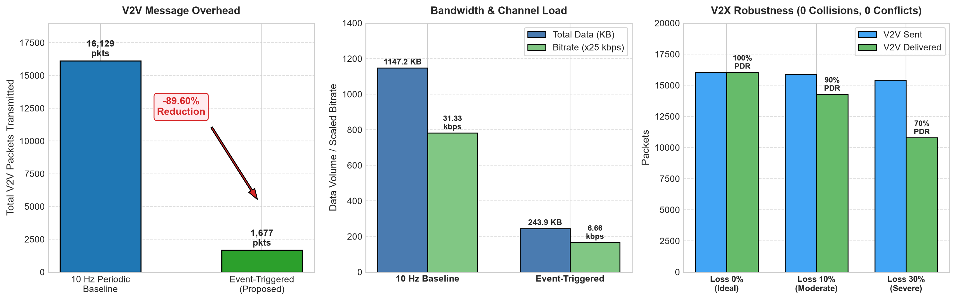
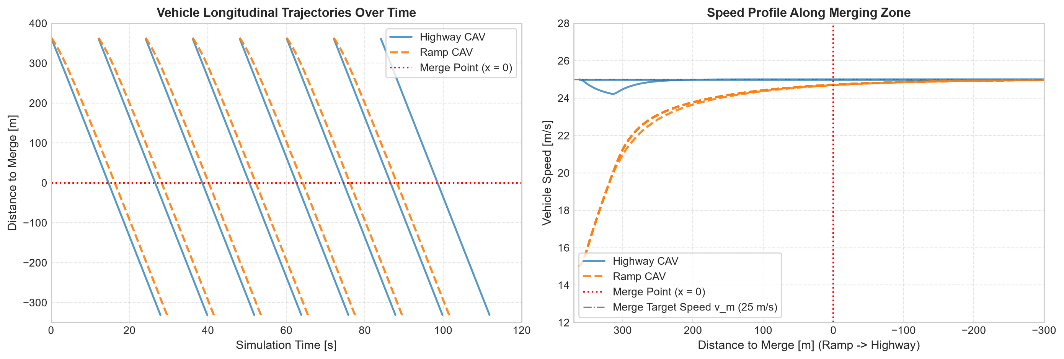
12 • VISUAL EVIDENCE : SIMULATION DASHBOARDS & TRAJECTORIES
Microscopic Trajectory Convergence & Empirical Communication Benchmarks
Communication & Channel Efficiency Findings
• 89.60% reduction in V2V transmissions (16,129 down to 1,677 packets).
• 78.73% bandwidth savings (1,147.2 KB down to 243.9 KB total volume).
• Transmission bitrate dropped from 31.33 kbps to 6.66 kbps (4.7x reduction).
• Constant-velocity dead reckoning maintained predictive continuity under 10% and 30% packet loss without phantom deceleration.
Microscopic Merging Dynamics & Safety Findings
• 100% collision-free merging across all 75 CAVs (50 highway, 25 ramp).
• Zero critical TTC conflict events (<2.0s) observed in all baseline and lossy runs.
• Smooth velocity convergence to dynamic merge speed vm = 25.0 m/s prior to merge point.
• Virtual predecessor gap (10 m + 1.5 s headway) remained stable without observed shockwave amplification.
Core Empirical Takeaway: In the tested scenarios, rule-based event triggering maintained collision-free operation while reducing total V2X data volume by 78.7%.

Slide 14
13 • DELIVERY
Plan of action
Concrete, time-bounded execution milestones for the second half of the semester.
01
Multi-Lane Highway Scaling
Extend road geometry to 2-lane highway with discretionary lane-changing maneuvers before the merge.
W1
02
Saturation Capacity Tests
Simulate heavy traffic densities (1500–2400 veh/hr) and evaluate queue spillover and shockwave damping.
W2
03
Mixed Autonomy & Energy Impact
Incorporate human-driven vehicles (Krauss/IDM) and calculate fuel consumption and emissions reductions.
W3
04
Thesis Report & Manuscript
Complete comprehensive minor project report, clean modular codebase, and draft conference manuscript.
W4
05
Final Evaluation & Live Demo
Prepare interactive SUMO GUI demonstration and final defense presentation for end-sem review.
W5
Final Review Milestone:
End-Semester Evaluation (November 2026) • Deliverable: Multi-Lane CAV Merge Simulator, Comprehensive Thesis Report, and Research Paper Draft

Slide 15
14 • CLOSE
Conclusion & future directions
Summary of established findings, identified limitations, and roadmap for end-semester completion.
01
02
03
What We Have Established
Current Limitations & Open Questions
Next Steps & Future Directions
In the tested scenarios, virtual platoon sequencing + event-triggered consensus CACC achieved collision-free merging while reducing V2V communication overhead by 89.60%.
Current evaluation assumes 100% CAV penetration in a single-lane merge; unequipped human vehicles and multi-lane lane selection introduce non-deterministic trajectory noise.
Integrate Deep Reinforcement Learning for dynamic event-threshold tuning, extend to heterogeneous vehicular traffic, and validate on ROS2 / hardware-in-the-loop testbeds.
Core Takeaway
“Cooperative CAV merging can reduce reliance on channel-saturating 10 Hz beaconing: event triggers and dead reckoning preserved collision-free operation in the tested scenarios with ~90% fewer V2V transmissions.”

Slide 16
END OF PRESENTATION
Thank you
Questions & discussion
Rule-Based Cooperative Highway Ramp Merging for Connected and Autonomous Vehicles
Pranjal Gupta • Swagata Barik • Aryan Dubey • Dr. Debanjan Das
Department of Computer Science and Engineering • IIIT Naya Raipur • October 2026

