Slide 1

Opening Department Store in Optimized Places of Bangalore, India
Swagata chakraborty

Slide 2
Introduction:
Groceries are the basic needs of day-to-day life. This results in the need for a large number of such stores everywhere. Industrialists, manufacturer, and many tradesmen often invests in the evergreen grocery business.
The purpose of this project is to analyse, visualize, cluster areas and predict where should we place our store. The project aims to answer the business question: Where should a person open a new department store in the city of Bangalore, India.
Industrialists, manufactures, tradesmen, entrepreneurs and small shopkeepers can also find this project useful. This project targets all audiences who are interested in opening departmental stores in Bangalore, India.

Slide 3
Data and its sources:
First, we need a list of neighbourhoods in Bangalore, India. I found this list on Wikipedia here. Using BeautifulSoup package we scrap this data
Next, we had to generate the latitude and longitude of these neighbourhoods using the Geocoder library.
The latitude and longitude of Bangalore was also required during map generation using Nominatim.
Lastly, we had to explore the surrounding 1000m area of each neighbourhood in order to get venues. For this we will use FourSquare API thus need a developer account in FourSquare. FourSquare API has one of the largest database of 105+ million places and is used by many developers. With the developer account, we can make 500 calls per day and with each call a JSON file was returned having all venue details.

Slide 4
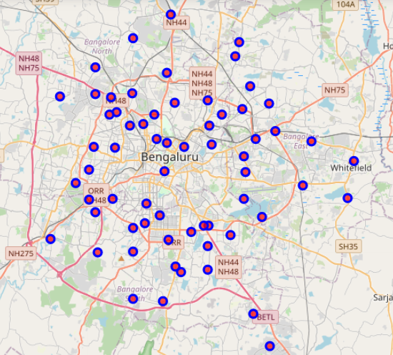
Data Extraction and Preparation Methodologies:
Bangalore, India
Using the list of neighbourhoods from Wikipedia and their latitudes, longitudes we generate this map using Folium Library.
Now, the last step is to explore the neighbourhoods of Bangalore and extract venue data us FourSquare API.
However, here in India getting venues were a bit difficult.
The next graph visualized how many venues we received from each neighbourhood.

Slide 5
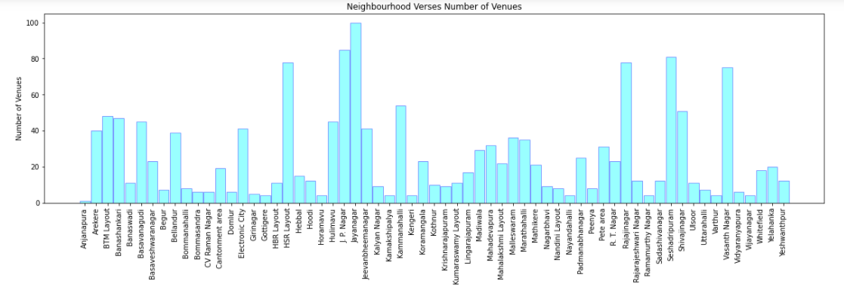
Data Extraction and Preparation Methodologies:

Slide 6
Data Analysis:
Categorical variables are of two types – Nominal and Ordinal. Ordinal categorical variables have numeric relationship among themselves. Thus, ranking ordinal categorical variables is easier. Hence, they can be encoded with numbers and ranked easily. For example, graduate, masters, PhD can be encoded as 1,2,3 where 1<2<3 because graduation degree is the most basic degree, master degree is higher than graduation and PhD is the highest degree.
But nominal categorical variables have no numeric relationship among themselves. Hence, they cannot be encoded with numbers and ranked. For example, names of different venue categories.
Thus, we will use OneHot encoding method here which will identify each venue category with a distinct binary number, also called encoding with dummy variables.
Using this method, we will find the top 10 venues of every neighbourhood and store them in a dataframe.

Slide 7
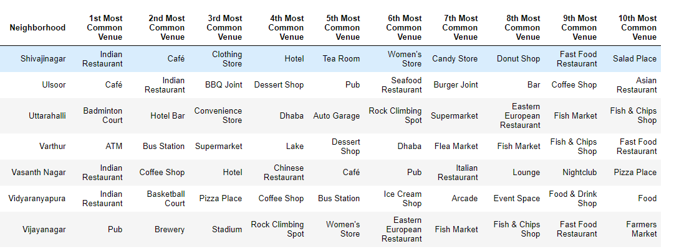
Data Analysis:

Slide 8
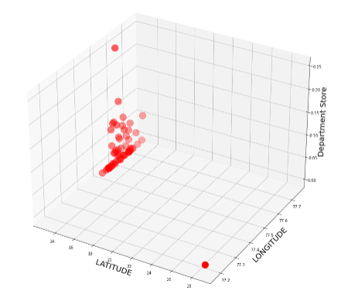
Predictive Modelling:
This graph shows how departmental stores are scattered over different latitudes and longitudes. They do not follow any particular pattern
We need to cluster the different neighbourhoods depending on their similar or dissimilar venues.
We will use the partitioned based clustering algorithm, KMeans present in the sklearn.cluster package.
In most of the cases, we receive k non-overlapping clusters. But in our case, clusters are overlapping, this is because two neighbourhoods are clustered together based on their similarity in venues and not on distance between them.
The next graph shows how elbow method is used to select the value of k which gives most accuracy.

Slide 9
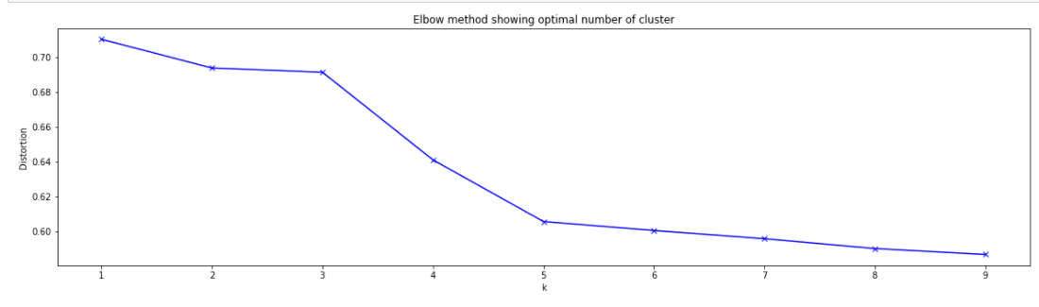
Predictive Modelling:

Slide 10
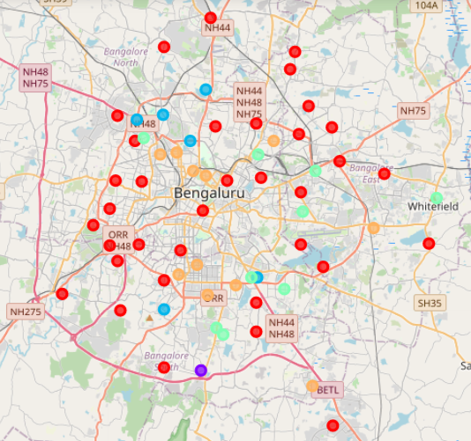
Predictive Modelling:

Slide 11
Results:
In the end, we have 5 different clusters.
Cluster 0 : Neighbourhoods with no existence of department stores.
Cluster 1 : Neighbourhood with low existence of department store.
Cluster 2 : Neighbourhoods with high existence of department store.
Cluster 3 : Neighbourhoods with moderate existence of department store.
Cluster 4 : Neighbourhoods with low existence of department store.

Slide 12
Precautions:
In this project, the density of civilians in a neighbourhood has not been taken into consideration. I believe that this is an important factor which can affect the sales of the store. Some areas have no existence of department stores which may (or may not) be due to no existence of civilians in that area. Hence, recommending to open store in such an area is risky. The financial status of the civilians can also affect the rate of sales. This project has to be worked upon more in order to remove such risks.

Slide 13
Conclusion:
The answer to the business question raised by this project is: For opening new department store recommended neighbourhoods are clustered under 1,3,4. Target audiences will find this project helpful. However, the precautions must be kept in mind.

