Slide 1


Analog Signal Conditioning For Robust Sensor Signal Extraction
Synthetix Hackathon Category: Electrical
Team Name: Digi Castro Team Members: Abhisek KR, 24BEC1028 Akash Nath, 24BEC1031 Swagat Mallick, 24BEC1072 Vedant Pandey, 24BEC1119

Slide 2
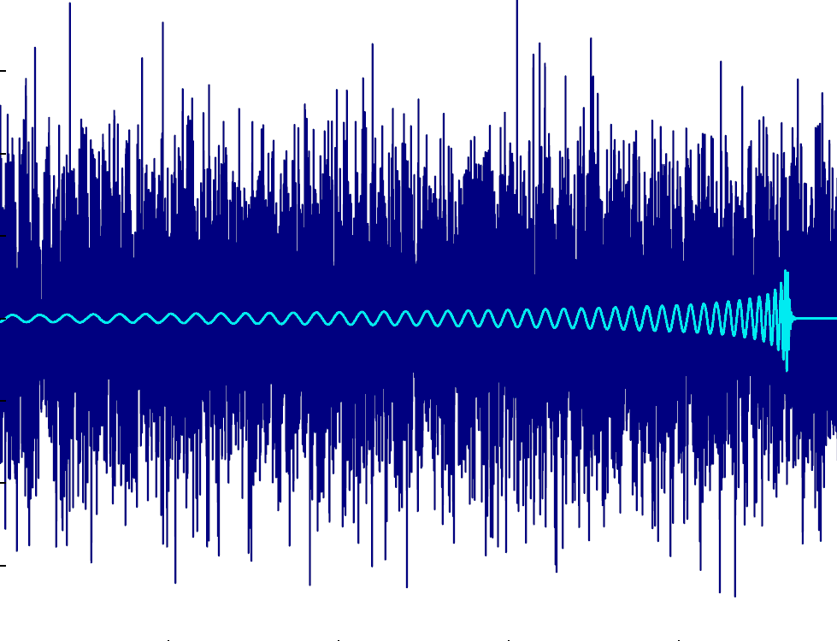
Industrial Signal Challenge
Sensors operate in electrically noisy environments where the input signal contains multiple overlapping interference components.
Because the sensor acts as a black-box source, we cannot alter it internally.
Goal: Extract the usable signal reliably for downstream logic processing.

Slide 3

Composite Signal Characteristics
600 Hz: Low frequency baseline drift
6 kHz: Usable Target Signal
18 kHz: Structured square wave interference
55 kHz: High-frequency EMI transients
Broadband: General white noise contamination

Slide 4
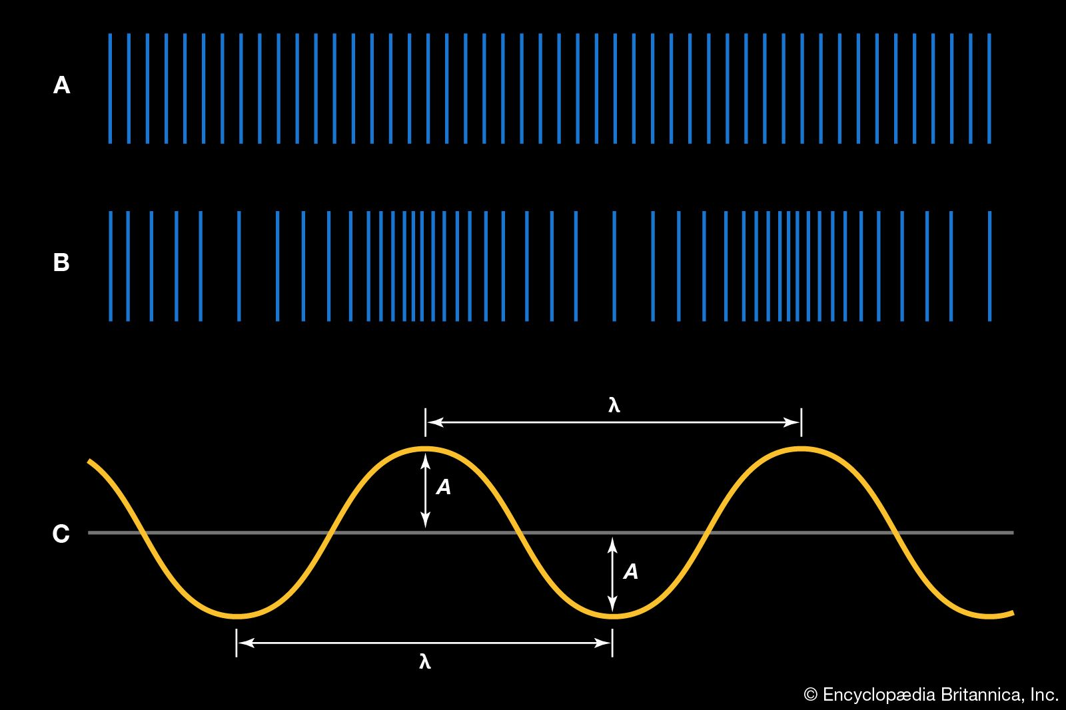
Proposed Architecture
Buffer Amplifier: Impedance matching from source.
High Pass Butterworth Filter: Removes 600Hz baseline drift.
Band Pass Filter: Centers and extracts 6 kHz.
Low Pass Butterworth Filter: Suppresses 18kHz & 55kHz EMI.
Variable Gain: Manual potentiometer tuning.

Slide 5
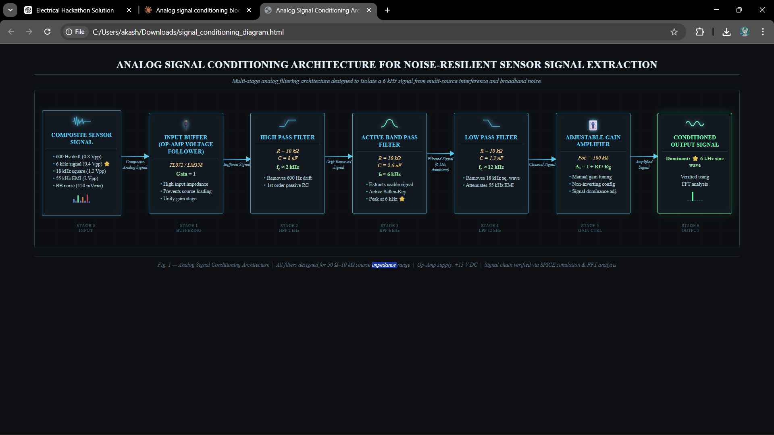
Block Diagram

Slide 6
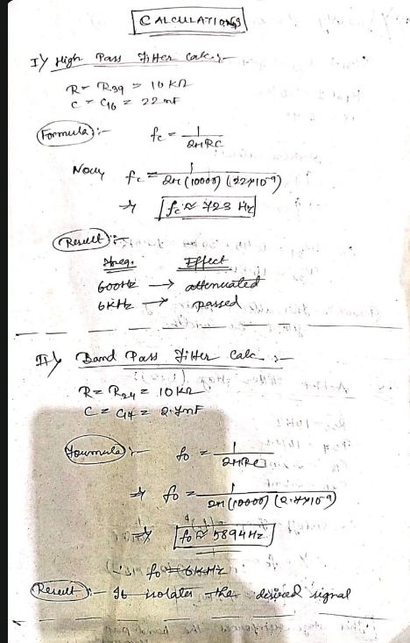
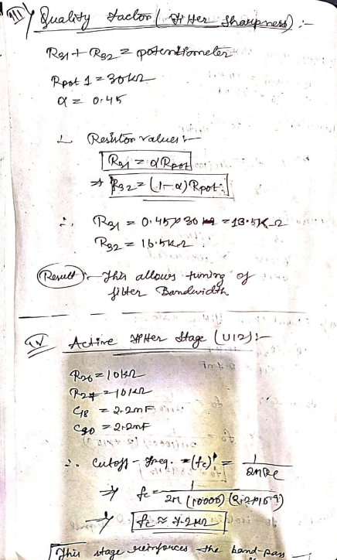
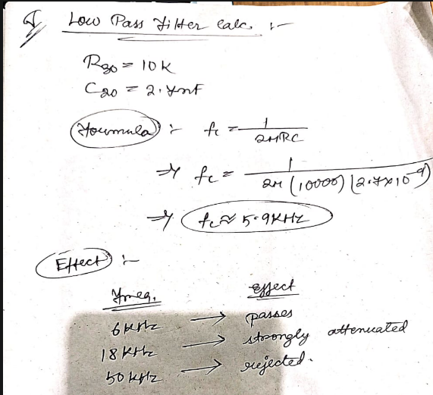
Calculations

Slide 7
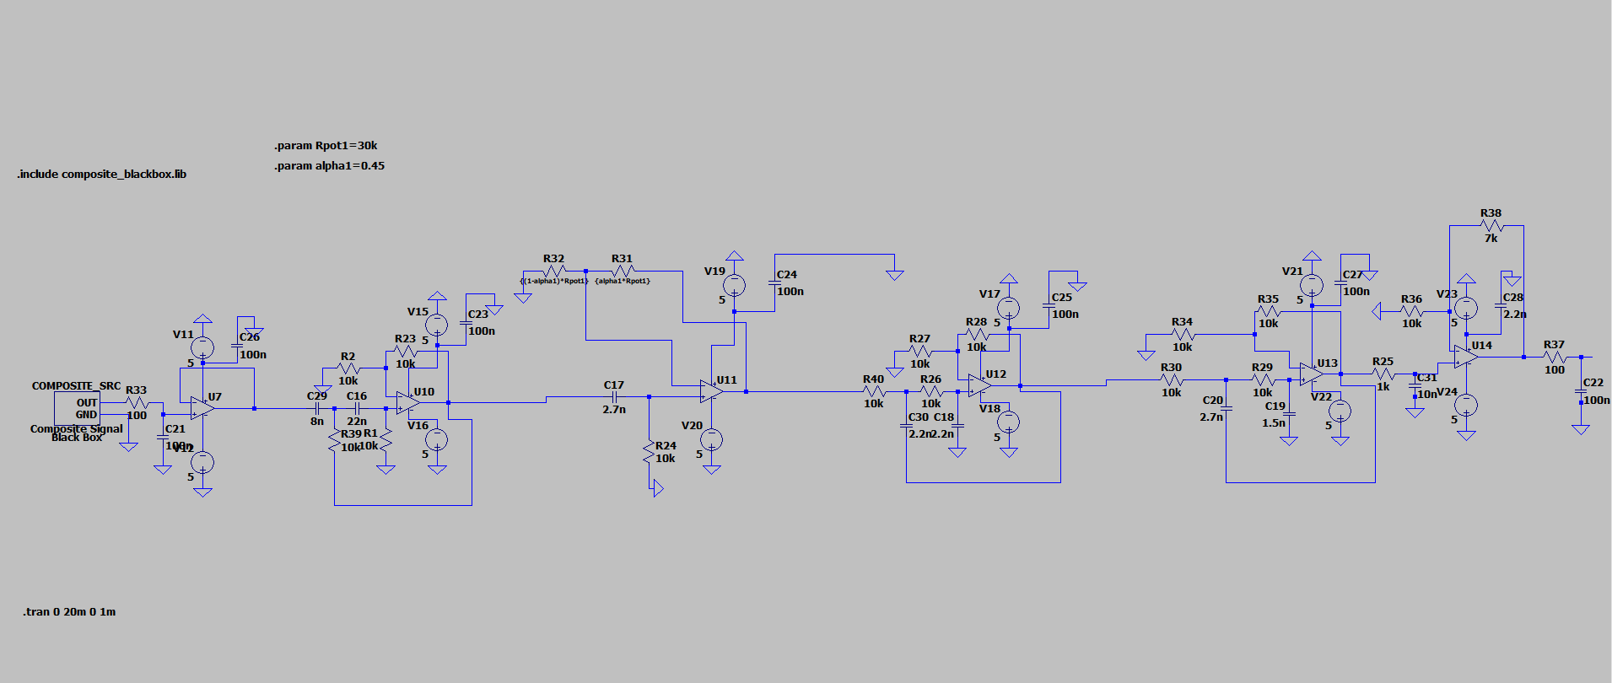
LT Spice Schematic

Slide 8
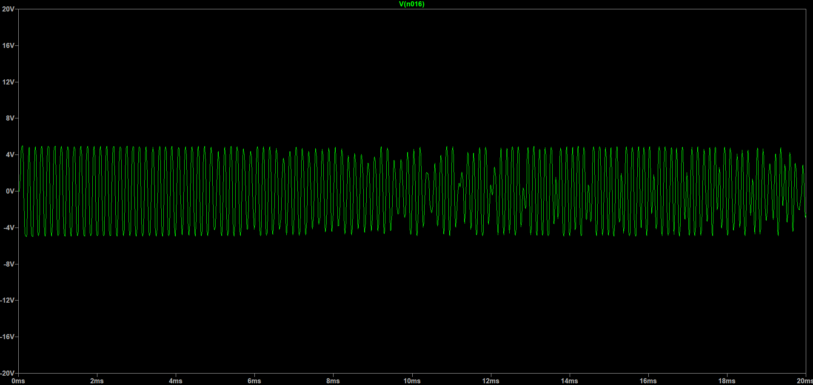
Output Graph (Transient Analysis)

Slide 9
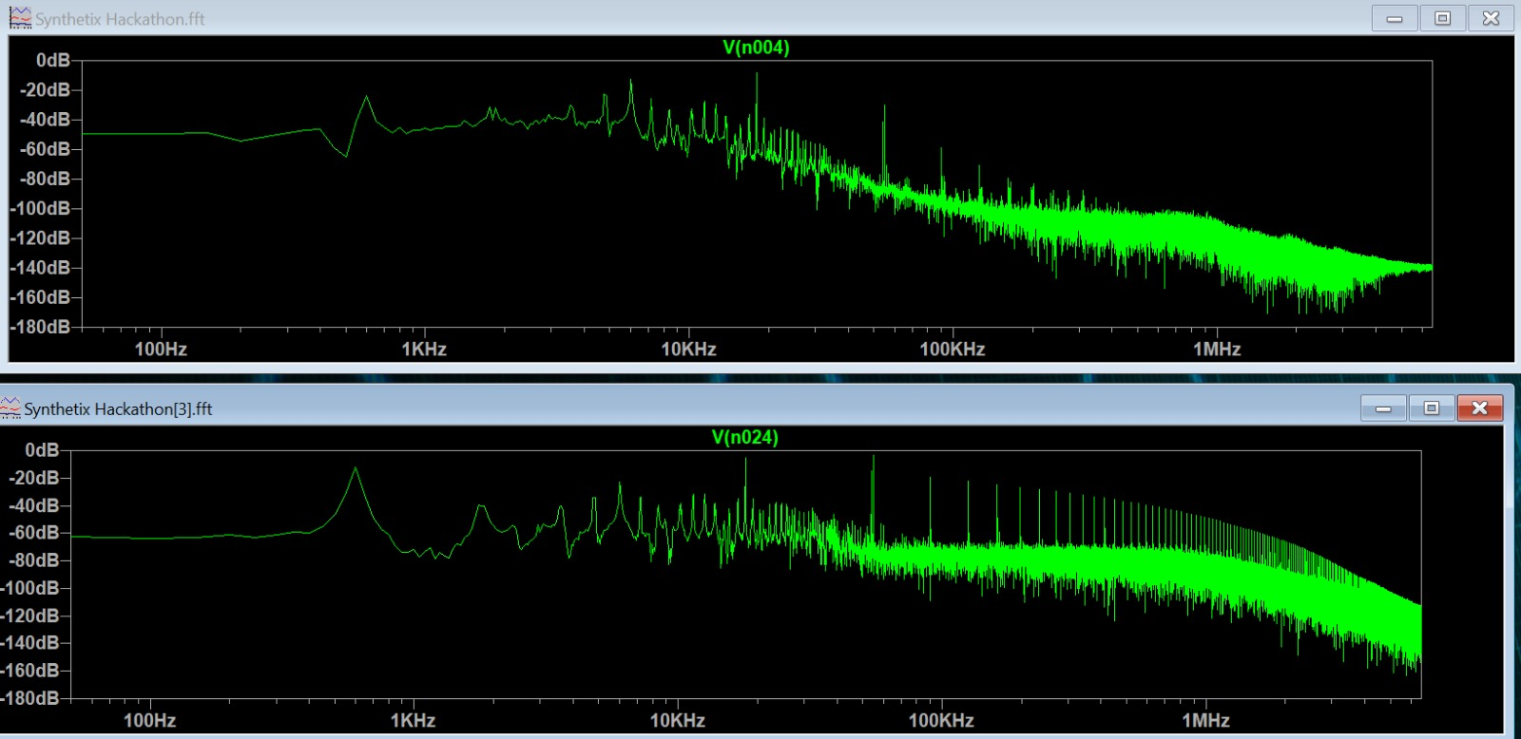
FFT Analysis
Input FFT Graph

Slide 10
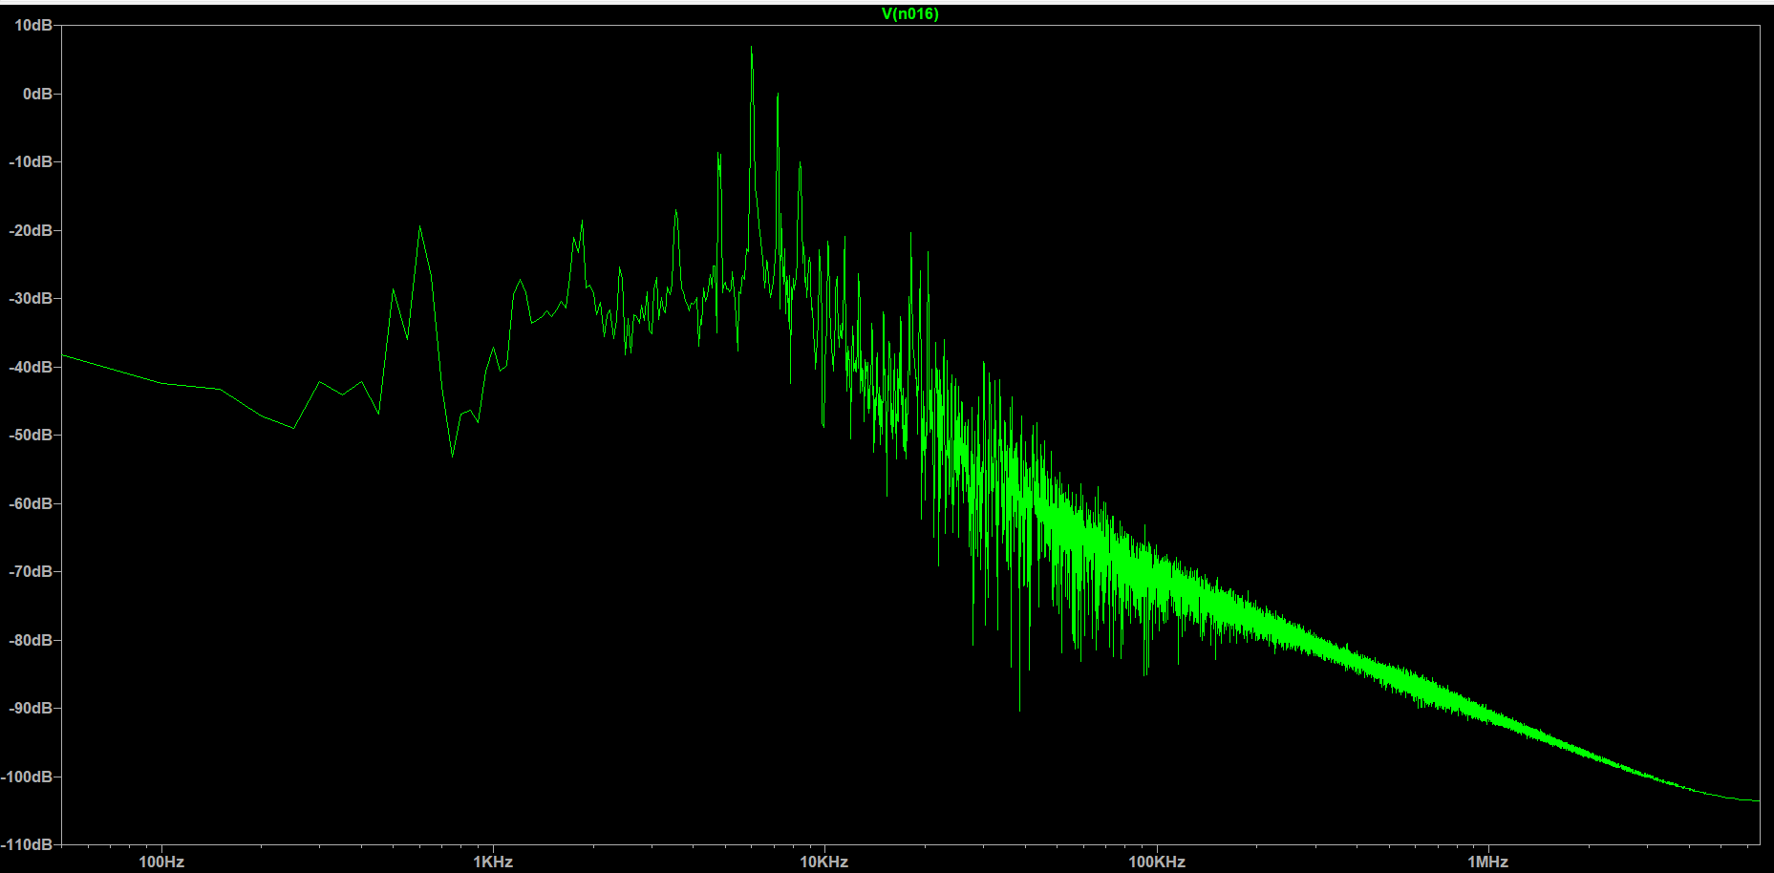
FFT Analysis
Output FFT Graph

Slide 11
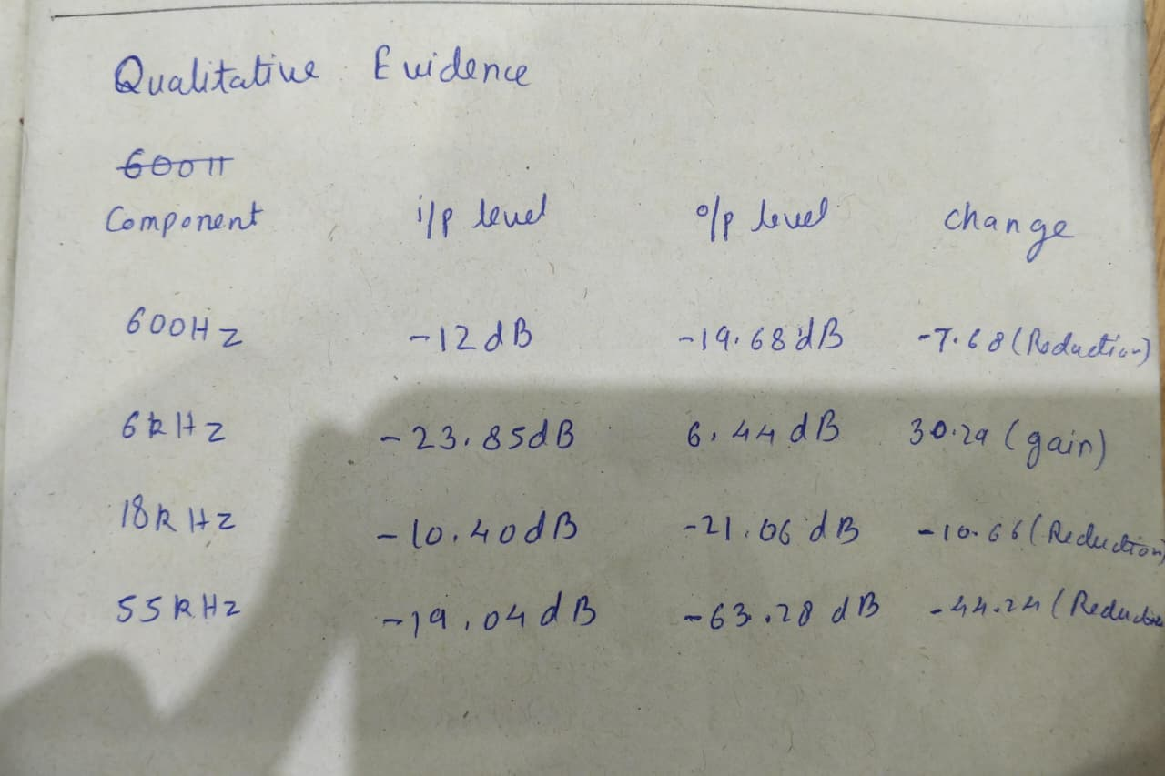
Qualitative Analysis

Slide 12
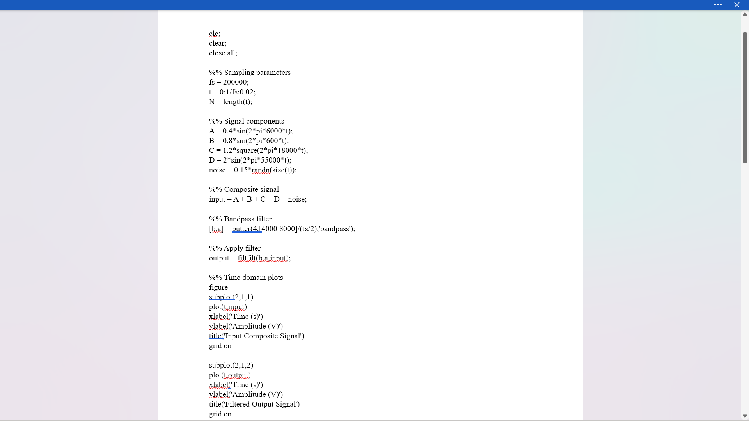
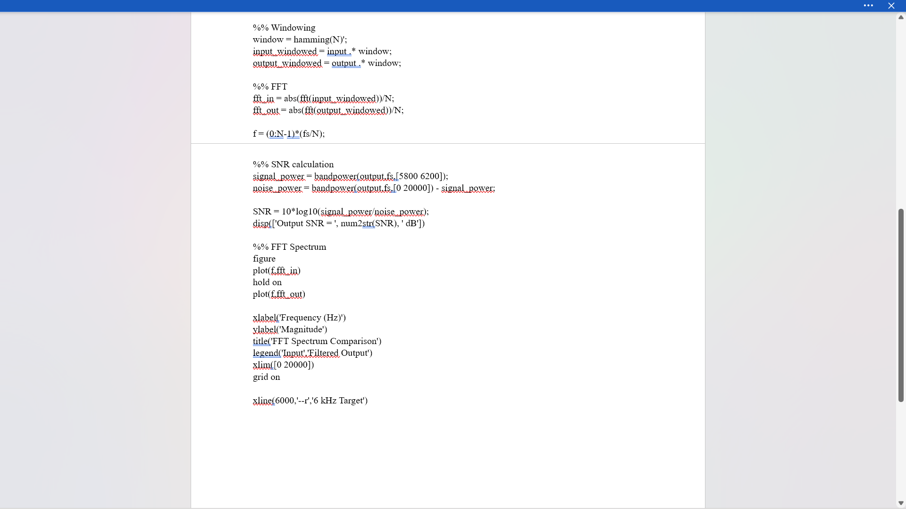
MATLAB Code

Slide 13
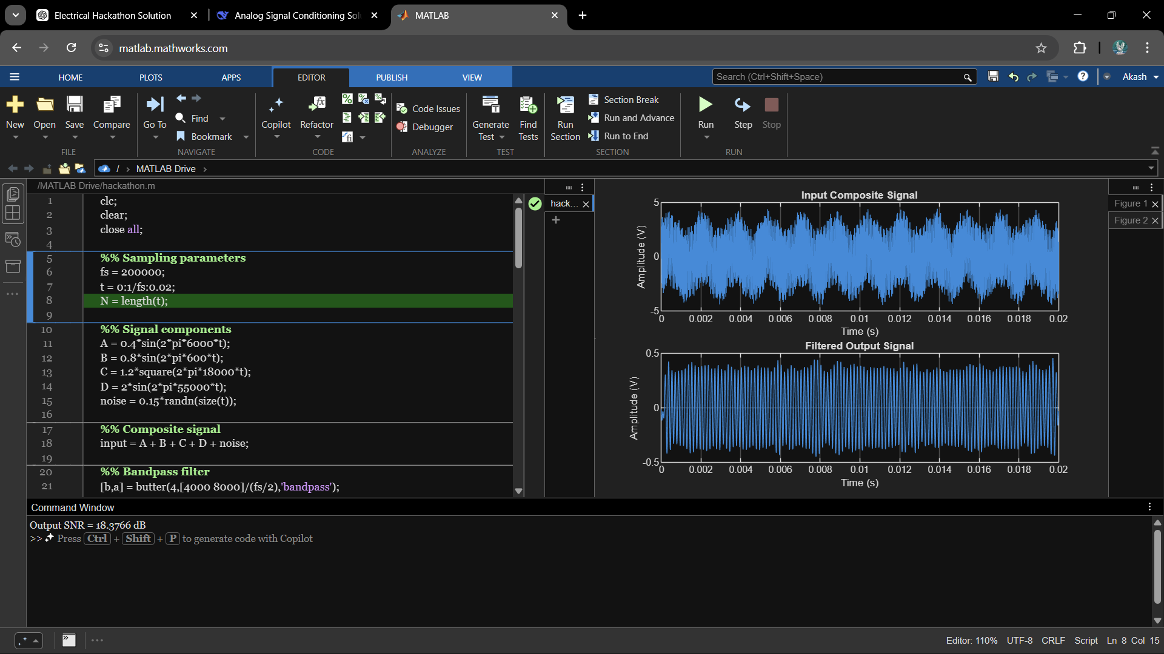
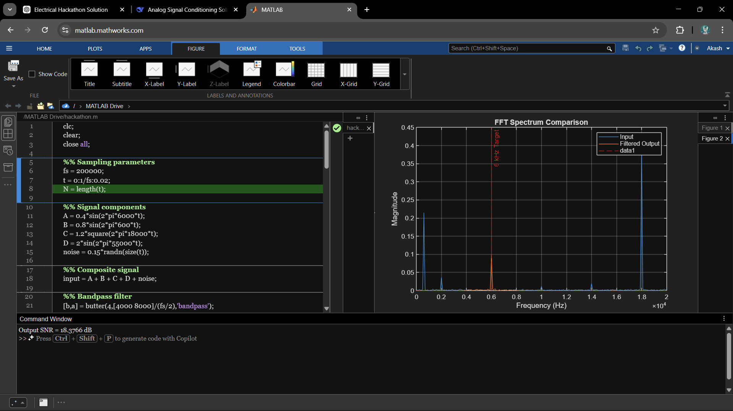
MATLAB Diagrams

Slide 14


Key Engineering Challenges
Interference Rejection
System Stability
Effectively eliminating low-frequency baseline drift while simultaneously rejecting strong high-frequency EMI transients and structured square wave harmonics.
Ensuring highly stable analog operation without accidental oscillation, while providing continuous manual control for dynamic on-the-fly tuning.

Slide 15





System Requirements
Extract
Suppress
Interface
Isolate the pure 6 kHz target signal with high fidelity.
Attenuate 600Hz drift, 18kHz square waves, and 55kHz noise.
Provide manual tuning and variable amplification controls.

