Slide 1
.
CoCrFeMnNi Thin films by
Electrodeposition
Dharamananda Saha CUSB2404112015
A.-M. J. Popescu, F. Branzoi, I. Constantin, M. Anastasescu, M. Burada, D. Mitrică, I. Anasiei, M.-T. Olaru, and V. Constantin, “Electrodeposition, Characterization, and Corrosion Behavior of CoCrFeMnNi High-Entropy Alloy Thin Films,” Coatings, vol. 11, no. 11, art. 1367, Nov. 2021,
doi: 10.3390/coatings11111367.

Slide 2
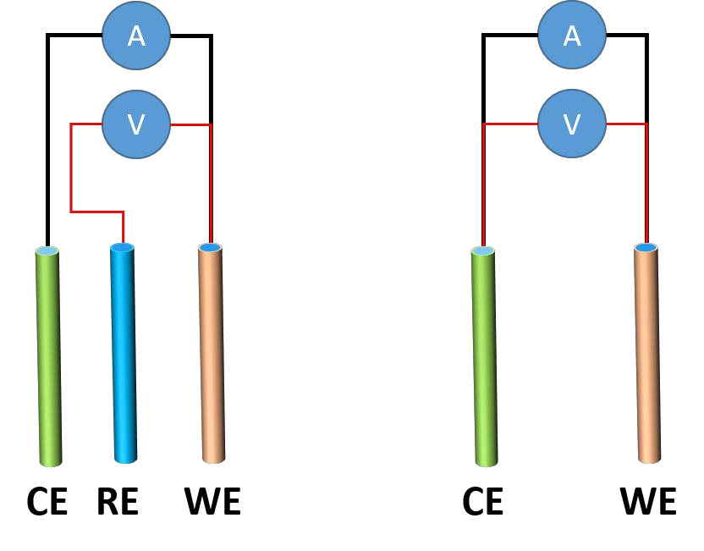
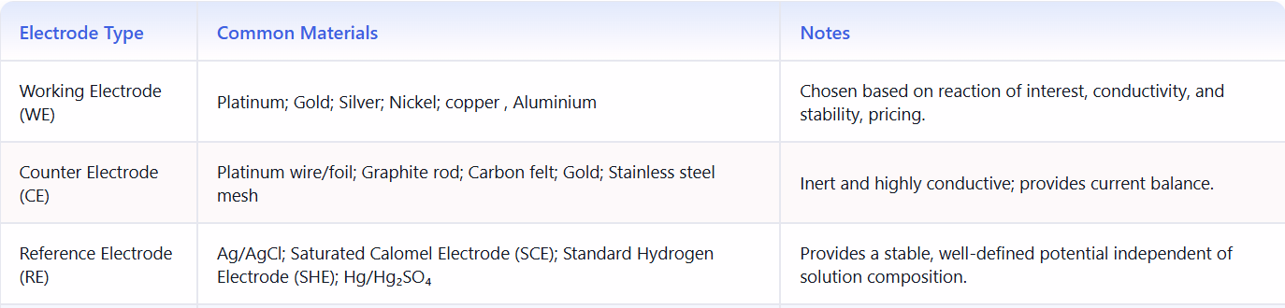
THREE ELECTRODE SETUP
Working Electrode (WE): The electrode at which the electrochemical reaction of interest occurs, and where current is measured as a function of potential.
Counter Electrode (CE): An inert electrode that completes the circuit by allowing current to flow, without participating in the main reaction under study.
Reference Electrode (RE): A stable electrode with a well-defined and constant potential, used as a reference point to control and measure the working electrode potential.

Slide 3
Potentiostatic electrodeposition
Definition:-
To deposit a material often metal onto an electrode from an electrolyte solution while a constant potential is maintained between working electrode and reference electrode
“The constant potential which is choosen should be more negative than the reduction potential of the ion we want to reduce “
For example :-
the reduction potential of Cu²⁺ is 0.34 V vs SHE
Cu²⁺ + 2e⁻ = Cu
The potential we give , decide how easily the electron flows to the Cu²⁺ ions , if the potential is slightly negative then the electrode became good electron donor.
The working electrode which is choosen is cooper because ,it has good conductivity , relatively cheap and provides smooth surface for deposition and uniform nucleation

Slide 4
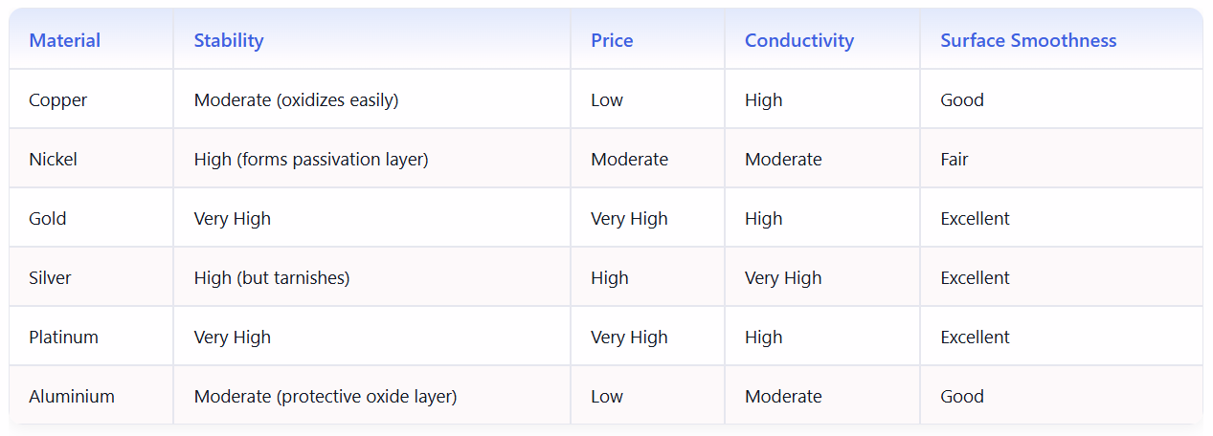
Copper forms metallic bonds readily with transition metals (Fe, Co, Cr, Mn, Ni).This ensures strong interfacial bonding between Cu and the HEA film.
Cu has an FCC structure, the same as FeCoCrMnNi (FCC HEA).This structural compatibility reduces lattice strain

Slide 5
ELECTROLYTE
The electrolyte which is choosen is DMSO-CH₃CN
It donot decompose before the reduction potential of Mn.
As it is a Organic compound it slow down the ion mobility , hence finer grains and more uniform films.
DMSO and CH₃CN are taken in the ratio 4:1. Both are polar Aprotic organic solvents.
Why 4:1?
Why Polar Aprotic Solvents?
Some of the solute are soluble in dmso and some are in ch3cn , to dissolve all the metal salts both are taken.
DMSO is more viscous than CH3CN . Using CH3CN with DMSO reduces the viscocity making ion diffusion rate faster.
More DMSO leads to rapid and uneven deposition and too much ch3cn could lead to rapid and uneven deposition.
Polar means which has a dipole moment. One end has positive polarity and one end has negative polarity .
When metal salt is added ,
cation( Co²⁺, Cr³⁺⁾ are attracted towards negative polarity
anions(NO⁻₃,Cl⁻) are attracted towards positive polarity.
+ + + - - -
+ Cl⁻ + - Co²⁺ -
+ + + - - -
When electricity is not applied then they are randomly distributed but when electricity is applied then they are attracted by opposite electrode , hence they feel the electric field force and get drifted hence viscousity.

Slide 6
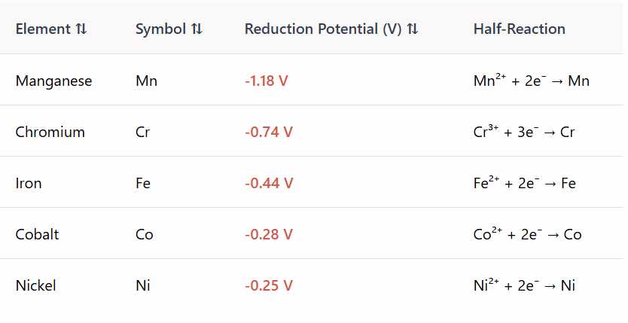
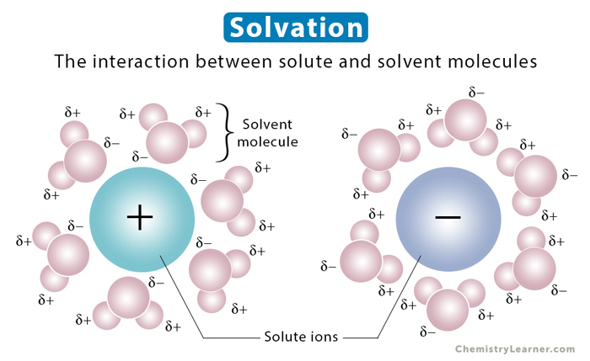
DMSO- CH₃CN
Co(NO₃)₂ Co²⁺(SOLVATED) + 2No₃⁻ (SOLVATED)
WORKING ELECTRODE
COUNTER ELECTRODE

Slide 7
PREPARATION OF ELECTROLYTE
TARGET VOLUME 100ML OF ELECTROLYTE
TARGET CONC. OF EACH METAL = 0.020 M
Mass of each metal to be mixed :-
CoCl₂- 129.84 g/mol , CrCl₃:- 158.36 g/mol and so on
MOLARITY = Number of moles of solute
Volume of solution (litre)
Mass of each metal that should taken:
no. of moles = 0.100 L * 0.020M
= 0.00200 m
So mass of metal salt that shoud be taken is ,
for example for CoCl₂: 0.00200 m * 129.84 g/mol
= 0.31672 g
In this case the metal salts which are taken are
Co(NO3)₂ [0.014 M] , FeCl₂ [ 0.012 M], CrCl₃ [0.016M], MnCl₂ [ 0.012M] , NiCl₂[0.012]
-0.28 V -0.44V -0.74V -1.18V -0.25v

Slide 8
FORMATION OF THIN FILMS
cathode
Cathode
METAL ions

Slide 9
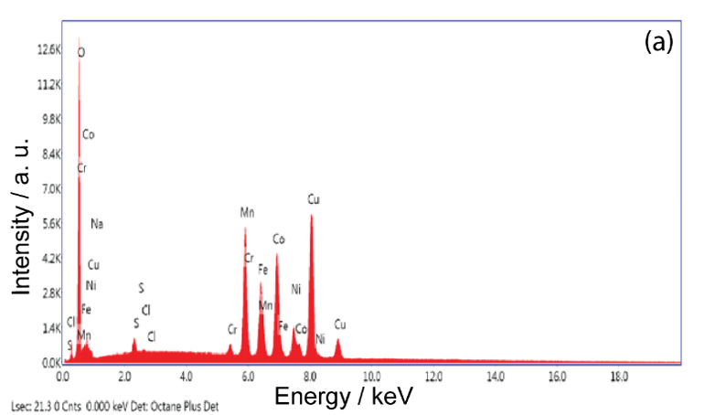
EDS characterization
2.1 V after 30 min

Slide 10
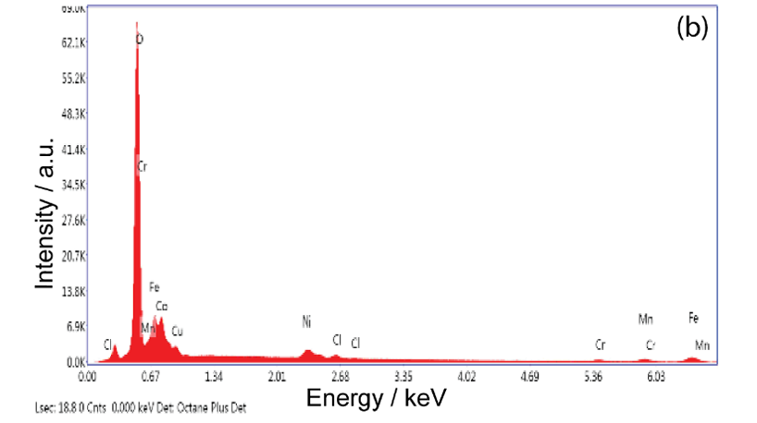
2.1 V after 60min

Slide 11
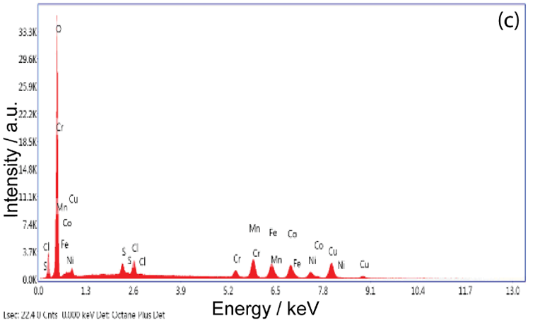
2.1 V after 90 min

Slide 12
Conclusions drawn from EDS:-
Maximum Co content (40.13 at%) is observed at a slightly less negative potential (−2.1 V) and at 60 min deposition time
.At −2.5 V , as deposition time increases from 30 - 60 -90 min:Co and Fe content decrease (less deposition of these two).Mn, Ni, and Cr content increase (more deposition of these).
30 min (a): Composition close to initial composition Co and Fe relatively higher.
60 min (b): Composition shifts slightly — Co still relatively high but starting to decrease.
90 min (c): Noticeable drop in Co and Fe peaks in EDS spectrum, with Mn, Cr, Ni peaks relatively stronger.
Deposition time tunes alloy composition: Shorter times gives higher Co and Fe fraction . And Longer times richer in Mn, Cr, Ni

Slide 13
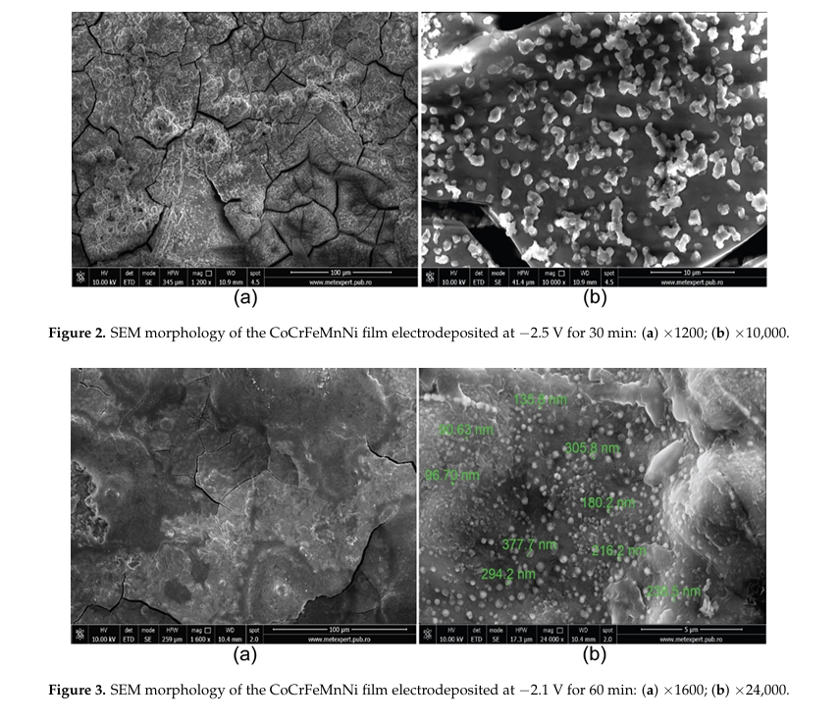

Slide 14
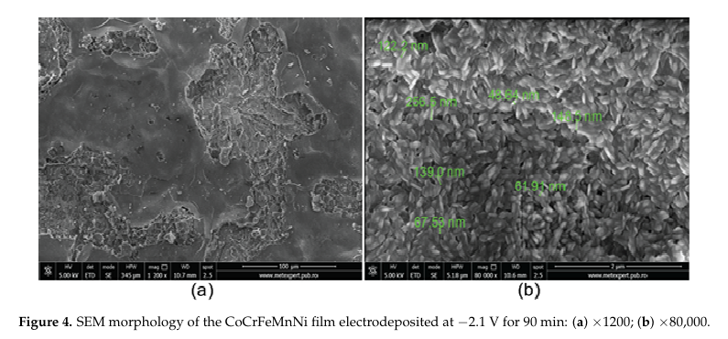

Slide 15
Conclusions drawn from SEM:-
Effect of Deposition
More negative potential (−2.5 V):Increases nucleation rate strongly i.e rapid deposition.
Leads to internal stress buildup ( fast growth). Microcracks form to release stress, even though the film is overall homogeneous
Less negative potential (−2.1 V):Slower, more controlled deposition.Allows adatoms to rearrange denser and more uniform structure. Hence, Fewer cracks, better spherical particle distribution
Effect of Deposition
TimeLonger time (90 min):Allows continuous nucleation and grain growth. Leads to grain refinement (smaller mean particle size), because New nuclei keep forming.Steady-state growth leads to finer microstructure.Improved film uniformity.
“Nucleation is extremely fast at -2.5 V results in spherical particles, but also induces microcracks due to internal stress.The surface is less uniform because growth is too rapid. At −2.1 V:Nucleation is slower , gives grains time to grow into wheat-grain morphology. Fewer internal stresses hence fewer cracks. Final film is more uniform, well-compacted, and has better adhesion. Longer time contribute more refined grains ,Continuous nucleation and steady-state growth leads to finer particle size distribution.This is why at 90 min, grain-shaped particles have smaller mean size compared to 30 min or 60 min. Integration with Chemical Composition ,More balanced elemental distribution at −2.1 V compared to −2.5 V. This means −2.1 V gives not only the best morphology but also the most chemically homogeneous film making it the optimal condition for HEA”
Optimal condition for smooth HEA film: Around −2.1 V, 60–90 min, giving spherical, homogeneous particles with minimal cracking.

