Slide 1

Memory Management for .NET

Slide 2
What are we here to solve…
Do you ever struggle to debug memory issues?
Do you feel like you know enough about .NET memory management to make good design choices?

Slide 3
Garbage Collection
This is the process that runs that is converting used (not in use) memory into available memory for you.
It has performance implications.
It is “smart” but makes a lot of assumptions.
Assumes that recently used memory is going to be more likely to be used.

Slide 4
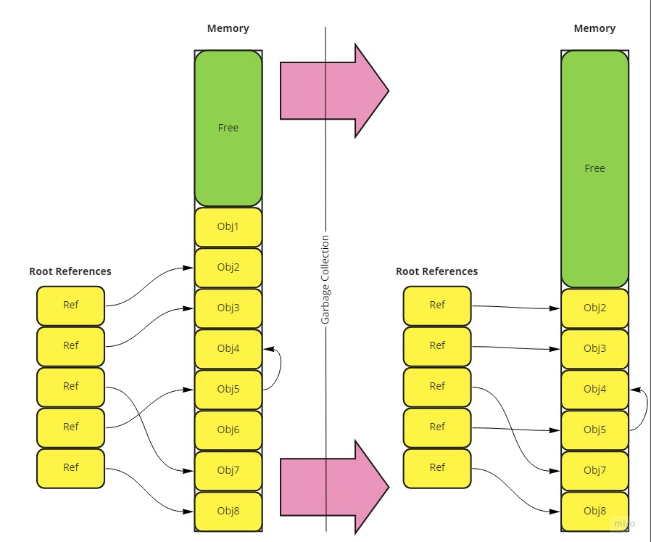
In a Picture

Slide 5
Some things to know
There are three buckets: Gen0, Gen1, Gen2
There are two heaps!
The SOH and the LOH
By default Gen2 runs as a background process on servers and synchronously on clients.
Not everything goes on a heap!?..
Notes:
You might ask why have three buckets. These end up being the ‘counters’ for how many times that a reference has survived.
You can control if the GC will run concurrent with the gcConcurrent element via app config.

Slide 6
Demo: Value types vs Reference Types
Stack or Heap and how it impacts the variables you use

Slide 7
Some more things to know
In order to maximize performance you want things to be removed in their first GC or survive for the application lifetime in Gen2
Lessons from the Bing team: https://www.infoq.com/presentations/bing-net-performance
Notes:
This video is a pretty good commentary on when you might choose to do some things like replace the implementation of the FCL.

Slide 8
Finalization
So how does the GC keep objects around if they need to be finalized?
They add a reference and a queue.

Slide 9
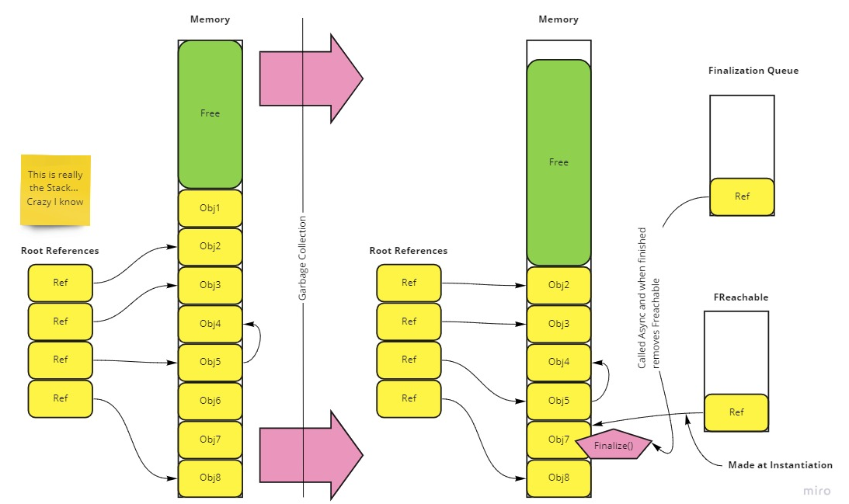
In a Picture

Slide 10
How do you see what is happening
GC Events
Useful when you are managing large sets of objects.
https://docs.microsoft.com/en-us/dotnet/standard/garbage-collection/notifications
GC Performance Counters
https://docs.microsoft.com/en-us/dotnet/framework/debug-trace-profile/performance-counters#memory
Notes:
We won’t be discussing GC Events today, but they are a powerful approach to taking ownership of the memory allocation in your apps.

Slide 11
How can you “prevent” Memory Problems
Less objects
Proactive list sizing
Less aggregation and grouping functions
Readonly on fields that are immutable
StringBuilder
Lazy Initialization
Clean livin’

Slide 12
Good Counters for Troubleshooting
% Time in GC
Allocated Bytes/second
Large Object Heap size
Gen 0 heap size
Gen 1 heap size
Gen 2 heap size
# Bytes in all Heaps
Notes:
I want to start with a small demonstration of PerfMon. There is a Data Collector template in the root directory of the Github repo for these demos.

Slide 13
Diagnostics
Performance Counters Demo
https://docs.microsoft.com/en-us/dotnet/framework/debug-trace-profile/performance-counters#memory

Slide 14
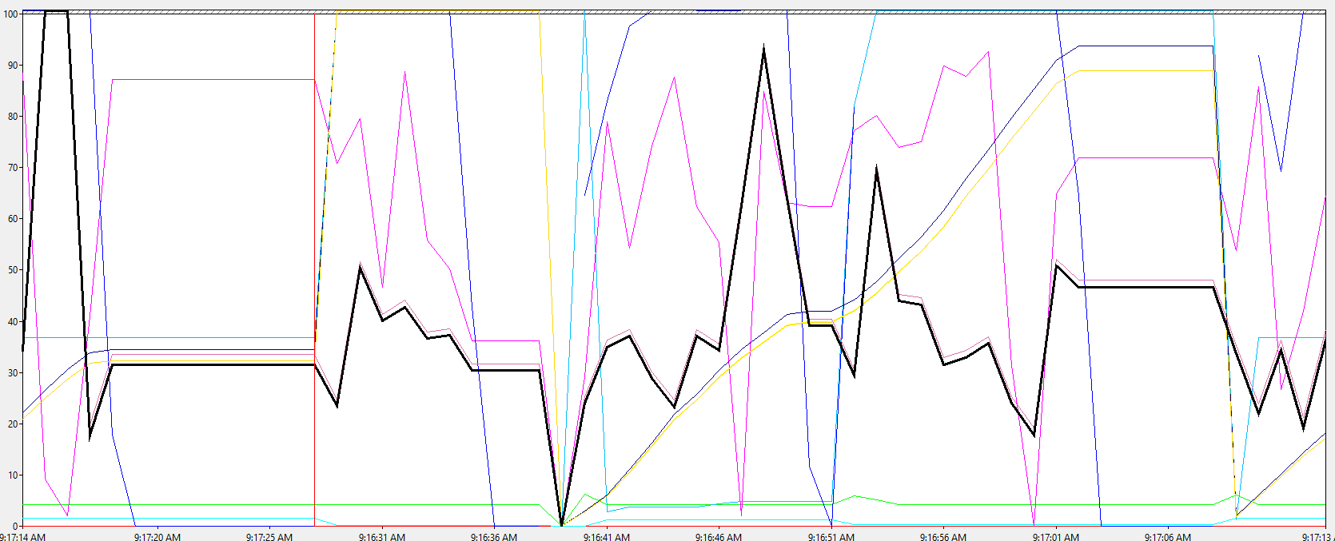
Looks like MADNESS, right?

Slide 15
GC Methods For You
The full list:
https://docs.microsoft.com/en-us/dotnet/api/system.gc?view=netframework-4.7.2#methods
Some of the “good” ones:
Collect()
AddMemoryPressure and RemoveMemoryPressure
TryStartNoGCRegion and EndNoGCRegion

Slide 16
WeakReferences
Say what?

Slide 17
A Definition
A weak reference permits the garbage collector to collect the object while still allowing the application to access the object. A weak reference is valid only during the indeterminate amount of time until the object is collected when no strong references exist. When you use a weak reference, the application can still obtain a strong reference to the object, which prevents it from being collected. However, there is always the risk that the garbage collector will get to the object first before a strong reference is reestablished.

Slide 18
The MS guidelines
Use long weak references only when necessary as the state of the object is unpredictable after finalization.
Avoid using weak references to small objects because the pointer itself may be as large or larger.
Avoid using weak references as an automatic solution to memory management problems. Instead, develop an effective caching policy for handling your application's objects.

Slide 19
WeakReferences Demo
Demo might stand for demolition…

Slide 20
Weak References Recommendations
FYI: MS built this tech for compilers and WPF apps
When to use: (http://www.philosophicalgeek.com/2014/09/03/practical-uses-of-weakreference/)
Memory use needs to be tightly restricted
Object lifetime is highly variable
Objects are relatively large, but easy to create
The object’s size is significantly more than the overhead of using WeakReference<T>
Working with many event subscribers to a control’s events: https://docs.microsoft.com/en-us/dotnet/framework/wpf/advanced/weak-event-patterns
Notes:
While MS built this feature for their own purposes in solving problems in WPF and the compiler, we can also use it to our advantage when presented the right use-case.
Look into dangling Events

Slide 21
In Review
Reference and Value Types
Garbage Collection Basics
Performance Counters and GC methods
WeakReferences
Notes:
I hope you do not come away from this with paranoia about the garbage collector; it is generally excellent without any fine-tuning

Slide 22
Questions

