Slide 1
C.O.M.F.E.
Cr1nge.com
Marshall Brown
Fred Brumovsky
Josh Holuboch

Slide 2
What is C.O.M.F.E?
Cr1nge.com
Optimised
Model for
Furnishing
Excellence
Room Layout Configuration Tool

Slide 3
Features
Custom room dimensions
Input objects (Type and Dimensions)
Generate and regenerate room configurations

Slide 4
Tools Used
GDScript for game engine
  Graphics handling
  Room generation
Version Control:
  Git/Github
Python for Machine learning:
  Pandas: data analysis
  Scikit-learn: machine learning
Communication:
  Discord

Slide 5
Development Processes
Primarily Incremental Development
Parts of XP
Continuously going back to modules that require further modification
Pair Programming
Refactoring
Simple Design

Slide 6
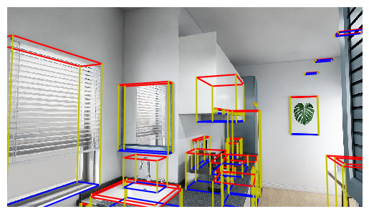
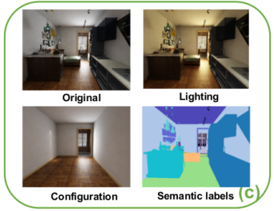
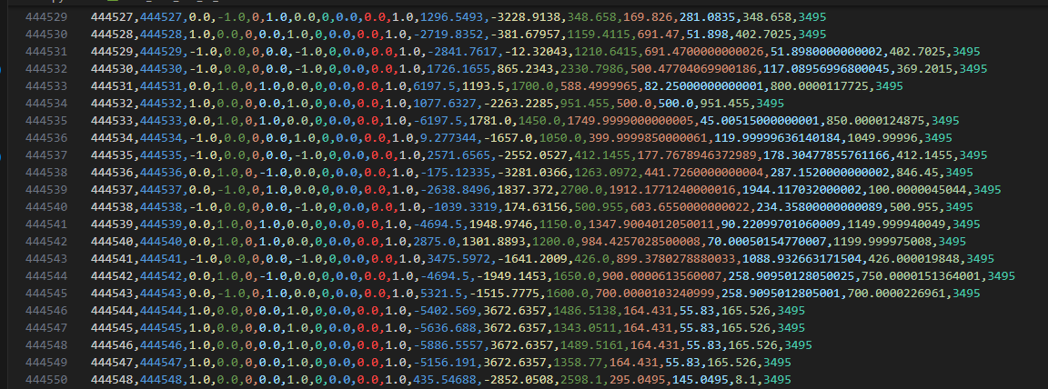
ML/Data

Slide 7
Challenges: Data
Finding a suitable dataset
Using the dataset
  PNGs
  170 - 510 GB
Bounding boxes – no labels
ML Model: 99.997% accuracy (sus )

Slide 8
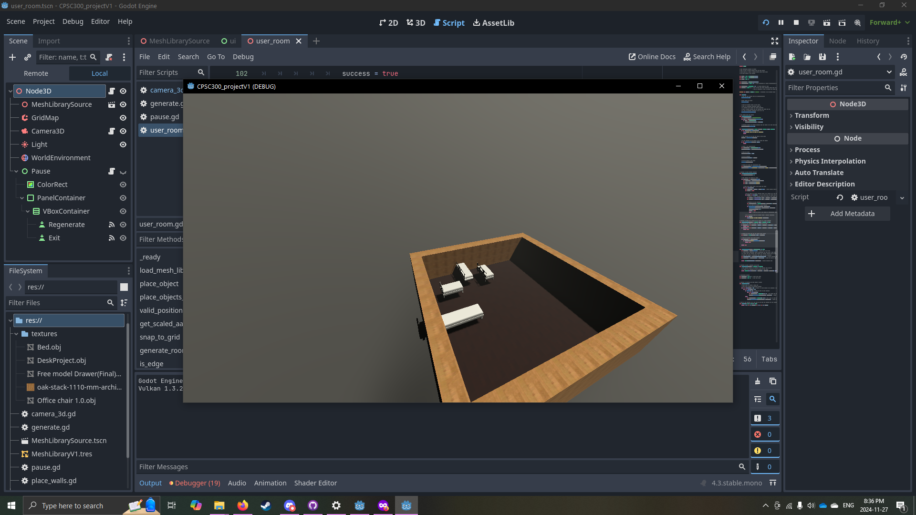
Challenges: Godot
Lots of boundary issues...

Slide 9
Demo

Slide 10
Future Plans
Must Do:
Improve machine learning model
Script to generate rooms for the ML model (in progress)
Connect ML model to room generator
Nice to Haves:
Performance improvements
Graphics improvements
Ability to move objects after generation

Slide 11
References
Structured3D Dataset
https://github.com/bertjiazheng/Structured3D/tree/master

Slide 12
☻♥☺Thank you ☺♥☻
Questions?

