Slide 1
C.O.M.F.E.
Cr1nge.com
Marshall Brown Fred Brumovsky Josh Holuboch

Slide 2
What is C.O.M.F.E?
Cr1nge.com
Optimised
Model for
Furnishing
Excellence
Room Layout Configuration Tool

Slide 3
Features
Custom room dimensions
Input objects (Type and Dimensions)
Generate and regenerate room configurations

Slide 4

Tools Used
GDScript for game engine
Graphics handling
Room generation
Version Control:
Git/Github
Python for Machine learning:
Pandas: data analysis
Scikit-learn: machine learning
Communication:
Discord

Slide 5
Development Processes
Primarily Incremental Development
Continuously going back to modules that require further modification
Parts of XP
Pair Programming
Refactoring
Simple Design

Slide 6
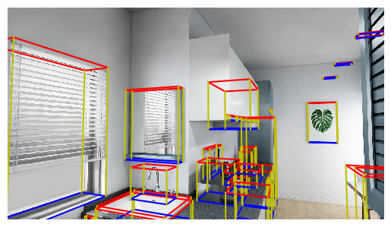
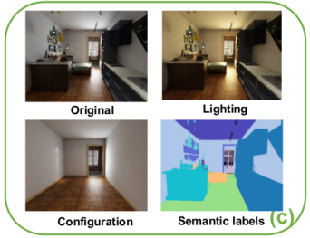
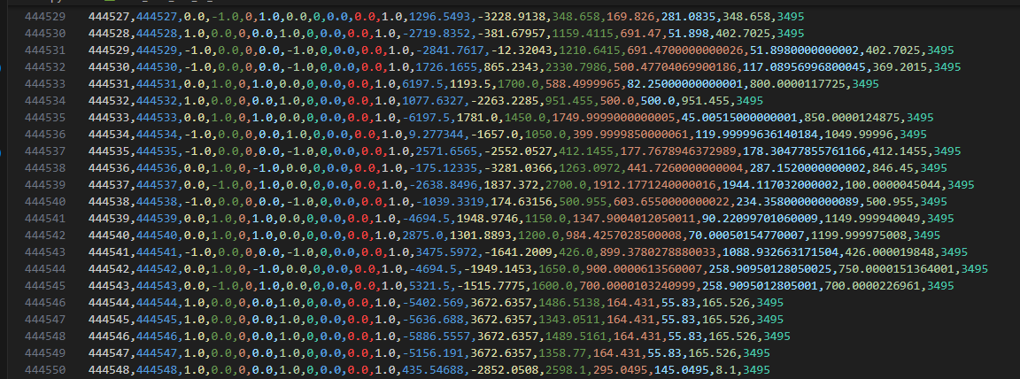
ML/Data

Slide 7
Challenges: Data
Finding a suitable dataset
Using the dataset
PNGs
170 - 510 GB
Bounding boxes – no labels
ML Model: 99.997% accuracy (sus )

Slide 8
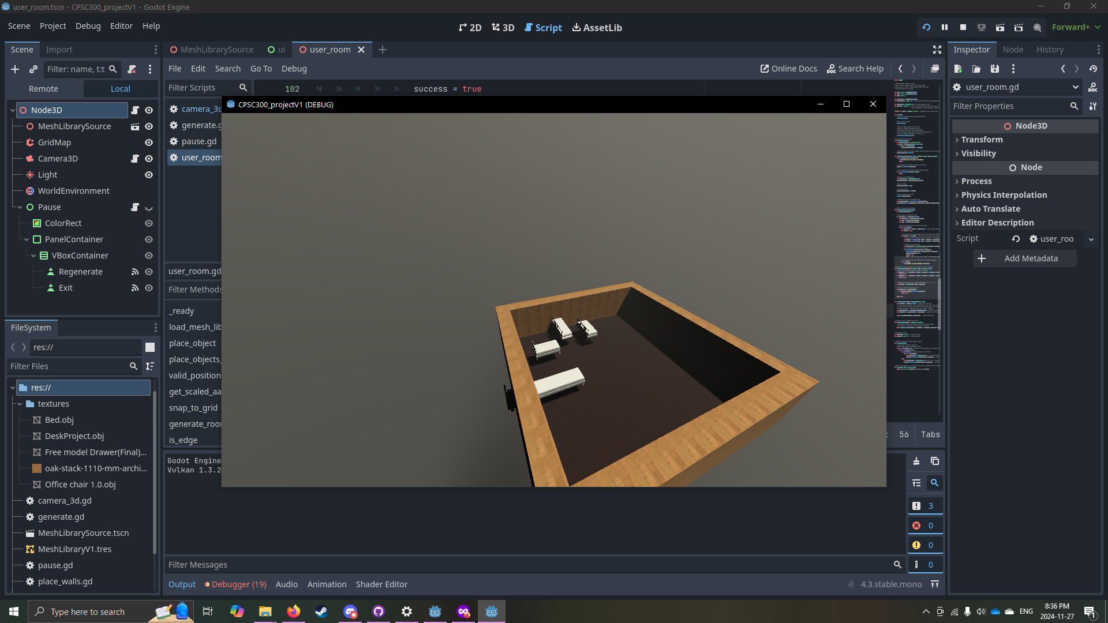
Challenges: Godot
Lots of boundary issues...

Slide 9

Demo

Slide 10
Future Plans
Must Do:
Improve machine learning model
Script to generate rooms for the ML model (in progress)
Connect ML model to room generator
Nice to Haves:
Performance improvements
Graphics improvements
Ability to move objects after generation

Slide 11
References
Structured3D Dataset https://github.com/bertjiazheng/Structured3D/tree/master

Slide 12

☻♥☺Thank you ☺♥☻
Questions?

