Slide 1

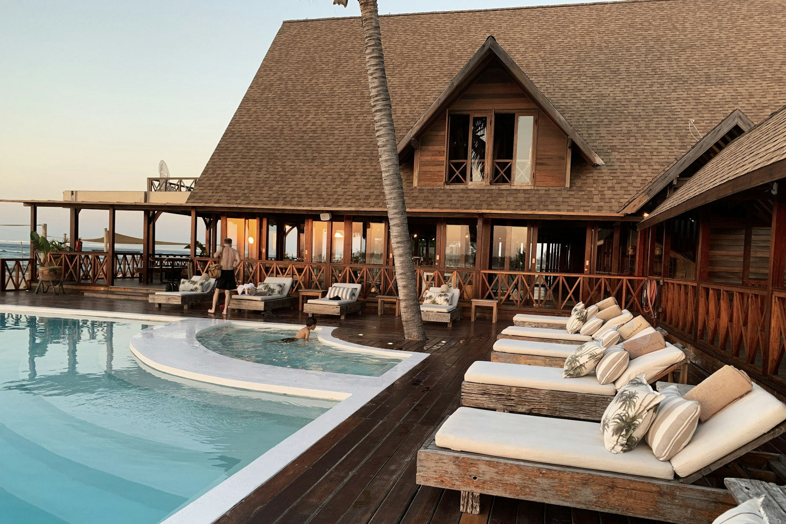
Hsquare
Property Brochure · 2026
PREMIUM STUDENT RESIDENCES
PREMIUM STUDENT RESIDENCE
Discover a home built on trust and elegance.
Hsquare Hostel Juhu blends modern student living with seamless experiences — a calm address designed for focus, community, and the rhythm of academic life in Juhu, Mumbai.
Hsquare Hostel Juhu
Near Juhu Beach, Juhu, Mumbai, Maharashtra 400049
LOCATION
PROPERTY TYPE
STARTS FROM
Enquire
Juhu, Mumbai
hostel
Rs 6,000
hsquare.in · 9820571030
01

Slide 2
Hsquare
Property Brochure · 2026
PREMIUM STUDENT RESIDENCES
ABOUT HSQUARE
A new standard for student living.
5,000+
15+
98%
24/7
HAPPY RESIDENTS
PREMIUM PROPERTIES
SATISFACTION RATE
SUPPORT & SECURITY
Hsquare creates curated student residences that blend timeless design, dependable service, and genuine community. Every home is hand-picked for safety, location, and the calm focus that academic life demands.
Curated Residences
Flexible Stays
On-Demand Care
Every Hsquare property is hand-picked for safety, design, and proximity to leading colleges and transit.
Choose monthly, semester, or annual plans with transparent pricing and zero hidden fees.
A dedicated 24/7 service team trained for everything from maintenance and laundry to meals.
hsquare.in · 9820571030
02

Slide 3
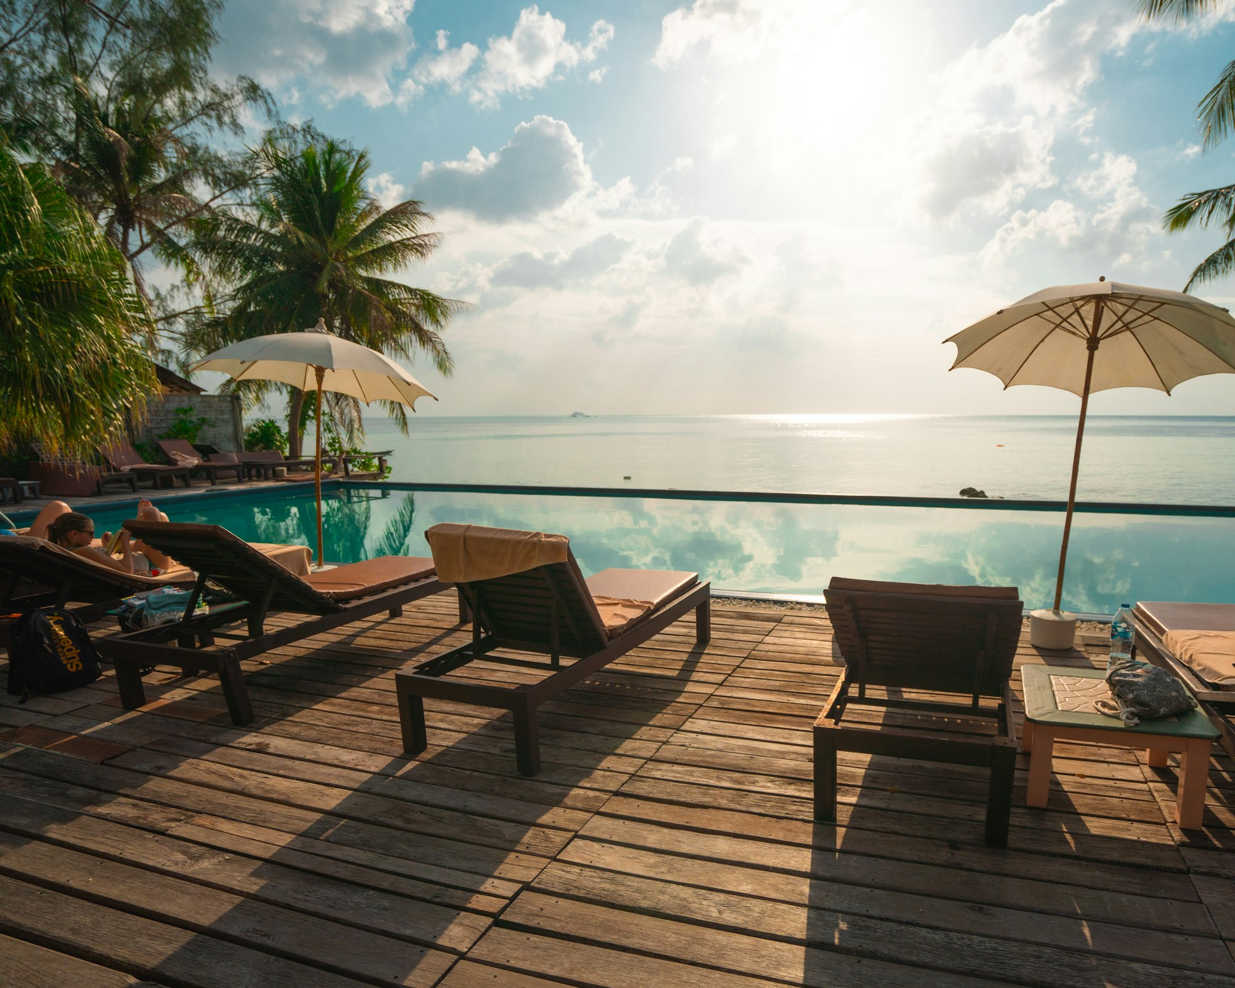
Hsquare
Property Brochure · 2026
PREMIUM STUDENT RESIDENCES
OVERVIEW
A residence crafted for student living.
Designed with intention — every detail of this residence supports rest, study, and connection. Curated common areas, considered amenities, and a service team obsessed with the small things.
Juhu, Mumbai · 9820571030 · juhu@hsquareliving.com
hsquare.in · 9820571030
03

Slide 4
Hsquare
Property Brochure · 2026
PREMIUM STUDENT RESIDENCES
AMENITIES & FACILITIES
What's Included
24/7 Security with CCTV
A La Carte Menu
Clean
Spacious Rooms
Common Eating Areas
Doctor on Call
Free Wifi
AC
Daily Housekeeping
Power Backup
Lift
Free Parking
Wardrobe or Closet
Clean Towels
Clean Linen
Fire NOC
Fire Extinguishers
Fire Exit
Security Guard
hsquare.in · 9820571030
04

Slide 5
Hsquare
Property Brochure · 2026
PREMIUM STUDENT RESIDENCES
OUR PACKAGES
Plans & Pricing
ESSENTIAL
PLUS
THE HIGHLANDER
Rs 5,25,000
THE STERLING
Rs 5,75,000
The Essentials
per month
Most Popular
per month
Occupancy Triple Sharing
Occupancy Triple Sharing
hsquare.in · 9820571030
05

Slide 6
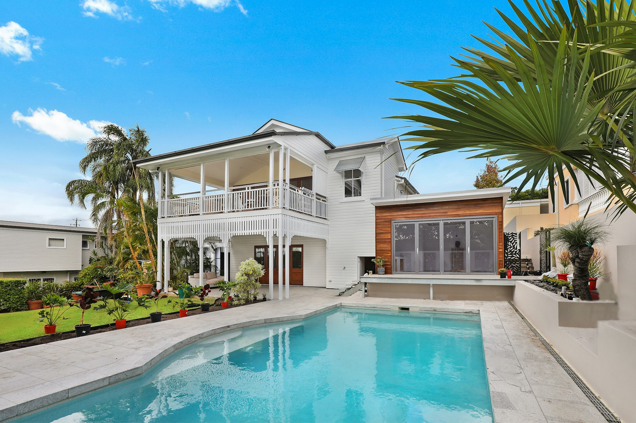
Hsquare
Property Brochure · 2026
PREMIUM STUDENT RESIDENCES
LOCATION
Perfectly Connected
Reserve your residence today
Near Juhu Beach, Juhu, Mumbai, Maharashtra 400049
Hsquare Hostel Juhu
hsquare.in · 9820571030 · juhu@hsquareliving.com
hsquare.in · 9820571030
06

