Slide 1
ARTIFICIAL NEURAL NETWORKS

Slide 2
INTRODUCTION
Biological Motivation
Human brain is a densely interconnected network of approximately 10¹¹ neurons, each connected to, on average, 10⁴ others.
Neuron activity is excited or inhibited through connections to other neurons.
The fastest neuron switching times are known to be on the order of 10⁻³ sec.

Slide 3
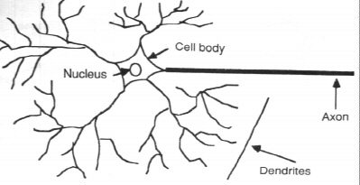
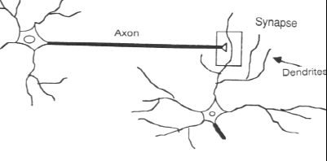
The cell itself includes a nucleus (at the center).
To the right of cell 2, the dendrites provide input signals to the cell.
To the right of cell 1, the axon sends output signals to cell 2 via the axon terminals. These axon terminals merge with the dendrites of cell 2.

Slide 4
Portion of a network: two interconnected cells.
Signals can be transmitted unchanged or they can be altered by synapses. A synapse is able to increase or decrease the strength of the connection from the neuron to neuron and cause excitation or inhibition of a subsequence neuron. This is where information is stored.
The information processing abilities of biological neural systems must follow from highly parallel processes operating on representations that are distributed over many neurons. One motivation for ANN is to capture this kind of highly parallel computation based on distributed representations.

Slide 5
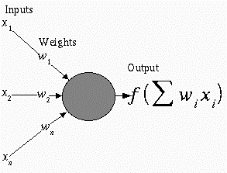
2. NEURAL NETWORK REPRESENTATION
An ANN is composed of processing elements called or perceptrons, organized in different ways to form the network’s structure.
Processing Elements
An ANN consists of perceptrons. Each of the perceptrons receives inputs, processes inputs and delivers a single output.
The input can be raw input data or the output of other perceptrons. The output can be the final result (e.g. 1 means yes, 0 means no) or it can be inputs to other perceptrons.

Slide 6
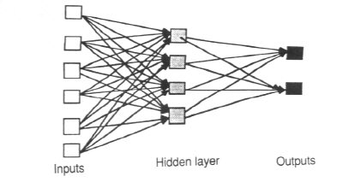
The network
Each ANN is composed of a collection of perceptrons grouped in layers. A typical structure is shown in Fig.2.
Note the three layers: input, intermediate (called the hidden layer) and output.
Several hidden layers can be placed between the input and output layers.

Slide 7
Appropriate Problems for Neural Network
ANN learning is well-suited to problems in which the training data corresponds to noisy, complex sensor data. It is also applicable to problems for which more symbolic representations are used.
The backpropagation (BP) algorithm is the most commonly used ANN learning technique. It is appropriate for problems with the characteristics:
  Input is high-dimensional discrete or real-valued (e.g. raw sensor input)
  Output is discrete or real valued
  Output is a vector of values
  Possibly noisy data
  Long training times accepted
  Fast evaluation of the learned function required.
  Not important for humans to understand the weights
Examples:
  Speech phoneme recognition
  Image classification
  Financial prediction

Slide 8
3. MULTILAYER NETWORKS AND THE BACKPROPOGATION ALGORITHM
Single perceptrons can only express linear decision surfaces. In contrast, the kind of multilayer networks learned by the backpropagation algorithm are capaple of expressing a rich variety of nonlinear decision surfaces.
This section discusses how to learn such multilayer networks using a gradient descent algorithm similar to that discussed in the previous section.
A Differentiable Threshold Unit
What type of unit as the basis for multilayer networks ?
  • Perceptron : not differentiable -> can’t use gradient descent
  • Linear Unit : multi-layers of linear units -> still produce only linear function
  • Sigmoid Unit : smoothed, differentiable threshold function

Slide 9
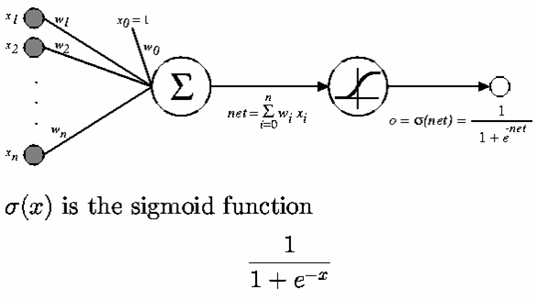
Figure 7. The sigmoid threshold unit.

Slide 10

Like the perceptron, the sigmoid unit first computes a linear combination of its inputs, then applies a threshold to the result. In the case of sigmoid unit, however, the threshold output is a continuous function of its input.
The sigmoid function σ(x) is also called the logistic function.
Interesting property:
• Output ranges between 0 and 1, increasing monotonically with its input.
We can derive gradient decent rules to train
• One sigmoid unit
• Multilayer networks of sigmoid units ⇒ Backpropagation

Slide 11
The Backpropagation (BP)Algorithm
The BP algorithm learns the weights for a multilayer network, given a network with a fixed set of units and interconnections. It employs a gradient descent to attempt to minimize the squared error between the network output values and the target values for these outputs.
Because we are considering networks with multiple output units rather than single units as before, we begin by redefining E to sum the errors over all of the network output units
E(w) = ½ ∑ ∑ (t_{kd} – o_{kd})² (13)
d ∈D k∈outputs
where outputs is the set of output units in the network, and t_{kd} and o_{kd} are the target and output values associated with the kth output unit and training example d.

Slide 12
The Backpropagation Algorithm (cont.)
The BP algorithm is presented in Figure 8. The algorithm applies to layered feedforward networks containing 2 layers of sigmoid units, with units at each layer connected to all units from the preceding layer.
This is an incremental gradient descent version of Backpropagation.
The notation is as follows:
  x_{ij} denotes the input from node i to unit j, and w_{ij} denotes the corresponding weight.
  δ_{n} denotes the error term associated with unit n.

Slide 13
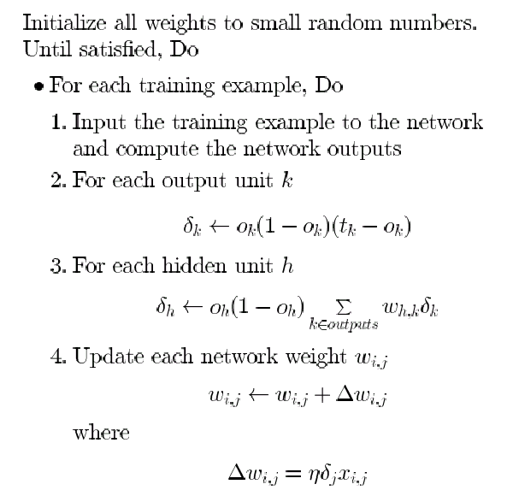
Figure 8. The Backpropagation algorithm

Slide 14
An Example of Back-propagation algorithm

Slide 15
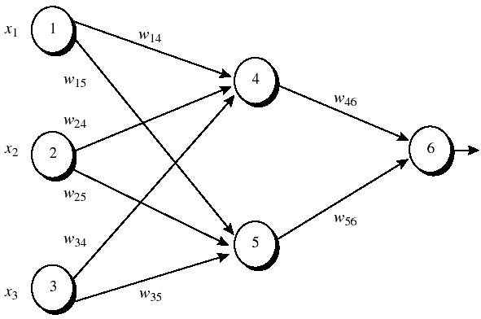
Figure 1: An example of a multilayer feed-forward neural network. Assume that the learning rate η is 0.9 and the first training example, X = (1,0,1) whose class label is 1.
Note: The sigmoid function is applied to hidden layer and output layer.

Slide 16
Table 1: Initial input and weight values
x₁ x₂ x₃ w₁₄ w₁₅ w₂₄ w₂₅ w₃₄ w₃₅ w₄₆ w₅₆ w₀₄ w₀₅ w₀₆
-----------------------------------------------------------------------------------
1 0 1 0.2 -0.3 0.4 0.1 -0.5 0.2 -0.3 -0.2 -0.4 0.2 0.1
Table 2: The net input and output calculation
Unit j Net input I_{j} Output O_{j}
-----------------------------------------------------------------------------------
4 0.2 + 0 -0.5 -0.4 = -0.7 1/(1+e^{0.7})=0.332
5 -0.3 +0+0.2 +0.2 =0.1 1/(1+e^{0.1})=0.525
6 (-0.3)(0.332)-(0.2)(0.525)+0.1 = -0.105 1/(1+e^{0.105})=0.474
Table 3: Calculation of the error at each node
Unit j δ_{j}
-----------------------------------------------------------------------------
6 (0.474)(1-0.474)(1-0.474)=0.1311
5 (0.525)(1-0.525)(0.1311)(-0.2)=-0.0065
4 (0.332)(1-0.332)(0.1311)(-0.3)=-0.0087

Slide 17
Table 4: Calculation for weight updating
Weight New value
------------------------------------------------------------------------------
w₄₆ -03+(0.9)(0.1311)(0.332)= -0.261
w₅₆ -0.2+(0.9)(0.1311)(0.525)= -0.138
w₁₄ 0.2 +(0.9)(-0.0087)(1) = 0.192
w₁₅ -0.3 +(0.9)(-0.0065)(1) = -0.306
w₂₄ 0.4+ (0.9)(-0.0087)(0) = 0.4
w₂₅ 0.1+ (0.9)(-0.0065)(0) = 0.1
w₃₄ -0.5+ (0.9)(-0.0087)(1) = -0.508
w₃₅ 0.2 + (0.9)(-0.0065)(1) = 0.194
w₀₆ 0.1 + (0.9)(0.1311) = 0.218
w₀₅ 0.2 + (0.9)(-0.0065)=0.194
w₀₄ -0.4 +(0.9)(-0.0087) = -0.408

Slide 18
7. SOME ANN APPLICATIONS
ANN application areas:
Tax form processing to identify tax fraud
Enhancing auditing by finding irregularites
Bankruptcy prediction
Customer credit scoring
Loan approvals
Credit card approval and fraud detection
Financial prediction
Energy forecasting
Computer access security (intrusion detection and classification of attacks)
Fraud detection in mobile telecommunication networks

Slide 19
References
F. D. Nittis, G. Tecchiolli & A. Zorat, “Consumer Loan Classification Using Artificial Neural Networks”, ICSC EIS’98 Conference, Spain Feb.,1998
R.L. Wilson and R. Sharda, “Bankruptcy Prediction Using Neural Networks,” Decision Support Systems, Vol. 11, No. 5, June 1994, pp. 545-557.
G. Zhang & M. Y. Hu, “Neural Network Forecasting of the British Pound/US Dollar Exchange Rate”, Omega, International Journal of Management Science, 26, 4(1998), 495-506.

Slide 20
1.Customer Loan Approval
Problem Statement. Many stores are now offering their customers the possibility of applying for a loan directly at the store, so that they can proceed with the purchase of relatively expensive items without having to put up the entire capital all at once.
Initially the offering of consumer loans was found only in connection with expensive purchases, such as cars, but it is now commonly offered at major department stores for purchases of washing machines, televisions, and other consumer goods.
The loan applications are filled out at the store and the consumer deals only with the store clerks for the entire process.
The store, however, relies on a financial company (often a bank) that handles such loans, evaluates the applications, provides the funds, and handles the credit recovery process when a client fails to fulfil the repayment schedule.

Slide 21
For this study, there were 1000 records of consumer loan applications that were granted by a bank, together with the indication whether each loan had been always paid on schedule or there had been any problem.
The provided data did not make a more detailed distinction about the kind of problem encountered by those “bad” loans, which could range from a single payment that arrived late to a complete defaulting on the loan.
ANN Application to Loan Approval
We use an ANN to classify the consumer loans and identify potentially risky loans, that is, loans that might not be repaid on schedule.

Slide 22
Input variables
Each application had 15 variables that included the number of members of the household with an income, the amount of the loan requested, whether or not the applicant had a phone in his/her house, etc.
Some of these variables were numerical (e.g. the number of relatives), while other used a digit as a label to indicate a specific class (e.g. the values 0,1,2,3 of variable 8 referred to four different classes of employment).

Slide 23
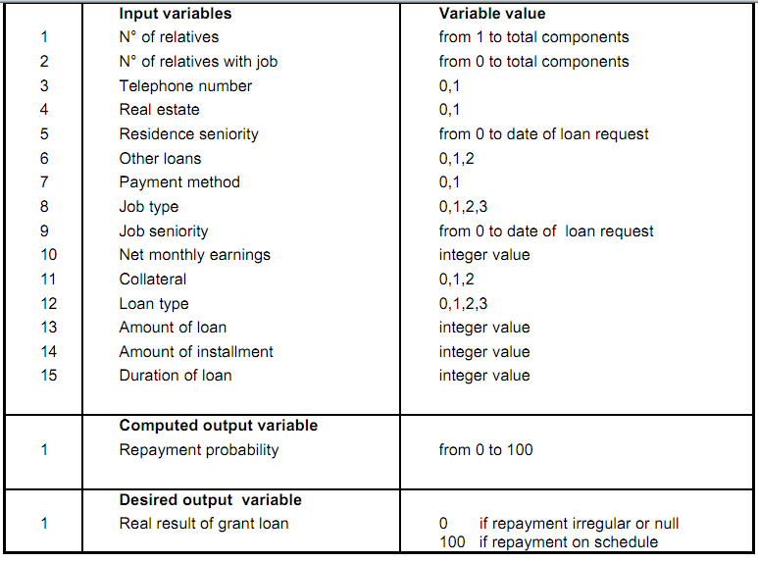
Table 1: Input and output variables

Slide 24
For each record, a single output variable indicated whether the loan reached was extinguished without any problem (Z=100) or with some problem (Z=0).
Network topology: Multi-Layer Perceptron (MLP) with one input layer, one hidden layer and one output layer. We use a network with 10 nodes in hidden layer.
Training Algorithm: For training ANN, Reactive Tabu Search, a metaheuristic has been used to train the ANN rather than back-propagation algorithm.
In its a-posteriori analysis, the bank classified loans with Z=0 as “bad loans”. In the provided data, only about 6% of the loans were classified as “bad”.

Slide 25
The output variable
The single output of our network turned out to be in the range from -30 to +130, whereas the corresponding “real” output was limited to the values Z=0 or Z=100. A negative value of the output would indicate a very bad loan and thus negative values were clamped to zero; similarly, output values above 100 were assigned the value of 100.
A 30% tolerance was used on the outputs so that loans would be classified as “good” if the ANN computed a value above 70, and “bad” is their output was less then 30.
Loans that fell in the intermediate band [30, 70] were left as “unclassified”. The rationale for the existence of the “unclassified” band is to provide an alarm requesting a more detailed examination of those loans, possibly by requesting additional information from the applicant.

Slide 26
Training set and test set
Of the available 1000 cases, 400 cases used to train the ANN.
Then this specific ANN was supplied with the remaining 600 cases of the testing set.
This set contained 38 cases that had been classified as bad (Z=0), while the remaining 562 cases had been repaid on schedule.
Figure 1 shows the output of ANN for all 600 cases analyzed. Each point on the horizontal axis corresponds to one of the 600 cases, with the output computed by the ANN shown by a diamond or a cross.

Slide 27
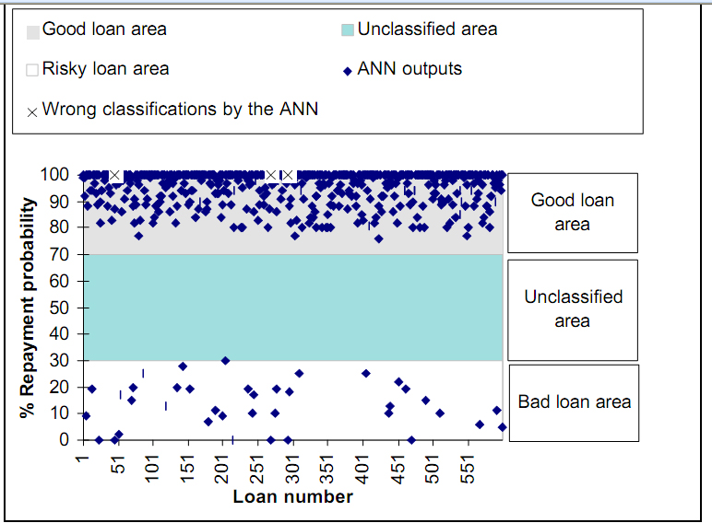
Figure 1: Loan classification by ANN

Slide 28
Experiment results
Clearly the ANN separates the given cases into two non-overlapping bands: the good ones near the top and the bad ones near the bottom. No loan was left unclassified, so in this case there would have been no cases requiring additional (human) intervention.
The ANN made exactly 3 mistakes in the classification of the test cases: those were 3 cases that the ANN classified as “good” loans, whereas in reality they turned out to be “bad”. Manual, a-posteriori inspection of the values of their input variables did not reveal any obvious symptoms that they were “problem cases”.
What could have likely happened is that the applicant did not repay the loan as schedule due to some completely unforeseen and unpredictable circumstance. This is also supported by the fact that the bank officers themselves approved those 3 loans, thus one must presume that they did not look too risky at application time.

Slide 29
The ANN, however, was more discriminating than the bank officers since the ANN would have denied 35 loan applications that scored less than 30.
As is turns out, all those 35 loans had problems with their repayments and thus the bank would have been well advised to heed the network’s classification and to deny those 35 applications.

Slide 30
2. Bankruptcy Prediction
Bankruptcy prediction problem is important to creditors, auditors and shareholders.
There have been a lot of work on developing neural networks to predict bankruptcy using financial ratios.
The ANN selected in the design phase for this problem was a three-layer feed-forward ANN using back-propagation.
The data for training the network consist of a small set of numbers for well-known financial ratios, and data were available on the bankruptcy outcomes corresponding to known data sets.

Slide 31
Application design
There are five input nodes, corresponding to five financial ratios:
  X1: Working capital/total assets
  X2: Retained earnings/total assets
  X3: Earnings before interest and taxes/total assets
  X4: Market value of equity/total debt
  X5: Sales/total assets
  (The same financial ratios selected by Altman, 1968)
Two output nodes gives the final classification (one indicating a bankrupt firm or and one indicating non-bankrupt firm).
  For instance, a bankrupt training case that has its bankrupt output node valued at 0.85 and its non-bankrupt node at 0.17.

Slide 32
The data source consists of financial ratios for 129 firms, 65 of which went bankruptcy and 64 non-bankrupt during the period between 1975 and 1982. The sample set is from Moody’s Industrial Manuals.
Financial ratios were calculated for each of the five aspects shown above, each of which became the input for one of the five input nodes.
For each set of data, the actual result, whether or not bankruptcy occurred, can be compared to the neural network’s output to measure the performance of the network and monitor the training.
ANN Architecture
This work uses BRAINMAKER, a neural network software package (California Scientific Software) which implement back-propagation training algorithm, to construct and test the ANN.
The architecture of the ANN is shown in the following figure with:
  5 input nodes
  10 hidden nodes
  2 output nodes

Slide 33
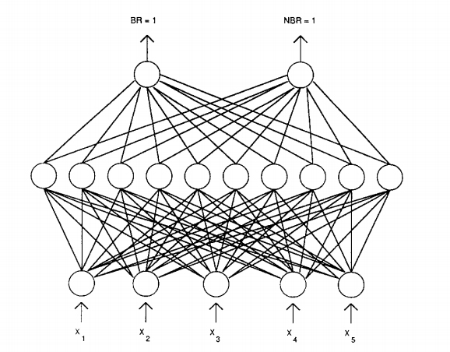

Slide 34
Training
The data set, consisting of 129 firms, was partitioned into a training set and a test set. The training set of 74 firms consisted of 38 that went bankrupt and 36 that did not. The needed financial ratios were computed and stored in the input file to the neural network and in a file for a conventional discriminant analysis program for comparison of the two techniques.
The neural network has three important parameters to be set: learning threshold, learning rate, and momentum.
  The learning threshold allows the developer to vary the acceptable overall error for the training case.
  The learning rate and momentum allow the developer to control the step sizes the network uses to adjust the weights as the errors between computed and actual outputs are fed back.

Slide 35
Testing
The ANN was tested in two ways: by using the test data set and by comparison with discriminant analysis. The test set consisted of 27 bankrupt and 28 non-bankrupt firms.
The ANN was able to correctly predict 81.5% of the bankrupt cases and 82.1% of the nonbankrupt cases.
  Overall, the ANN did much better predicting 22 out of the 27 actual cases (the discriminant analysis predicted only 16 cases correctly).
  An analysis of the errors showed that 5 of the bankrupt firms classified as non-bankrupt were also misclassified by the discriminant analysis method. A similar situation occurred for the non-bankrupt cases.
The result of the testing showed that ANN implementation is at least as good as the conventional approach. An accuracy of about 80% is usually acceptable for ANN applications. At this level, a system is useful because it automatically identifies problem situations for further analysis by a human expert.

Slide 36
3. Exchange Rate Forecasting
Exchange rate forecasting is an important and challenging task due to the unpredictability of the foreign exchange rate.
Neural networks have general nonlinear function mapping capability.
Neural networks are nonparametric data-driven models which impose little prior assumptions on the underlying processes from which data are generated.
So neural networks are suitable for forecasting exchange rates.
But building a neural network forecaster is a non-trivial task.
Although there exists many types of neural networks, multi-layer feed-forward networks are still the most commonly-used.

Slide 37
Neural network for time series forecasting
Neural networks are able to capture the underlying pattern or autocorrelation structure within a time series even when the underlying law governing the system is unknown or too complex to describe.
The most popular neural network used for forecasting is the feed-forward multilayer network (MLP), given in the Figure 3.1.
For a univariate time series forecasting problem, the inputs of the network are the past, lagged observations of the data series and the outputs are the future values.
The network represented in Figure 3.1 is a mapping function of the form:
y_{t+1} = f(y_{t}, y_{t-1},…, y_{t-p})
where y_{t} is the observations at time t and p is the dimension of the input vector or the number of past observations related to the future value.

Slide 38
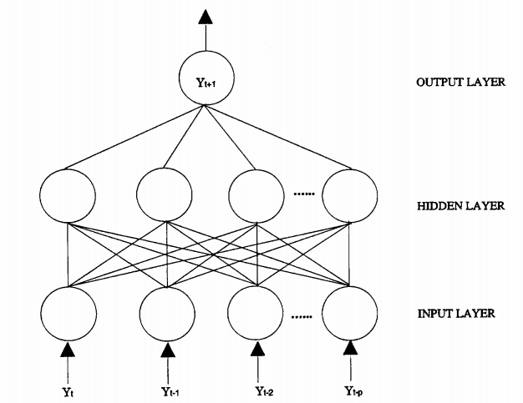
Figure 3.1 A feedforward neural network for time series forecasting

Slide 39
The neural network training objective is to find the weights in order that some overall predicted error measure such as the sum of the squared errors (SSE) is minimized.
For this network structure, SSE can be written as:
N
SSE = Σ (y_{i} – a_{i})²
i= p+1
where a_{i} is the output from the network.

Slide 40
Experiments
Three-layer feedforward neural networks are used.
Logistic (sigmod) activation functions are used in the hidden layer and the linear activation function is used in the output layer.
Number of input nodes: varies from 1 to 10
Number of hidden nodes: can be 4,8, 12, 16 and 20.
No data normalization is required. Raw data are used.
The large sample is consisted of 887 observations from 1976 to 1992 and the small one includes 261 data points from 1998 to 1992.
The test sample for both cases is the 1993 data which has 52 observations.
Three time horizons of one month, six months and twelve months. Forecasts are generated for the first 4 weeks, 26 weeks and 52 weeks of the test sample corresponding to the three forecast horizons.
Focus on one-step-ahead forecasting (it uses the current observations to predict the next one).

Slide 41
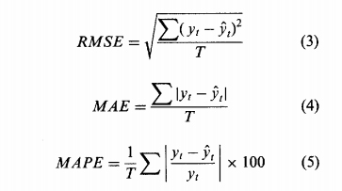
Performance measures and comparison
Here, three popular criteria: RMSE, MAE and MAPE are used to evaluate the predictive performance of neural network.
where y_{t} is the actual observation, ŷ_{t} is the predicted value and T is the number of predictions.
These criteria are mean based and are frequently used measures in the literature.

Slide 42
Experimental Results
As the number of input nodes increases, RMSE decreases. So the number of input nodes has great impact on the model fitting process of neural networks.
As the number of hidden nodes increases, RMSE decreases. This pattern is observed consistently in each level of the input node.
As more hidden nodes are used, the NN becomes more ‘powerful’ in modeling the data. But too powerful networks are undesirable because they tend to memorize the specific features of the individual observations causing poor generalization.
The network with 6 input nodes is the overall best architecture.
With 6 input nodes for the large sample in one-month horizon, the network with 16 hidden nodes yield the smallest RMSE, MAE and MAPE.
Correctly identifying the number of input nodes is more important than identifying the number of hidden nodes.

Slide 43
Notes on Generalization and Overfitting
Termination condition
  Until the error E falls below some predetermined threshold
  This is a poor strategy
Overfitting problem
  Backpropagation is susceptible to overfitting the training examples at the cost of decreasing generalization accuracy over other unseen examples.
  To see the danger of minimizing the error over the training data, consider how the error E varies with the number of weight iterations.

Slide 44
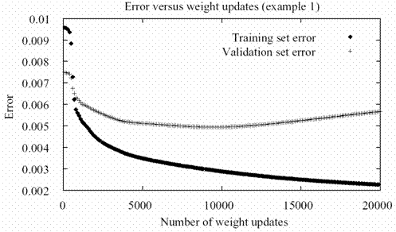
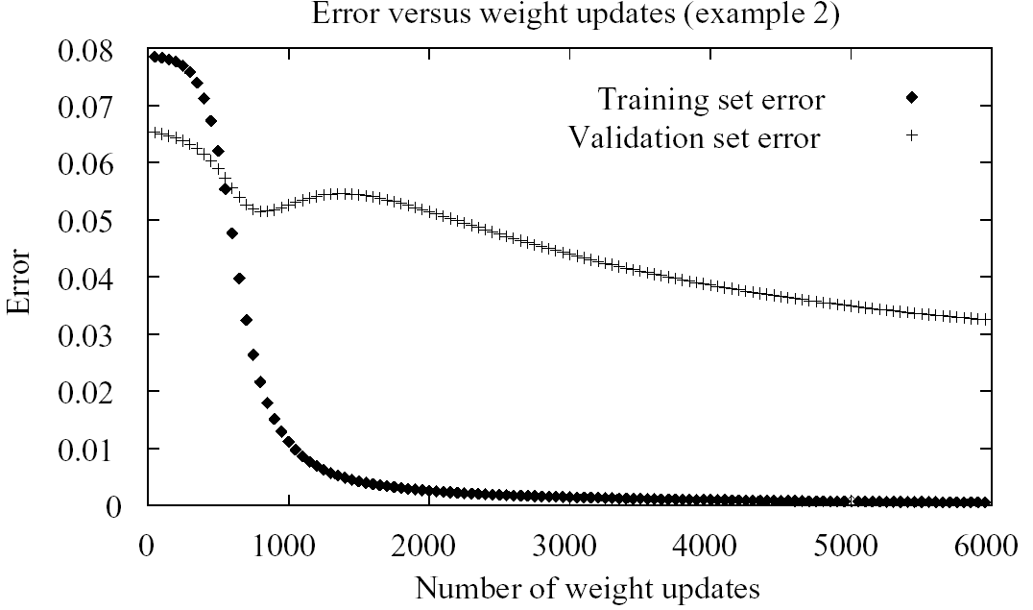
The upper line shows the error E measured over a different validation set of examples.
The error measured over the validation examples first decreases, then increases, even as the error over training examples continues to decrease.
This occurs because the weights are being tuned to fit idiosyncrasies of the training examples that are not representative of the general distribution of examples.

Slide 45
Techniques to overcome over-fitting problem
Weight decay : Decrease each weight by some small factor during each iteration. The motivation for this approach is to keep weight values small.
Cross-validation: a set of validation data in addition to the training data. The algorithm monitors the error w.r.t. this validation data while using the training set to drive the gradient descent search.
  How many weight-tuning iterations should the algorithm perform? It should use the number of iterations that produces the lowest error over the validation set.
  Two copies of the weights are kept: one copy for training and a separate copy of the best weights thus far, measured by their error over the validation set.
  Once the trained weights reach a higher error over the validation set than the stored weights, training is terminated and the stored weights are returned.

Slide 46
4. Conclusions
Neural networks have matured to the point of offering real practical benefits in many of their applications.
Applying neural networks in business is a science and also an art.
The design process of NN for business applications still involves much try-and error.
Although there exists many types of neural networks, three-layer feed-forward networks are still the most commonly-used.
Beside back-propagation algorithms, there are several other effective methods for training neural networks.

