Slide 1

NLP and Word Embeddings
Negative sampling
deeplearning.ai

Slide 2
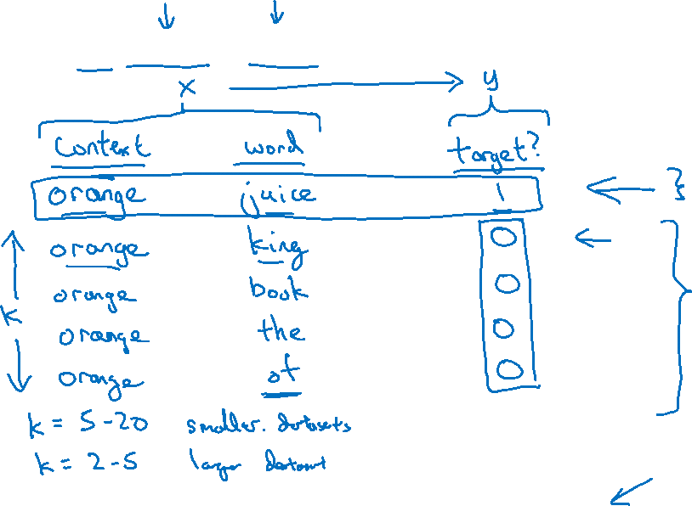
Defining a new learning problem
I want a glass of orange juice to go along with my cereal.
[Mikolov et. al., 2013. Distributed representation of words and phrases and their compositionality]

Slide 3

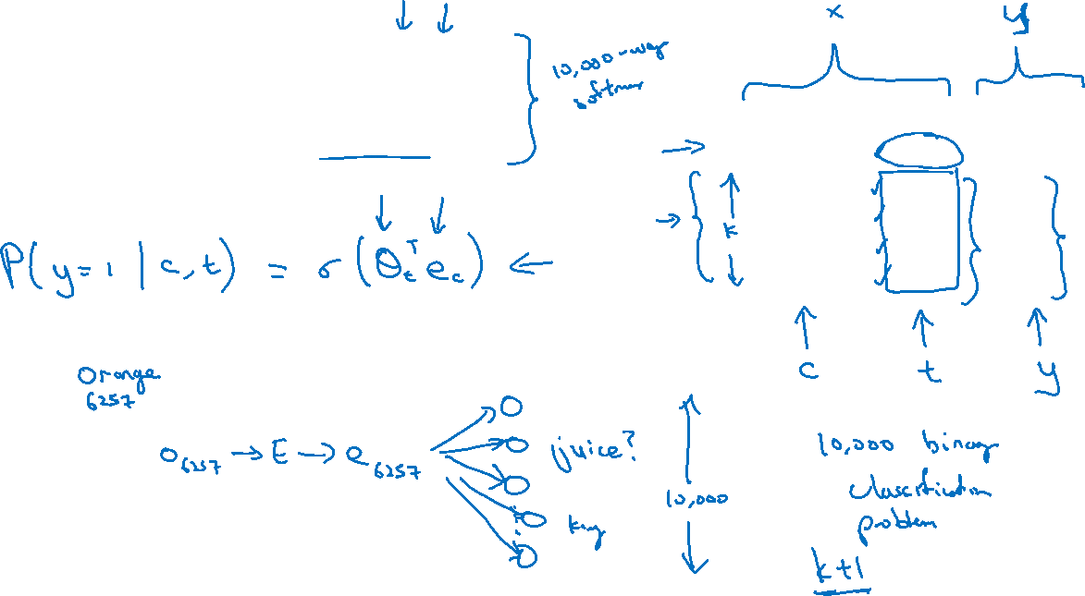



Model
$$p\left(t | c\right)=\frac{e^{θ_{t}^{T}e_{c}}}{\sum_{j=1}^{10,000}{e^{θ_{j}^{T}e_{c}}}}$$
Softmax:
context
word
target?
orange
juice
$$1$$
orange
king
$$0$$
orange
book
$$0$$
orange
the
$$0$$
orange
of
$$0$$

Slide 4
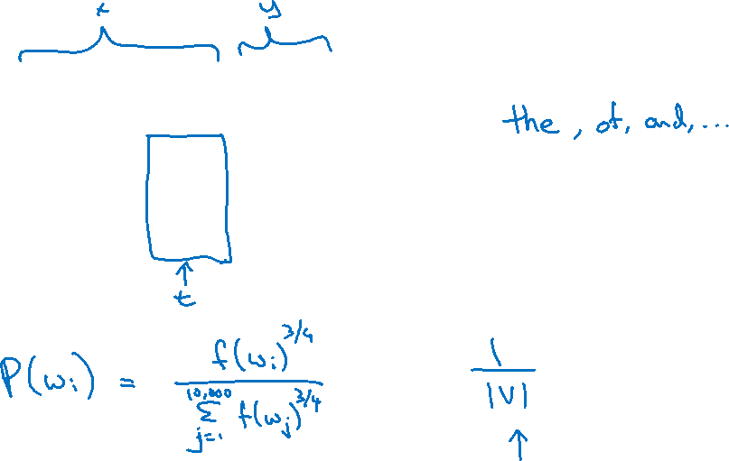
Selecting negative examples
context
word
target?
orange
juice
$$1$$
orange
king
$$0$$
orange
book
$$0$$
orange
the
$$0$$
orange
of
$$0$$

