Slide 1

NLP and Word Embeddings
Word2Vec
deeplearning.ai

Slide 2
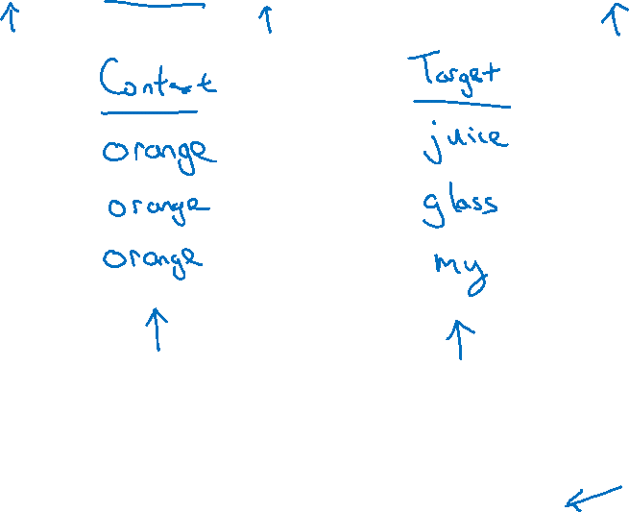
Skip-grams
I want a glass of orange juice to go along with my cereal.
[Mikolov et. al., 2013. Efficient estimation of word representations in vector space.]

Slide 3
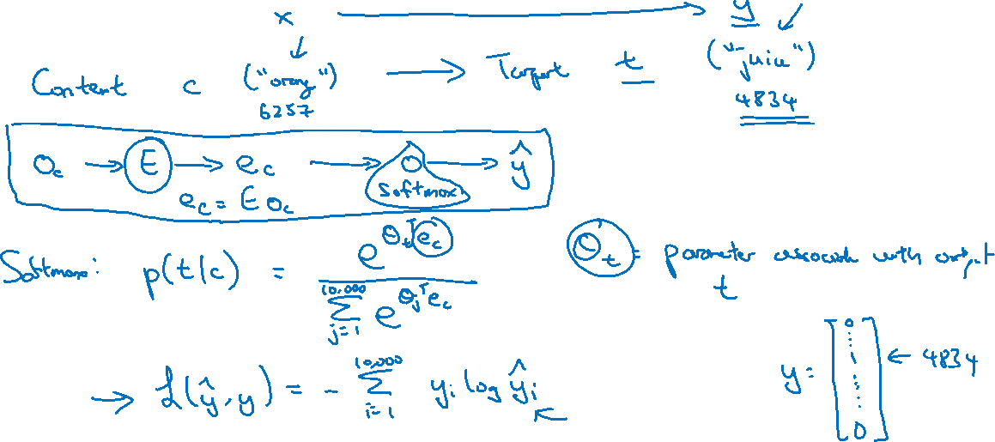
Model
Vocab size = 10,000k

Slide 4
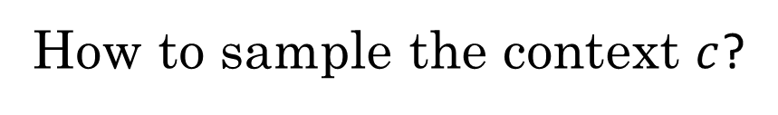
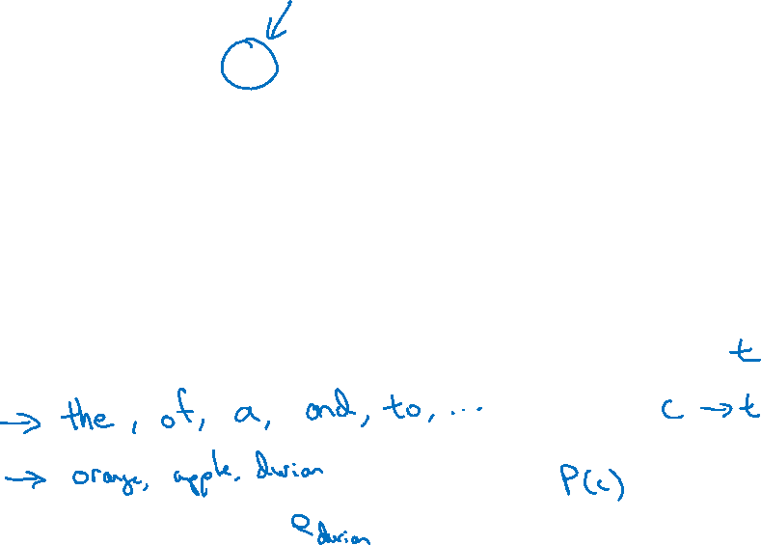
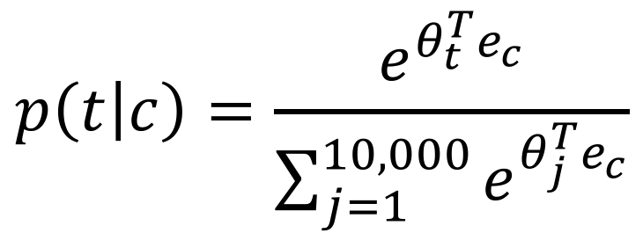
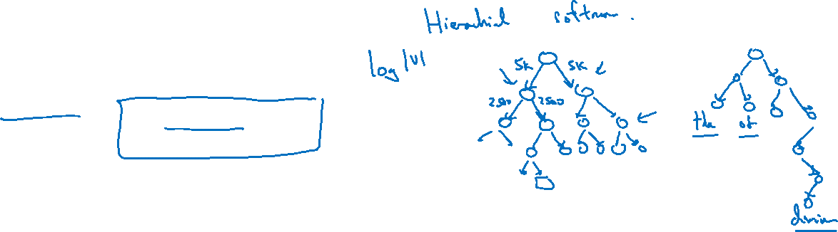
Problems with softmax classification
$$p\left(t | c\right)=\frac{e^{θ_{t}^{T}e_{c}}}{\sum_{j=1}^{10,000}{e^{θ_{j}^{T}e_{c}}}}$$
How to sample the context $c$?

