Slide 1


A Project by Swathi, Arumugam and Nishka

Slide 2

Why
Exercise in environment design
Capture real life interactions between the various components of our game
Inspire children to take up roles in better management of resources
We hope that with time, this environment can also be used train a Q learning agent to optimize bus planning in NTU and across the country

Slide 3
Approach
Number of buses player adds increases fuel cost
Number of people waiting increases social cost
Buses and bus stops with max capacity increases social costs
Goal of the player is to minimize these costs

Slide 4
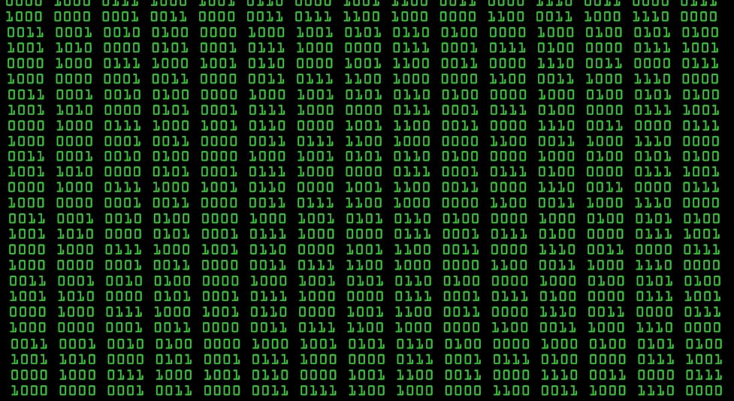
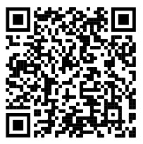
Methods Used
Pygame for the visualization
Please refer to this link for a detailed view of game mechanics

Slide 5
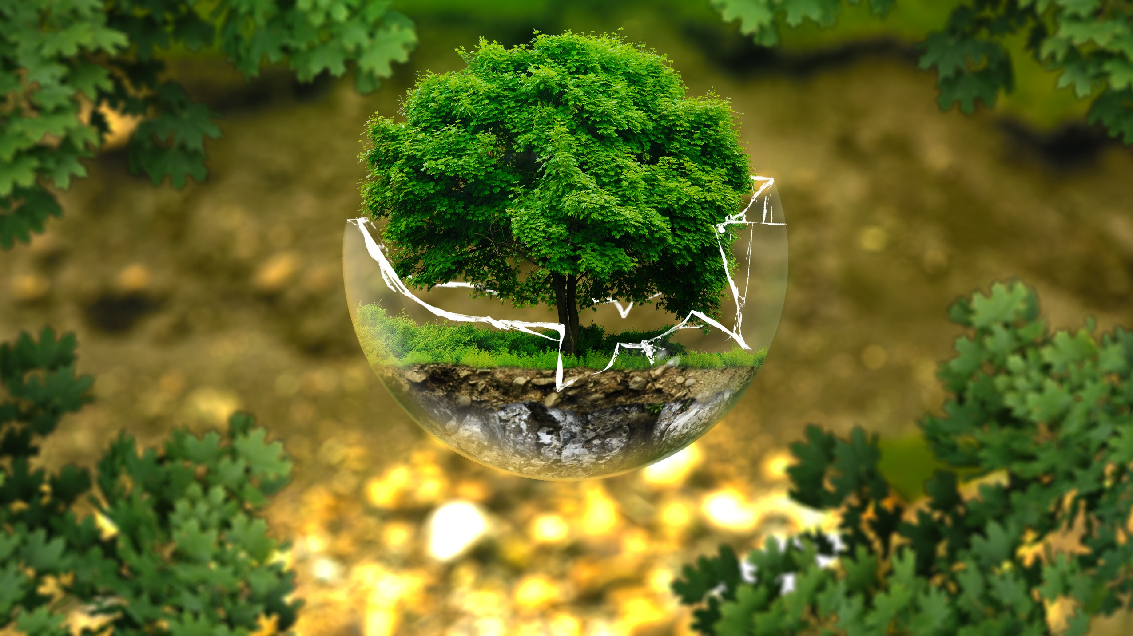
Impact & Scope
This game will help the user visualize the difficulty in solving the optimization problem revolving around scheduling of buses
The final aim of this project is to
-help people reduce the amount of fuel used and subsequently, the carbon footprint
-reduce waiting time and inconvenience caused to students and NTU faculty

