Slide 1
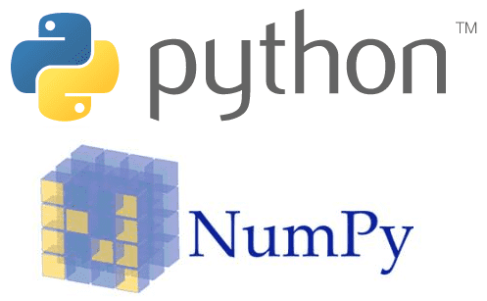


Rap God
Ran out of creative juice?
No idea how to write lyrics?
New song lyrics in seconds with Rap God
Generate lyrics Using AI
With a click of a button, generate a rap lyrics that rhymes using machine learning algorithms by combining and completing lines from existing rap lyrics.
Tech Stack
Python
Numpy
Keras
Tensorflow
Pronouncing
Markovify
Short Sample (Auto Generated)
She on that moontalk
and this is my commode
Time's of the fronting?
I'm ahead of my dream
Is in the air
Louboutin on the clouds
Thank God for so long
By the way it is
I'd feel the effect though
I gotta get this
Now she on fire
Developed by: Ng Kai Cong & Liow Zhu Hui

