Slide 1
Executive summary: GS AWM leads on flow growth; margin hinges on markets and allocation
• GS AWM AUS reached $4.10tn (2026-09-30); trailing-four-quarter organic growth 14.9% vs BlackRock 6.5%, Invesco 7.6% and T. Rowe -3.2% (latest available quarters). GS growth includes low-fee liquidity-product inflows.
• Fee yield is the pressure point: T4Q yields are 34.8 bps (GS), 15.6 (BLK), 23.9 (IVZ), 38.6 (TROW); fitted trends are -0.33, -0.35, -2.89 and -1.27 bps a year.
• Eight-quarter outlook: pre-tax margin in the final quarter is 29.3% base, 31.2% bull, 25.5% bear and 15.7% under a -25% equity stress.
• Allocation matters (synthetic split): Liquidity Solutions shows 36.4% margin on a revenue basis but -20.1% under activity-based costing (rank 2 to 6); price new mandates off marginal cost, not allocation.
• GCC private wealth office: illustrative NPV $170m, but 93% comes from terminal value (explicit-period NPV $11m): Monte Carlo: mean NPV $255m, 10% chance of loss; staging a pilot first was worth -$87m (negative: it delays a project that is positive in most paths).
Sources: SEC 10-Q/10-K and 8-K Ex.99.1 filings (GS, BLK, TROW, IVZ); AssetLens scenario model; synthetic allocation | Synthetic business-unit data where marked.

Slide 2
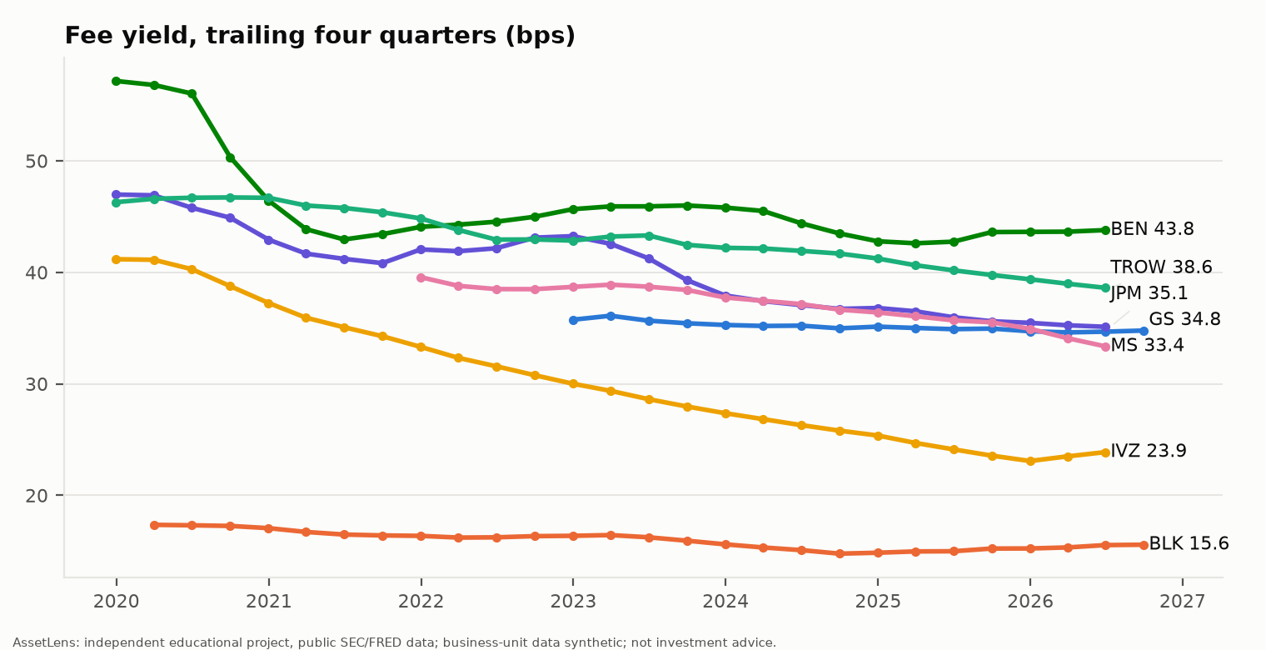
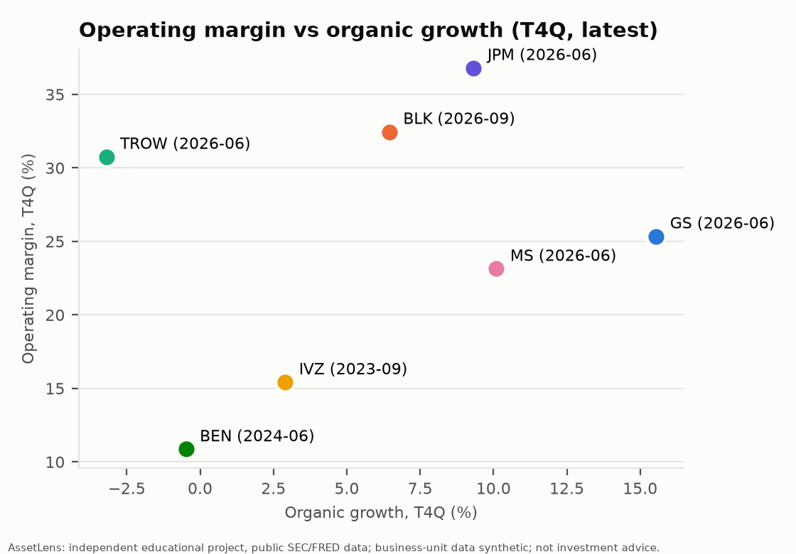
Competitive position: growth and fee yield versus peers
• Operating margin T4Q: GS 25.3% (as of 2026-06-30; segment pre-tax), BLK 32.5%, IVZ 15.4%, TROW 30.8%, JPM AWM 36.8%, MS IM 23.1%, BEN 10.9%.
• Comparability: GS = AWM segment / AUS; BLK market impact is a residual; IVZ fees are gross; margins are GAAP operating (see appendix).
Sources: GS 10-Q/10-K AWM tables; BLK, TROW, IVZ Ex.99.1 earnings releases; warehouse mart_peer_benchmark | Synthetic business-unit data where marked.

Slide 3
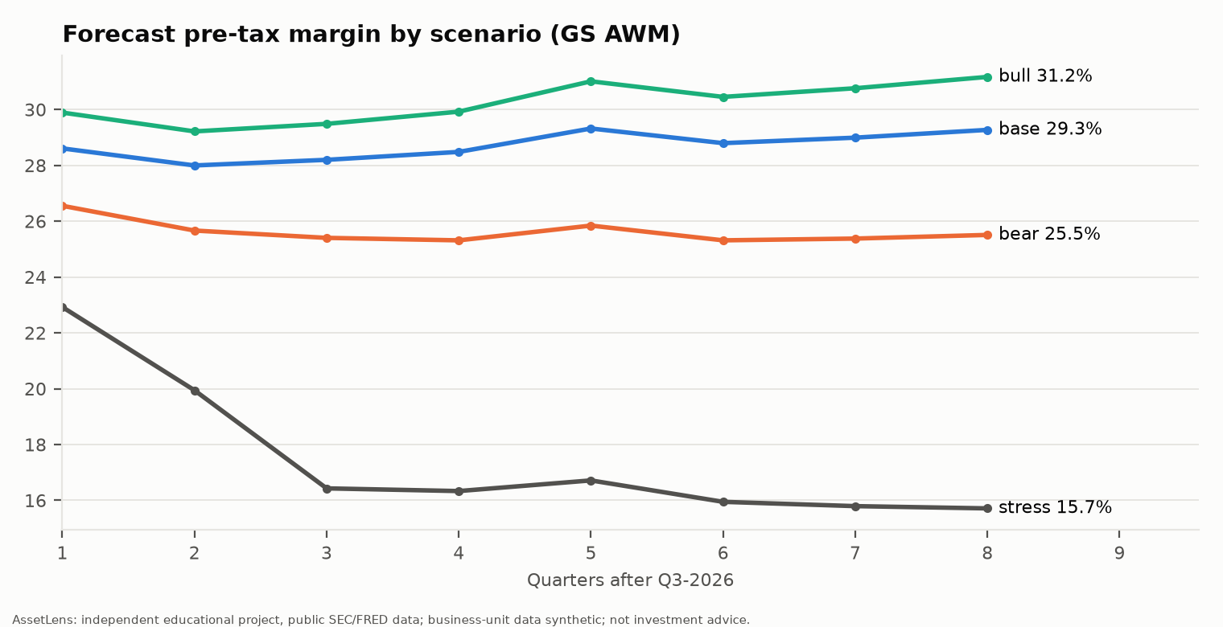
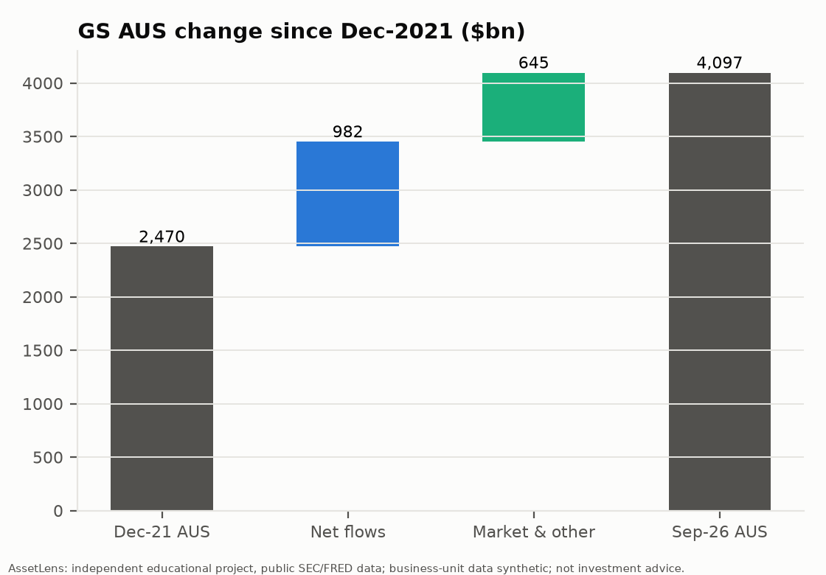
Financial outlook and risk: scenarios for the next eight quarters
• Eight-quarter cumulative pre-tax earnings: $14.8bn bull, $12.8bn base, $9.7bn bear, $5.2bn stress.
• Since Dec-2021 net flows added $982bn of AUS (40% of the opening balance), market and other $645bn.
• Key risks: incentive-fee and Investments volatility, liquidity-product flows reversing, fee compression, lending credit costs. H1-2026 pre-tax earnings ran -16% versus a top-down budget (30% margin target per GS 10-Q; 8% revenue growth is an AssetLens assumption).
Sources: AssetLens driver model (config/scenarios.yaml: assumptions, not forecasts); GS public base data | Synthetic business-unit data where marked.

Slide 4
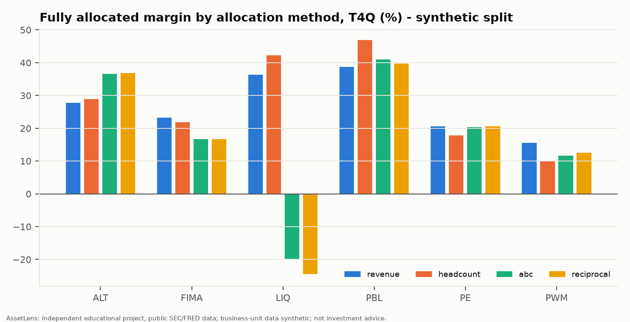
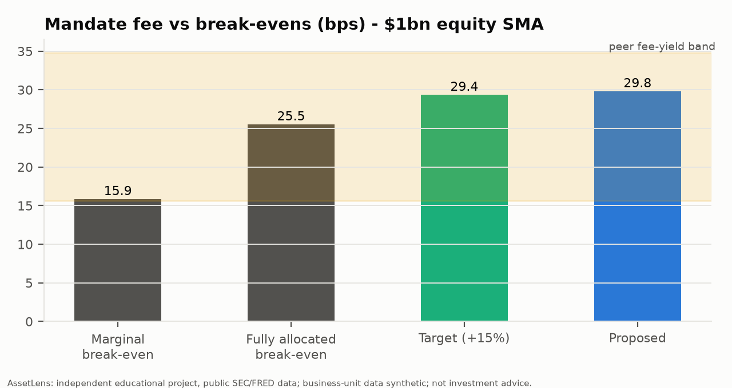
Profitability and pricing: allocation changes the ranking, marginal cost sets the floor
• 4 of 6 businesses change rank depending on the allocation method (synthetic).
• $1bn equity SMA: break-even fee 15.9 bps marginal, 25.5 bps fully allocated; proposed 29.8 bps. Minimum viable AUM $378m marginal / $623m fully allocated.
• Rule: never price below marginal break-even; target fully allocated break-even plus a 15% hurdle margin.
Sources: Synthetic business split calibrated to GS AWM totals; allocation methods per M8; pricing engine per M9 | Synthetic business-unit data where marked.

Slide 5
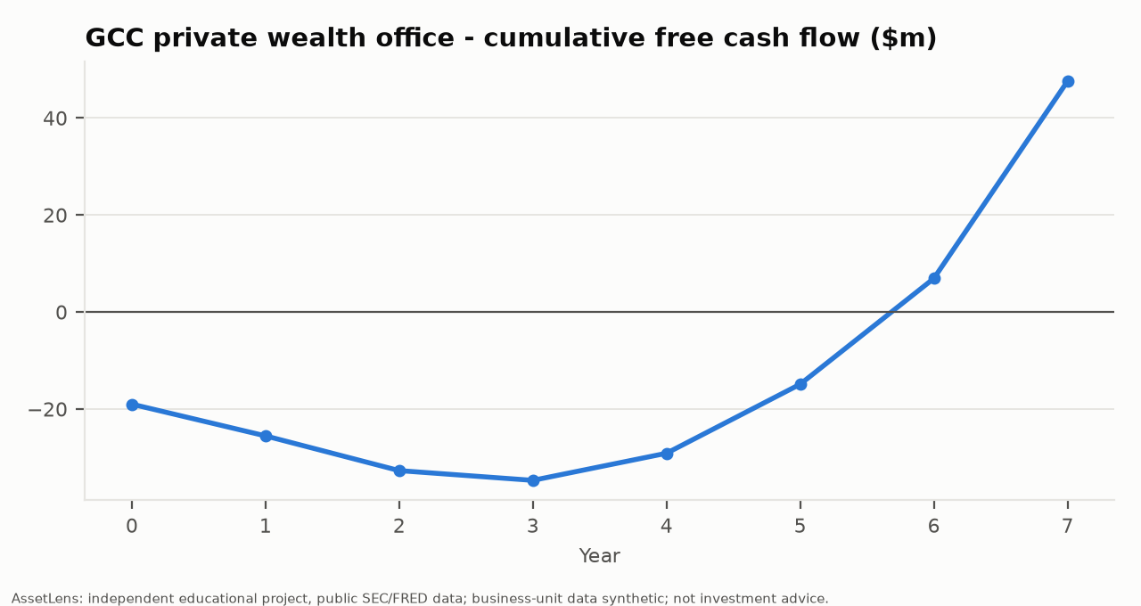
Growth and strategic initiatives: GCC expansion case and savings programme
• Base case (DIFC): NPV $170m, IRR 50%, payback 5.7 years, peak funding $35m.
• Terminal value is 93% of NPV; the explicit seven-year NPV is $11m.
• Monte Carlo (1,000 paths): mean NPV $255m (P10 $3m, P90 $577m), 10% chance of loss.
• Staged entry (pilot, expand if AUM clears $350m at year 2; 52% pass): option value -$87m, i.e. staging lowers expected value; use it only as risk control.
• Recommendation: conditional go on the full plan, gated on validating AUM per advisor and net revenue bps; the explicit-period NPV is small so the case rests on terminal value.
• Savings programme (synthetic): 40 initiatives, $382m target, $119m realised to date.
Sources: AssetLens GCC business case (config/assumptions.yaml, illustrative; tax: UAE 15% minimum top-up tax, KSA 20%); synthetic savings tracker | Synthetic business-unit data where marked.

Slide 6
Appendix: methodology, data sources, comparability and assumptions
• Data: SEC EDGAR 10-K/10-Q and 8-K Exhibit 99.1 (GS, BLK old and new CIK, TROW, IVZ); FRED. Every public fact carries accession number, table locator and raw text.
• Quality gate: AUM roll-forwards are accepted only if begin + flows + market + other = end and chain with the prior quarter. GS reconciliation checks pass 19/19 per test.
• GS perimeter: AWM segment re-based in the FY2022 10-K; quarterly AWM series starts 2022 Q1. Q3-2026 opex and pre-tax not yet filed (10-Q due).
• Fee yield = quarterly fees x4 / average AUM; organic growth = net flows x4 / beginning AUM; margins GAAP operating (GS: segment pre-tax).
• Forecast: driver-based (flows, market returns, fee compression, comp ratio with floor); scenario inputs are assumptions. Budget: 30% margin target is from GS's 10-Q; 8% revenue growth is an assumption.
• Synthetic: business-unit P&L, cost pools, headcount, advisors, GL, T&E, savings. Calibrated so totals equal public segment figures.
• AssetLens is an independent educational project built from publicly available SEC filings and FRED data. It is not affiliated with, endorsed by, or based on any non-public information from Goldman Sachs or any other company named. Business-unit, headcount, advisor, expense and compensation data are synthetic, generated to be consistent with public segment totals, and do not represent any company's internal figures. Nothing here is investment advice.
Sources: docs/MODEL_DOCUMENTATION.md, docs/DECISIONS.md | Synthetic business-unit data where marked.

