Slide 1
Historical Gas Price Analysis
By Samuel Wallace and Connor McInnes
Notes:
Good morning. For our project we decided programmatically analyze historical gas price data. To do this, we first found a reliable source of historical gas pricing information. From here we had to determine a method of scraping this data from our source, cleaning it up a bit, and converting it into an XML form to import into Excel for easy analysis.

Slide 2

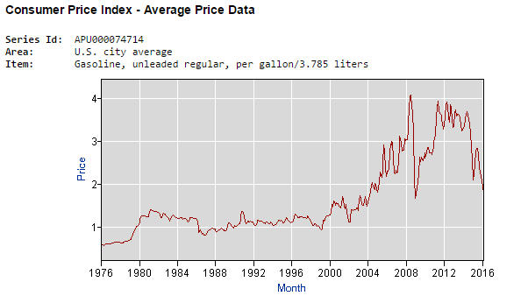
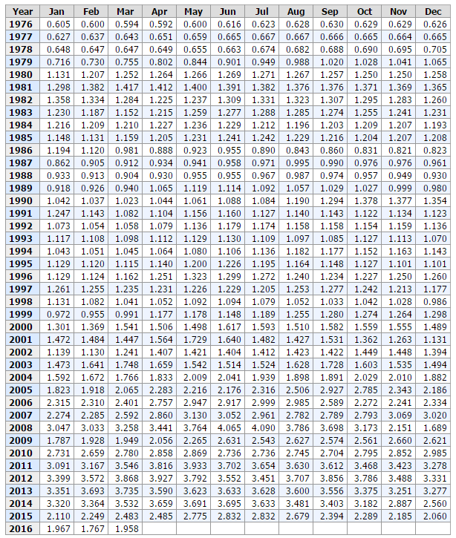
Notes:
After a bit of research, we went with the United States Bureau of Labor Statistics. As you can see on the screen, We’ve got monthly price quotes dating all the way back to 1976. This data was great, so we downloaded a local copy of this pages source code to our machine and wrote a C program to scrape the pertinent data. Parsing this data from our source ended up being the bulk of the work of our project.

Slide 3
Parsing Source File
1. Loop through Source File and parsing out relevant data
2. Create a 2D array from parsed data
3. Manipulate 2D array into XML form
Notes:
After manual inspect of our source file we found that the relevant data was only found on lines 686 – 813. With that in mind, we decided to loop over each of those lines creating a string from each one. We used a series of If/Else statements along with ASCII values to parse through each of the resulting 127 string leaving only relevant data. With just the needed information left, we organized this into a 2D array. This made converting the data into an XML form a very simple process.

Slide 4


Notes:
We wrote an XML document in a form Excel can recognize. In doing this we made it possible to actually work with the data from our source, manipulate it and display it in any way we choose, as opposed to the static views presented on the original page. More specifically, we will be able to determine yearly/monthly trends over time and display it in a variety of more visually appealing formats. Any questions?

