Slide 1
Meeting – ASR follow up
Jonathan de Bruin and Parisa Zahedi

Slide 2
What did we do the last weeks?
Compared available active learning packages
Compared passive learning and active learning
Experimented with classical models and Neural Networks for text classification
Dropped R and moved to Python
Trying to deal with unbalanced labels
Explored different query strategies
Studied the Burr Setlles paper

Slide 3
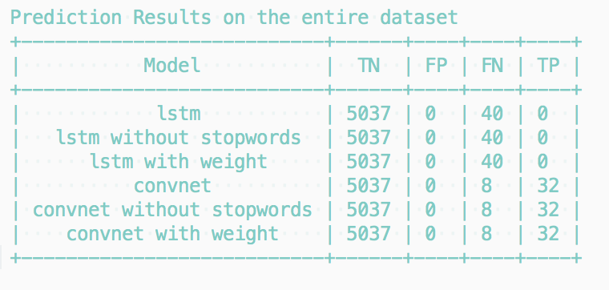
Neural Networks (& TensorBoard)
Notes:
Show tensorboard
Embedding layer (not possible in R)
Stopwords
Overfitting
tensorboard --logdir notebooks/logs/

Slide 4
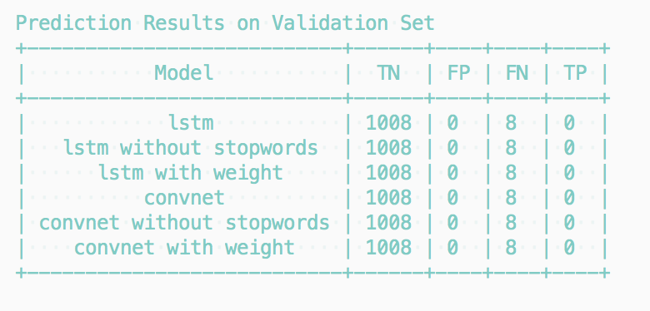
Neural Networks (& TensorBoard)
Notes:
Show tensorboard
Embedding layer (not possible in R)
Stopwords
Overfitting
tensorboard --logdir notebooks/logs/

Slide 5
Classical approach
Word counts, NaiveBayes
precision: 0.9947
recall: 0.9858
Word counts, Tf-idf, SVC
Precision 0.9843
Recall 0.992
 | Pred 0 | Pred 1
True 0 | 4966 | 71
True 1 | 1 | 39
 | Pred 0 | Pred 1
True 0 | 5037 | 0
True 1 | 40 | 0
Notes:
Show tensorboard
Embedding layer (not possible in R)
Stopwords
Overfitting

Slide 6
Active learning packages
google/active-learning (Python)
Outdated, no API. Good ideas in there.
ntucllab/libact (Python)
libact: Pool-based Active Learning in Python (Yang et al. 2017)
Scientific background
ramhiser/activelearning (R)
Not written in Python

Slide 7
Demonstration Active Learning
Digits dataset with binary labels.
Systematic review dataset with classical model.
Notes:
tensorboard --logdir notebooks/logs/

Slide 8
Questions and research directions
Should we divide the data into a train and test set?
No need to generalize the model, isn't it?
Unbalanced labels - How to deal with this?
Stopping criteria – When do we stop?
Notes:
1) treshold above 0
2) Number of FN should not exceed 1%
3) Total number of paper + the number of paper you already saw should not exceed 500
At least 5 iterations meeting stopping criteria

