Slide 1



Relational Collaborative Filtering:
Modeling Multiple Item Relations for Recommendation
Xin Xin, Xiangnan He, Yongfeng Zhang, Yongdong Zhang, Joemon Jose
School of Computing Science, University of Glasgow
School of Data Science, University of Science and Technology of China
Department of Computer Science, Rutgers University
1
2
3
2
1
1
2
3
Presented by Xin Xin@SIGIR19, July 22, 2019
Notes:
Hello everyone, I’m Xin from university of Glasgow. It’s my honor to stand here and give the talk. This research is conducted jointly by UofG, USTC and Rutgers University. The topic is about how to model multiple item relations under the settings of collaborative filtering.

Slide 2
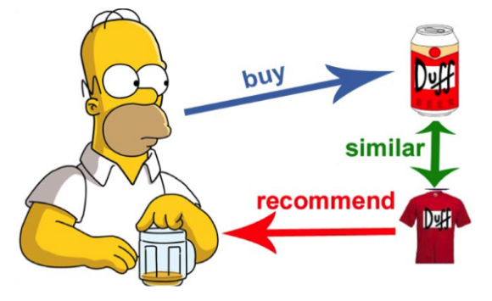
Item-based Collaborative Filtering(ICF)
ICF estimates user preference based on item similarity
The similarity is evidenced by user co-interaction patterns (collaborative similarity)
a special item relation motivated from user perspective
macro-level, coarse-grained and lacks of semantics
There are multiple item relations in real word
reveals knowledge from item perspective
micro-level, fine-grained and semantic meaningful
How can we incorporate multiple item relations for better recommendation?
Notes:
Let’s start with the common case of item-based collaborative filtering. The key idea of ICF is that user preference on the target item can be inferred from the similarity of this item to all items the user has interacted in the past. This kind of similarity is evidenced by the users’ co-interaction pattern, so we can name it as “collaborative similarity”.
This collaborative similarity can be seen as a special relation between items. However, it is macro-level, coarse-grained and lacks of semantic meaning. It’s difficult to reveal the true reasons of user decisions just based on it and therefore it’s hard to provide more effective recommendations.
However, in the real world, there are multiple item relations. For example, two movies may share the same director, two products may complement with each other.
These relations are micro-level, fine-grained and full of concrete meanings.

Slide 3
Incorporating Item Relations
Motivation
There are multiple item relations in the real world
Users tend to pay different attentions to the relations when making choices
Item relations improve the interpretability of recommendation
Contribution
From ICF to RCF (relational collaborative filtering)
We develop a hierarchy attention mechanism to capture user-item preference
Extensive experiments on movie and music recommendation

Slide 4

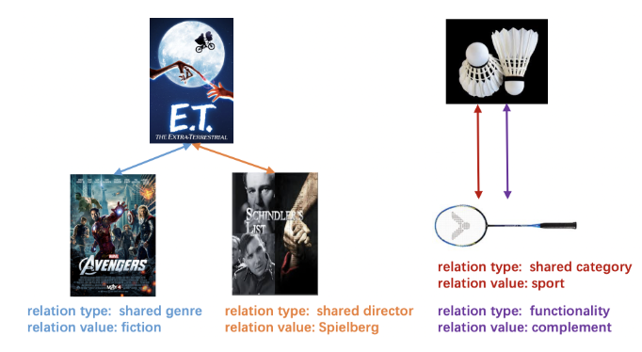

Multiple Item Relations
Relation definition
Relation example
collaborative similarity is a special (latent) item relation:
Notes:
We first introduce the definition of item relations. We define the relations between two items as a set of tuples, which are composed of relation type and relation value. For example, we can see that ET and avenger shared the same genre, which is fiction more precisely. So relation type describes how items are related in an abstract way while relation value gives details to describe it in a fine-grained level. We can also see that there may be multiple item relations between two items like the relations between badminton and racket. Besides, collaborative similarity can be seen as a special latent item relation with r_0=t_0, v_0

Slide 5
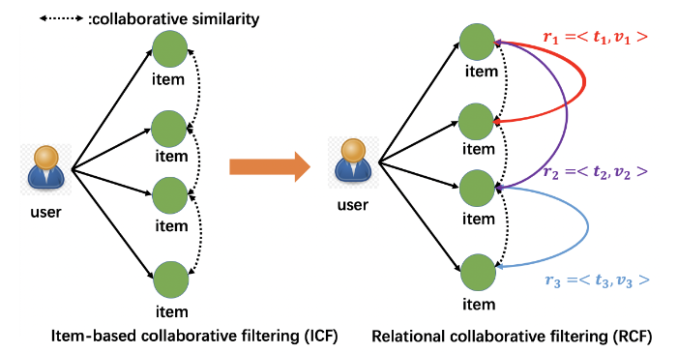
Relational Collaborative Filtering(RCF)
ICF==>RCF
Notes:
Based on such item relations, we propose relational collaborative filtering for better recommendation. As shown in this graph, the links between items of ICF are implicit and single. However, the links of RCF are explicit and multiple. This means that the interaction graph contains not only user-item interactions but also item-item relations.

Slide 6







User-Item Preference Modeling
$$i_{1}$$
Users tend to pay different attentions to different relation types
$$i_{2}$$
$$i_{3}$$
…
$$i_{4}$$
$$i_{n}$$
target item $i$
Notes:
Now let’s see how to model user preference with the relation enhanced data. Suppose the target item is i, and I_U^+ denotes the item set the user u has interacted in the past.
An intuitive motivation is that users tend to pay different attentions to different relation types. For example, some users may prefer movies which share same actors, while some users may prefer movies fall into same genres.

Slide 7









User-Item Preference Modeling
…
$$i_{1}$$
$$i_{1}$$
$$i_{3}$$
$$i_{2}$$
…
$$i_{3}$$
$$i_{2}$$
$$i_{3}$$
…
…
$$i_{4}$$
…
$$i_{4}$$
$$i_{6}$$
$$i_{n}$$
target item $i$
Notes:
The first thing we perform is to divide I_u^+ into different subsets according to the relation types. So users will pay different weights to different I_ui^t.

Slide 8




User-Item Preference Modeling
…
$$i_{1}$$
$$i_{1}$$
$$i_{3}$$
$$i_{2}$$
…
$$i_{3}$$
$$i_{2}$$
$$i_{3}$$
…
…
$$i_{4}$$
…
$$i_{4}$$
$$i_{6}$$
$$i_{n}$$
$(u,i)$preference
representation of
target item $i$
ID embedding
set of relation types
attention weights for type $t$
Notes:
Suppose p_u denotes the userID embedding which represents the user inherent interests, we can formulate the user-item preference as:XXXXXXXX

Slide 9




User-Item Preference Modeling
Model $α\left(u,t\right):$
softmax
first level attention
user ID embedding
relation type embedding
Notes:
Here, we adopt the attention mechanism to calculate alpha(u,t). We first calculate the attention score between user embedding and type embedding, and then use the softmax operation to get the final weights.

Slide 10


User-Item Preference Modeling
Model $α\left(u,t\right):$
Model $s_{u,i}^{t}$:
Considering both item pairs and corresponding relation values
attention operations
Notes:
After that, we need to model s_ui^t for each subset.
We define s_ui^t as the weighted sum of the item embeddings in it. The weight is calculated with the second-level attention.
It’s obvious that the relation value accounts for an important part during this process. For example, a user may pay attention to genres when watching a movie. However, among all the genres, he is most interested in fiction other than romantic. As a result, we should consider both the items and the corresponding relation values when modeling s_ui^t.

Slide 11


User-Item Preference Modeling
Model $α\left(u,t\right):$
Model $s_{u,i}^{t}$:
attention operations
smoothed softmax
second level attention
target item embedding
relation value embedding
historical item embedding
Notes:
Based on such observations, we formulate the second level attention beta with three input, the target item, the historical item and the relation value. Here we use a smoothed version of sofmax. Because the size of different I_ui^t may differ largely.

Slide 12


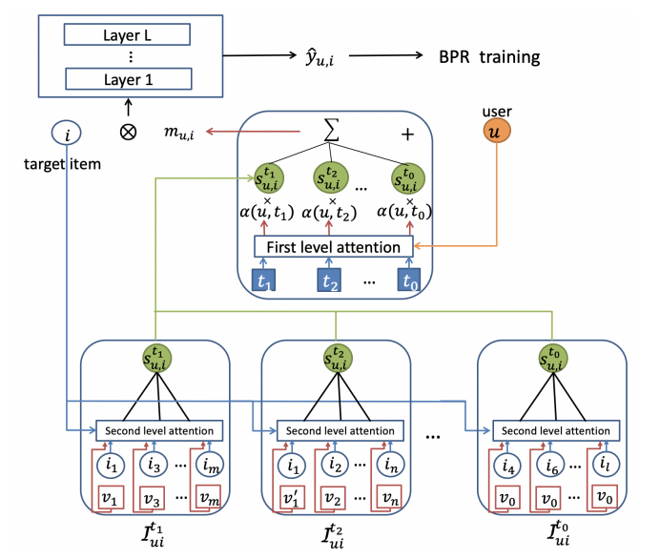
User-Item Preference Modeling
Prediction score:
Pair-wise BPR training:
Notes:
Finally, the predicted score y_ui is defined as XXXXXX. Then we utilize the pair-wise BPR training framework to give the positive items a higher rank. The overall structure of this process can be seen on the figure. In a nutshell, we proposed a two-level hierarchy attention mechanism to model the user-item preference.

Slide 13





Item-Item Relation Modeling
Relations as Knowledge Graph
Relational ranking
For a triplet $(i,r,j)$
Scoring function:
Pair-wise ranking loss:
relation embedding
value embedding
type embedding
$$r=<t,v>$$
Notes:
Besides the recommendation task, we also formulated a task to model the item relations. We want the item embedding has the ability to reflect the relation structure between them. So we use techniques from the well developed knowledge graph embedding field. First, we formulate the relation embedding as the sum of the corresponding type embedding and value embedding. Based on that, for a triplet (i,r,j) which means item i and item j has relation r, we can formulate the scoring function f(I,r,j) and then we can use the similar BPR training framework to let the positive j have a higher rank. This task can be used to perform relation prediction and enhance the learning of embeddings.

Slide 14
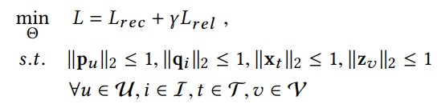
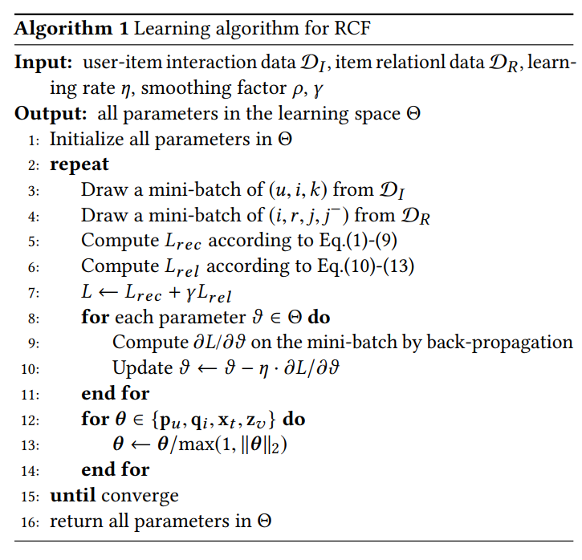
Multi-task learning
Loss function:
Notes:
Finally, we jointly train the recommendation task and relation task using mini-batch gradient descent. We force the embedding to falls into a unit vector scope to avoid the effect of the vector norm.

Slide 15
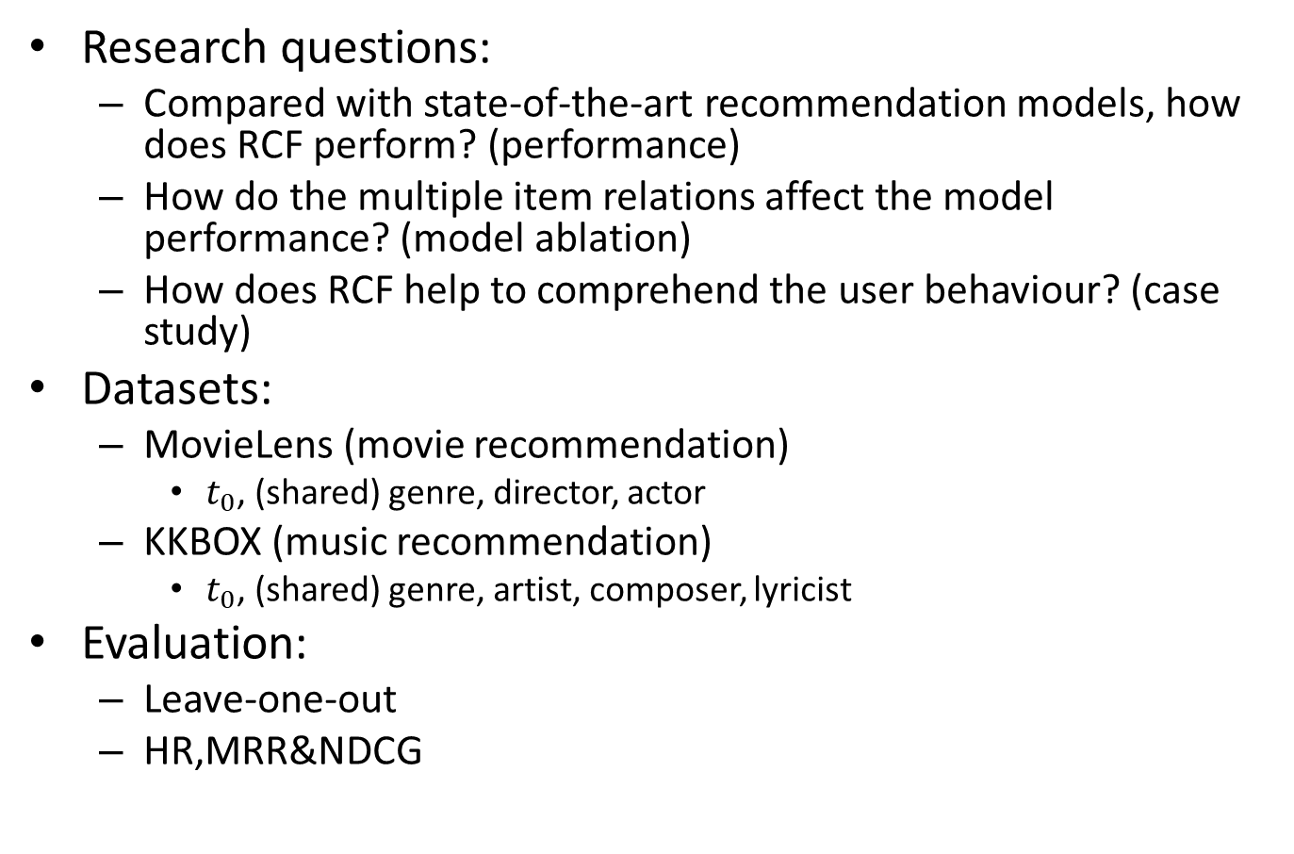
Experiments
Research questions:
Compared with state-of-the-art recommendation models, how does RCF perform? (performance)
How do the multiple item relations affect the model performance? (model ablation)
How does RCF help to comprehend the user behaviour? (case study)
Datasets:
MovieLens (movie recommendation)
$t_{0}$, (shared) genre, director, actor
KKBOX (music recommendation)
$t_{0}$, (shared) genre, artist, composer, lyricist
Evaluation:
Leave-one-out
HR,MRR&NDCG
Notes:
The experiments mainly focus on three aspects, performance, model analysis and case study. We choose two dataset: movielens and KKBOX, corresponding to movie and music recommendation. For evaluation, we adopt the leave-one-out strategy and use HR, MRR and NDCG as evaluation metrics.

Slide 16
Experiments
Baselines:
ICF
MF [Koren et al, 2009]
FISM [Kabbur S et al, KDD13]
NAIS [He et al, TKDE18]
Feature based
FM [Rendle, et al, ICDM2010]
NFM [He et al, SIGIR17]
KG-based
CKE [Zhang et al, KDD16]
MOHR[Kang et al, CIKM18]
Notes:
For comparison, we adopt methods from different perspective. For ICF, we include MF, FISM and NAIS. For feature-based methods, we invovle fm and NFM. Besides, we also include two methods which incorporate knowledge graphs into recommendation.

Slide 17
Results
RQ1 (performance@10)
Movielens
KKBOX
Model | MF | FISM | NAIS | FM | NFM | CKE | MOHR | RCF
HR | 0.1273 | 0.1325 | 0.1367 | 0.1410 | 0.1495 | 0.1404 | 0.1463 | 0.1591
MRR | 0.0430 | 0.0474 | 0.0477 | 0.0496 | 0.0495 | 0.0476 | 0.0485 | 0.0598
NDCG | 0.0642 | 0.0671 | 0.0683 | 0.0707 | 0.0725 | 0.0688 | 0.0733 | 0.0821
Model | MF | FISM | NAIS | FM | NFM | CKE | RCF
HR | 0.6691 | 0.6866 | 0.6932 | 0.6949 | 0.7178 | 0.6930 | 0.7940
MRR | 0.4065 | 0.4103 | 0.4153 | 0.4219 | 0.4432 | 0.4332 | 0.5718
NDCG | 0.4690 | 0.4844 | 0.4966 | 0.4869 | 0.5088 | 0.4952 | 0.6253
RCF achieves the best performance on both datasets, especially in music domain
Incorporating item relations improves recommendation quality
Notes:
We can see that RCF achieves the best performance in both two datasets. This demonstrate that incorporating concrete item relations can help to improve recommendation quality. Besides, we can also see that improvement is bigger in music field. We will demonstrate it more precisely in the case study part.

Slide 18
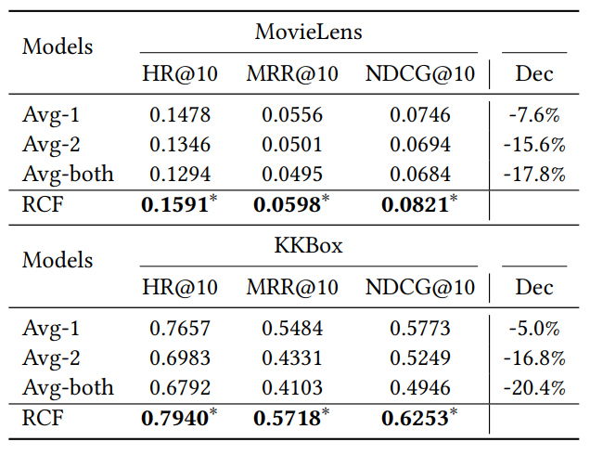
Results
RQ2(model ablation)
Effect of attention
Learnable attention weights give better recommendation
Notes:
RCF models the user preference with two level attention. Here we replace the attention with average pooling and see the results. It’s obvious that the attention mechanism grants the model a better performance.

Slide 19
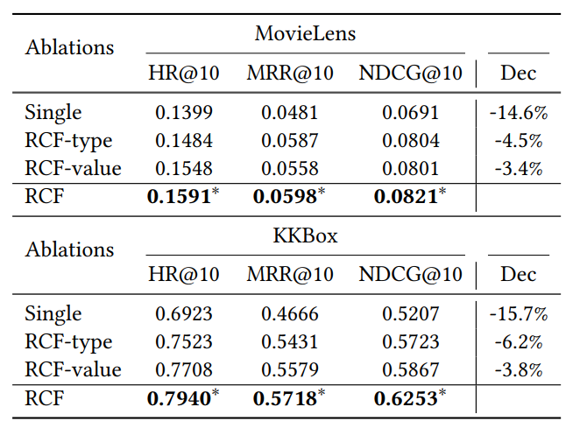
Results
RQ2(model ablation)
Effect of relation
Both relation types and relation values are necessary
Notes:
We also conduct experiments to see the effect of relations. We define the relation as a tuple of relation type and relation value. Here we modify our model to just consider one part of the relations. For example, relation-type means we just consider relation type in our model. It’s obvious that both the relation type and relation value are necessary to better depict item relations. Considering both of them gives us better results.

Slide 20
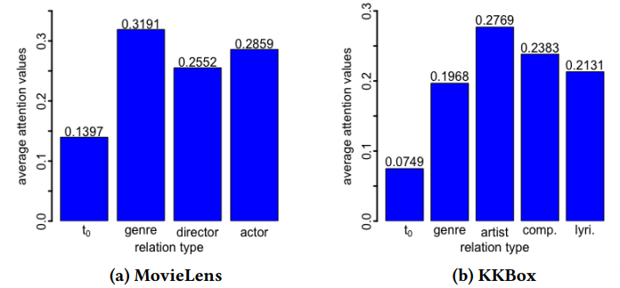
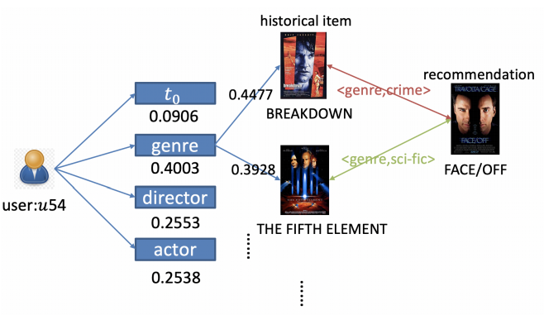
Results
RQ3(case study)
User as a whole
movie→genre
music→artist
Individual case study
Incorporating item relations helps to improve the interpretability of recommendation
Notes:
We calculate the average a(u,t) for all users on the two datasets. We can see that for movies, users tend to pay more attention to genres when making decisions. For music, the artist is the most important factor.
Besides, we can also see that a(u,t_0) in music recommendation is very small. Because t_0 is the relation type corresponding to collaborative similarity, so it means that user behavior when listening to music has more explicit patterns. This helps to explain why RCF achieves bigger improvement in KKBOX dataset.
We also select a random user in Movielens dataset and shows the learned attention weight. As shown in the figure, this user pays more attention in genre when selecting movies. Then among all genres, he is most interested in crime. Because he has watched breakdown, so we recommend face/off to him.
This demonstrate that incorporating item relations helps to improve the interpretability of recommendation

Slide 21
Conclusion & Future Work
Take-home messages:
Incorporating item relations helps to improve both quality & interpretability of recommendation
Both relation types and relation values are important to depict item relations
Users pay different attentions when making decisions
for movie: genre, for music: artist
user behavior in music domain has more explicit patterns
Future work
user-user relations
graph computing (e.g., GCN)

Slide 22
Reference
[Sarwar et al.,2001]. Item-based collaborative filtering recommendation algorithms. In WWW
[Kabbur et al.,2013]. Fism: factored item similarity models for top-n recommender systems. In KDD
[He et al.,2018]. NAIS: Neural attentive item similarity model for recommendation. In TKDE
[Koren et al.,2009] Matrix factorization techniques for recommender systems. In Computer.
[Rendel et al.,2010] Factorization machines. In ICDM
[He et al.,2017] Neural factorization machines for sparse predictive analytics. In SIGIR
[Zhang et al.,2016] Collaborative knowledge base embedding for recommender systems. In KDD
[Kang et al.,2018] Recommendation through mixtures of heterogeneous item relationships. In CIKM

Slide 23
Thank you Q&A

