Slide 1
Zabbix Monitoring
Introduction • Architecture • Concepts • Benefits
Zabbix Introduction | 1

Slide 2
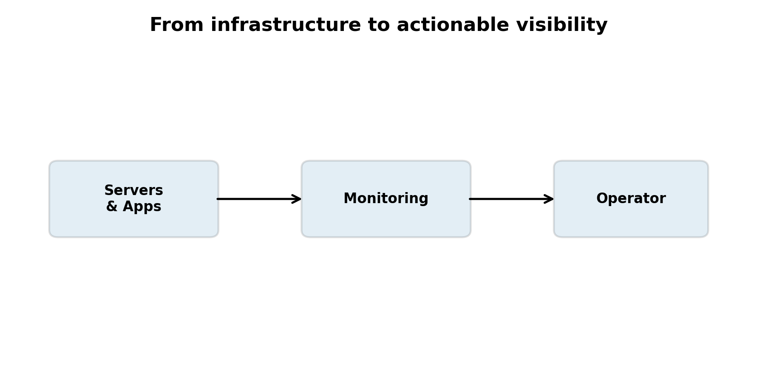
Why Do We Need Monitoring?
Imagine being responsible for hundreds of servers.
What if one server runs out of disk space, CPU becomes abnormal, or a service stops?
Manual checking does not scale.
Monitoring continuously observes systems and helps teams detect problems early.
Zabbix Introduction | 2

Slide 3
Reactive vs. Proactive Operations
Without monitoring: Server fails → customer notices → engineer investigates.
With monitoring: Metric changes → Zabbix detects condition → problem/alert → engineer investigates.
Goal: identify important conditions before they become customer-impacting incidents whenever possible.
Zabbix Introduction | 3

Slide 4
What Is Zabbix?
Open-source monitoring and observability platform.
Monitors infrastructure, networks, applications and services.
Collects CPU, memory, disk, network, availability, response-time and other metrics.
Processes measurements, evaluates conditions, creates events/problems and presents results.
Core idea: Collect → Store → Analyze → Detect → Alert → Visualize.
Zabbix Introduction | 4

Slide 5
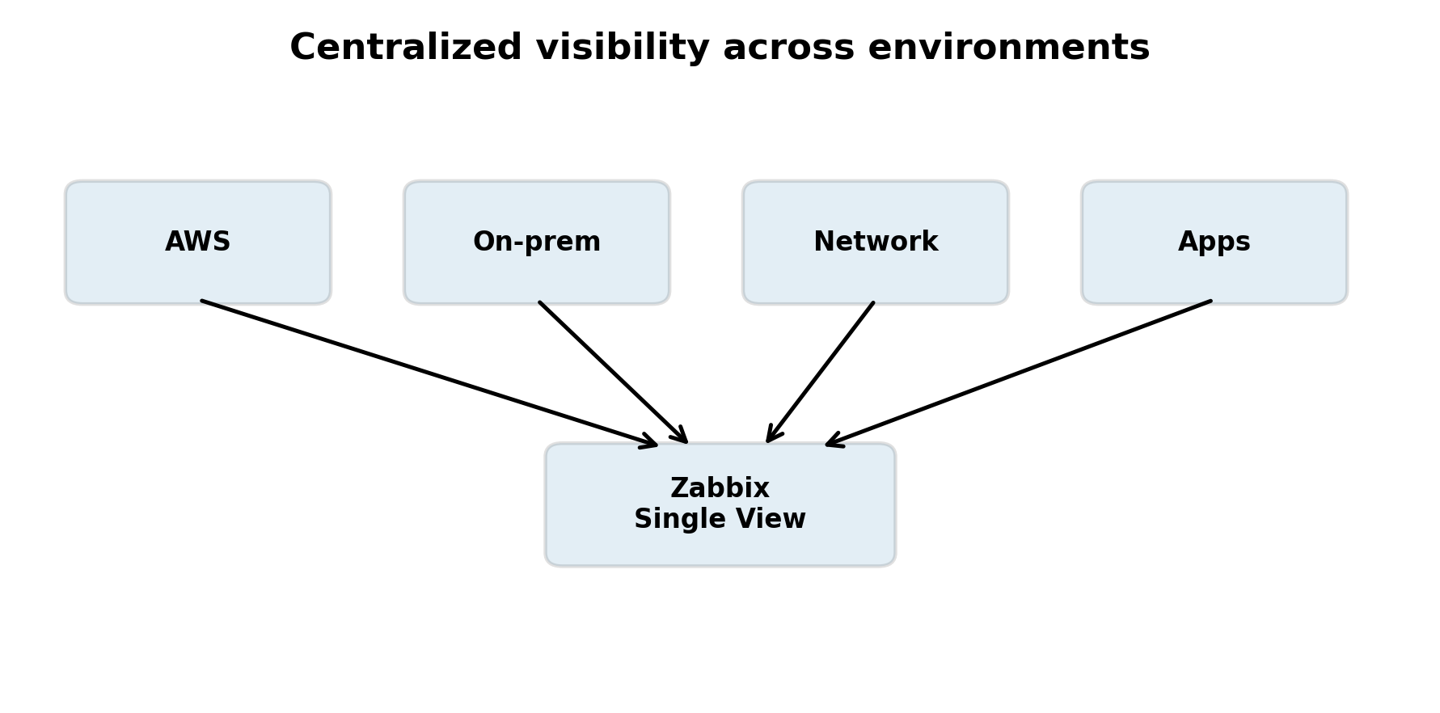
What Can Zabbix Monitor?
Servers and virtual machines
Cloud infrastructure and workloads
Network devices and interfaces
Databases and applications
Web services and endpoints
Containers and other infrastructure components
Operating-system metrics, processes and services
Zabbix Introduction | 5

Slide 6
Zabbix Is More Than a Dashboard
Monitoring — continuously collect measurements.
Problem detection — identify conditions requiring attention.
Event management — track state changes.
Alerting — notify people or systems when configured conditions occur.
Visualization — dashboards, graphs and problem views.
Historical analysis — understand past behavior and trends.
Zabbix Introduction | 6

Slide 7
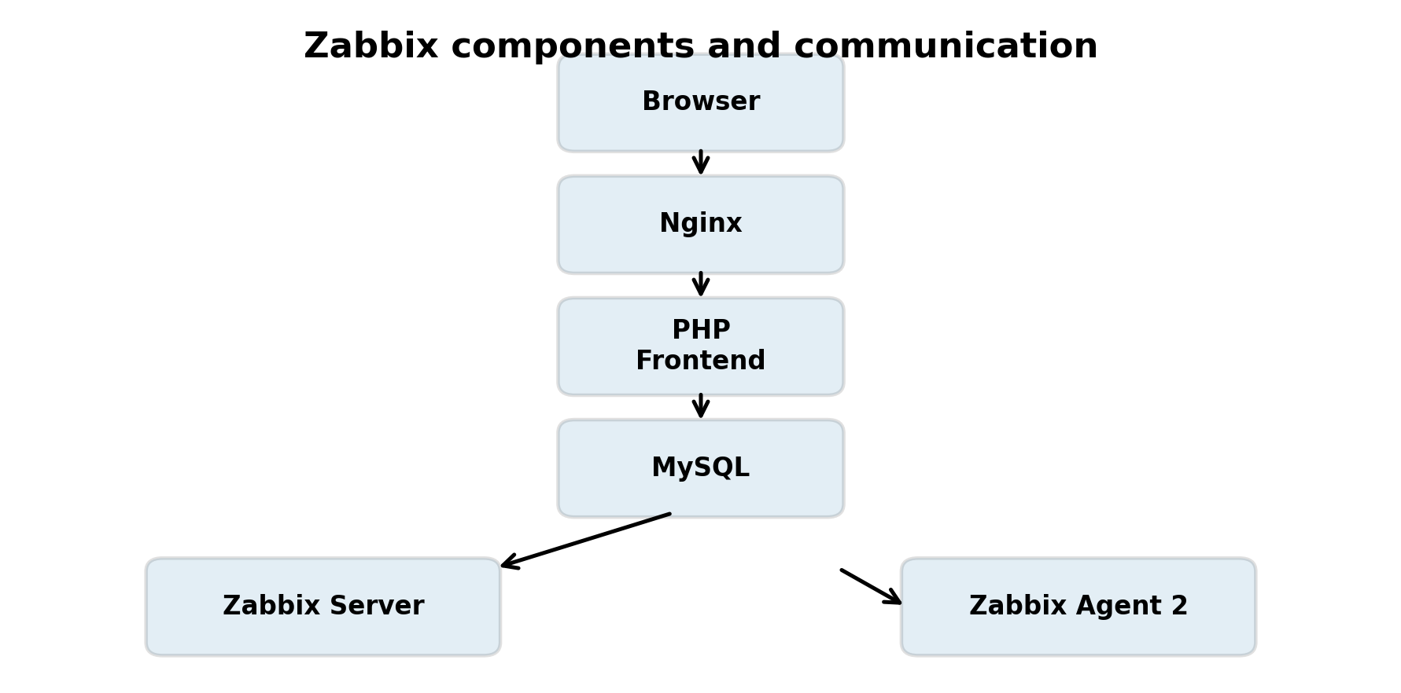
Zabbix Architecture
Browser → Nginx → Zabbix Frontend (PHP)
Frontend ↔ MySQL database
Zabbix Server = central monitoring engine
Zabbix Server ↔ Zabbix Agent 2
Monitoring path: Agent → Server → Database
Web path: Browser → Nginx → PHP/Frontend → Database
Zabbix Introduction | 7

Slide 8
The Five Components to Remember
Zabbix Agent 2 — sensor/collector on the monitored machine.
Zabbix Server — central monitoring engine and decision-maker.
MySQL — persistent backend storing Zabbix configuration and monitoring data.
Zabbix Frontend — web application used to configure and visualize Zabbix.
Nginx + PHP/PHP-FPM — web-serving and runtime components supporting the frontend.
Zabbix Introduction | 8

Slide 9
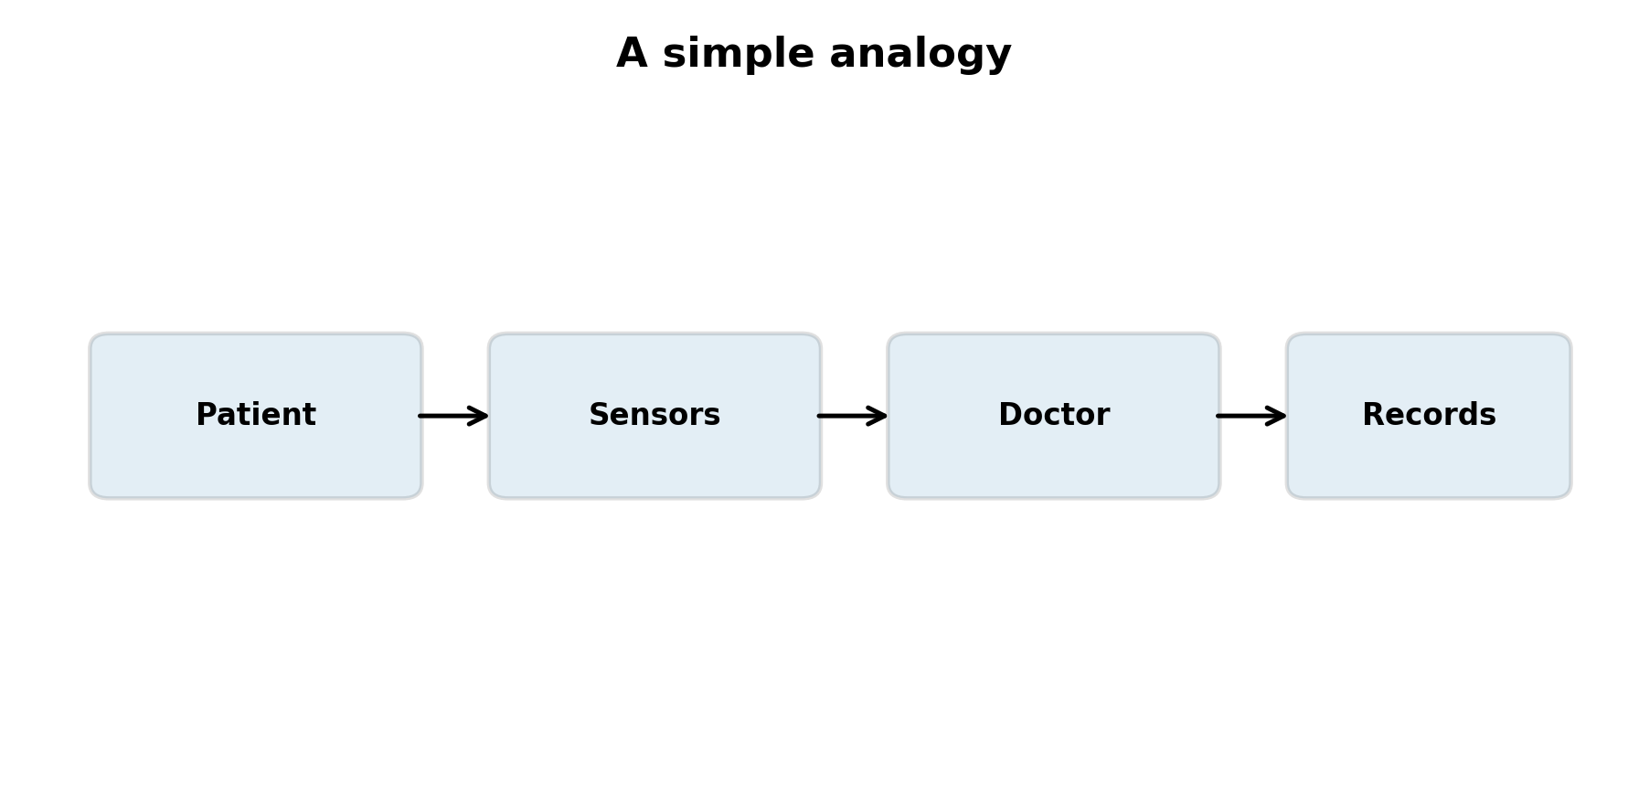
A Simple Hospital Analogy
Patient → server/application being monitored.
Sensors → Zabbix Agent and other data-collection methods.
Doctor / monitoring engine → Zabbix Server.
Medical records → database.
Hospital dashboard → Zabbix Frontend.
Zabbix Introduction | 9

Slide 10
The Monitoring Flow
1. Agent collects a measurement: CPU utilization = 73.4%.
2. Zabbix Server receives and processes the measurement.
3. Relevant data is stored in MySQL.
4. Triggers evaluate configured conditions.
5. A problem/event can be created when a condition becomes true.
6. Frontend displays current and historical information.
Zabbix Introduction | 10

Slide 11
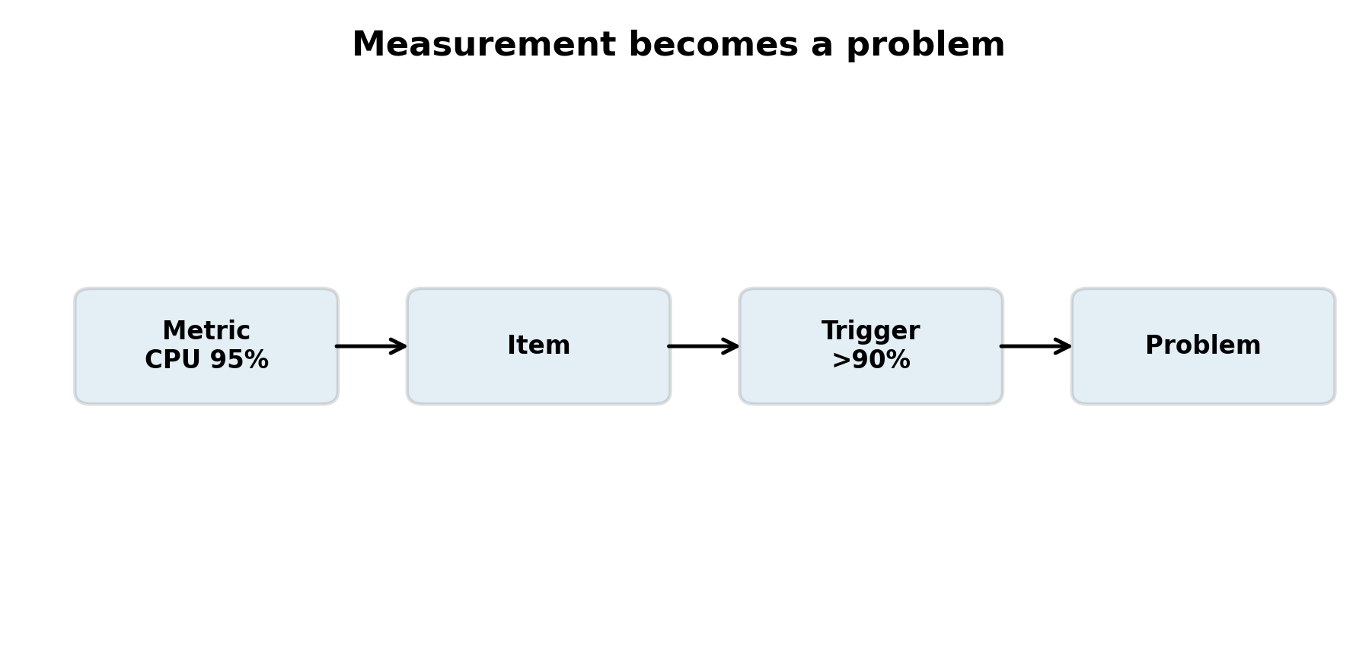
Host, Item and Trigger
Host — the thing being monitored, e.g. an EC2 instance.
Item — what we measure, e.g. CPU utilization, memory or disk usage.
Trigger — the condition that determines when a measurement represents a problem.
  Example Item: CPU utilization
  Example Trigger: CPU > 90% for 5 minutes
Zabbix Introduction | 11

Slide 12
Item → Trigger → Problem → Recovery
Metric: CPU = 95%.
Item collects the value.
Trigger evaluates: CPU > 90% for 5 minutes.
Problem is created when the trigger becomes true.
CPU returns below the recovery condition.
Problem recovers and Zabbix records the state change.
Zabbix Introduction | 12

Slide 13
Why Templates Matter
Templates package reusable monitoring configuration.
They can contain items, triggers, discovery rules, graphs and related configuration.
Example: Linux by Zabbix agent.
Apply a suitable template instead of configuring every Linux server individually.
Templates make monitoring consistent and scalable.
Zabbix Introduction | 13

Slide 14
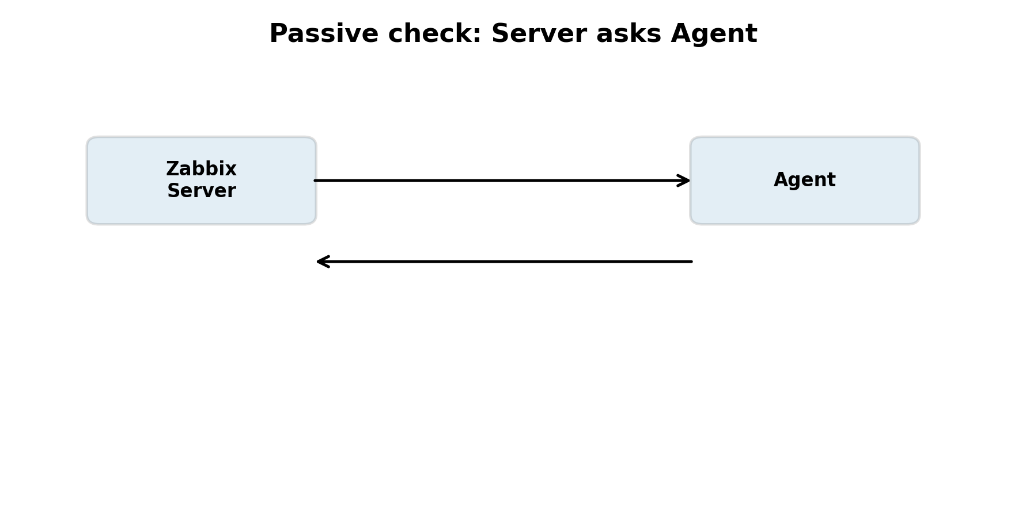
Passive vs. Active Checks
Passive: the Zabbix Server asks the Agent for a value.
  Server → Agent: 'Give me CPU utilization.'
  Agent → Server: 'CPU = 72%.'
Active: the Agent contacts the Server to obtain monitoring instructions and sends collected results.
Our initial AWS lab uses passive checks.
Zabbix Introduction | 14

Slide 15
Where Nginx, PHP and MySQL Fit
Nginx: receives HTTP requests and serves the web frontend.
PHP/PHP-FPM: executes the Zabbix frontend application logic.
MySQL: stores persistent Zabbix data.
These are part of the web/application side.
They are not in the TCP path used for a passive Agent check.
Zabbix Introduction | 15

Slide 16
Two Important Data Flows
Monitoring flow: Zabbix Agent → Zabbix Server → MySQL.
Web UI flow: Browser → Nginx → PHP/Zabbix Frontend → MySQL.
Key distinction: the Agent communicates with the Zabbix Server, not directly with MySQL or Nginx.
Zabbix Introduction | 16

Slide 17
Why Zabbix Is Useful in Cloud Environments
Cloud environments can contain many dynamic resources.
Organizations may operate AWS, on-premises systems, VMs, network devices and applications.
Centralized monitoring can provide a common operational view.
Zabbix can complement native cloud monitoring.
Useful for availability, performance, troubleshooting and capacity analysis.
Zabbix Introduction | 17

Slide 18
Key Benefits
Open-source monitoring platform
Centralized visibility across monitored systems
Broad monitoring capabilities
Problem detection and alerting
Historical data and trend analysis
Dashboards and visualization
Reusable templates
Integration and automation capabilities
Zabbix Introduction | 18

Slide 19
What Zabbix Does Not Do Automatically
Monitoring does not automatically fix every problem.
Example: Disk usage reaches 95%.
Zabbix can detect the condition and create a problem/alert.
Automated remediation requires additional configuration and an appropriate workflow.
Monitoring tells you what is happening; automation determines what action should happen next.
Zabbix Introduction | 19

Slide 20
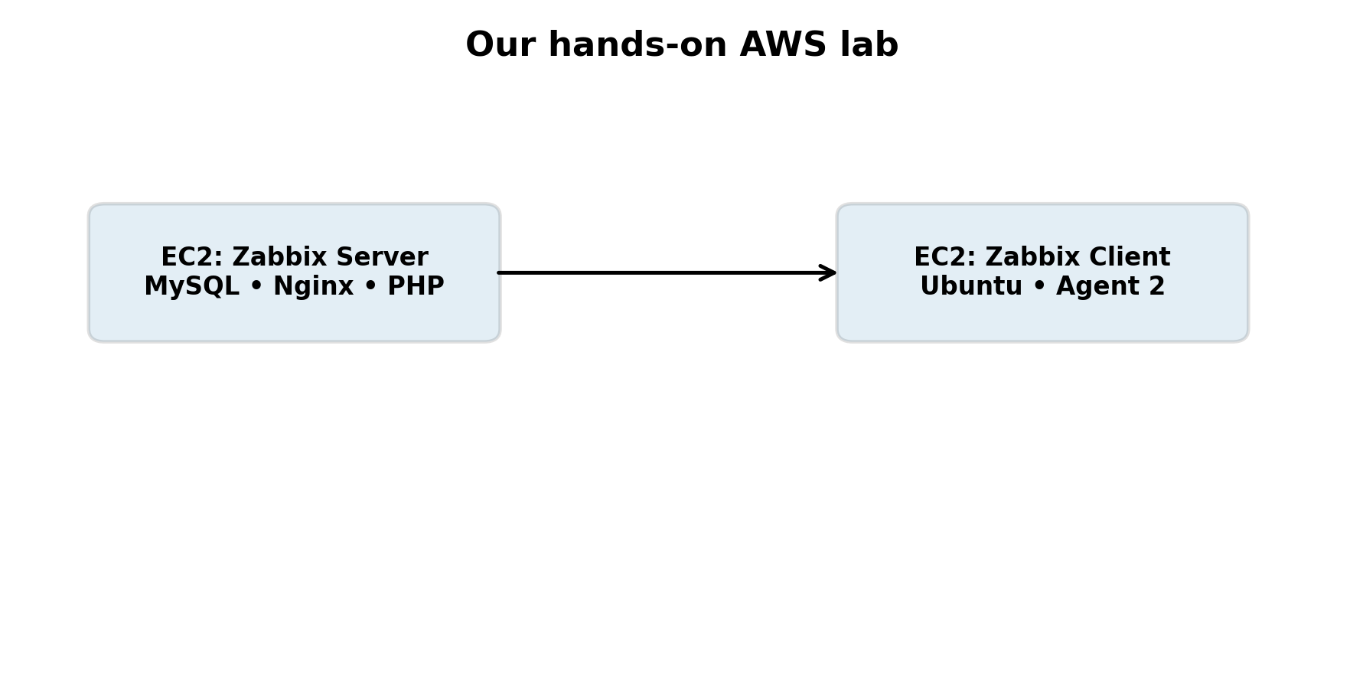
Our AWS Hands-On Lab
Zabbix Server EC2: monitoring engine, MySQL, Nginx and PHP frontend.
Zabbix Client EC2: Ubuntu with Zabbix Agent 2.
Private network communication between Server and Agent.
Configure a Linux monitoring template.
Observe CPU, memory and other metrics.
Deliberately create high CPU → observe Problem → stop load → observe Recovery.
Zabbix Introduction | 20

Slide 21
The End-to-End Lab Journey
1. Create AWS EC2 instances.
2. Install Zabbix Server and supporting components.
3. Create and initialize the MySQL database.
4. Configure Nginx and the Zabbix frontend.
5. Install and configure Zabbix Agent 2.
6. Add the client host and apply a template.
7. Validate agent.ping and monitoring availability.
8. Create CPU load → observe Problem → stop load → observe Recovery.
Zabbix Introduction | 21

Slide 22
A Simple Mental Model
Agent = Sensor
Zabbix Server = Brain
MySQL = Memory
Frontend = Control panel
Nginx = Web server / front door
PHP = Application runtime
Item = Measurement
Trigger = Rule
Problem = Condition requiring attention
Template = Reusable monitoring package
Zabbix Introduction | 22

Slide 23
Class Opening — 60-Second Script
Imagine you are responsible for hundreds of servers, applications, databases and network devices.
You cannot continuously log in to every machine and check them manually.
Zabbix continuously collects data, evaluates conditions, detects problems and presents the results through a centralized interface.
Today we will build this environment on AWS and follow one problem from measurement → trigger → problem → recovery.
Zabbix Introduction | 23

Slide 24
Key Takeaways
Zabbix is a monitoring and observability platform.
Agent collects; Server processes; Database persists; Frontend visualizes.
Items define what to measure; triggers define when a condition is a problem.
Templates make monitoring reusable and scalable.
Now we move from concepts to a complete AWS implementation.
Zabbix Introduction | 24

