Slide 1
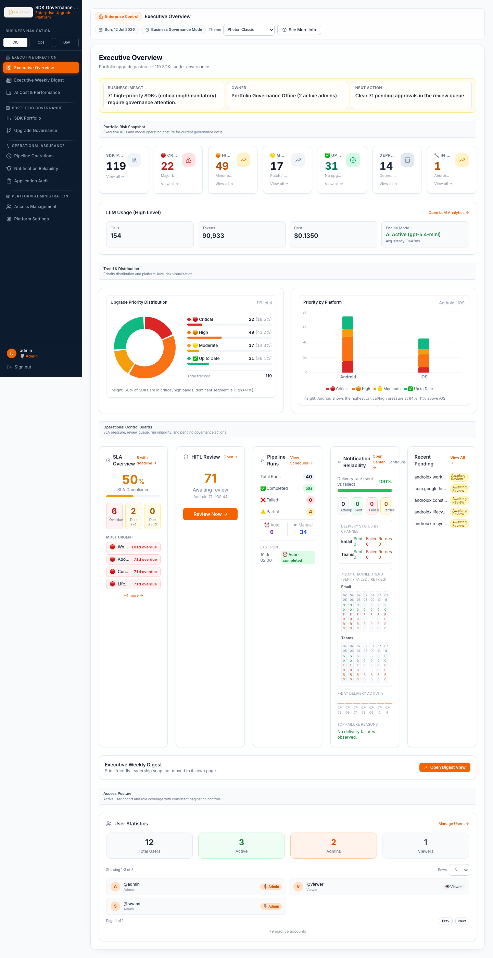
Library Management Application
Client Feature Overview, Advantages, and Operating Workflow
A governance platform for tracking Android and iOS libraries, detecting version changes, generating AI-assisted upgrade guidance, and coordinating approvals and notifications.
Platforms
Architecture
UX
Android + iOS
FastAPI Microservices
React Dashboard
Library Management Application
1

Slide 2
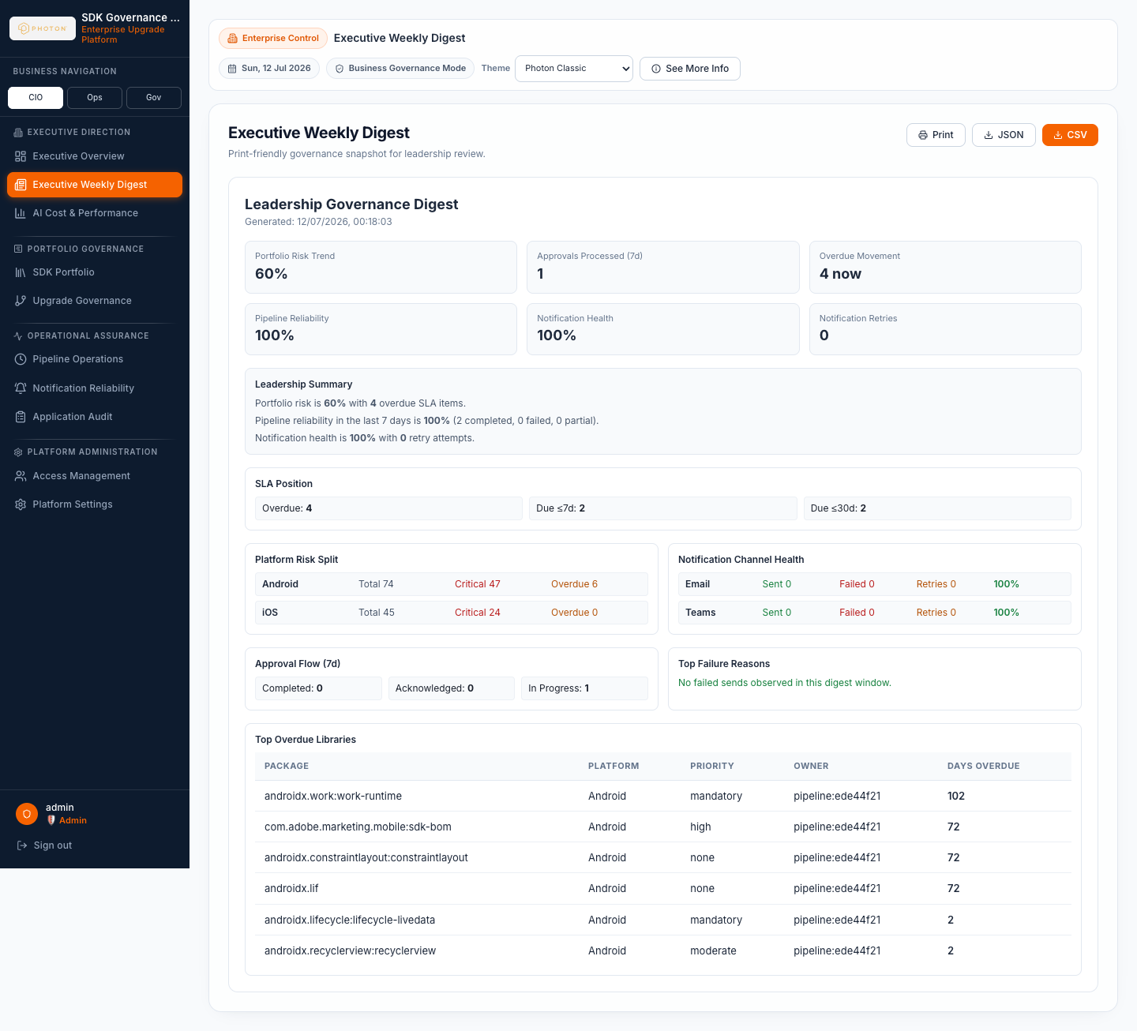
Executive Summary
What the application does for business and technology teams
Central source of truth
Automated intelligence
Controlled execution
Maintains one governed inventory of mobile SDKs, current versions, latest versions, ownership, status, and notes.
Fetches version metadata, compares current vs latest, classifies urgency, and produces upgrade guidance.
Uses HITL review, audit records, scheduler visibility, and notifications so teams can act with evidence.
Client outcome
Reduce manual effort spent checking SDK release pages and comparing versions.
Make upgrade decisions consistent across teams with rule-based and AI-assisted rationale.
Expose operational risk, overdue work, approval status, and LLM cost in a leadership-ready dashboard.
Preserve traceability for audit, compliance, and governance reviews.
Library Management Application
2

Slide 3
Business Challenges Addressed
Why this application matters to a client organization
Fragmented inventory
Slow upgrade discovery
SDK/version data often lives across spreadsheets, repositories, release notes, and team knowledge.
Teams manually check vendor pages and app dependency files, which delays awareness of important releases.
Inconsistent priority decisions
Limited governance evidence
Security, payment, crash, patch, and major-version signals may be interpreted differently by each team.
Without approval history and audit logs, it is hard to show who decided what and why.
Poor operational visibility
Leadership needs a concise view of risk, overdue upgrades, pipeline health, and cost of AI usage.
Library Management Application
3

Slide 4
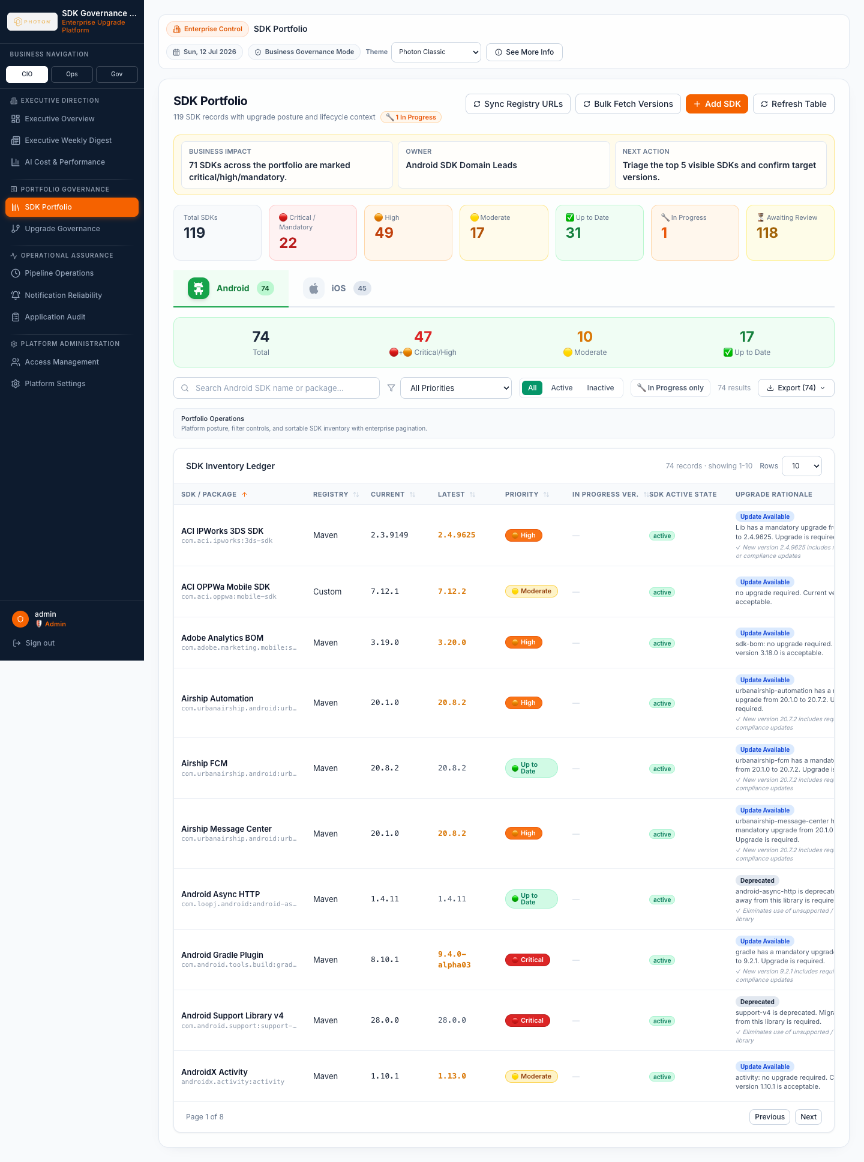
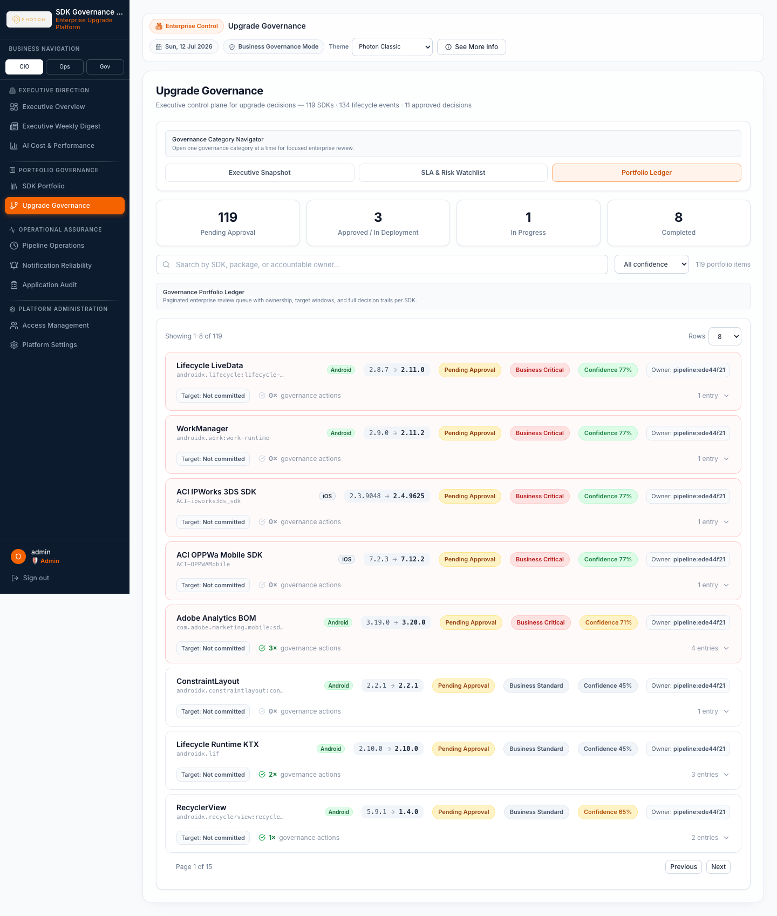
Feature Map
The product modules available to client users
Executive Overview
SDK Portfolio
Upgrade Governance
Portfolio health, risk signals, LLM usage, and operational summary.
Library inventory, version history, lifecycle state, ownership, and exports.
HITL review, approval/rejection, decision evidence, and lifecycle tracking.
Pipeline Operations
Notifications
Audit, Analytics, Settings
Scheduler controls, current run, stage SLAs, retry visibility, and history.
Email and Teams delivery status, retry signals, and communication assurance.
Audit trail, AI cost/performance, prompt governance, and access controls.
Library Management Application
4

Slide 5
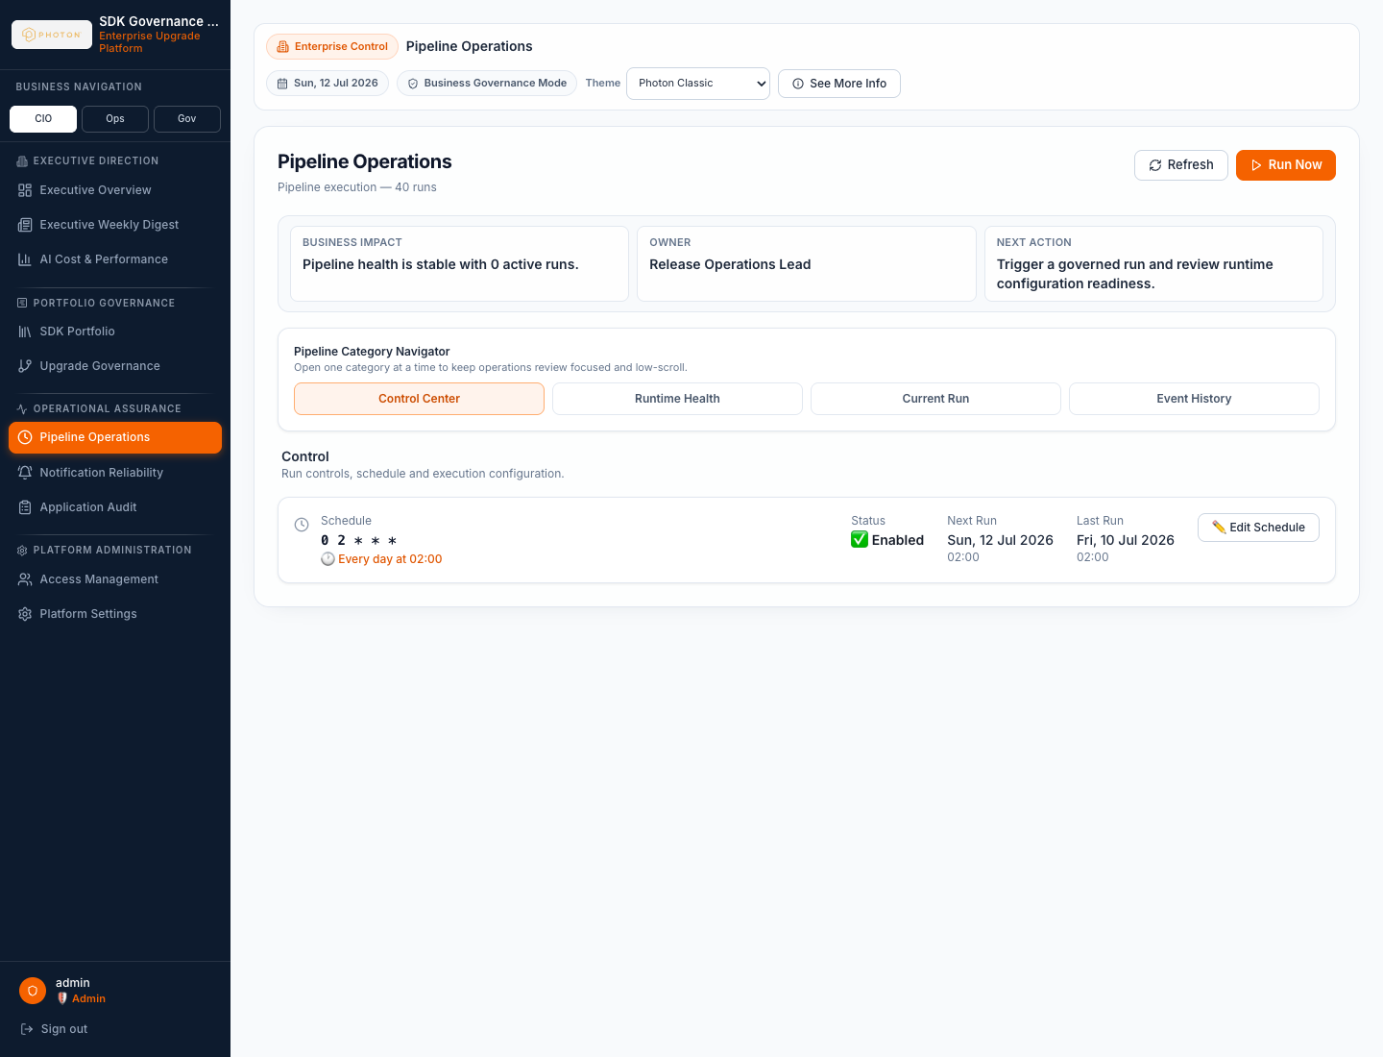
How It Works
End-to-end pipeline from inventory to stakeholder action
Inventory
Scrape
Compare
Classify
Recommend
Notify
SDK list and current versions
Fetch latest versions and history
Detect version gaps
Priority and business impact
AI guidance or rule fallback
Email / Teams / dashboard
The scheduler executes the canonical steps in order: fetch libraries, scrape metadata, fetch version history, compare, recommend, notify.
Each run persists status, duration, items processed, timestamps, and failure details.
The UI exposes live progress, stage-level SLA indicators, run history, and root-cause summaries.
Recommendations are stored in the database so the client sees a stable, auditable read path.
Library Management Application
5

Slide 6
Executive Overview Dashboard
Leadership can see portfolio risk and operating health in one place
Portfolio health and upgrade posture for Android and iOS libraries.
Risk score, critical/high items, overdue work, and scheduler status.
LLM usage summary: calls, tokens, estimated cost, mode, and latency.
Designed for management review without needing to inspect individual service logs.
Advantage
Turns a technical dependency problem into an executive-ready risk and governance view.
Library Management Application
6

Slide 7
SDK Portfolio Management
A governed inventory for libraries, versions, ownership, and exportable records
List, add, edit, deactivate/reactivate, and delete libraries.
View business details, technical package metadata, notes, ownership, and lifecycle status.
Version History supports selecting an intermediate version and setting it as the current active version.
Export-ready table views support reviews, reporting, and follow-up planning.
Advantage
Removes spreadsheet drift and gives application teams one shared source of truth.
Library Management Application
7

Slide 8
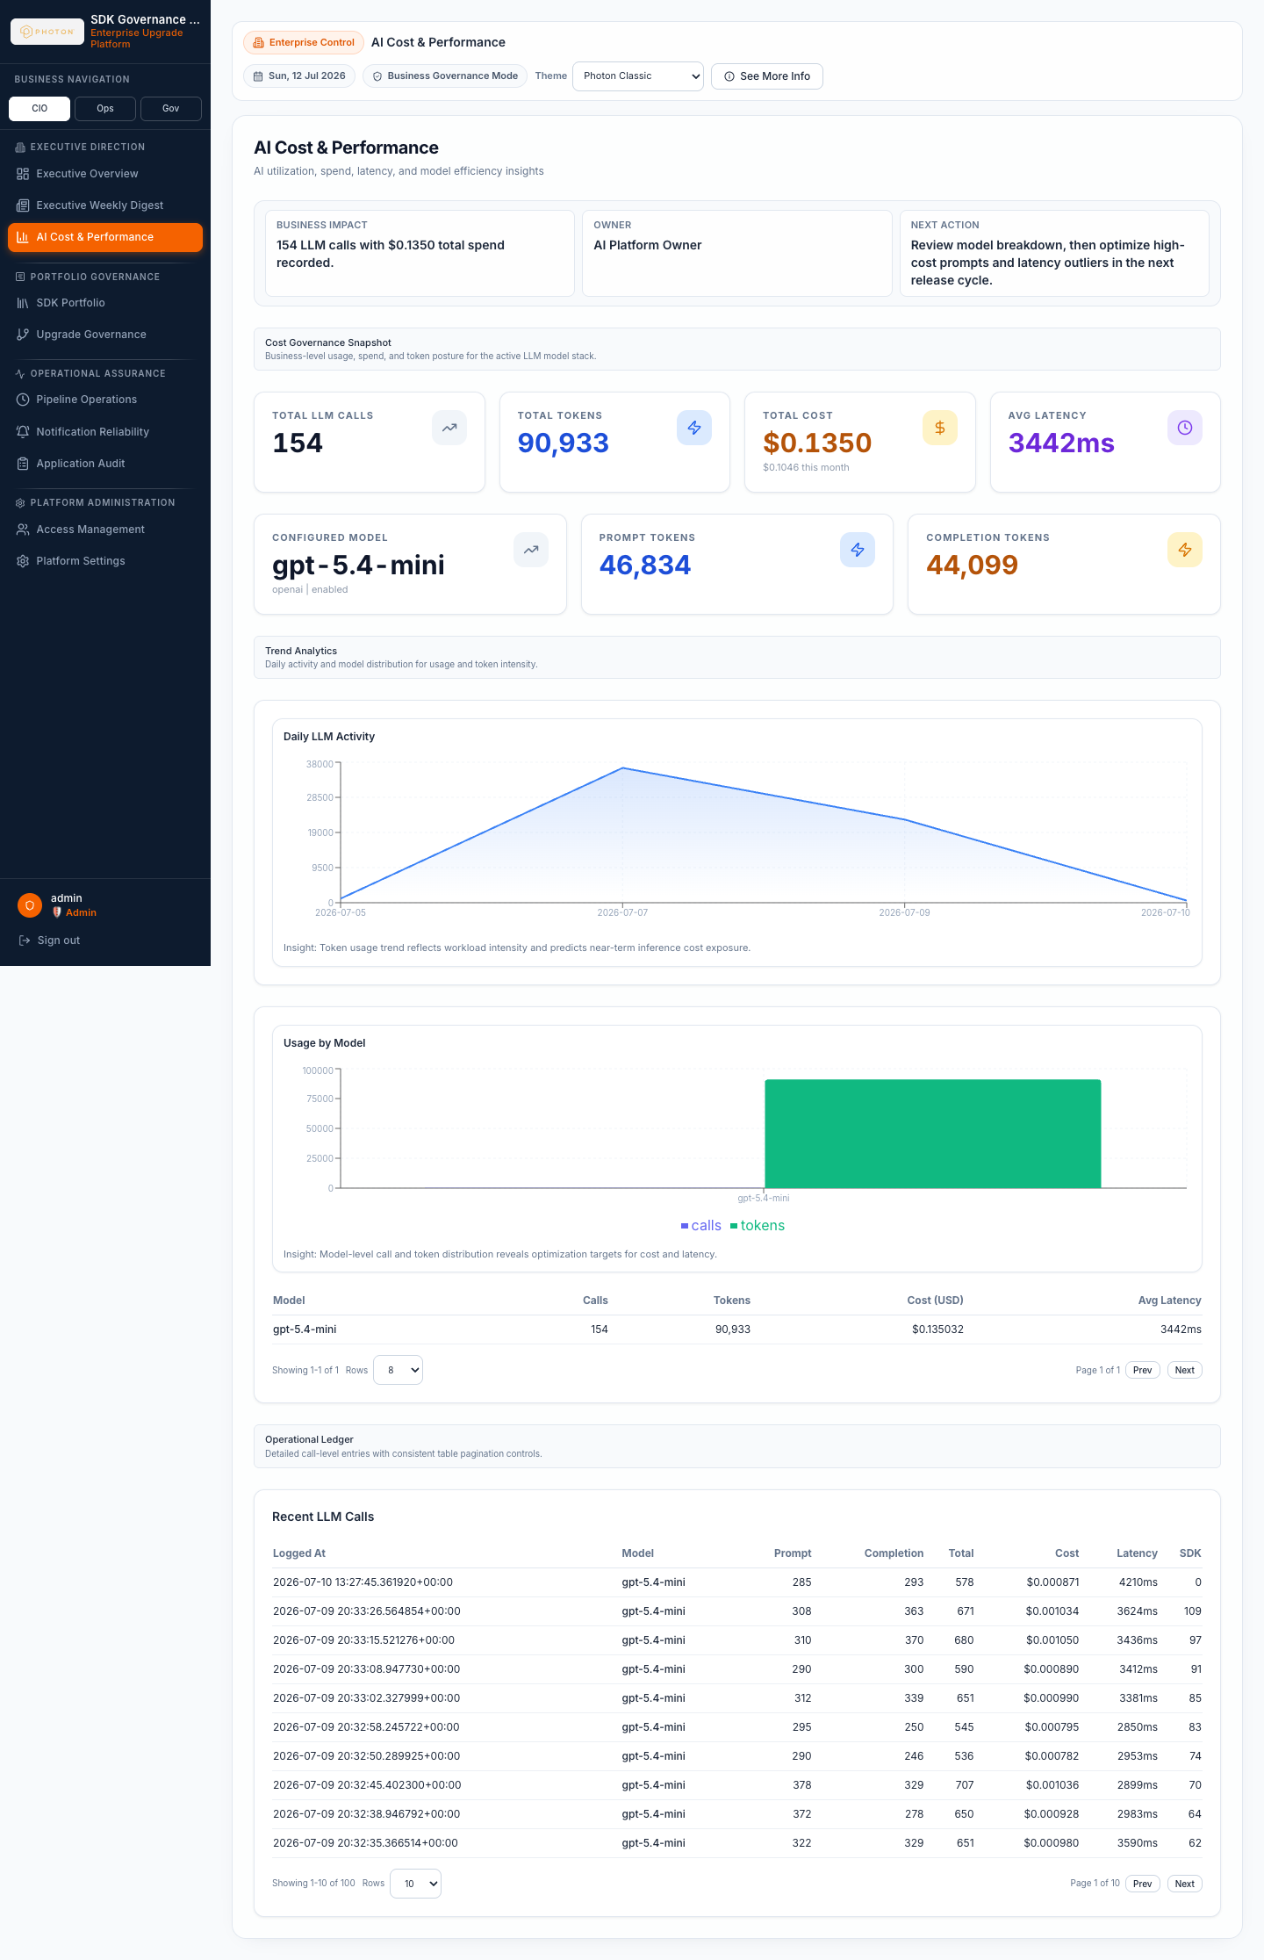
Recommendation Intelligence
Consistent upgrade guidance with AI support and rule-based safety
Priority logic
The LLM path generates structured JSON recommendations with business-friendly rationale.
If the LLM is unavailable or returns invalid output, the application falls back to deterministic rules.
Prompt templates and provider settings are controlled from the backend settings UI.
Usage logging captures tokens, cost, latency, model, and runtime mode.
Critical
Major version bump, CVE, deprecated library, breaking change.
High
Minor version bump, security/payment/compliance signal, sensitive SDK floor.
Moderate
Patch bump, bug fix, performance, stability, recommended update.
Low / None
Cosmetic, documentation, optional update, or already up to date.
Advantage
Clients get faster upgrade analysis while retaining explainability, cost control, and fallback behavior.
Library Management Application
8

Slide 9
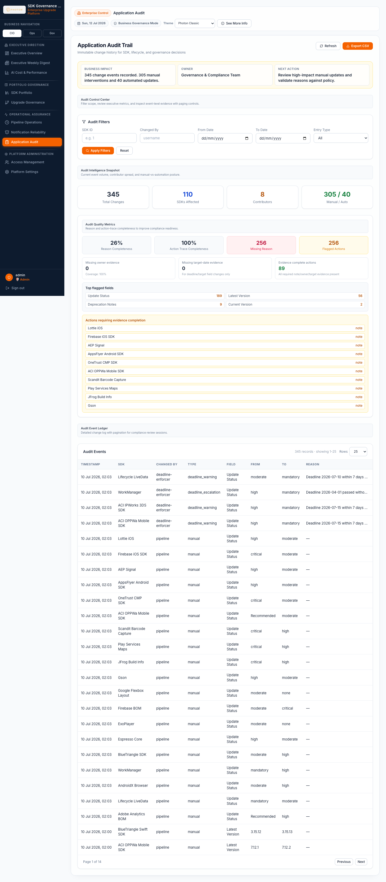
Human-in-the-Loop Governance
Approval workflow for important upgrades
1
2
3
4
Recommendation Created
Review Required
Approve / Reject
Implement & Track
Upgrade decision is classified and persisted.
Actionable items enter HITL review.
Reviewer records decision and evidence.
Lifecycle state, audit record, and notifications are updated.
Library Management Application
9

Slide 10
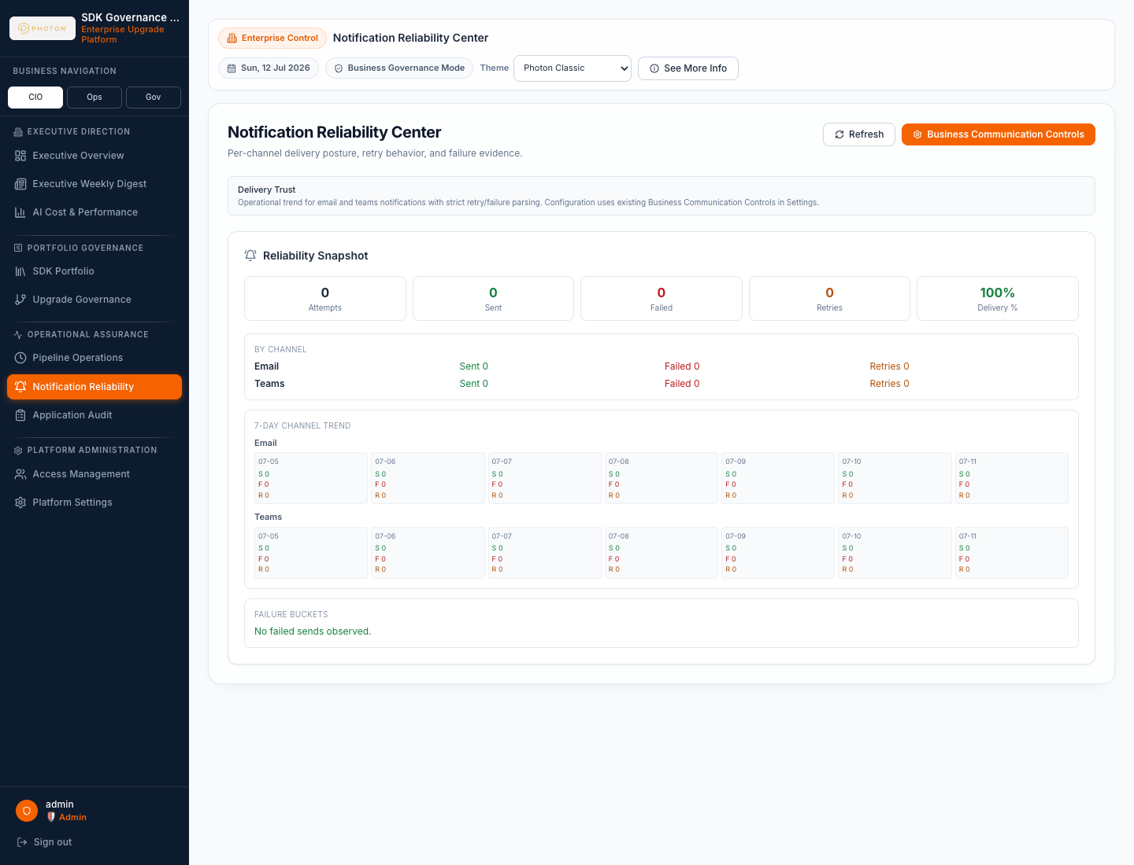
Operations and Notifications
Run control, delivery reliability, and scheduled communication
Manual and scheduled runs with run history and stage status.
Stage-level SLA visibility and root-cause summary for failed or partial runs.
Email and Teams channels with notification logs and reliability indicators.
Weekly digest view for leadership-ready status communication.
Library Management Application
10

Slide 11
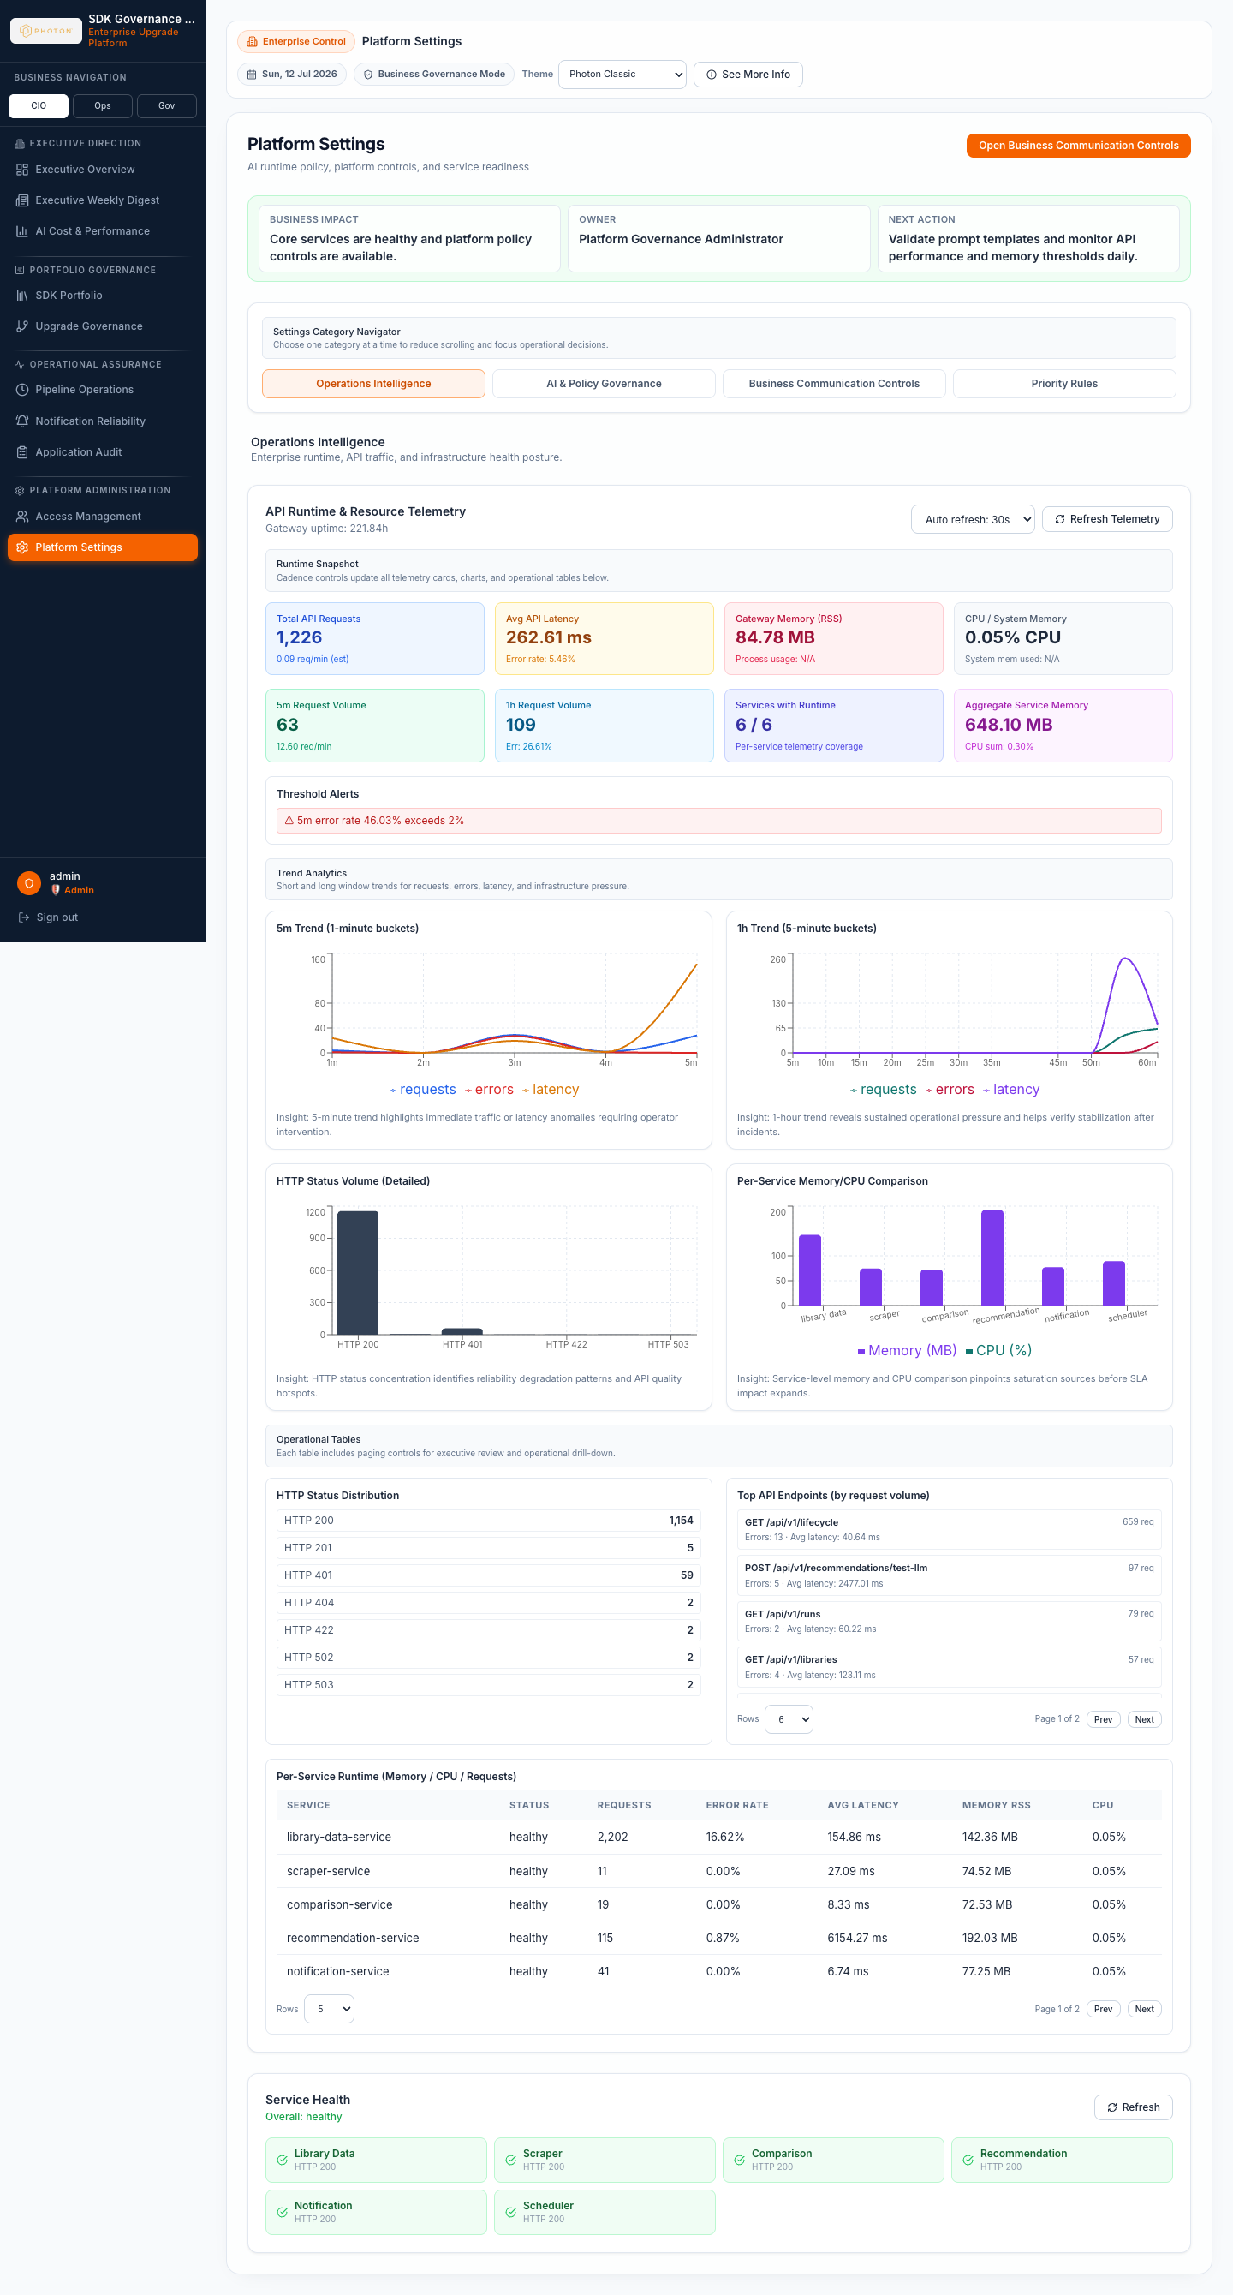
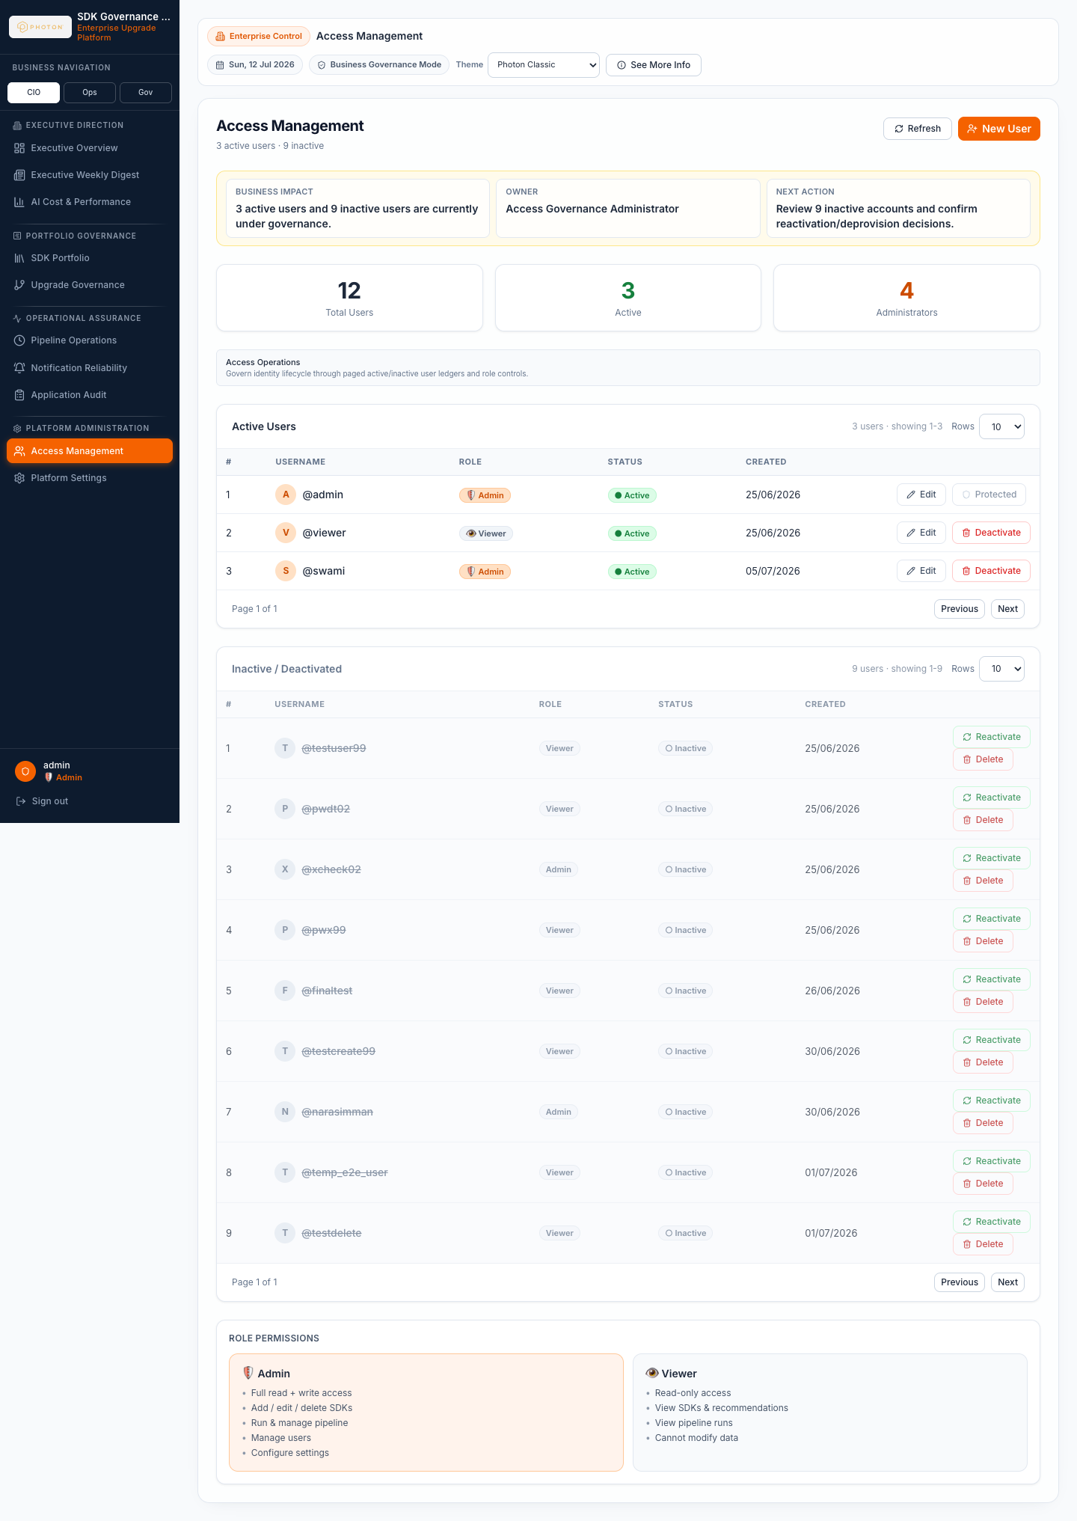
Administration, Security, and Cost Control
Settings and controls that make the platform manageable
Admin settings for LLM provider, model, keys, prompt templates, and application controls.
Role-aware access for admin and viewer/reviewer users.
LLM analytics for calls, tokens, estimated spend, latency, and recent usage.
Audit trail for configuration, governance, and administrative activity.
Library Management Application
11

Slide 12
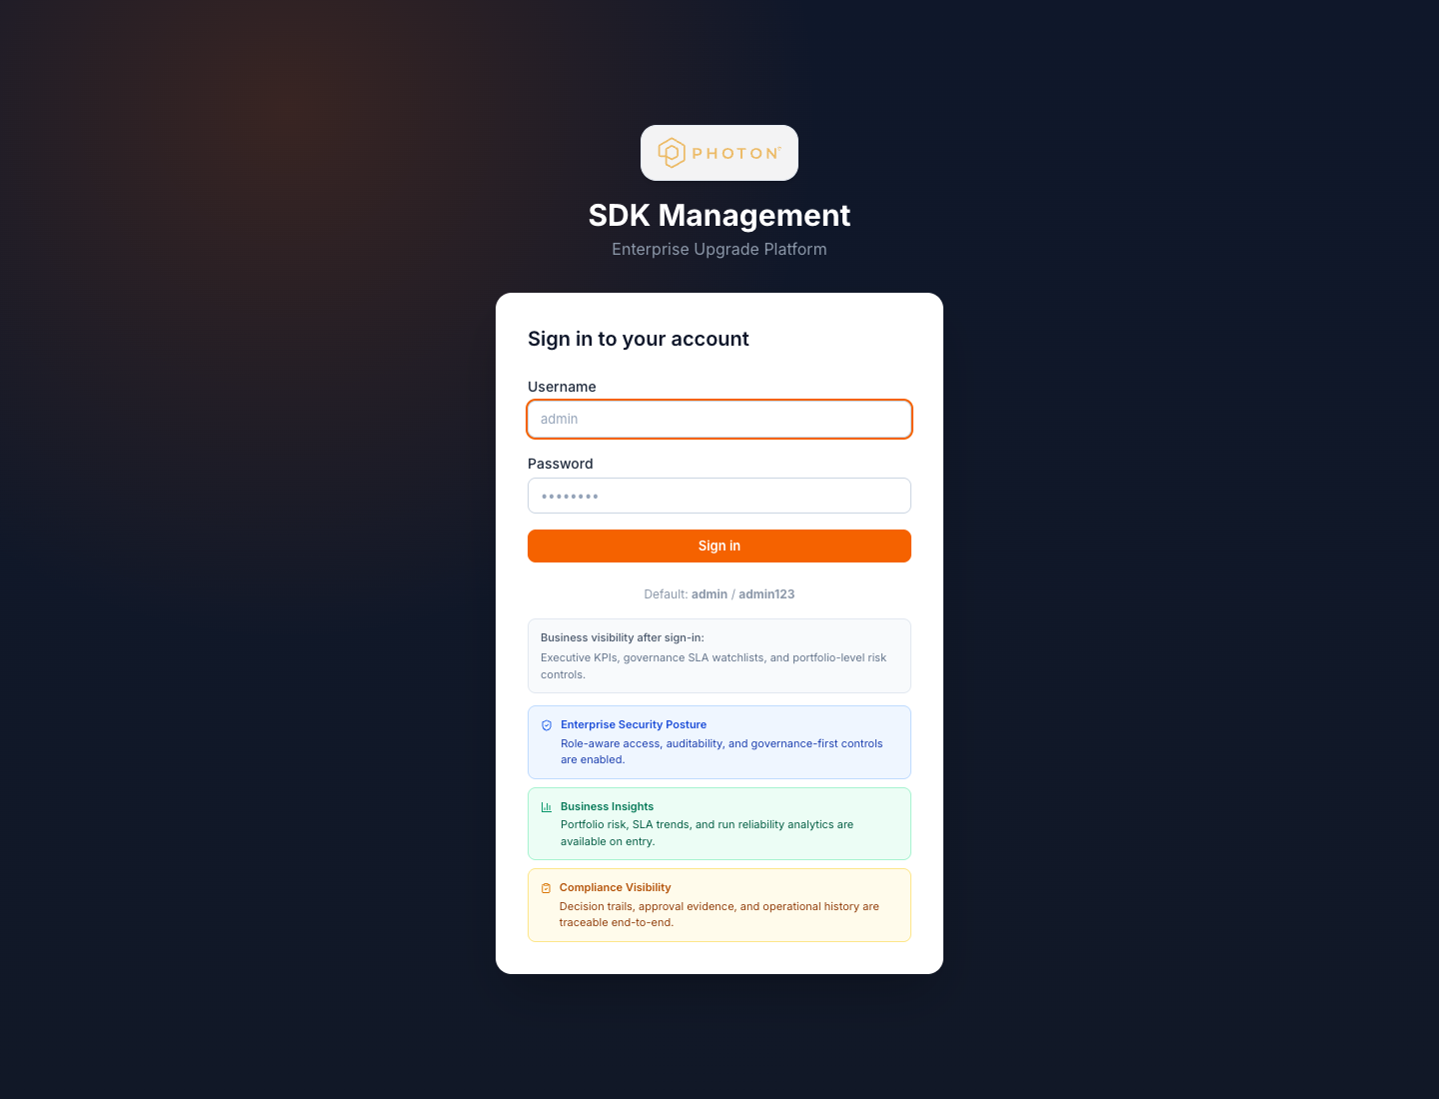
Technical Architecture
Microservices designed around clear operating boundaries
API Gateway
Library Data
Scraper
Comparison
Auth and routing
Inventory, settings, recommendations
Version metadata
Version gap detection
Recommendation
Notification
Scheduler
React UI
LLM + rule fallback
Email and Teams
Pipeline orchestration
Client-facing experience
Operational baseline
FastAPI services with SQLite-backed persistence for the current release baseline.
Scheduler stores run state, step metadata, timestamps, processed counts, and failure details.
Recommendation read path uses persisted records to avoid stale runtime cache behavior.
Service lifecycle remains operable through the project management script.
Library Management Application
12

Slide 13
Client Advantages
Business value delivered by the application
Faster discovery
Better prioritization
Governed decisions
Automated registry checks reduce manual research and keep teams aware of new releases.
Critical, high, moderate, and low classifications help teams focus on the right upgrades first.
HITL approvals, audit trails, and lifecycle states preserve decision evidence.
Lower operational risk
AI with control
Leadership visibility
SLA visibility, overdue tracking, and notifications reduce silent dependency drift.
LLM recommendations are monitored for cost, latency, mode, and fallback behavior.
Executive dashboard and weekly digest translate technical debt into business posture.
Suggested client message: "This platform gives engineering and leadership one reliable operating model for mobile SDK governance."
Library Management Application
13

Slide 14
Recommended Demo Flow
1. Start with Executive Overview to frame the business value.
2. Open SDK Portfolio to show the inventory and version history.
3. Walk through Recommendation Intelligence and priority classification.
4. Demonstrate HITL Governance, Scheduler, Notifications, Audit, and Analytics.
5. Close with client advantages and implementation architecture.
Outcome: a clearer upgrade process, lower dependency risk, stronger evidence for governance, and better visibility for both engineering and leadership.
Library Management Application
14

