Slide 1

04
03
02
01
HOSPITAL AMR
Full operator-facing software
Contents
Planning
Implementation
Deployment
Objective

Slide 2
01
02
03
04
Contents
Objective
Planning
Implementation
Deployment

Slide 3

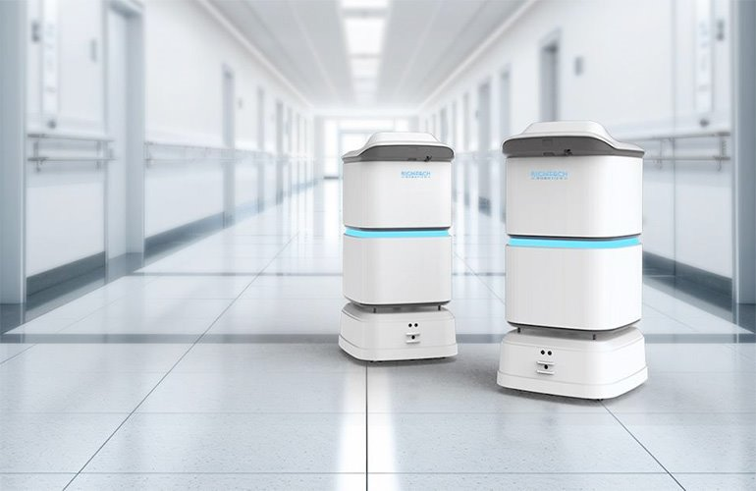
OBJECTIVE
Design and develop the full operator-facing software layer for a hospital Autonomous mobile robot (AMR) delivery system.
The system consists of three interfaces:
Nurse facing mobile app
On-Robot touch screen interface
Web-based Fleet Management System (FMS)
All three interfaces must communicate over the hospital Wi-Fi network and be accessible from anywhere within the hospital without requiring a fixed workstation

Slide 4
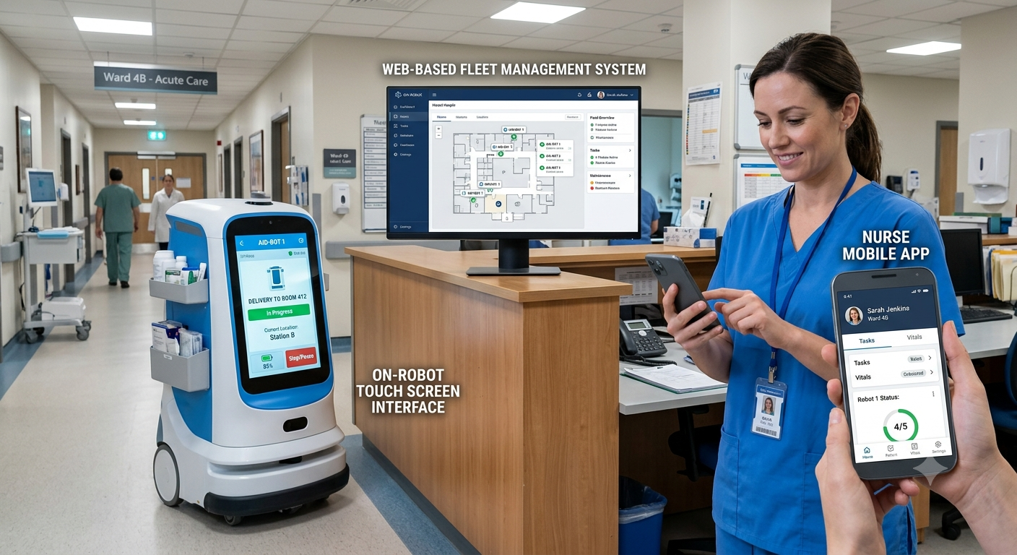
OBJECTIVE
Design and develop the full operator-facing software layer for a hospital Autonomous mobile robot (AMR) delivery system.
The system consists of three interfaces:
Nurse facing mobile app
On-Robot touch screen interface
Web-based Fleet Management System (FMS)
All three interfaces must communicate over the hospital Wi-Fi network and be accessible from anywhere within the hospital without requiring a fixed workstation

Slide 5
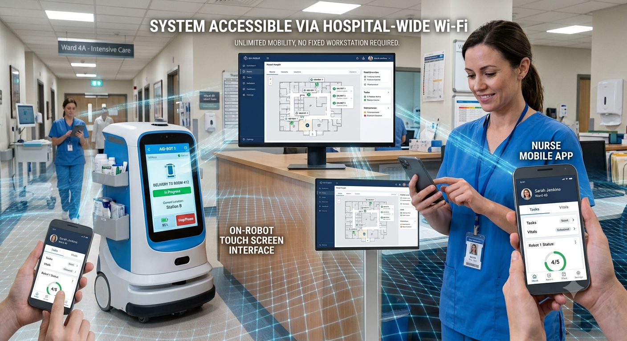
OBJECTIVE
Design and develop the full operator-facing software layer for a hospital Autonomous mobile robot (AMR) delivery system.
The system consists of three interfaces:
Nurse facing mobile app
On-Robot touch screen interface
Web-based Fleet Management System (FMS)
All three interfaces must communicate over the hospital Wi-Fi network and be accessible from anywhere within the hospital without requiring a fixed workstation

Slide 6
OBJECTIVE
Design and develop the full operator-facing software layer for a hospital Autonomous mobile robot (AMR) delivery system.
The system consists of three interfaces:
Nurse facing mobile app
On-Robot touch screen interface
Web-based Fleet Management System (FMS)
All three interfaces must communicate over the hospital Wi-Fi network and be accessible from anywhere within the hospital without requiring a fixed workstation

Slide 7

why
1.Avoidance of Wasted Clinical Time and Staff Fatigue
Nurses spend 20-30% of their shift walking between wards delivering items
2.Maintains Sample Temperature
3. Reduce Human Error Risk and robots lift heavy
40% of hospital staff report burnout partly due to logistics burden
4.Infection Control

Slide 8
why
1.Avoidance of Wasted Clinical Time and Staff Fatigue
Nurses spend 20-30% of their shift walking between wards delivering items
60% of lab samples experience temperature excursions during manual transport
2.Maintains Sample Temperature
3. Reduce Human Error Risk and robots lift heavy
40% of hospital staff report burnout partly due to logistics burden
4.Infection Control

Slide 9
why
1.Avoidance of Wasted Clinical Time and Staff Fatigue
1 in 5 medication errors occur during manual transport
Nurses spend 20-30% of their shift walking between wards delivering items
60% of lab samples experience temperature excursions during manual transport
2.Maintains Sample Temperature
Robot carries upto 20kg, with different comparment electronically locked
3. Reduce Human Error Risk and robots lift heavy
40% of hospital staff report burnout partly due to logistics burden
4.Infection Control

Slide 10
why
1.Avoidance of Wasted Clinical Time and Staff Fatigue
1 in 5 medication errors occur during manual transport
Nurses spend 20-30% of their shift walking between wards delivering items
60% of lab samples experience temperature excursions during manual transport
2.Maintains Sample Temperature
Zero touch everywhere while nurse or patience touch everywhere while traveling
3. Reduce Human Error Risk and robots lift heavy
Robot carries upto 20kg, with different comparment electronically locked
40% of hospital staff report burnout partly due to logistics burden
4.Infection Control

Slide 11
why
1.Avoidance of Wasted Clinical Time and Staff Fatigue
Nurses spend 20-30% of their shift walking between wards delivering items
1 in 5 medication errors occur during manual transport
60% of lab samples experience temperature excursions during manual transport
2.Maintains Sample Temperature
Zero touch everywhere while nurse or patience touch everywhere while traveling
3. Reduce Human Error Risk and robots lift heavy
40% of hospital staff report burnout partly due to logistics burden
Robot carries upto 20kg, with different comparment electronically locked
4.Infection Control

Slide 12
PLANNING
FIGMA – Design (For three interface)
Understand requirement, collect functionality and identify needs (brainstrom)
Create user story and persona – covering every functionality
Define the problem that needs to be solved and information architecture and introduce user flows
Create low-fidelity design and then prototypes (create a design system and guide)
Implementation
AMR-FMS backend service
Front end visualization for Nurse app, robot on-screen and web dashboard
Ros2 with Jazzy and harmonic gazebo for robot simulation
Integration part for connecting front end to the back and backend to the ROS2
Database - PostgreSQL
User Credentials, audit trails

Slide 13
Implementation
React for mobile nurse app, robot on-screen touch and web dashboard interface
Python fastAPI for sever side AMR-Fleet Management System with JWT authentication
Postgre sql for database and audit logging and user credential storage with bycrypt hashing
ROS2 for robot simulation and visualization in gazebo and map creation and navigation
rosbridge for converting json received through websockets and parses it into native ROS2message
Roslibjs for sending the json object via websockets and used to create publisher, action, subscriber, to connect to rosbridge server
Use redis to store user session, position of robot,mission queue and keeping what we need most, telemetry queue and audit logs will be stored here then stored to database
Postgre SQL is used for immutable audit trail
Create Edge case and scenarios and cover every case in the implementation.

Slide 14
Deployment Using LAN
IP based addressing for device connection
Making Your System "Findable", the system should be accessible via a local domain like http://amr.hospital.local. This is where DNS is used.
Reverse Proxy to direct the traffic correctly as different application uses different ports.
Add multiple origin for every service in the CORS configuration
Manual testing for deployment- get laptops IP address, allow CORS from any origin, start everything in the laptop, update the api url in the frontend with the IP address and port number, test from localmachine then from other device on the same wifi

Slide 15
Figma
Frontend
Backend
Integration
Deployment

Slide 16
THANK YOU

