Slide 1

HOSPITAL AMR SYSTEM
Full Operator-Facing
Software
Nurse App · Robot Interface · Fleet Management Dashboard

Slide 2




AGENDA
Contents
01
02
03
04
Objective
Planning
Implementation
Deployment
02

Slide 3
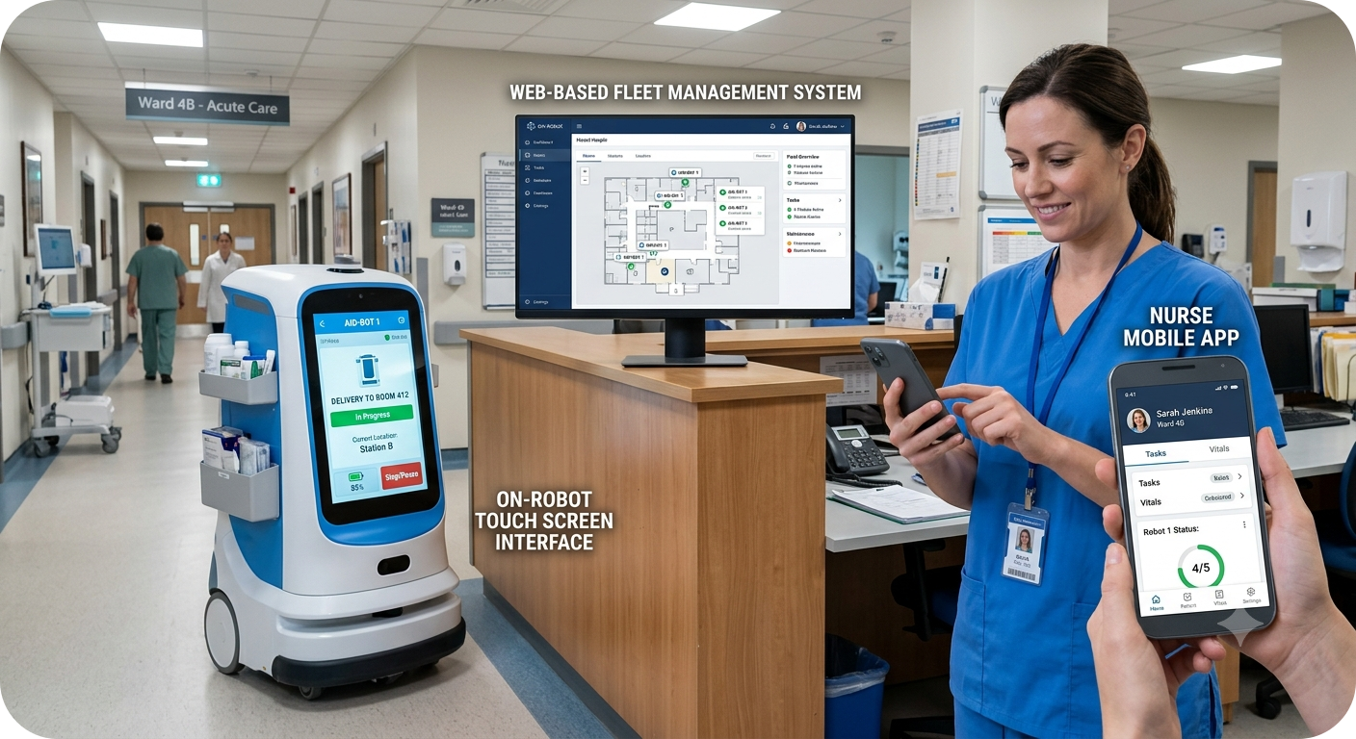




01 · OBJECTIVE
What We're Building
Design and develop the full operator-facing software layer for a hospital Autonomous Mobile Robot (AMR) delivery system.
THREE INTERFACES
Nurse-facing mobile app
On-robot touchscreen interface
Web-based Fleet Management System (FMS)
All three interfaces communicate over the hospital Wi-Fi network and are accessible anywhere in the hospital — no fixed workstation required.
03

Slide 4




WHY AN AMR SYSTEM
The Case for Autonomous Delivery
Avoid Wasted Clinical Time & Fatigue
Maintain Sample Temperature
20–30% of a nurse's shift is spent walking deliveries between wards
40% of hospital staff report burnout linked to logistics burden
60% of lab samples experience temperature excursions during manual transport
Reduce Human Error
Infection Control
1 in 5 medication errors occur during manual transport
Robot carries up to 20 kg across individually locked compartments
Zero-touch delivery removes a contact point between staff, patients, and transported items
04

Slide 5



02 · PLANNING
Figma Design Process
1
Discover
Understand requirements, collect functionality, and identify needs through brainstorming.
2
User Stories & Personas
Create user stories and personas covering every functionality.
3
Define & Map Flows
Define the problem to be solved, the information architecture, and introduce user flows.
4
Prototype
Create low-fidelity designs, then prototypes — including a design system and style guide.
05

Slide 6



03 · IMPLEMENTATION
Technology Stack
Frontend
Backend
React for the nurse mobile app, on-robot touchscreen, and web dashboard
Python FastAPI powers the AMR Fleet Management System
JWT-based authentication
Robotics & Simulation
Data
ROS2 (Jazzy) with Gazebo (Harmonic) for robot simulation
rosbridge + roslibjs bridge the web layer to ROS2 over WebSockets
PostgreSQL for user credentials and immutable audit trails
Passwords hashed with bcrypt
06

Slide 7


03 · IMPLEMENTATION
Integration Layer
Redis holds fast-changing state: user sessions, live robot position, the mission queue, and a telemetry buffer.
Telemetry and audit events flow from Redis into PostgreSQL for permanent, immutable storage.
rosbridge converts JSON received over WebSockets into native ROS2 messages.
roslibjs runs in the frontend to publish, subscribe, and call actions against the rosbridge server.
Edge cases and failure scenarios are catalogued and covered across the implementation.
DATA PATH
Frontend
FastAPI
Redis
PostgreSQL
ROBOT LINK
Frontend
rosbridge
ROS2
07

Slide 8



04 · DEPLOYMENT
Deployment on the Hospital LAN
IP-based addressing connects every device on the hospital network.
MANUAL TEST CHECKLIST
A local domain (e.g. http://amr.hospital.local) makes the system “findable” via DNS.
1
Get the host laptop's IP address
2
Allow CORS from any origin
A reverse proxy routes traffic correctly, since each service runs on a different port.
3
Start all services locally
CORS is configured with multiple allowed origins — one per service.
4
Update the frontend API URL with the IP + port
5
Test from the local machine, then from another device on the same Wi-Fi
08

Slide 9
ROADMAP
End-to-End Delivery Flow
01
02
03
04
05
Figma
Frontend
Backend
Integration
Deployment
09

Slide 10
HOSPITAL AMR SYSTEM
Thank You
Questions & Discussion

