Slide 1
Operation Manual for imToolBox (v1.9)
Renliang Yuan
4/20/2021

Slide 2
Contents
Installing the program ……p3
As stand-alone exe ……p4
As add-on App in Matlab ……p5-6
Load data files ……p7
.ser/.dm3/.dm4 and other formats ……p7
A series of images ……p8
Image operation ……p9
Show different slice in the stack ……p9
Adjust contrast and gamma ……p10
Crop image ……p11
Image size rescaling
Parallelization setting
Basic analysis of scanning diffraction ……p12
Virtual annular dark field image ……p12
Strain analysis of scanning diffraction ……p13
Determine strain calculation method ……p14
Determine peak fitting method ……p15-16
Process single image or image stack ……p17
Generate strain maps ……p18
Export results ……p19
Orientation mapping
Determine and view the reciprocal lattice
Load neural network model
Set the scanning map dimension
Fine adjusting the reciprocal lattice
Tilt map setting and generate 2D tilt map
Defect classification

Slide 3

1. Installing the program - overview
imToolBox is developed using Matlab scripts and GUIDE/AppDesigner for graphic user interface.
The software can be run in two ways: stand-alone exe; functions can be called in Matlab.
The stand-alone exe is compiled using Matlab R2022a, which can be used with a free compatible Matlab Runtime. No Matlab license required.
Function version requires a working version of Matlab installed, of version R2016a or later.
Updated in v1.8

Slide 4

1.1 Installing the program – as stand-alone exe
Double click imtoolboxInstaller.exe
The installation tool will download the matlab runtime for you (internet required)
The application will be installed in your computer
Note: as a stand-alone exe, the number of cores used in parallelization is fixed.
Updated in v1.8

Slide 5

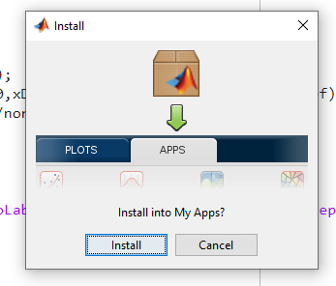
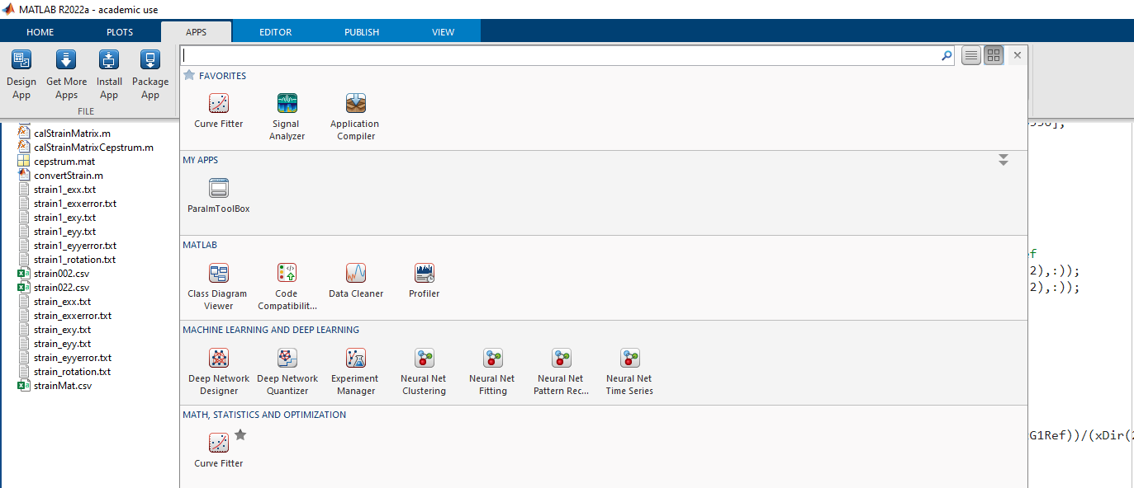

1.2 Installing the program – as add-on apps in Matlab
Step 0: get your matlab (R2019b or newer, for older version please use ParaImtoolBox.mlappinstall)
Step 1: double click ImToolBox.mlappinstall
Step 2: matlab will prompt you to install the app
Find it in the App tab in matlab main user interface
Step 4
Updated in v1.8

Slide 6
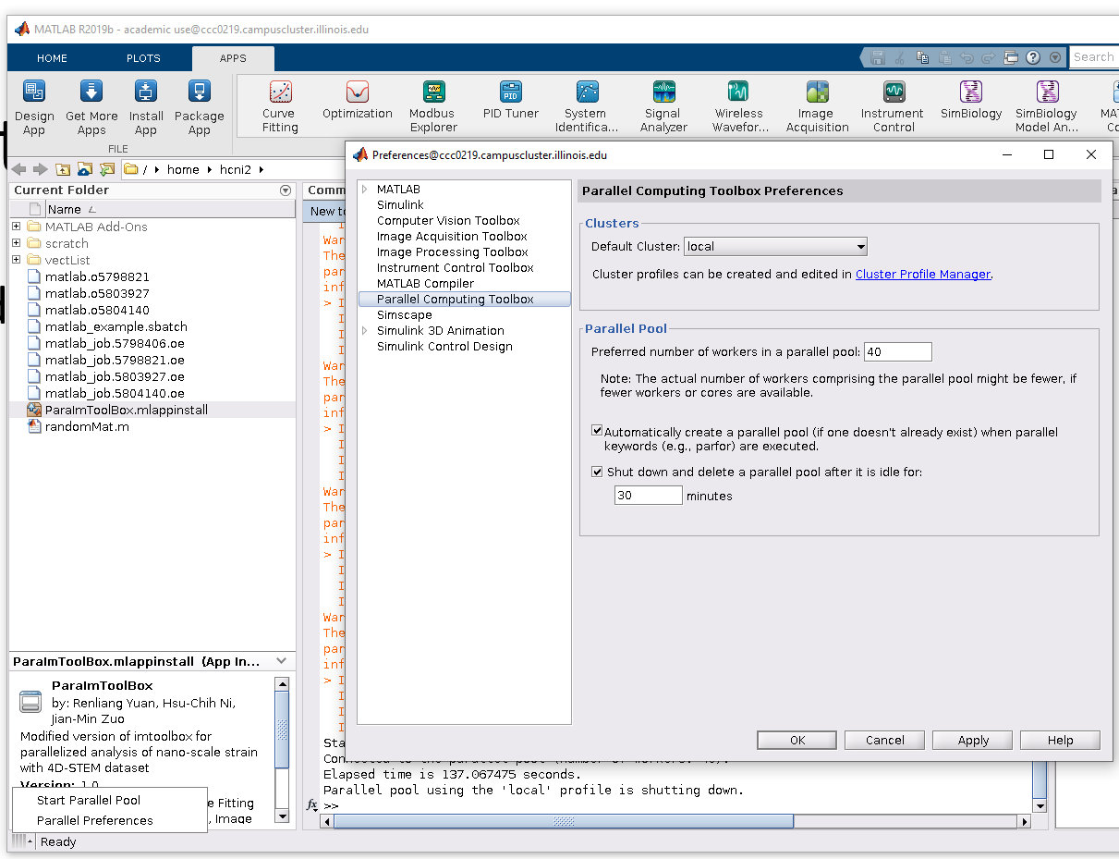
1.2 Installing the program – as add-on apps in Matlab (continue)
Parallelization setting
Step 1: Click the left down parallel preference button (first click the four straight line icon)
Step 2: set the Preferred number of CPU cores to use
Updated in v1.8

Slide 7
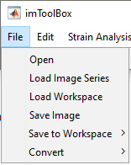
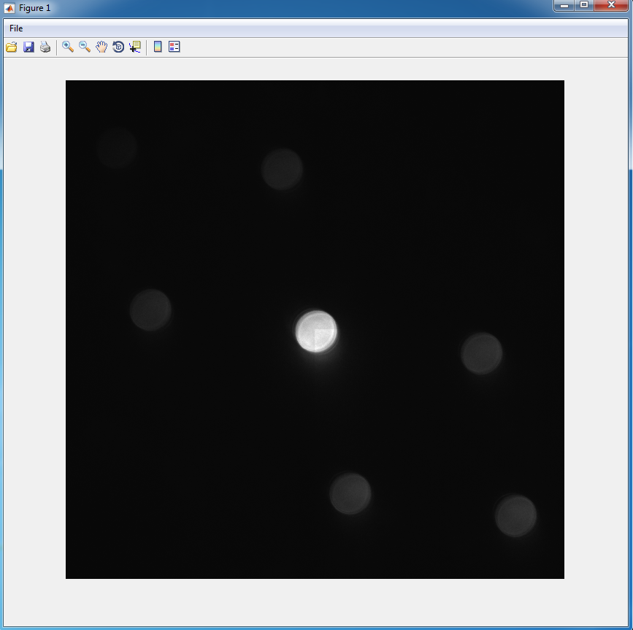
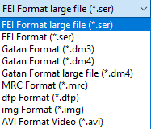
2.1 Load data files: .ser/.dm3/.dm4 and other format image stack
Menu -> File -> Open
Select data format (.ser, .dm3, .dm4, etc)
If the file size exceeds computer memory, select ‘Gatan Format large file(*.dm4)’ or ‘FEI Format large file(*.ser)’ instead
Select file and click ‘open’.
A separate window will show up with the image stack.
Note
For FEI format, .emi file which contains metadata is not needed. Only image or image stack saved in .ser file can be read directly.
Also support .dfp file generated from Zmult and .img file with 8-byte header.
Currently mrc is not supported for parallelization
Updated in v1.8

Slide 8
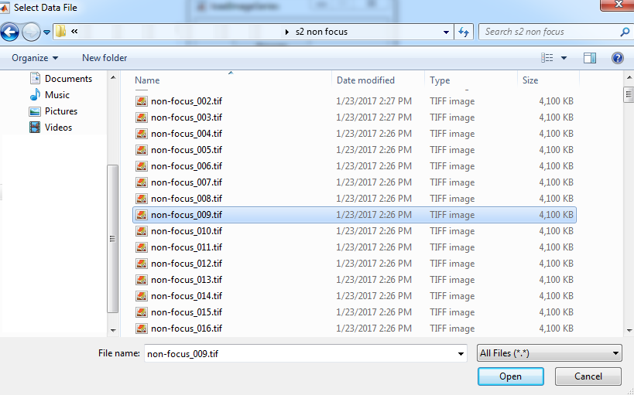
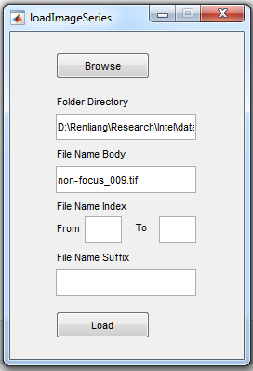
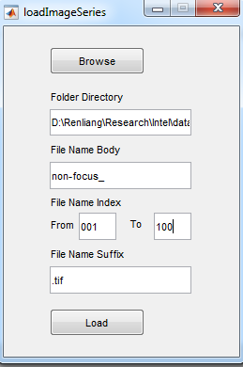
2.2 Load data files: a series of images
Menu -> File -> Load Image Series
Click ‘Browse’
Go to the data folder and select any one of the images
Modify filename body, fill in index range and filename suffix
The filename format must be ‘File Name Body’+’File Name Index’+’File Name Suffix’.
Index must be number and can have zeros in the beginning (up to 5 digits in total).
Click ‘Load’ and a separate window will show up with the image stack.

Slide 9
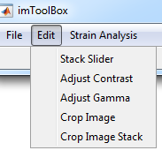
3 Image operation
3.1 Show different slice in the stack
Menu -> Edit -> Stack Slider to open
Select the window with image stack first and then select the stackSlider window.
Click ‘Update’ to link the image stack to stackSlider. (see gif on the right)
Use the slider or the textbox to select different slice of the image. Image will be updated in original figure window.
gif

Slide 10
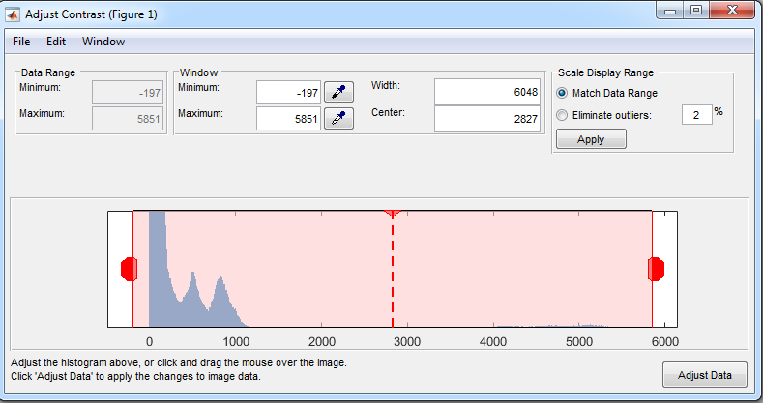
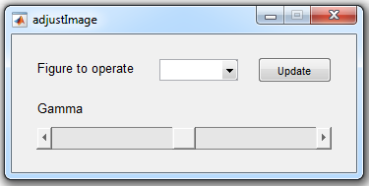
3 Image operation
3.2 Adjust contrast and gamma
Select the window with image first and then select imToolBox window.
Menu -> Edit -> Adjust Contrast / Adjust Gamma
Adjust Contrast: a new window will pop up with the histogram of the image. Drag the red rectangle to adjust contrast and brightness. The change will be reflected in image immediately. There is no need to click ‘Adjust Data’ button. Otherwise, you may not be able to restore the original display setting.
Adjust Gamma: a new window will pop up with the slider to adjust gamma. Similar to stack slider, remember to select the image window first and click ‘Update’. Slide the scroll to adjust gamma.

Slide 11
3 Image operation
3.3 Crop image
Select the window with image first and then select imToolBox window.
Menu -> Edit -> Crop Image / Crop Image Stack
The mouse will become a cross and the image window will be activated.
Click and drag a box on the region you want to crop.
Release the mouse and a new window with cropped image will show up. (see gif on the right)
When using Crop Image Stack, it will crop the same area of all the images in the stack and generate a new image stack.
gif

Slide 12
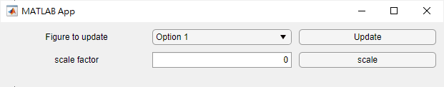
3 Image operation
3.3 image size rescaling
Menu -> Edit -> rescale
Update figure to operate as shown in 3.1. It must be an image stack.
Type in the scale factor and click scale
Example: original image is 512*512. scale factor 0.5 will reduce the images size to 256*256
Updated in v1.9

Slide 13
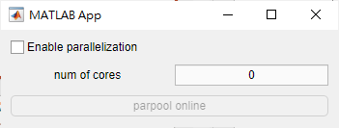
4.Parallelization setting
Menu -> Others -> parallel preference
Enable parallelization: when checked, strain analysis of center 6, 3x3, all, and defect classification will be parallelized.
Num of cores: set the number of cores to use in the multi-cores processing. If left 0, the program will automatically choose
Click “parpool online” to activate the parpool. If enable parallelization is checked and parpool isn’t already activated, it will start automatically when using compatible functions.
Updated in v1.9

Slide 14
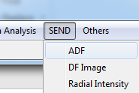
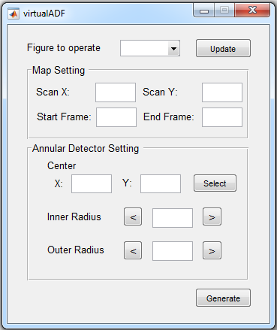
5 Basic analysis of scanning diffraction
5.1 Virtual annular dark field (VADF) image
Menu -> SEND -> ADF to open virtualADF window
Update figure to operate as shown in 3.1. It must be an image stack.
Determine the size of final VADF image by typing the pixel number of each dimension as Scan X and Scan Y.
If only part of the image stack is needed, type in the start and end frame. The start frame will be the first pixel in the VADF image.
Determine the center of VADF detector by clicking ‘Select’ button in Annular Detector Setting panel. Your mouse will become a crosshair. Single click the image where the desired center locates and press Enter. If needed, modify the numbers in X and Y coordinates to adjust position precisely.
Type in the pixel number of inner radius and outer radius of VADF detector. Use arrow buttons on left and right to decrease or increase.
Click ‘Generate’ button to generate VADF image using the settings above.
Updated in v1.5

Slide 15
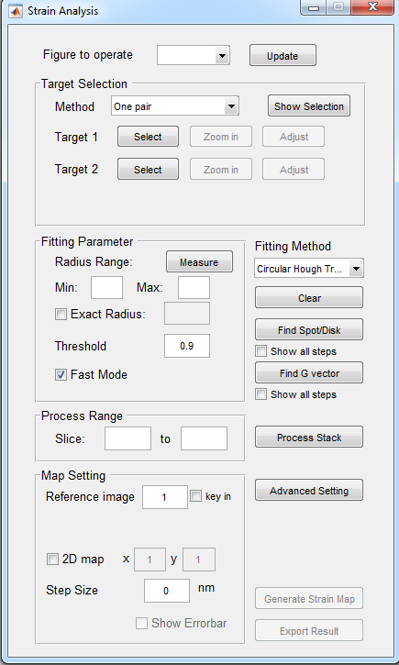
6 Strain analysis of scanning diffraction
Menu -> Crystallography Analysis -> Strain to open Strain Analysis window
Select the figure to operate by selecting the image window first and clicking ‘Update’. All operation below will only apply to this ‘Figure to operate’.
Note: currently there is a UI bug so the strain analysis window will be a very small window at the lower left of your screen when started. Drag and enlarge the window can fix it.
Updated in v1.8

Slide 16
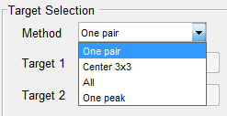
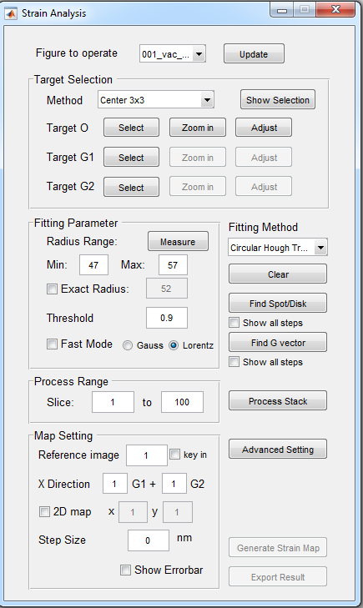
6 Strain analysis of scanning diffraction
6.1 Determine strain calculation method
There are four different modes available for strain analysis:
One pair: Calculate strain from one pair of diffraction peaks. Strain can be calculated only along one direction. Need to select 2 targets.
Center 3x3: Center beam and 8 adjacent diffraction peaks are used to calculate 2D strain tensor. Need to select 3 targets: O, reciprocal basis g1, and g2.
All: All detectable diffraction peaks are used to calculated 2D strain tensor. Need to select 3 targets: O, reciprocal basis g1, and g2.
One peak: Detect the movement of a single peak. Can be used to measure electric field. Need to select 1 target.
Select targets:
Click ‘Select’ button after ‘Target’ and drag a box around peak of interest. Adjust the box with peak at center if needed. ‘Select’ button now becomes ‘Done’ button. Click ‘Done’ when finished. Do the same for all targets.
Use ‘Zoom in’ button to show an enlarged view of the target selected, and ‘Adjust’ button to adjust the pixel value precisely.
After selecting all targets, use ‘Show Selection’ button to preview all target sub-regions for peak detection. Repeat step 1~2 if needed.
Updated in v1.5

Slide 17
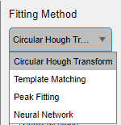
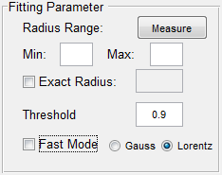
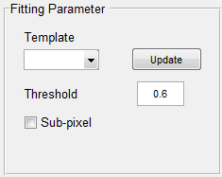
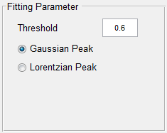
6 Strain analysis of scanning diffraction
6.2 Determine peak fitting method
There are three different methods available for peak detection:
Circular Hough Transform: Detect disk position by applying circular Hough transform to disk edge. Suitable for disk pattern.
Click ‘Measure’ button and drag a circle around the diffraction disk. Adjust size to be same as disk. Click ‘Done’ (previously ‘Measure’) button to update radius range values.
Fast Mode: Find peak position in accumulator matrix by weighted average. Recommended threshold: 0.9~0.99.
Non-fast mode: Use Gaussian or Lorentzian peak fitting to find peak position in accumulator matrix (more accurate but slower). Recommended threshold: 0.3~0.6.
Template Matching: Detect peak position by comparing with a template using normalized cross-correlation. Suitable for both spot and disk patterns.
Make a template by cropping from the original image and update template window similar to updating figure to operate.
Check ‘Sub-pixel’ to allow for sub-pixel cross-correlation.
Recommended threshold: 0.6.
Peak Fitting: Detect peak position by peak fitting. Suitable for spot pattern.
Recommended threshold: 0.3~0.6.
Updated in v1.5

Slide 18
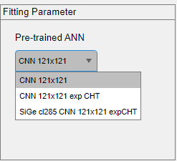
6 Strain analysis of scanning diffraction
6.2 Determine peak fitting method (continue)
There are three different methods available for peak detection:
Convolution neural network: Detect disk position by applying a pretrained CNN model. Only applicable with relatively large radius disk. The box selected in section 5.1 target “Select targets” need to be 121 by 121 in pixels.
Select one of the pretrained models. Recommend model: CNN121x121 exp CHT
Updated in v1.8

Slide 19
6 Strain analysis of scanning diffraction
6.3 Process single image or image stack
Check and adjust the fitting parameter:
Set a sub-image containing only one diffraction peak as figure to operate. This sub-image can be cropped from original image or by using ‘Zoom in’ button in ‘Target Selection’ panel.
Click ‘Find Spot/Disk’ button to detect the peak position using current fitting method. Adjust parameters if fitting result is not perfect. Check ‘Show all steps’ box below to display all steps for peak detection for a detailed diagnosis.
Process single image:
With diffraction pattern as figure to operate and all targets and fitting parameters set, click ‘Find G vector’ button to calculate deformation matrix from current diffraction pattern.
Adjust parameters if errors are large and repeat step 1. Check ‘Show all steps’ box below to display fitting result of each diffraction peak used.
Process image stack:
Input the range of slice number in image stack desired to be processed.
Click ‘Process Stack’ button and wait for it to finish.
Delete any markers on figure to operate.
Updated in v1.5

Slide 20


6 Strain analysis of scanning diffraction
6.4 Generate strain maps
Set reference for strain calculation: 3 ways
Single image in the stack: input the slice number.
A continuous range of images: input the start and end slice number.
Numerical input: check ‘key in’ box and input pixel values of reciprocal vectors as reference.
Determine x direction of strain:
Input any linear combination of basis vectors G1 and G2. ex. For Si 110 pattern, G1 = 1-1-1, G2 = 1-11, then strain 110 = G1+G2, strain 001 = G1-G2.
1D profile or 2D map
Check ‘2D map’ box to set ouput as 2D maps, otherwise 1D profile is generated.
Input number of pixels in x and y dimension of the 2D map. This usually should match with scanning steps.
Step size in 1D profile
Change the axis label in 1D profile to match with experiment. If step size = 0, only number of steps will be shown in the plot.
Error bar
Check ‘Show Errorbar’ button to include errorbar in 1D profile or error maps for 2D output. These errors are estimated based on peak fitting error of each diffraction peak used to calculate strain.
Click ‘Generate Strain Map’ button to display strain profile/map.
Updated in v1.5

Slide 21
6 Strain analysis of scanning diffraction
6.4 Export results
After generating strain maps, click ‘Export Result’ button to save the strain data as txt files.
Updated in v1.5.1

Slide 22
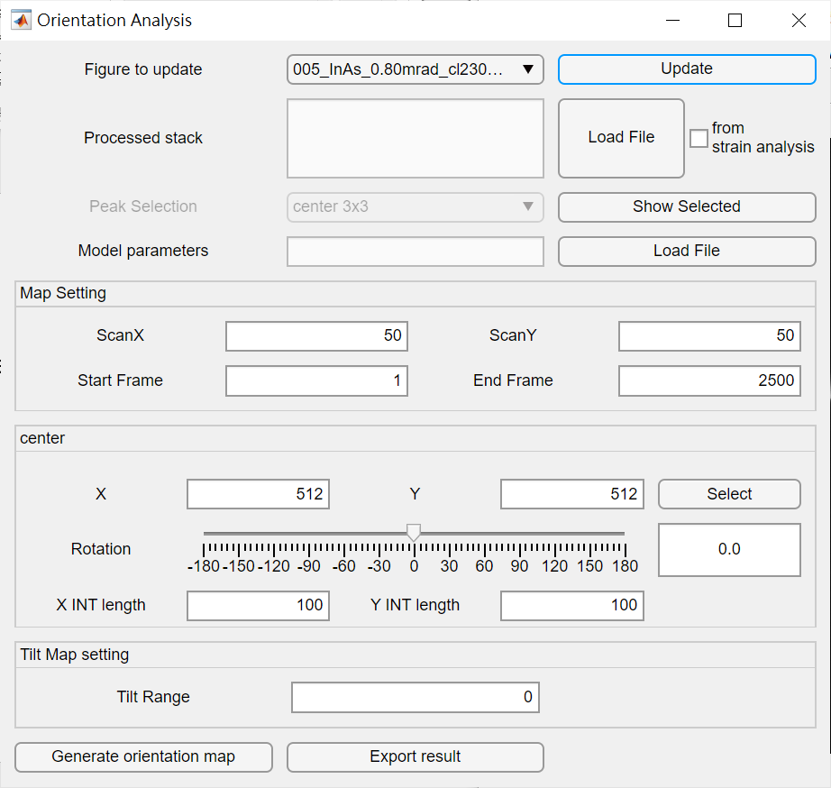
7 Orientation analysis of scanning diffraction
7.1 Determine and view the reciprocal lattice
Menu -> Crystallography Analysis -> Orientation to open Orientation Analysis window
Select the figure to operate by selecting the image window first and clicking ‘Update’. All operation below will only apply to this ‘Figure to operate’.
There are two ways to define the reciprocal lattice:
By strain analysis: if strain analysis is done as discussed in section 5, by checking “from strain analysis” checkbox can load the result of strain analysis automatically. Peak selection function is only available with this method.
By predefine configuration file: click “Load File” button to load a configuration file. Peak selection should be predefined in the configuration file and it is not available for the user to change it in this way.
Click show selected to view the defined reciprocal lattice
Updated in v1.8

Slide 23
7 Orientation analysis of scanning diffraction
7.2 load neural network model
Click load file button to load the neural network model.
Updated in v1.8

Slide 24
7 Orientation analysis of scanning diffraction
7.3 Set the scanning map dimension
Set the x, y dimension of the scan for 2D tilt mapping
Use start frame and end frame to select the range for processing
Updated in v1.8

Slide 25
7 Orientation analysis of scanning diffraction
7.4 Fine adjusting the reciprocal lattice
select the center of the reciprocal lattice if the diffraction pattern is not perfectly centered by clicking “select” button. After that, click at the center of the diffraction pattern and press enter. An alternative way is to directly change the value. This is only available with loading a configuration file in 6.1
Using the rotation slidebar to adjust the reciprocal lattice. This is only available with loading a configuration file in 6.1
Adjust the size of the integration box with “X INT length” and “Y INT length”. The goal of this setting is to fully enclosed the whole disk in the integration box.
Updated in v1.8

Slide 26
7 Orientation analysis of scanning diffraction
7.5 Tilt map setting and generate 2D tilt map
Use tilt range to set the range of tilting colormap. Usually 1~2 is a good value.
Press “Generate orientation map” to start analysis.
Three images will be generated. One for X direction tilt, one for Y direction tilt, and one for a vector colormap for the tilt vector.
Pressing “Export result” can save the tilt value as two .csv file, X tilt and Y tilt respectively.
Updated in v1.8

Slide 27
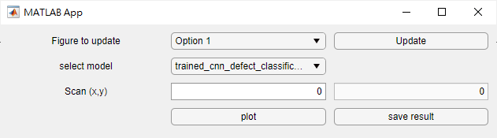
8 defect classification of scanning diffraction
Menu -> Crystallography Analysis -> defect to open defect classification window
Select the figure to operate by selecting the image window first and clicking ‘Update’. All operation below will only apply to this ‘Figure to operate’.
Select the preferred model to use (only one option for now)
Enter number of pixel per row of the scan in the left-hand side input line.
Click plot to calculate and plot the result.
Click save result to save the probability of three type of defects (no defect, point defect , line defect) and the classification into CSV.
Note:
1->line defect, 2->no defect 3->point defect
The input dimension of the input diffraction patterns must be 256*256. If the dataset is in another format, image size rescaling function (3.3) can be used to rescale it into 256*256
Updated in v1.9

