Slide 1

Databases

Slide 2
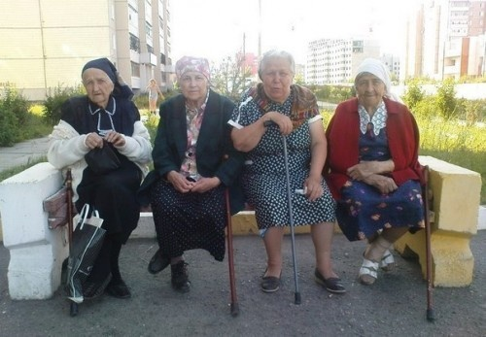
What is database

Slide 3
What is database
A structured set of data held in a computer, especially one that is accessible in various ways.
- "a database covering nine million workers"

Slide 4
How we Structure Data Relational
NoSQL
Graph
Where we store data
inMemory
inHDD
Centralized ? Centralized
Distributed
License ? Commercial Open Source

Slide 5
How we structure data

Slide 6
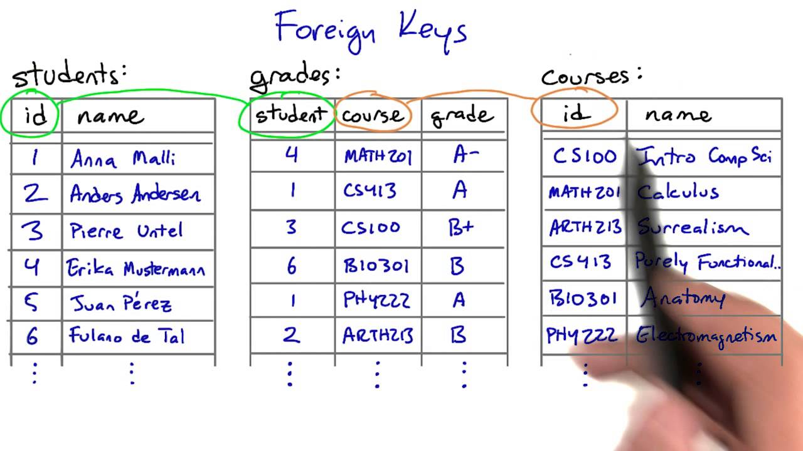
Relational Databases
- A database structured to recognize relations between stored items of information

Slide 7
Relational Databases
1. Have tables
2. Rules how to store data (Normal Forms)
3. Have query language SQL to select data. SELECT * FROM Students, Grades where Grades.grade = ‘A+’
4. Can be used for any task, but not always the best option.

Slide 8
Relational Databases
Oracle
Microsoft SQL
MySQL
MariaDB
PostGreSQL (PGsql)

Slide 9
NoSQL
Have only 1 table, where we store KEY and VALUE
KEY | VALUE
1 | werf23525c2345c
2 | 235c235c23523c545
3 | 745754f57vv45754v7
4 | 5v7457v3457v34v34457v
5 | 3v5737v57v375v357
6 | 34v575v75345v73v3

Slide 10
NoSQL
Can not make SQL query, no relationship between data, only one table
Works super fast
Consume small resources
Can be used for Auth, for storing documents (like signle entity, storing pictures e.t.c)

Slide 11
NoSQL
Cassandra
Redis
MongoDB
CouchDB
Oracle NoSQL

Slide 12
Graph
A graph database, also called a graph-oriented database, is a type of NoSQL database that uses graph theory to store, map and query relationships
=> Just to know that that type exists is ok.

Slide 13
Where we store data
In Memory | In PC
H2 (relational) | MySQL (relational)
In-Memory Database (relational) | Oracle (relational)
Redis (NoSQL) | MSSQL (relational)
 | Cassandra (NoSQL )

Slide 14
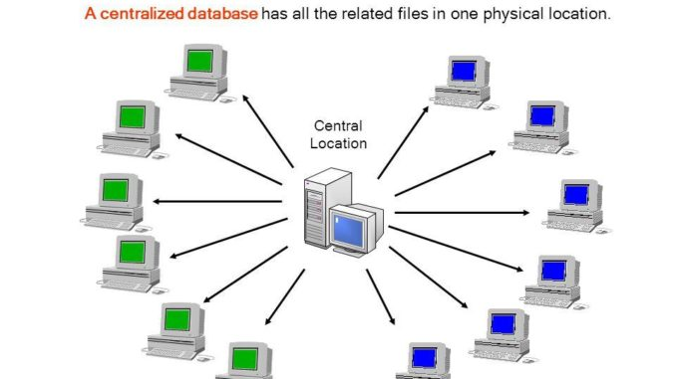
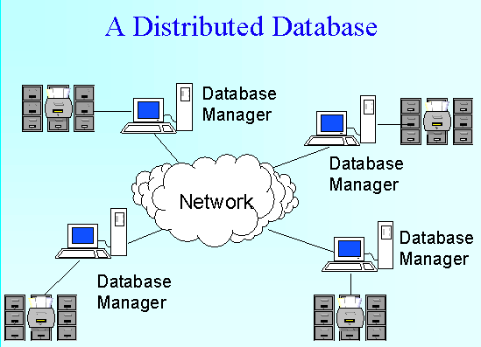
Centralized ?
Centralized | Distributed
Oracle (Relational) | Cassandra ( NoSQL )
MySQL (Relational) | Teradata Database (Relational)

Slide 15
Licensed ?
Commercial | Open Source
Oracle(relational) | Redis (NoSQL, Distributed)
Microsoft SQL (relational ) | PostGreSQL (relational)
 | Cassandra ( NoSQL, Distributed )

Slide 16
Quezz 1
1. Can there be Distributed Commercial noSQL database ?
2. Can there Open Source Distributed NoSQL database ?
3. Can there be centralized opensource relation database ?
4. Can there be Commercial, NoSQL, Distributed, Relational Database ?
5. I want to build application for a bank system what database I should take (by types)
6. I want to store User names and Country that it belongs ? What database I should take ? What should be best option ?
7. My System (database) should not have central location and have fault tolerance, what database I should select ?
8. What is SQL ?
9. Can I use SQL for Redis ?
10. What is PLSQL ?

Slide 17
Quezz 2
1. What is Table ?
2. How many tables we have in NoSQL ?
3. Tell me about Oracle database
4. Can I store Relational Commercial database in Cloud ?
5. What is normal form ?
6. What normal form we have in NoSQL ?
7. One student decided to save all lecture notes to his head. Is it a database ? What database it is ? (Types)
8. What word SELECT is about ? What it can be ?
9. How many different database we have ?
10. What database is the best ?

