Slide 1
Is OOP design ok
Exercise
Notes:
https://yuml.me/diagram/scruffy/class/draw

Slide 2
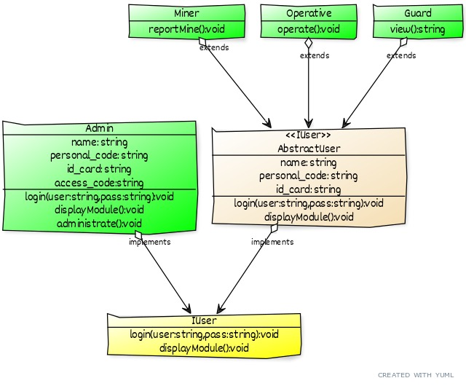
Mining corporation intranet
Notes:
// Cool Class Diagram
// ------------------
[AbstractUser{bg:wheat}]<>implements>[IUser{bg:yellow}|login(user:string,pass:string):void;displayModule():void]
[Admin{bg:green}|name: string;personal_code: string;id_card: string;access_code:string|login(user:string,pass:string):void;displayModule():void;administrate():void]<>implements>[IUser{bg:yellow}]
[≪IUser≫;AbstractUser|name: string;personal_code: string;id_card: string|login(user:string,pass:string):void;displayModule():void]
[Miner{bg:green}|reportMine():void]<>extends>[AbstractUser{bg:yellow}]
[Operative{bg:green}|operate():void]<>extends>[AbstractUser{bg:yellow}]
[Guard{bg:green}|view():string]<>extends>[AbstractUser{bg:yellow}]

Slide 4
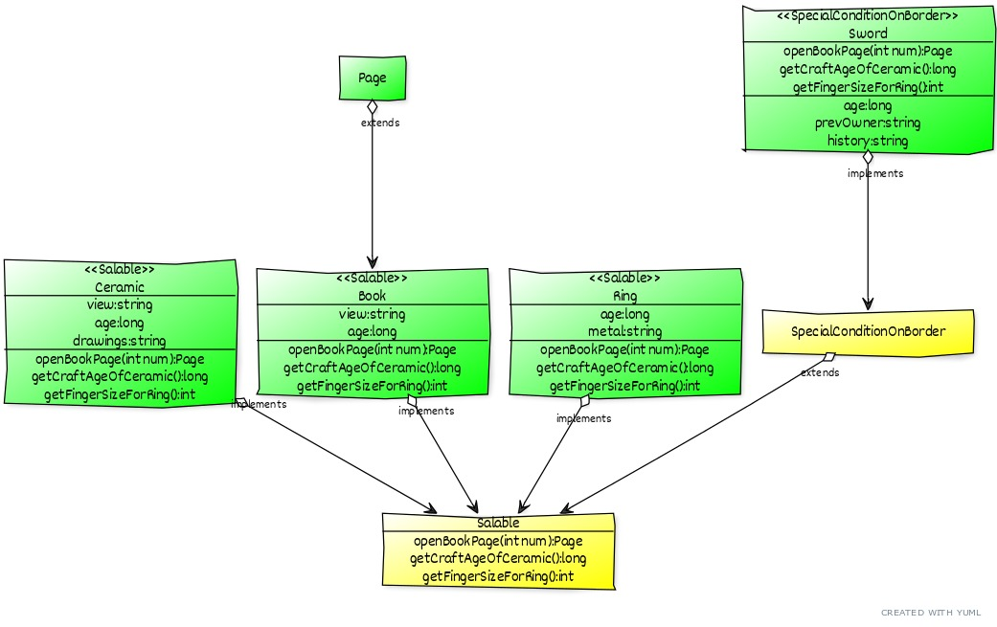
Antiquity shop
Notes:
[<<Salable>>Ceramic{bg:green}|view:string;age:long;drawings:string|openBookPage(int num):Page;getCraftAgeOfCeramic():long;getFingerSizeForRing():int]<>implements>[Salable{bg:yellow}|openBookPage(int num):Page;getCraftAgeOfCeramic():long;getFingerSizeForRing():int]
[<<Salable>>Book{bg:green}|view:string;age:long|openBookPage(int num):Page;getCraftAgeOfCeramic():long;getFingerSizeForRing():int]<>implements>[Salable]
[<<Salable>>Ring{bg:green}|age:long;metal:string|openBookPage(int num):Page;getCraftAgeOfCeramic():long;getFingerSizeForRing():int]<>implements>[Salable{bg:yellow}|openBookPage(int num):Page;getCraftAgeOfCeramic():long;getFingerSizeForRing():int]
[Page{bg:green}]<>extends>[Book]
[<<SpecialConditionOnBorder>>Sword{bg:green}|openBookPage(int num):Page;getCraftAgeOfCeramic():long;getFingerSizeForRing():int|age:long;prevOwner:string;history:string]<>implements>[SpecialConditionOnBorder{bg:yellow}] <>extends> [Salable]

Slide 5

Extends ??
What openBookPage should do ? How to implement it ?
What is salable ???

Slide 6
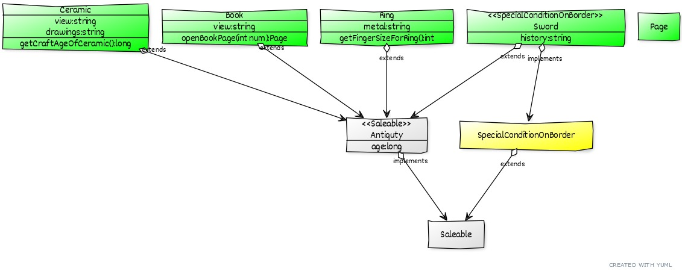
Notes:
[Ceramic{bg:green}|view:string;drawings:string|getCraftAgeOfCeramic():long]<>extends>[Antiquty]
[Book{bg:green}|view:string|openBookPage(int num):Page]<>extends>[Antiquty]
[Ring{bg:green}|metal:string|getFingerSizeForRing():int]<>extends>[Antiquty]
[Page{bg:green}]
[<<SpecialConditionOnBorder>>Sword{bg:green}|history:string]<>implements>[SpecialConditionOnBorder{bg:yellow}] <>extends>[Saleable]
[<<SpecialConditionOnBorder>>Sword{bg:green}]<>extends>[Antiquty]
[<<Saleable>>Antiquty{bg:wheat}|age:long]<>implements>[Saleable{bg:yellow}]

Slide 7
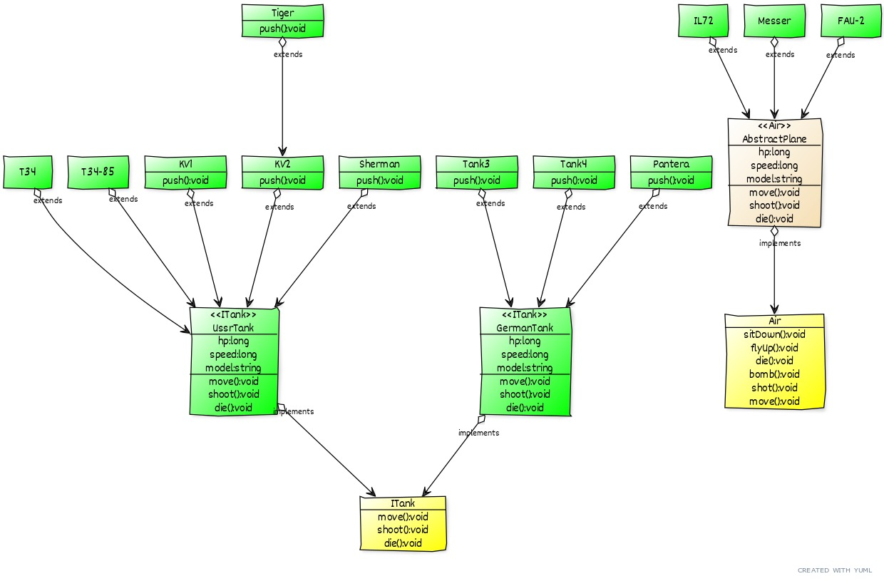
WW2 War Game
Notes:
[<<ITank>>GermanTank{bg:green}|hp:long;speed:long;model:string|move():void;shoot():void;die():void]<>implements>[ITank{bg:yellow}|move():void;shoot():void;die():void]
[<<ITank>>UssrTank{bg:green}|hp:long;speed:long;model:string|move():void;shoot():void;die():void]<>implements>[ITank{bg:yellow}|move():void;shoot():void;die():void]
[T34{bg:green}]<>extends>[UssrTank]
[T34-85{bg:green}]<>extends>[UssrTank]
[KV1{bg:green}|push():void]<>extends>[UssrTank]
[KV2{bg:green}|push():void]<>extends>[UssrTank]
[Tank3{bg:green}|push():void]<>extends>[GermanTank]
[Tank4{bg:green}|push():void]<>extends>[GermanTank]
[Pantera{bg:green}|push():void]<>extends>[GermanTank]
[Tiger{bg:green}|push():void]<>extends>[KV2]
[Sherman{bg:green}|push():void]<>extends>[UssrTank]
[<<Air>>AbstractPlane{bg:wheat}|hp:long;speed:long;model:string|move():void;shoot():void;die():void]<>implements>[Air{bg:yellow}|sitDown():void;flyUp():void;die():void;bomb():void;shot():void;move():void]
[IL72{bg:green}]<>extends>[AbstractPlane]
[Messer{bg:green}]<>extends>[AbstractPlane]
[FAU-2{bg:green}]<>extends>[AbstractPlane]

Slide 8
Need method push ? Yes lets make Tiger ussr to extend method push from KV2
Let `s allow rocket return home like plane ?
Sure, other tanks not exists, so extends from existing

Slide 9
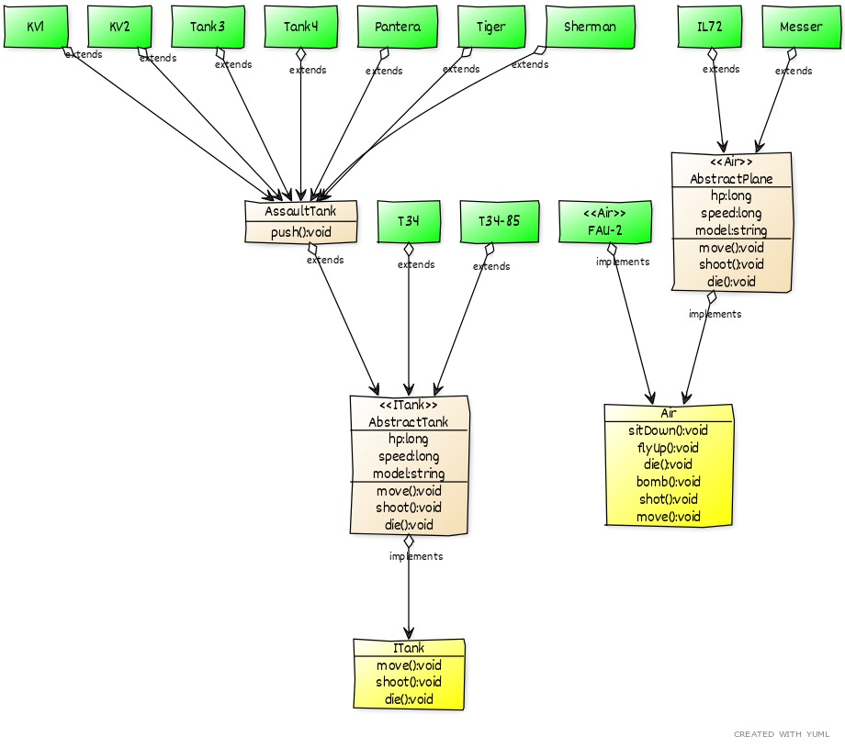
Notes:
[<<ITank>>AbstractTank{bg:wheat}|hp:long;speed:long;model:string|move():void;shoot():void;die():void]<>implements>[ITank{bg:yellow}|move():void;shoot():void;die():void]
[AssaultTank{bg:wheat}|push():void]<>extends>[AbstractTank]
[T34{bg:green}]<>extends>[AbstractTank]
[T34-85{bg:green}]<>extends>[AbstractTank]
[KV1{bg:green}]<>extends>[AssaultTank]
[KV2{bg:green}]<>extends>[AssaultTank]
[Tank3{bg:green}]<>extends>[AssaultTank]
[Tank4{bg:green}]<>extends>[AssaultTank]
[Pantera{bg:green}]<>extends>[AssaultTank]
[Tiger{bg:green}]<>extends>[AssaultTank]
[Sherman{bg:green}]<>extends>[AssaultTank]
[<<Air>>AbstractPlane{bg:wheat}|hp:long;speed:long;model:string|move():void;shoot():void;die():void]<>implements>[Air{bg:yellow}|sitDown():void;flyUp():void;die():void;bomb():void;shot():void;move():void]
[IL72{bg:green}]<>extends>[AbstractPlane]
[Messer{bg:green}]<>extends>[AbstractPlane]
[<<Air>>FAU-2{bg:green}]<>implements>[Air]

