Slide 1
Scrum
Aleksander Gozdek
Software Development Academy

Slide 2
WHAT
IS
SCRUM?

Slide 3
Scrum Workflow
Iterative and incremental agile software development framework for managing product development.

Slide 4
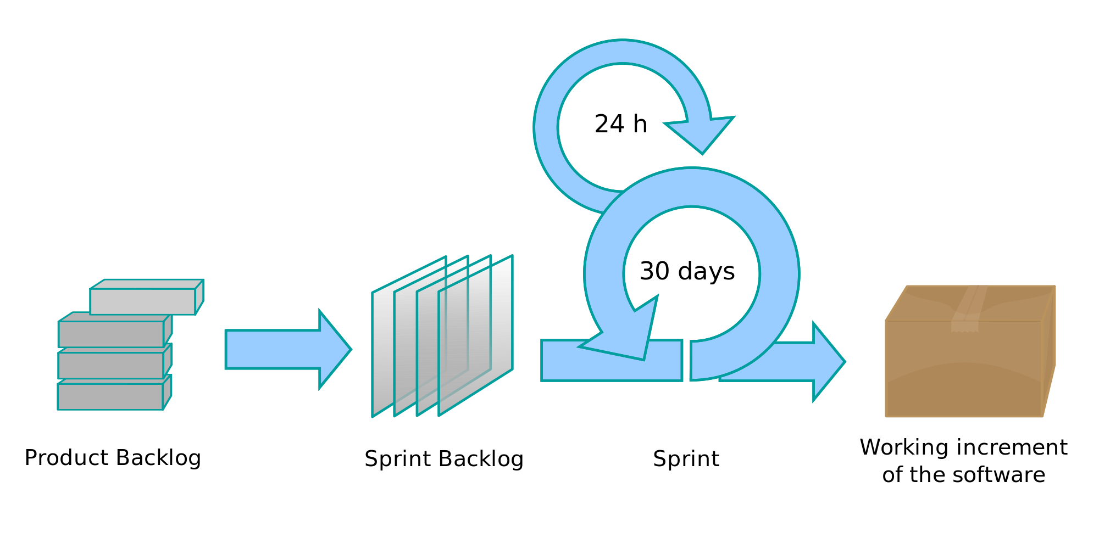
Scrum Workflow
https://upload.wikimedia.org/wikipedia/commons/thumb/5/58/Scrum_process.svg/2000px-Scrum_process.svg.png

Slide 5
SCRUM
VALUES

Slide 6
Commitment
Team members individually commit to achieving their team goals, each and every Sprint.

Slide 7
Courage
Team members know they have the courage to work through conflict and challenges together so that they can do the right thing.

Slide 8
Focus
Team members focus exclusively on their team goals and the Sprint Backlog; there should be no work done other than through their backlog.

Slide 9
Openness
Team members and their stakeholders agree to be transparent about their work and any challenges they face.

Slide 10
Respect
Team members respect each other to be technically capable and to work with good intent.

Slide 11
SCRUM
ROLES

Slide 12
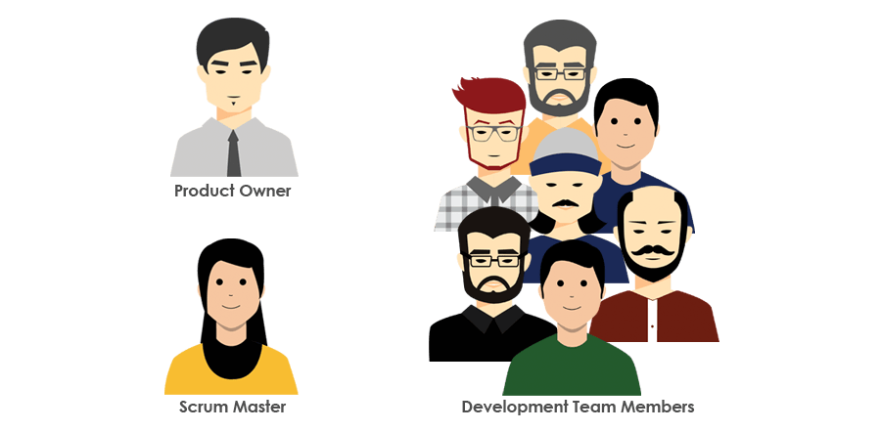
Scrum Roles
http://stephaniedelfin.com/notes/scrum/img/scrumTeam.png

Slide 13

Product Owner
Represents the product's stakeholders and the voice of customer; and is accountable for ensuring that the team delivers value to the business.

Slide 14
Product Owner
Creates and maintains the Product Backlog
Prioritizes and sequences the Backlog according to business value or ROI
Conveys the Vision and Goals at the beginning of every Release and Sprint
Communicates status externally
Can terminate a Sprint if it is determined that a drastic change in direction is required

Slide 15

Scrum Master
Accountable for removing impediments to the ability of the team to deliver the product goals and deliverables.

Slide 16
Scrum Master
Helps the team to determine the definition of done for the product
Helps the Product Owner maintain the Product Backlog
Coaches the team, within the Scrum principles
Promotes self-organization within the team
Facilitates team events to ensure regular progress
Educates key stakeholders in the product on Scrum principles
Notes:
The Scrum Master is not a traditional team lead or project manager,
but acts as a buffer between the team and any distracting influences.

Slide 17

Development Team
Responsible for delivering potentially shippable increments of product at the end of each Sprint (the Sprint goal).

Slide 18
Development Team
Made up of 3–9 individuals who do the actual work
Self-organizing
Cross-functional, with all of the skills as a team necessary to create a Product Increment (analyze, design, develop, test, technical communication etc.)

Slide 19
SCRUM
EVENTS

Slide 20
Sprint
The basic unit of development in Scrum. The Sprint is a timeboxed effort; that is, it is restricted to a specific duration.
The duration is fixed in advance for each Sprint and is normally between one week and one month, with two weeks being the most common

Slide 21
Sprint Planning
At the beginning of a Sprint. Main purpose is to communicate the scope of work that is intended to be done during that Sprint.
Time-boxed to a four-hour limit for a two-week Sprint.

Slide 22
Daily Scrum
Each day during a Sprint, the team holds a Daily Scrum.
Starts precisely on time even if some Development Team members are missing
Should happen at the same time and place every day
Is timeboxed to fifteen minutes

Slide 23
Daily Scrum
What did I do yesterday that helped the Development Team meet the Sprint goal?
What will I do today to help the Development Team meet the Sprint goal?
Do I see any impediment that prevents me or the Development Team from meeting the Sprint goal?
Notes:
Any impediment e.g.,
stumbling block,
risk,
issue,
delayed dependency,
assumption proved unfounded
identified in the Daily Scrum should be captured by the Scrum Master

Slide 24
Sprint Review
At the end of a Sprint. Reviews the work that was completed and the planned work that was not completed.
Presents the completed work to the stakeholders (a.k.a. the demo). The recommended duration is two hours for a two-week Sprint .

Slide 25
Retrospective
At the end of a Sprint. Reflects on the past Sprint. Identifies and agrees on continuous process improvement actions.
What went well during the Sprint?
What could be improved in the next Sprint?

Slide 26
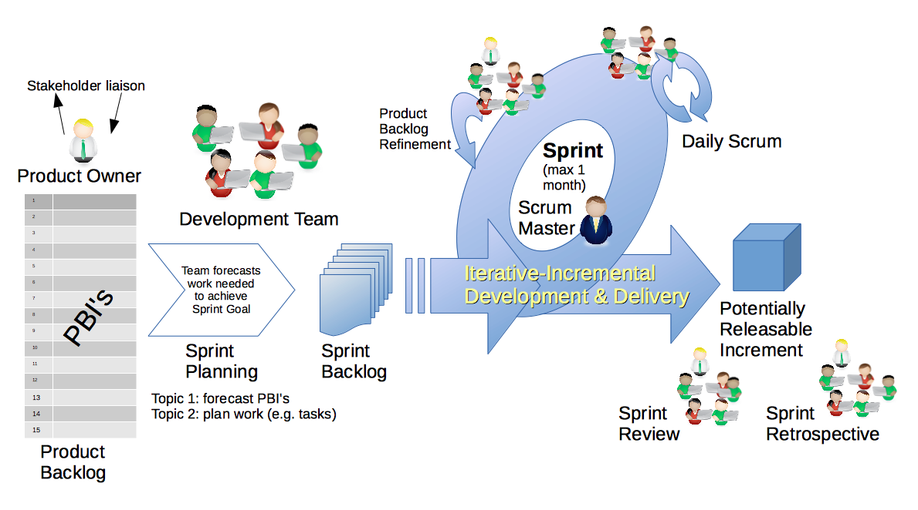
Scrum Workflow
https://upload.wikimedia.org/wikipedia/commons/d/df/Scrum_Framework.png

Slide 27
SCRUM
ARTIFACTS

Slide 28
PRODUCT
BACKGLOG
#1

Slide 29
Scrum Workflow
https://upload.wikimedia.org/wikipedia/commons/d/df/Scrum_Framework.png

Slide 30
Product Backlog
An ordered list of requirements that a Scrum Team maintains for a product.
The Product Owner orders the Product Backlog Items (PBIs) based on considerations such as risk, business value, dependencies, and date needed.
Features
Bug Fixes
Non-Functional Requirements
Notes:
Typically, the Product Owner and the Scrum Team come together
and write down everything that must be prioritized, and this becomes
content for the first Sprint
The Product Owner prioritizes which Product Backlog Items are most needed.
The team then chooses which items they can complete in the coming Sprint.

Slide 31
Product Backlog
The Product Backlog does not contain "user stories"; it simply contains items.
Those items can be expressed as user stories, use cases, or any other requirements approach that the group finds useful.

Slide 32
SPRINT
BACKGLOG
#2

Slide 33
Scrum Workflow
https://upload.wikimedia.org/wikipedia/commons/d/df/Scrum_Framework.png

Slide 34
Sprint Backlog
List of work the Development Team must address during the next Sprint.
The Development Team should keep in mind its past performance assessing its capacity for the new Sprint, and use this as a guideline of how much 'effort' they can complete.
Notes:
The Product Backlog Items may be broken down into tasks by the Development Team.
Tasks on the Sprint Backlog are never assigned. This promotes self-organization.

Slide 35
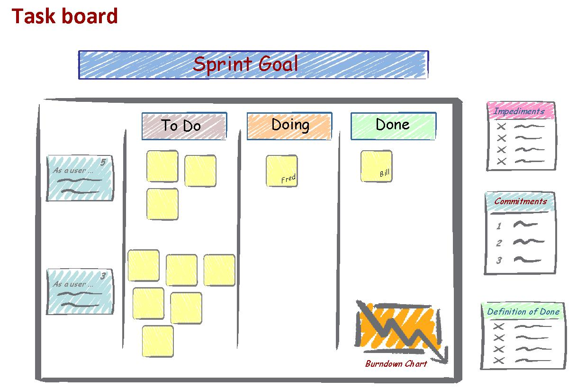
Sprint Backlog
https://yorkesoftware.files.wordpress.com/2015/01/task-board-overview.jpg

Slide 36
#3
INCREMENT

Slide 37
Scrum Workflow
https://upload.wikimedia.org/wikipedia/commons/d/df/Scrum_Framework.png

Slide 38
Increment
Potentially shippable increment is the sum of all the Product Backlog Items completed during a Sprint, integrated with the work of all previous Sprints.
At the end of a Sprint, the increment must be complete, according to the Scrum Team's definition of done (DoD)

Slide 39
Definition of Done (DoD)
List of activities that add verifiable/demonstrable value to the product.
Notes:
What does it mean?

Slide 40
Definition of Done (DoD)
List of activities that add verifiable/demonstrable value to the product.
writing code,
coding comments,
unit testing,
integration testing,
release notes,
design documents

Slide 41
EFFORT
ESTIMATION

Slide 42
Effort Estimation
Typically, effort estimates are over-optimistic and there is a strong over-confidence in their accuracy.

Slide 43
Key Factors should be taken into account
Domain Knowledge
Risks
Complexity
Historical Data
Buffer Time

Slide 44

Estimation Idea
http://blog.radissonblu.com/wp-content/uploads/2014/09/frankfurt-tallest-skyscraper.jpg

Slide 45
T-Shirt Sizes
XL
L
M
S
1pt
2-3pt
5pt
8pt

Slide 46
Fibonacci Number
0, 1, 1, 2, 3, 5, 8, 13, 21, 34,…

Slide 47
SOFTWARE
REQUIREMENTS

Slide 48
Software Requirements is a communication problem
When the business side dominates
It mandates functionality and dates with little concern that the developers can meet both objectives, or whether the developers understand exactly what is needed.
When the developers dominate
The communications, technical jargon replaces the language of the business and the developers lose the opportunity to learn what is needed by listening.
The communications, technical jargon replaces the language of the business and the developers lose the opportunity to learn what is needed by listening.

Slide 49
Common Problems
Fixed, hard to change
Feature centric rather than Value centric
Specify What, not Why
Hard to validate

Slide 50
Scrum Guide and Requirements
”
The Product Backlog lists all features, functions, requirements, enhancements, and fixes that constitute the changes to be made to the product in future releases. Product Backlog items have the attributes of a description, order, estimate and value.
The Scrum Guide

Slide 51
USER
STORY

Slide 52
User Story
Extreme programming (XP) introduced the practice of expressing requirements in the form of User Stories, short descriptions of functionality–told from the perspective of a user.

Slide 53
User Story
Let the user (the business man) freely express his idea, uninfluenced and undeterred by system-hardened developers

Slide 54
User Story Format
Triple A
As an [actor] I want [action] so that [achievement].
Notes:
The format canonised by Mike Cohn

Slide 55
User Story Format
As a Flickr member, I want to set different privacy levels on my photos, so I can control who sees which of my photos.
Notes:
The format canonised by Mike Cohn

Slide 56
User Story
It’s hard to use user stories for non-functional requirements.

Slide 57
User Story
If you cannot produce user story maybe
there is no value in it.

Slide 58
User Story
If you cannot produce user story maybe
there is no value in it.

Slide 59
INVEST IN GOOD USER STORIES

Slide 60
INVEST - INDEPENDENT
Dependencies between stories lead to prioritization and planning problems. For example, suppose the customer has selected as high priority a story that is dependent on a story that is low priority.

Slide 61

INVEST - NEGOTIABLE
Story cards are reminders to have a conversation rather than fully detailed requirements themselves

Slide 62
INVEST - NEGOTIABLE
Good Story Example
As User I can pay for posting job offer with credit card. Note: Accept Visa, MasterCard and American Express

Slide 63
INVEST - NEGOTIABLE
Bad Story Example
As User I can pay for posting job offer with credit card. Note: Accept Visa, MasterCard and American Express. On purchases over $100, ask for card ID from back of card. The system can specify what is the type of the card based on two first digits of a card number. The system can store card number for future use. Collect expiration date of the card.
Notes:
Too much information.
It’s hard to work on such items.
In many cases specifying details too soon just creates more work

Slide 64
INVEST – VALUABLE TO USERS OR CUSTOMERS
Avoid stories that are only valued by developers.
All connections to the database are through a connection pool.
All error handling and logging is done through log4j library.
Notes:
Focused on the technology and the advantages to the programmers
Ideas behind these stories are good ones but they should instead be written so that the benefits to the customers

Slide 65
INVEST – VALUABLE TO USERS OR CUSTOMERS
Avoid stories that are only valued by developers.
Up to fifty users should be able to use the application with a five-user database license.
All errors are presented to the user and logged in a consistent manner.

Slide 66
INVEST – VALUABLE TO USERS OR CUSTOMERS
The best way to ensure that each story is valuable to the customer or users is to have the customer write the stories.

Slide 67
INVEST – ESTIMABLE
Developers should be able to estimate (or at least take a guess at) the size of a story or the amount of time it will take to turn a story into working code.

Slide 68
INVEST – ESTIMABLE
There are three common reasons why a story may not be estimable:
Developers lack domain knowledge.
Developers lack technical knowledge.
The story is too big.

Slide 69
INVEST – SMALL
Story size does matter because if stories are too large or too small you cannot use them in planning.

Slide 70
INVEST – SMALL
As user I can plan a vacation in reservation system.
Notes:
Important feature but too big
It involves a lot of tasks
It should be splitted into smaller ones

Slide 71
INVEST – SMALL
But sometimes stories can be too small...
Notes:
the developer says he doesn't want to write down or estimate
doing that may take longer than making the change

Slide 72
INVEST – TESTABLE
Successfully passing tests proves that a story has been successfully developed.
Whenever possible, tests should be automated.

Slide 73
INVEST – TESTABLE
There is a very small subset of tests that cannot realistically be automated.
A novice user is able to complete common application workflows without training
Notes:
Can be tested but cannot be automated

Slide 74
INVEST – TESTABLE
Untestable stories are typicaly nonfunctional requirements, which are requirements about the software but not directly about its functionality.
A user must find the software easy to use.
Notes:
Can be tested but cannot be automated

Slide 75
GATHERING STORIES

Slide 76
Exercise #1
Draw layout of website that contains apartments to rent. Users should be able to find interesting announcement.

Slide 77
Exercise #2
Draw layout of website that contains apartments to rent. It should contain 3 pictures of announcement in one row. It should have 1 scrollbar on the right side. It should have 2 forms on the top of the page to specify search criteria. It should have 1 login form in the right upper corner.

Slide 78
Gathering Techniques
Stories will be evolving, coming and going throughout the project, we need a set of techniques for gathering them iteratively.

Slide 79
Gathering Techniques
Questionnaires
Observation
Story-Writing workshops
Notes:
Most users are not very adept at understanding, and especially at expressing, their true needs

Slide 80
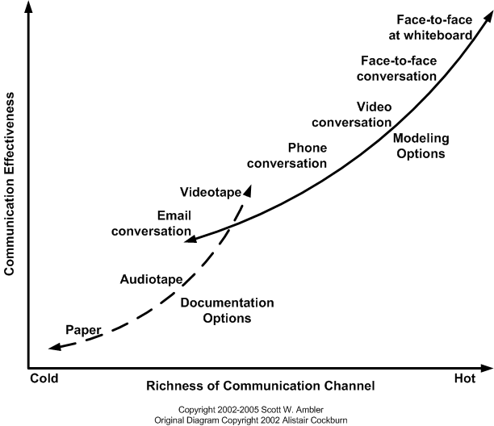
Gathering Techniques

Slide 81
User Interviews
It is not sufficient to ask the user "So, what do you need?“
Ask open questions, not closed-ended
Notes:
Most users are not very adept at understanding, and especially at expressing, their true needs

Slide 82
USER ROLE
MODELING

Slide 83
User Role Modeling
Analyze who will use the system.
To avoid writing all stories from the perspective of a single user, identify the different user roles who will interact with the software.

Slide 84
User Role Modeling
Focus on user’s goal.
e.g. Job Seeker at job portal:
search for job (based on skills, salary, location)
automate the process so he doesn’t have to search manually each time
easily apply for jobs
make his resume visible for employers

Slide 85
WRITE CLOSED STORIES

Slide 86
Write Closed Stories
A closed story is one that finishes with the achievement of a meaningful goal.

Slide 87
Write Closed Stories
“A recruiter can manage the ads she has placed.”
Managing the ads she's placed is not something that is ever completely done.

Slide 88
Write Closed Stories
Instead we can specify:
A recruiter can review resumes from applicants to one of her ads.
A recruiter can change the expiration date of an ad.
A recruiter can delete an application that is not a good match for a job.

Slide 89
Write Closed Stories
If you need, you can also specify constraints:
The new system must use our existing database.
The software must run on all versions of Windows.

Slide 90
Use Active Voice
Rather than saying: "A resume can be posted by a Job Seeker"
Use: "A Job Seeker can post a resume."

Slide 91
ACCEPTANCE TESTING
USER STORIES

Slide 92
Acceptance Testing
Acceptance tests provide basic criteria that can be used to determine if a story is fully implemented.
Notes:
Having criteria that tell us when something is done is the best way to
avoid putting too much, or too little, time and effort into it.

Slide 93
Acceptance Testing
“A company can pay for a job posting with a credit card” may have the following written on the back:
Test with Visa, MasterCard and American Express (pass).
Test with Diner's Club (fail).
Test with good, bad and missing card ID numbers.
Test with expired cards.
Test with different purchase amounts (including one over the card's limit).

Slide 94
Acceptance Testing
Think in TDD way. Without seeing that test, some programmers can forget to support this case.
That’s why acceptance tests should be written before the programmer begins coding.
Notes:
Test with different purchase amounts (including one over the card's limit)

Slide 95
Acceptance Testing
Ideally, as the customer and developers discuss a story they reflect its details as tests.
At the start of an iteration the customer should go through the stories and write any additional tests he can think of.
What can go wrong during the story?
Are there circumstances when this story may behave differently?
Notes:
Acceptance tests should be written by the customer rather than by a developer.

Slide 96
COMMON
MISTAKES

Slide 97
Common Mistakes
As a user I’d like to manage announcements, so I’d be able to delete outdated or invalid announcements

Slide 98
Common Mistakes
As a user I’d like to manage announcements, so I’d be able to delete outdated or invalid announcements
Vague User Story
Who is user? Administrator or simple user? What does it mean to manage? Does it mean to list all announcements or just mine?

Slide 99
Common Mistakes
As Developer I’d like to have 64-bit Java on Prod Environment, to let me fully utilize machine performance

Slide 100
Common Mistakes
As Developer I’d like to have 64-bit Java on Prod Environment, to let me fully utilize machine performance
No User Value
It’s technical debt story. It doesn’t give user any value. It’s non-functional requirement.

Slide 101
Common Mistakes
As user I’d like to have faster system, to let me find announcements in quicker way. Conditions of Satisfaction: System respond to average requests in less than 3s. Task connected to story: Install 64-bit Java.
Notes:
How to improve that?

Slide 102
Common Mistakes
As user, I’d like to be able to filter announcements.

Slide 103
Common Mistakes
As user, I’d like to be able to filter announcements.
To vague. We don’t know why the user needs that.
We don’t know anything about what are criterion. No conditions of satisfaction.
Notes:
Without them user story cannot be fully understood for Devs.
Hard to estimate that: example with filtering

Slide 104
BREAKING DOWN
EPICS

Slide 105
Epic
Simply Epic is a “big story”.
Stories that often comprise a complete workflow for a user. Their business value isn't realized until the entire epic is complete.
Notes:
Epics generally take more than one or two sprints to develop and test.
Like action movie there is
Car chases
Shooting
Running

Slide 106
Themes
Themes may be thought of as groups of related stories.
Often these stories all contribute to a common goal or are related in some obvious way, such as all focusing on a single customer.
Notes:
I have filed the James Bond movies together. They are a theme.

Slide 107
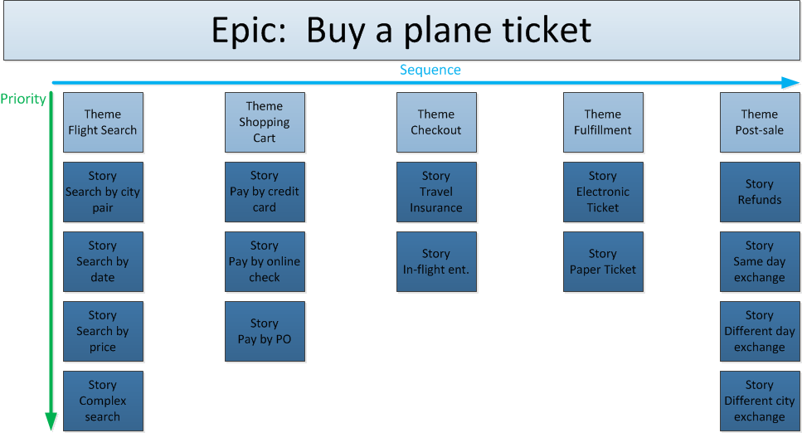
How does it look like?
http://www.payton-consulting.com/wp-content/uploads/2015/01/StoryMap1.png
Notes:
The top layer of the stories represent the minimal marketable features.
The others are more likely to be implemented later.

Slide 108
USER
STORY
WORKSHOP

Slide 109
Exercise – User Stories
Form groups.
Choose product to work on.
- Brainstorm Value Statements
- Product Roadmap
- Think about Epics
Generate User Stories.
- Think about User Roles
Introduce Acceptance Criteria.
Estimate stories. Use estimation techniques.
Breakeout session - slice stories into smaller ones.

