Slide 1
FinAgent: Compliance Research Platform for AML/PEP/Sanctions
From fragmented sources to auditable conclusions — faster
Devang Swami
GITHUB - https://github.com/swamx/FinAgent.git

Slide 2
Problem Statement
The compliance analyst's real workflow today
A compliance analyst may spend hours gathering evidence before making a single risk recommendation. The challenge isn't finding information — it's connecting information across multiple trusted sources and producing an auditable conclusion.
Analyst workflow today:
Search sanctions list manually → 15–30 min
Cross-reference subsidiaries → 30–60 min (often skipped)
Pull SEC filings, court records → 30–60 min
Synthesise into a written rationale → 30–60 min
Total per case: 2–4 hours
Risk: incomplete evidence, missed relationships, undocumented reasoning
Approach | What it misses | Business consequence
Keyword sanctions screening | No relationship awareness — "Deripaska" misses "Basic Element" (his holding company) | Entities pass screening despite sanctioned ownership
Vector-only RAG | Similarity doesn't encode control or ownership | Analyst concludes "low risk" on incomplete evidence
Manual graph lookup | No document corpus — can't explain why an entity is risky | Defensible rationale requires manual research anyway

Slide 3
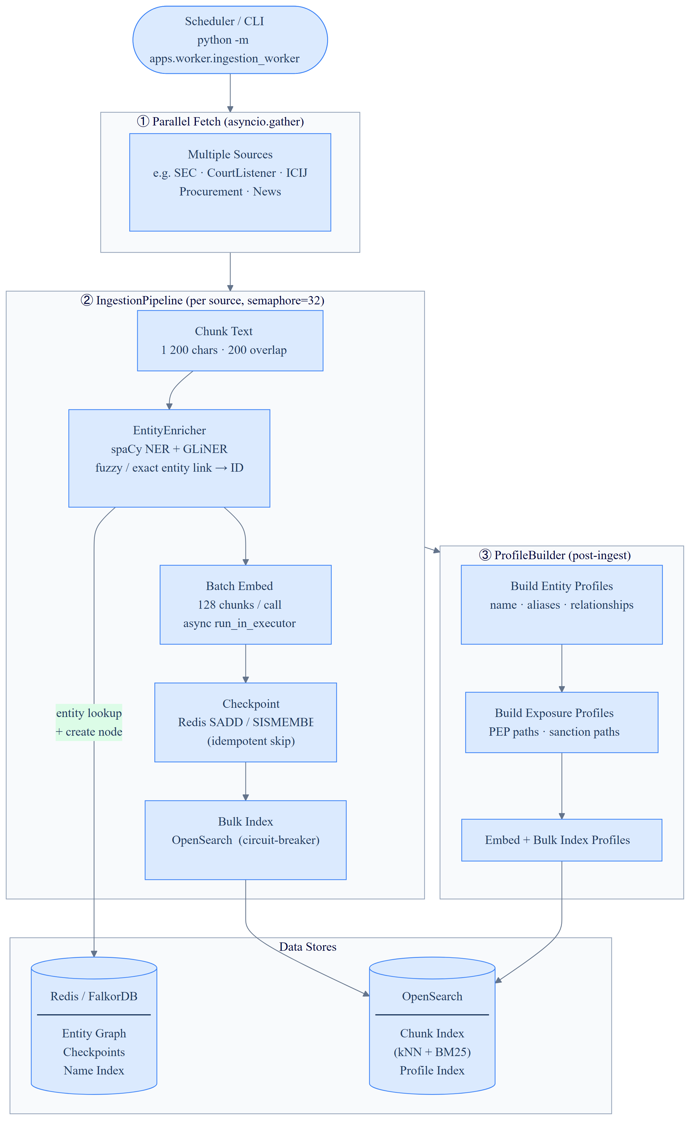
System Architecture - Ingestion Pipeline
Production Designs:
Spark/Flink/KNative Eventing Serving on EKS or Managed services with Kafka Intermediatory
AWS Lambda with AWS SQS Intermediatory

Slide 4
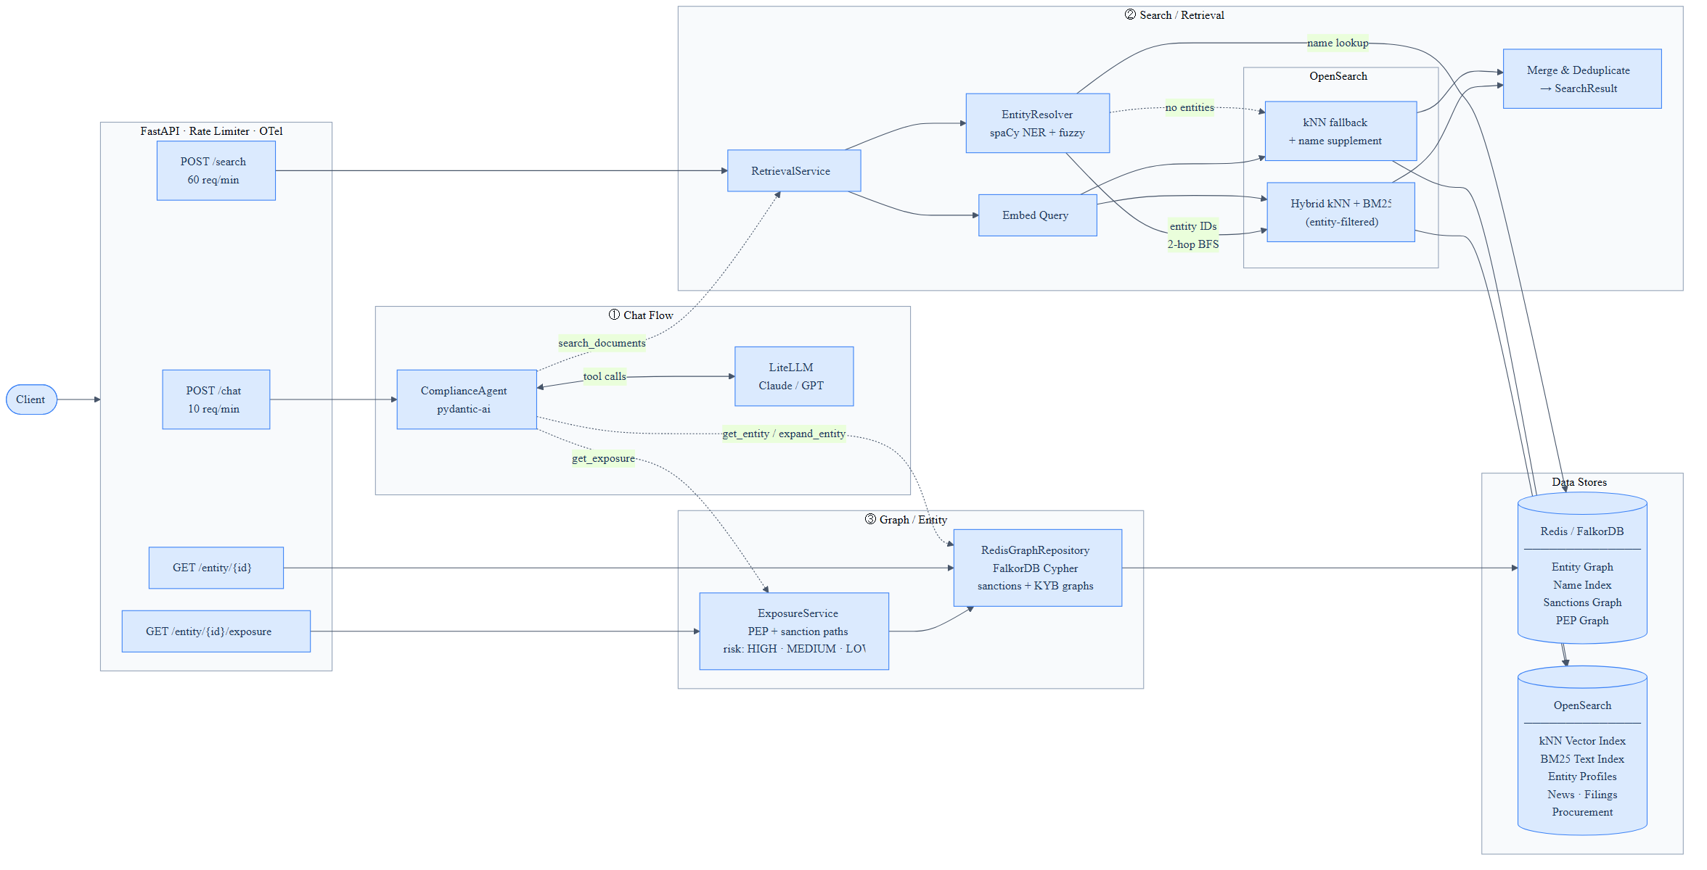
System Architecture - Agentic Search Services

Slide 5
Key Decision #1: Graph-First Hybrid Retrieval
Graph-first retrieval pipeline
Stage 1 catches sanctions records.
Stage 2 catches documents that mention related entities but aren't linked in the graph.
Stage 3 catches news and procurement that has no graph node at all. Each stage adds evidence quality.
Chunking strategy
1200-char chunks, 200-char overlap — tuned to preserve sentence boundaries in legal and regulatory language; smaller chunks hurt context_recall on multi-part questions
Synthetic profile documents — for each entity, a structured summary doc is indexed separately from raw source chunks; this gives retrieval a high-signal anchor
entity_ids field — every chunk stores a list of resolved entity IDs at index time, enabling Stage 2 entity-filtered hybrid search without a post-filter rerank
Link: https://github.com/swamx/FinAgent/blob/main/docs/Demo.md#architecture-at-a-glance

Slide 6
Key Decision #2: Agent Design & Engineering Challenges
Framework choice: PydanticAI over LangChain
The agent is ~60 lines. Zero chains, zero memory objects, no LCEL.
LangChain's abstractions add surface area without adding capability at this scale. The signal isn't which framework won — it's knowing when a framework adds accidental complexity rather than essential capability.
PydanticAI gave type-safe dependency injection, native async, and a Pydantic-validated tool signature. That was sufficient.
Circuit breakers on every external boundary
LiteLLM (LLM calls) fail_max=3 timeout=60s
OpenSearch fail_max=5 timeout=30s
FalkorDB fail_max=5 timeout=30s
Why this matters for compliance: A circuit breaker on the LLM boundary means a model service outage degrades gracefully — the API returns a structured error rather than leaving the analyst waiting on a hung request.

Slide 7
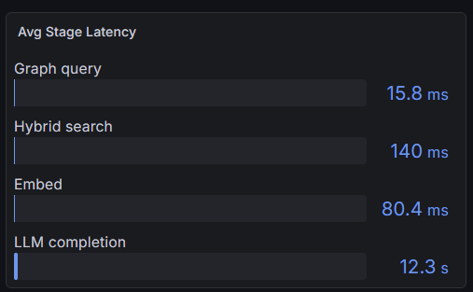
Key Decision #2: Agent Design – Issues & Fixes
Preventing infinite tool loops
Problem encountered in testing:
expand_entity("unknown corp") → returns "[]"
LLM interpretation: "tool returned empty, try different query"
LLM action: retries expand_entity 20+ times before timeout
Effect: 20× latency, cost spike, no answer
Why this happens: An LLM reads "[]" as "no results yet" — it has no prior instruction telling it that an empty graph response is terminal, not retryable.
This was an easy fix honestly kept it here because a similar bug in Claude Opus 4.7 existed which impacted us and increased usage for queries which had non-English non-noun words [Reddit-ClaudeBug]
Three-layer fix:
Fix 1 — Return a natural-language message, not an empty list:
"Entity not found in knowledge graph. Do not retry this tool.
Use search_documents instead to find relevant evidence."
Fix 2 — Hard usage cap:
UsageLimits(request_limit=8) → raises UsageLimitExceeded at turn 8
Fix 3 — Explicit fallback order in system prompt:
expand_entity → search_documents → get_exposure → conclude
(if a tool returns a not-found message, proceed to next stage)

Slide 8
Demo
Scenario 1: Sanctioned entity with graph expansion
Scenario 2: Procurement cross-reference
Scenario 3: Hallucination trap — the trust test

Slide 9
Conclusion
The system is designed around one question:
"Can a compliance professional trust this answer enough to act on it?“
Trust requires
sourced evidence — every answer cites a document
complete evidence — graph expansion surfaces relationships vector search misses
honest uncertainty — hallucination detection refuses out-of-scope queries
auditability — OTel traces every call; eval scores are live metrics, not snapshots

Slide 10
APPENDIX — Tech Stack
Layer | Technology | Decision rationale
Agent framework | PydanticAI 0.4.2 | Minimal surface area; type-safe deps; ~60 lines
LLM gateway | LiteLLM | Single boundary; vendor-agnostic; one env var swap
Chat model | Qwen3-4B (Ollama) | Local, data sovereign, 4GB VRAM, Apache 2.0
Embedding | nomic-embed-text | Local 768-dim; no API key; on-prem data retention
Knowledge graph | FalkorDB (RedisGraph fork) | Cypher queries; Redis wire protocol; low-latency traversal
Vector store | OpenSearch 2.13 | BM25 + kNN hybrid; nmslib/cosinesimil; entity_ids filter
NER | spaCy + GLiNER | Hybrid: GLiNER preferred on span overlap at 0.45 threshold
Entity resolution | RapidFuzz | token_sort_ratio at 85% threshold for name variant matching
Observability | grafana/otel-lgtm | OTel → Tempo + Prometheus + Loki; 4 pre-built dashboards
Eval | RAGAS + LLM-as-judge | Faithfulness/relevancy/precision/recall + groundedness 0–1
Rate limiting | slowapi | Per-IP: 10/min chat, 60/min search; 429 + Retry-After
Circuit breakers | aiobreaker | 8 breakers on all external dependencies
API | FastAPI | Three routers: /chat, /entity, /search

