Slide 1
Cucumber Testing
Branden Ogata
ICS 665

Slide 2
What is Cucumber?
Testing Tool
Available at http://cukes.info/
Aims to support behavior-driven design
Uses the Gherkin language
Includes Capybara
Focuses on web design

Slide 3

Required Files
‘cucumber-rails’
‘rspec-rails’
Fairly common in Rails projects
‘database_cleaner’
Optional
ansicon (for Windows)
Enables colored output in console
Makes reading output easier

Slide 4
Course Availability Site
Tracks courses on UH Manoa Course Availability website
When seat is open for a desired course, sends notification to user
Gives students better opportunity to register for the courses they want or need
Current status:
Basic layout set
User accounts
Create account
Sign in, sign out
Edit account information
View selected courses

Slide 5
Preparation
What do we want the application to do?
User should be able to sign in
How to determine if this was successful?
More specifically, how does the user know that he or she logged in?
What are the possible results?
Success
Failure

Slide 6
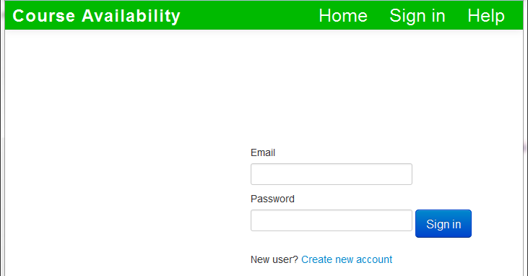
Signin Page

Slide 7
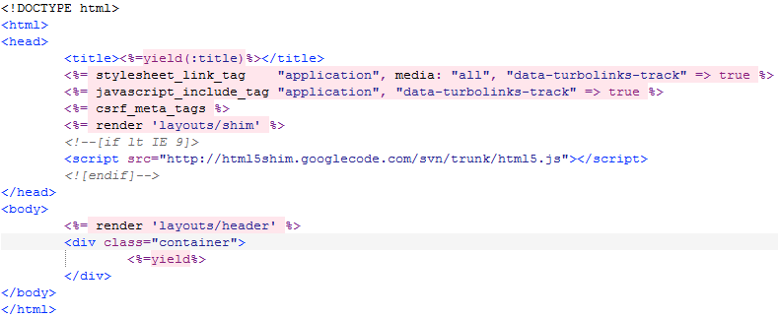
Main Template (application.html.erb)

Slide 8
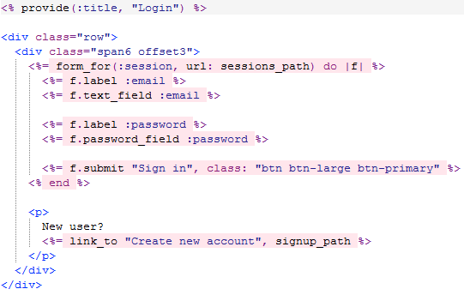
Signin Page Code (new.html.erb)

Slide 9
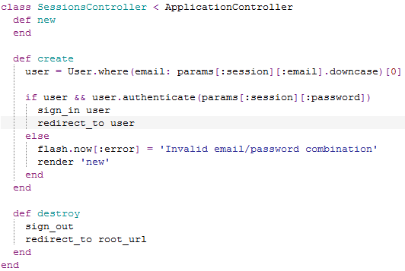
Signin Page Controller (sessions_controller.rb)

Slide 10
Feature File
[file name].feature
Located in features directory of project
Contains expected behavior in plain text
Essentially everything in the previous slide
Written in formatted English
Uses certain keywords

Slide 11
Step by Step: Feature
A process that the application can do
The overall test being run
Uses the “Feature” keyword
Usually one feature per file
In this case, test user log in
Feature: Signing in

Slide 12
Step by Step: Scenario
A potential outcome to test
Can have multiple scenarios in feature
In this case, logging in failed
Feature: Signing in
Scenario: Unsuccessful signin

Slide 13
Step by Step: Given-When-Then
Given
Precondition
When
Impetus
Then
Expected result
Feature: Signing in
Scenario: Unsuccessful signin
Given a user visits the
signin page
When he or she submits
invalid signin information
Then he or she should see an
error message

Slide 14
Step by Step: And
Joins multiple clauses
“But” keyword also exists
However, have never seen its use
Feature: Signing in
Scenario: Successful signin
Given a user visits the
signin page
And user has an account
When he or she submits valid
signin information
Then he or she should see
his or her profile page
And he or she should see a
signout link

Slide 15
Notes on Given-When-Then, And
Connotations above are based on convention
Cucumber/Gherkin does not really differentiate between them
Hypothetically, could use the keywords out of order
Would reduce readability

Slide 16
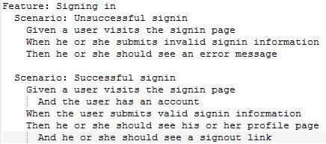
Current Feature File

Slide 17
Running Cucumber Tests
From command prompt
bundle exec cucumber features
This will almost certainly differ for other languages, environments, etc.

Slide 18
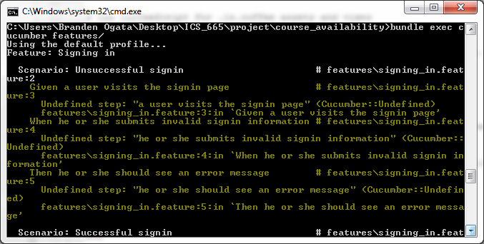
However…

Slide 19
Step Definitions
Explain what the Given/When/Then/And lines should do
Written in Ruby
Again, may differ when working in other languages
Consist of
Keyword
Given/When/Then/And
String/Regex
The text following the keyword in the feature file
Block
Some action or test

Slide 20
Examples
Feature File
Step Definition
Given a user visits the signin page
Given /^a user visits the signin page$/ do
visit signin_page
end

Slide 21
Examples
Feature File
Step Definition
When he or she submits invalid signin information
When (/^he or she submits invalid signin information$/) do
click_button "Sign in"
end

Slide 22
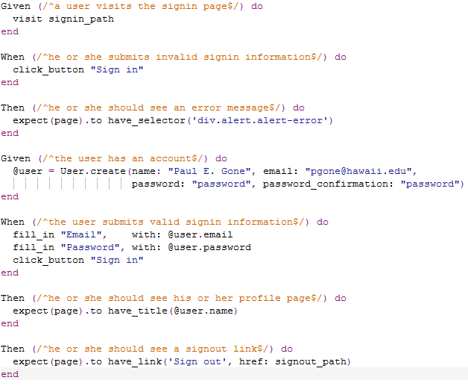
Completed Step Definitions

Slide 23
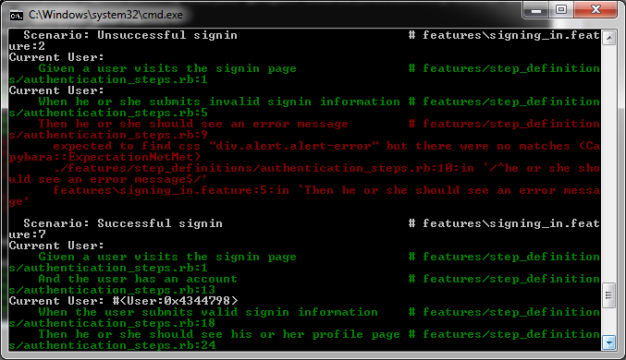
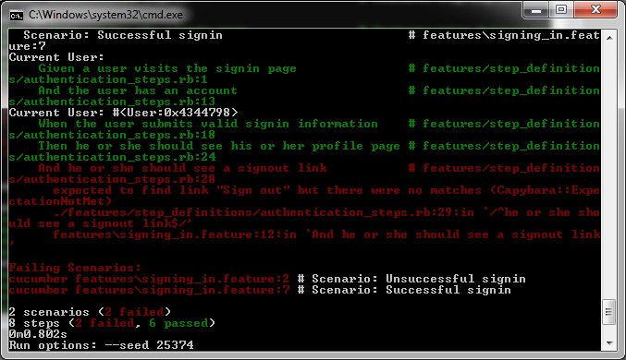
Running the Test Again

Slide 24
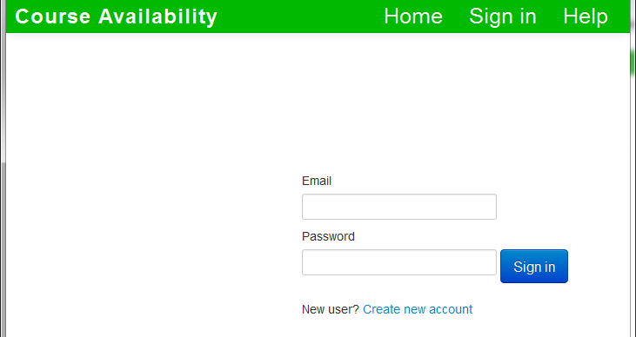
Failed Test—Unsuccessful Signin Case
Then he or she should see an error message
expect(page).to have_selector('div.alert.alert-error')
expected to find css "div.alert.alert-error" but there were no matches
As shown on right, no error message

Slide 25
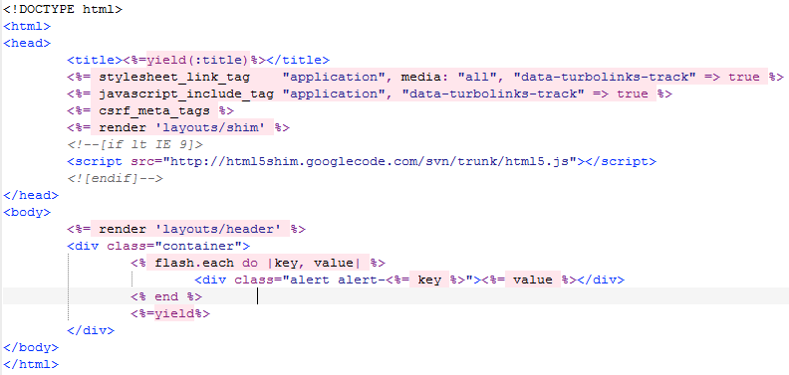
Fixing Unsuccessful Signin Case

Slide 26
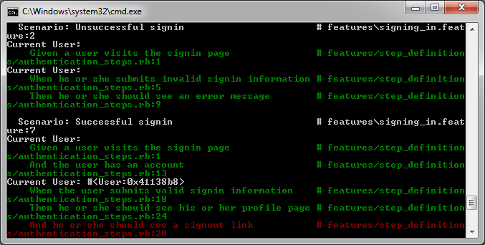
Test After First Fix

Slide 27
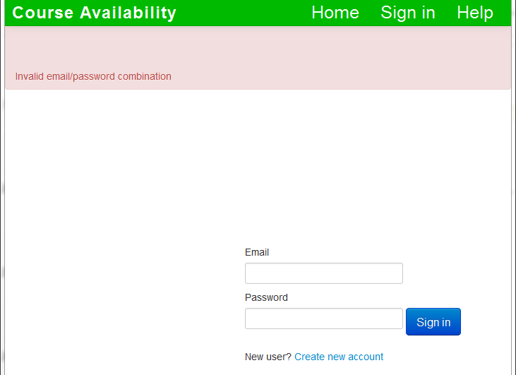
Page After First Fix

Slide 28
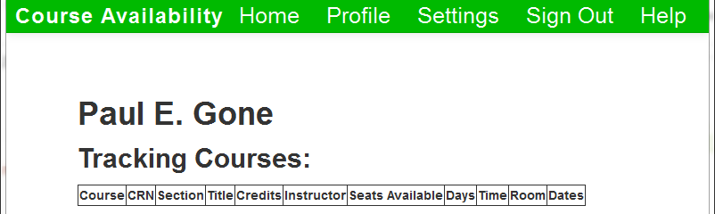
Failed Test—Successful Signin Case
And he or she should see a signout link
expect(page).to have_link('Sign out', href: signout_path)
expected to find link "Sign out" but there were no matches
Technically no “Sign out” link
However, there is a “Sign Out” link

Slide 29
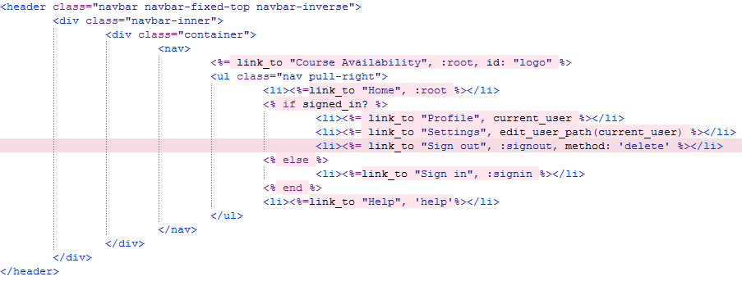
Fixing Successful Signin Case

Slide 30
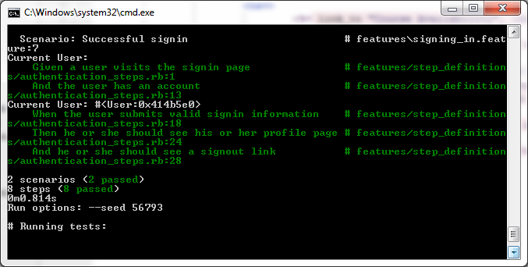
Test After Second Fix

Slide 31
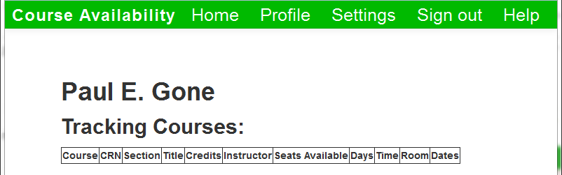
Page After Second Fix

Slide 32
Potential Disadvantages
Essentially need to write tests twice
Once for the feature file
Once for the step definitions
Therefore does not really get away from having to write lower-level code
Formatting Issues
Though possible for non-programmers to use, somewhat strict syntax
False Positives
Might detect error that does not significantly affect user experience or functionality

Slide 33
Conclusion
Cucumber (+ Capybara, Rspec)
Testing tool focused on behavior-driven design
Takes a higher-level perspective
Written in two stages
Near-English feature file
Ruby step definitions
Despite disadvantages, still worth considering for Ruby (on Rails) projects

