Slide 1
⚡ Electric Vehicles (EVs): Driving the Future 🚗
Clean, Smart, and Sustainable Transportation

Slide 2
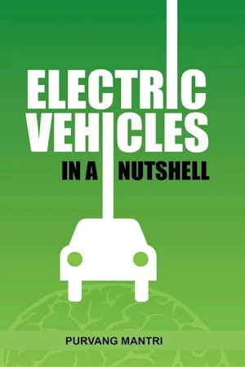
What are Electric vehicles? 🔋
EVs are vehicles powered by electric motors
instead of fuel engines.They run on batteries
charged using electricity.
Types: BEV, PHEV, HEV

Slide 3
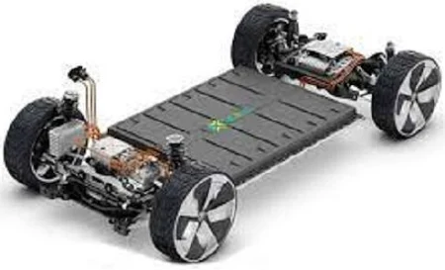
How EVs Work ⚙?
.1.Battery stores electricity to power the car 🔋
.2. Electric motor uses the battery power to move the wheels ⚡
.3. Controller controls speed, power, and braking 🖥
.4. Charging is done at home, public stations, or fast chargers 🔌
.5. Regenerative braking recovers energy when slowing down 🚗💨.

Slide 4
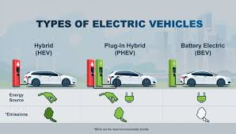
Types of EVs 🚘..
BEV: Fully electric
PHEV: Electric + fuel engine
HEV: Mainly fuel engine with electric assistance

Slide 5
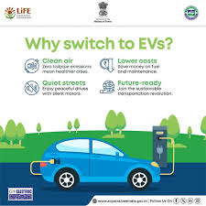
Advantages of Evs 🌱
Eco-Friendly: Zero emissions 🌍
Low Running Cost: Electricity cheaper 💰
Less Maintenance: Fewer moving parts 🔧
Smooth & Quiet Ride: Silent & powerful 🤫

Slide 6
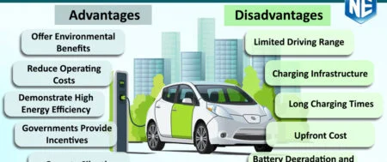
Challenges of EVs ⚠
Limited Range 🚗
Charging Infrastructure 🔌
Battery Cost 💵
Long Charging Time ⏳

Slide 7
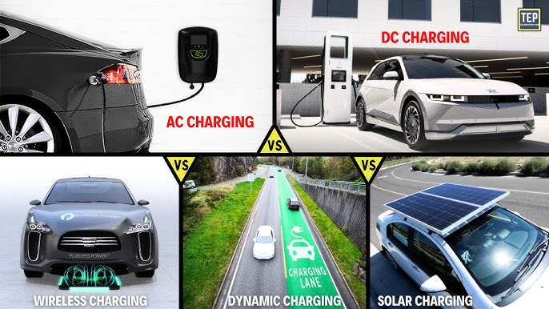
Charging Methods 🔋⚡
Home Charging: Slow but convenient 🏠
Public Charging: Medium speed 🏢
Fast Charging / Superchargers:
30–60 mins ⚡🚀

Slide 8
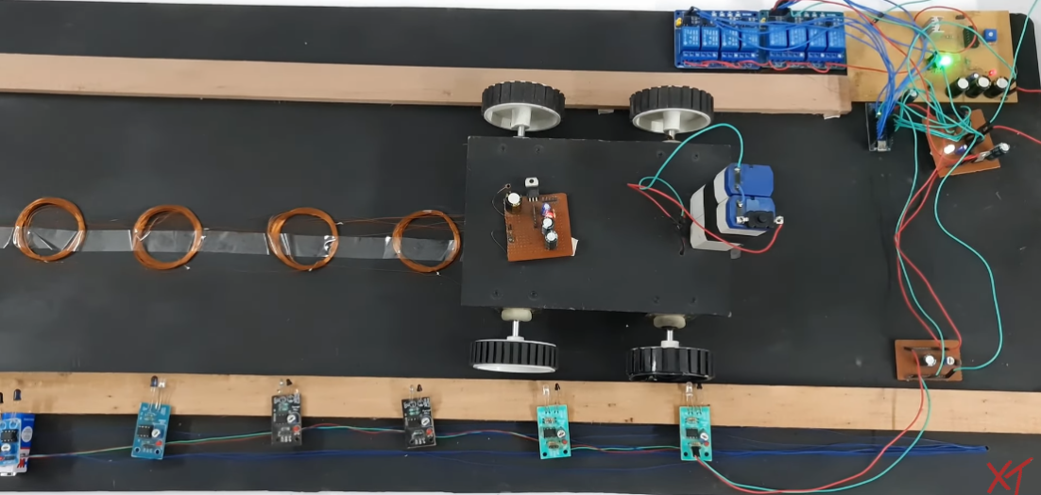
Our Special Project 🚗⚡🔋
Idea: Electric vehicles charge while driving!
How: Embedding copper coils under the road and receiver
coils in the EV to transfer energy wirelessly.
Benefit:EVs never need to stop for chargingReduces
range anxiety
and makes long trips easierSaves time and increases
convenienceImage
idea: Car driving on a road with glowing energy transfer
lines

Slide 9
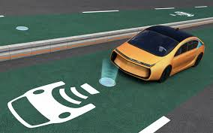
Conclusion ✅
EVs are shaping the future of clean & smart transportation ⚡
Reduce pollution, save energy, and provide smooth,
quiet rides 🌱
Our project makes driving and charging seamless,
a step toward the next-gen smart roads 🚗🔋

Slide 10
“Thank you 😊”
Glowing road with an EV charging wirelessly 🔋

