Slide 1



Django
Web development team -APSSDC

Slide 2
Django
Django is a free and open source web application framework written in Python ,more than a collection of modules that make development easy
1.How to install Django
Pip install Django
2.How to create Django project
Django-admin startproject myproject

Slide 3
Django
3.How to run project
python manage.py runserver
URL stands for Uniform Resource Locator. address of a given unique resource on the Web
a unique resource. Such resources can be an HTML page, a CSS document, an image, etc Example: http://engineering.apssdc.in
https: is server engineering.apssdc.in is the domain name

Slide 4
Django
Django have defult server
Python server is supported static and dynamic urls
Django server port number
127.0.0.1:8000 if u change we can
Python manage.py run server port number ex:12.61.05.07
let me discuss code how to run a project and how to implement the project

Slide 5
Django
Django have defult server
Python server is supported static and dynamic urls
Django server port number
127.0.0.1:8000 if u change we can
Python manage.py run server port number ex:12.61.05.07
let me discuss code how to run a project and how to implement the project

Slide 6
Django
settings.py
INSTALLED_APPS = [
'django.contrib.admin',
'django.contrib.auth',
'django.contrib.contenttypes',
'django.contrib.sessions',
'django.contrib.messages',
'django.contrib.staticfiles',
'url',
]

Slide 7
Django
url.py
from django.contrib import admin
from django.urls import path
from url import views
urlpatterns = [
path('admin/', admin.site.urls),
path('hi/',views.hi,name='hi',),
path('hello/',views.hello,name='hello',),
path('rollno/<int:id>',views.rollno,name='rollno'),
path('st/<str:ld>',views.st,name='st'),
]

Slide 8
Django
Views.py
from django.shortcuts import render,redirect
from django.http import HttpResponse
def hi(request):
return HttpResponse("""<h2>Hello Students</h2>""")
def hello(request):
return HttpResponse("""<h2>Hello Students we are in Hello Function</h2>""")
def rollno(reg,id):
txt = '<h2>This is ur id {} </h2>'.format(id)
return HttpResponse(txt)
def st(reg,ld):
txt = '<h2>This is ur id {} </h2>'.format(ld)
return HttpResponse(txt)

Slide 9
Django
Message-:filling data into the various user input fileds in forms,when u click on submit,
the data will be stored into the server.server will checkout the data,
it will shows the alert message depends on(success,warning,info,error) then it will show on the top one-time notification is called message
How import messages
from django.contrib import messages
Types of Messages
Constant Tag
DEBUG debug

Slide 10
Django
INFO info
SUCCESS success
WARNING warning
ERROR error
Message example
from django.contrib import messages
messages.add_message(request, messages.INFO, 'Hello world.')

Slide 11
Django
messages.debug(request, '%s SQL statements were executed.' % count)
messages.info(request, 'Three credits remain in your account.')
messages.success(request, 'Profile details updated.')
messages.warning(request, 'Your account expires in three days.')
messages.error(request, 'Document deleted.')

Slide 12
main.html
<body><div class="dt">
{% if messages %} {% for m in messages %}
<div class="alert alert-{{m.tags}}" style="margin-top:20px;">{{ m }}</div>
{% endfor %}{% endif %}
<div id="login">
<form action="{%wel'%}" autocomplete="on" method='post'>
{% csrf_token %}
<h1>Log in</h1>
<input id="username" name="username" required="required" type="text" placeholder="ur name"/>
<input id="password" name="password" required="required" type="password" placeholder="org" />
<input type="submit" value="Login" />
</form></div></body>

Slide 13
Wel.html
body>
{% if messages %}
{% for m in messages %}
<div class="alert alert-{{m.tags}}" style="margin-top:20px;">{{ m }}</div>
{% endfor %}
{% endif %}
<h2 style="text-align: center; color: blue">Welcome to My Web Site</h2>
</body>

Slide 14
url.py
from django.contrib import admin
from django.urls import path,include
urlpatterns = [
path('',include('login_.urls')),
path('admin/', admin.site.urls),
]

Slide 15
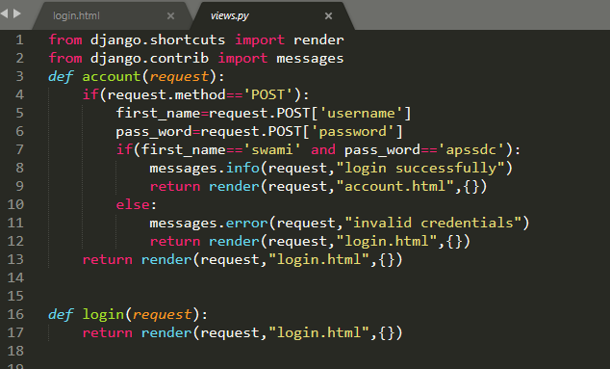
Views.py

Slide 16

Thank you
Slides created, maintained and distributed by Web development Team - Andhra Pradesh State Skill Development Corporation (All these Slides are open source)

