Slide 1
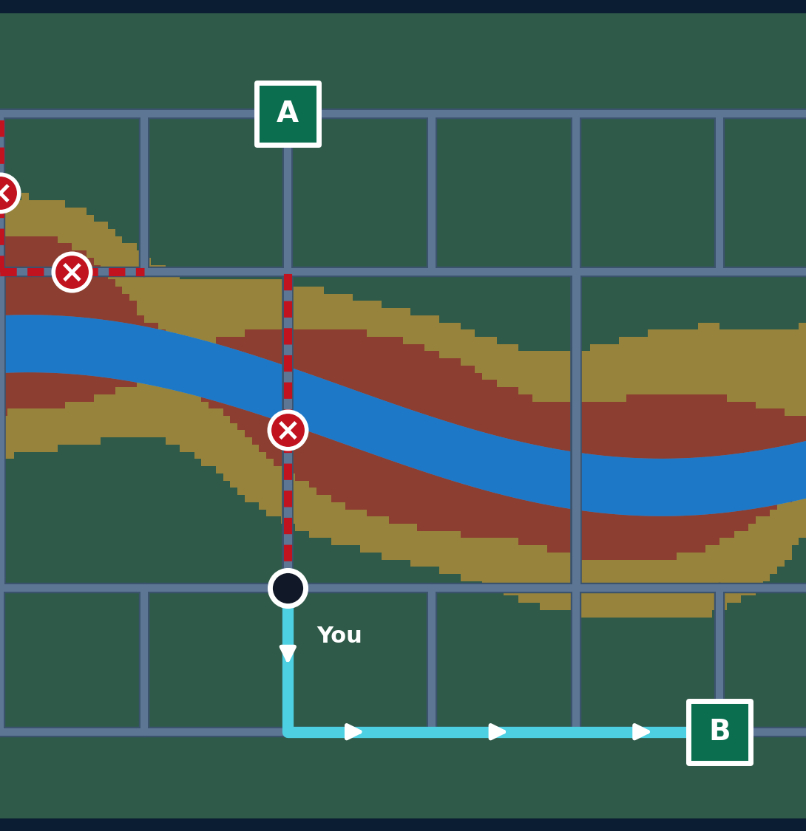
FloodSense AI
Predict the flood. Block the danger. Move people to safety.
Predict
Map
Route
Shelter
AI-powered flood prediction, risk zoning and live evacuation planning
Notes:
Open with the one-line idea: a system that tells people whether flooding will happen, which areas are dangerous and where to go.

Slide 2








Static flood maps can't keep up
Today
FloodSense AI
Static risk maps, updated by hand
Risk recalculated as rain and river data change
Evacuation routes fixed on paper
Routes rebuilt around blocked roads
Flooded roads found too late
Early warning before roads go under
Shelter overload and guesswork
People spread across shelters by capacity
Notes:
Contrast: a static map is out of date the moment the rain changes. Our system is built around change.

Slide 3










How the system works
INPUT DATA
OUTPUT
Rainfall
Low / Medium / High
River / water level
Risk zone map
AI flood prediction
Location & elevation
Safest evacuation route
Random Forest / XGBoost
Road network
Nearest safe shelter
Low
Medium
High
Shelters & capacity
e.g. rain rising + river rising → 82% flood probability
Lives-protected score
Rain ↑ → risk changes → roads blocked → route changes → people reassigned
Notes:
Left to right: data in, AI prediction, then risk map, route, shelter and score. The ribbon is the core idea: everything updates when conditions change.

Slide 4
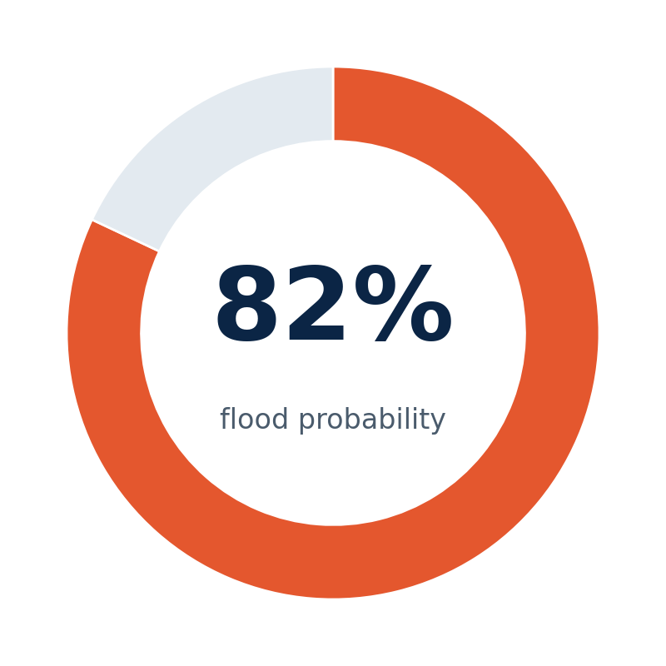
AI flood prediction
HIGH RISK
Rainfall rising
River level rising
Low elevation
Model: Random Forest first, XGBoost to improve · scikit-learn
Notes:
Start simple: Random Forest on rainfall, river level and elevation. Output is a probability mapped to Low, Medium or High. Chart values are illustrative.

Slide 5
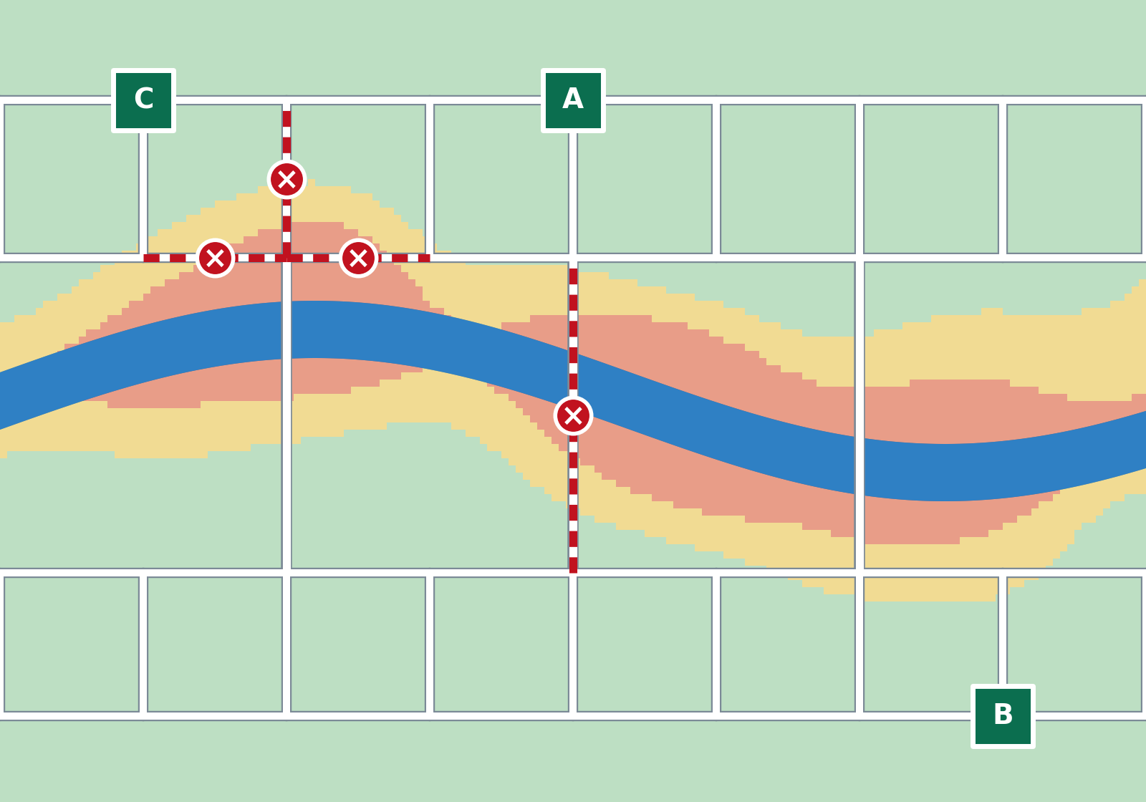
Risk zones update with the rain
High risk
Evacuate now; roads here get blocked
Moderate risk
Watch closely; prepare to move
Safe
Shelters and safe routes live here
Flooded road, removed from routing
×
Notes:
Heavy-rainfall scenario. Zone size comes from the model output plus river distance and elevation. Map is a simulated demo scene.

Slide 6
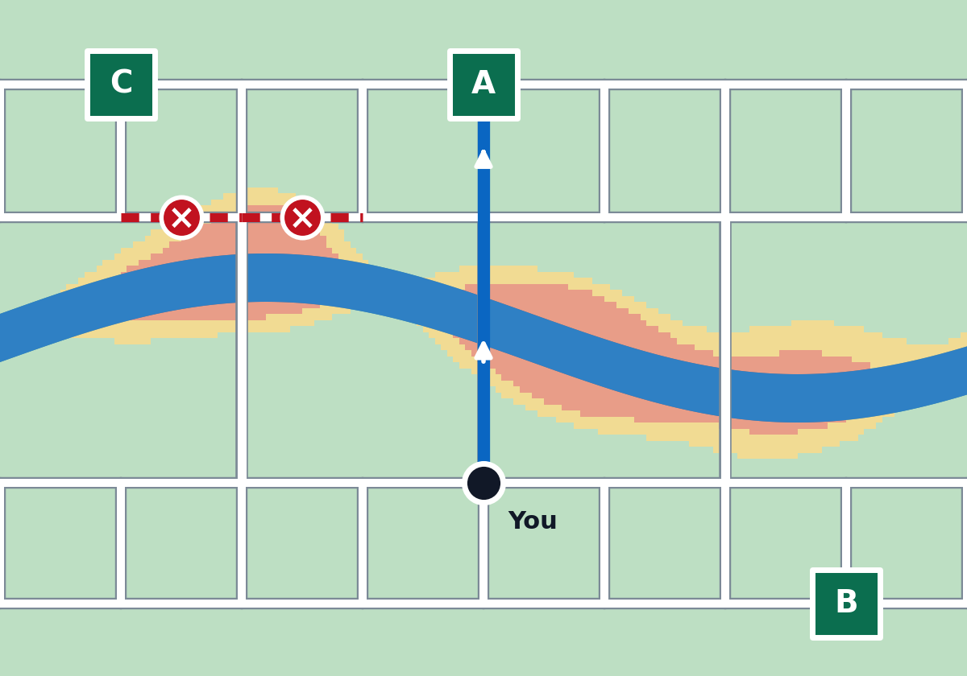
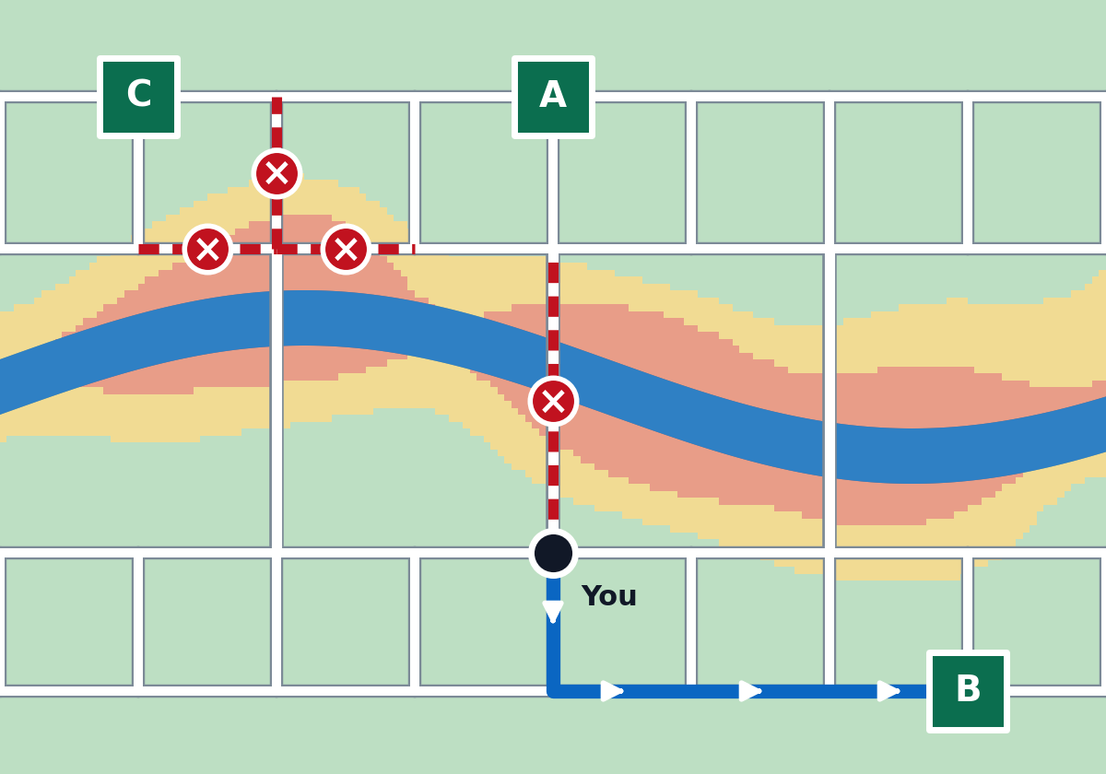

When a road floods, the route changes
Moderate rain: bridge open → Shelter A
Heavy rain: bridge flooded → rerouted to Shelter B
Dijkstra / A*: flooded roads are removed from the graph; cost = distance × risk
Notes:
Same person, same start point. When rainfall rises, the middle bridge is flagged flooded and the system reroutes automatically, here to Shelter B.

Slide 7

Shelter allocation & lives protected
1,000
people protected
100%
evacuation coverage
Fill the nearest safe shelter first, then overflow to the next. Never exceed capacity.
Notes:
Example from the brief: capacities 300, 500, 400 for 1,000 people. The allocator respects capacity and recomputes whenever a shelter becomes unreachable.

Slide 8




Tech stack & live demo
BUILD
DEMO
Frontend
HTML/CSS/JS or React
Click “Heavy Rainfall”
Red risk zones appear
1
Map
OpenStreetMap + Leaflet.js
Click “Evacuate”
Flooded road detected, route changes
2
Backend
Python, Flask / FastAPI
Shelter assigned
People reassigned within capacity
3
AI + routing
scikit-learn, Dijkstra / A*
Lives protected
Score updates live
4
Rain changes. Routes change. Lives protected.
Notes:
Close on the core idea: rain increases, flood risk changes, dangerous roads are blocked, routes change automatically and people are reassigned to available shelters.

