Slide 1
B.TECH SOFTWARE ENGINEERING PROJECT REVIEW
Electricity Theft Detection &
Consumer Inspection Platform
Machine Learning-Based Electricity Theft Detection and Inspection Management
Student Investigator:
Swanand Siknis
Registration Number: 24BRS1358
Programme & Institution:
B.Tech CSE — Artificial Intelligence & Robotics
VIT Chennai

Slide 2
02 | PROBLEM STATEMENT
Challenges in Electricity Distribution
Smart meters are a relatively new development in India's electricity sector, and their adoption is creating more opportunities to use detailed consumption data.
Traditional meter-reading methods provide less detailed information about daily electricity usage.
Smart-meter data can help identify unusual consumption patterns that may indicate electricity theft.
Distribution companies need a more organized way to review suspicious cases and manage inspections.
Electricity Theft Intelligence & Inspection Platform | VIT Chennai
Swanand Siknis (24BRS1358) | Slide 2 of 35

Slide 3
02 | PROBLEM STATEMENT
From Prediction to Verification
ML predictions alone cannot confirm theft; physical on-site inspection is still necessary.
Consumer services, inspection work and official communication should be easier to manage through one connected system.
Central Problem Statement:
"How can we use smart-meter data to identify possible electricity theft and manage the inspection process through one organized system?"
Electricity Theft Intelligence & Inspection Platform | VIT Chennai
Swanand Siknis (24BRS1358) | Slide 3 of 35

Slide 4
03 | PAST WORK IN THIS AREA
Past Work in This Area
1. Existing ML Approaches
  Researchers have widely applied machine learning algorithms to identify potential electricity theft from smart-meter consumption data. Studies show that customer daily usage patterns can reveal consumption anomalies, bypass behavior, and sudden drops in load that indicate unauthorized use.
2. Model Selection and Benchmarking
  A published benchmark study by Petrlik et al. (2022) evaluated five machine learning models on real smart-meter consumption data. The study demonstrated that tree-based algorithms significantly outperform linear models for tabular consumption data. Based on these verified findings and our own test evaluations, XGBoost was selected as the champion model for its superior detection capability and robustness against missing readings.
3. Existing Systems and the Operational Gap
  Existing research and software tools focus primarily on offline classification accuracy. However, there is a clear operational gap between detecting suspicious consumption and managing the subsequent inspection process. An isolated risk prediction does not schedule field visits, assign officers, or record physical inspection findings.
Electricity Theft Intelligence & Inspection Platform | VIT Chennai
Swanand Siknis (24BRS1358) | Slide 4 of 35

Slide 5
03 | PAST WORK IN THIS AREA
Research Gaps
Gap 1 — Growing Use of Smart Meters in India
Smart meters provide detailed consumption data, creating an opportunity to use daily electricity usage patterns to help identify possible theft. As smart metering expands, utilities need practical tools to make use of this data.
Gap 2 — Disorganized Inspection Workflows
Electricity distribution companies need a more organized way to review suspicious cases, assign inspection staff, schedule visits and record inspection results. Manual scheduling and unprioritized audits lead to inefficient field operations.
Gap 3 — No Single Connected Workflow and Closed-Loop in Existing Systems
The project aims to bring smart-meter-based risk detection and inspection management together, with consumer services and board communication in the same platform. Existing tools rarely connect model predictions with verified field outcomes.
Electricity Theft Intelligence & Inspection Platform | VIT Chennai
Swanand Siknis (24BRS1358) | Slide 5 of 35

Slide 6
04 | METHODOLOGY
Software Engineering Process
Requirements Analysis: Identify the users, their needs and the system requirements.
System Design: Plan the architecture, database, user roles and workflows.
UML Modelling: Use UML and other diagrams to represent the system before implementation.
Incremental Development: Build the system in separate modules and integrate them.
Testing: Test the APIs, access permissions and main workflows.
Final Integration: Validate the complete system across all user roles.
Electricity Theft Intelligence & Inspection Platform | VIT Chennai
Swanand Siknis (24BRS1358) | Slide 6 of 35

Slide 7
04 | METHODOLOGY
Operational ML and Inspection Flow
End-to-End Operational Flow:
Smart-Meter Data → Data Preprocessing → XGBoost Risk Prediction → Inspection Prioritization → Physical Verification (use that data for relearning making this a closed loop system)
Model Evaluation Results:
• Champion Model: XGBoost Classifier.
• Field Inspection Impact: 4.9x efficiency improvement over random manual auditing.
Only about 8-9% theft cases in the dataset.
Electricity Theft Intelligence & Inspection Platform | VIT Chennai
Swanand Siknis (24BRS1358) | Slide 7 of 35

Slide 8
05 | NOVELTY OF MY PROJECT
Novelty of My Project
Identify Suspicious Consumption: Use smart-meter consumption patterns to identify possible electricity theft rather than relying solely on random manual checks.
Prioritize Field Inspections: Help employees prioritize cases for physical inspection, focusing limited officer capacity on high-risk consumers first.
Explain Predictions with SHAP: Show why a consumer was flagged using SHAP explanations, giving officers clear evidence before visiting a location.
Manage the Complete Inspection Workflow: Manage case review, officer assignment, visit scheduling, map views and recorded inspection outcomes in one system.
Unified Utility Platform Vision: Bring inspection operations, consumer services (billing telemetry, dispute filing) and board communications into one planned platform.
Electricity Theft Intelligence & Inspection Platform | VIT Chennai
Swanand Siknis (24BRS1358) | Slide 8 of 35

Slide 9
06 | SDLC MODEL
SDLC Model: The Incremental Model
Why I Selected the Incremental Model:
The project has several separate modules: the data/ML pipeline, backend APIs, inspection portal, and consumer/board portals.
Each module can be developed and tested in stages before moving to the next part of the system.
New modules can be integrated into the existing system with lower risk of breaking working functionality.
Electricity Theft Intelligence & Inspection Platform | VIT Chennai
Swanand Siknis (24BRS1358) | Slide 9 of 35

Slide 10
06 | SDLC MODEL
Incremental Development Progression
• Increment 1 — Data & ML Engine [COMPLETE]
Data cleaning, feature extraction, XGBoost champion model, and SHAP explainability.
• Increment 2 — Backend & Database [COMPLETE]
MySQL 8.0 schema (16 tables), FastAPI REST APIs, JWT authentication, and RBAC.
• Increment 3 — Inspection Portal [COMPLETE]
Employee dashboard, priority queue, case details, map, and outcome recording modal.
• Increment 4 — Consumer & Board Portals [COMPLETE]
Consumer usage telemetry, bill dispute filing, and board communications.
Electricity Theft Intelligence & Inspection Platform | VIT Chennai
Swanand Siknis (24BRS1358) | Slide 10 of 35

Slide 11
07 | PROJECT PHASES
Development Process
1. Requirements Analysis
• Requirements were identified for consumers, employees and board communication staff.
• A detailed Software Requirements Specification (SRS) was prepared and submitted earlier.
2. System Design
• UML diagrams were used to plan the system, its interactions and component boundaries.
• Database structure and relationships were designed using a normalized MySQL schema (16 tables).
3. Implementation
• The project was divided into eight working phases to manage complexity.
• Each phase covers a distinct part of the system and builds on earlier deliverables.
Electricity Theft Intelligence & Inspection Platform | VIT Chennai
Swanand Siknis (24BRS1358) | Slide 11 of 35

Slide 12
07 | PROJECT PHASES
Phases 1 to 4: Completed Deliverables
• Phase 1 — Requirements and Data Audit [Complete]
Identify system requirements; inspect the dataset and plan preprocessing.
• Phase 2 — Data and ML Engine [Complete]
Clean and prepare the data; build consumption features and train/evaluate the model.
• Phase 3 — Backend and Database [Complete]
Create the database (16 tables) and backend APIs; implement authentication and RBAC.
• Phase 4 — Inspection Portal [Complete]
Build the employee dashboard, inspection queue, SHAP details, map, outcomes and reports.
Electricity Theft Intelligence & Inspection Platform | VIT Chennai
Swanand Siknis (24BRS1358) | Slide 12 of 35

Slide 13
07 | PROJECT PHASES
Phases 5 to 8: Underway & Pending Deliverables
• Phase 5 — Consumer and Board Portals [Complete]
Build Consumer Portal and Board Communication Portal; connect workflows to backend.
• Phase 6 — Feedback and Model Lifecycle [Underway]
Extend the use of verified inspection results; improve future model evaluation.
• Phase 7 — Security and Documentation [Pending]
Improve security and integration; complete documentation and deployment preparation.
• Phase 8 — Final Testing [Pending]
Test all user roles and major workflows; resolve issues and validate complete system.
Electricity Theft Intelligence & Inspection Platform | VIT Chennai
Swanand Siknis (24BRS1358) | Slide 13 of 35

Slide 14
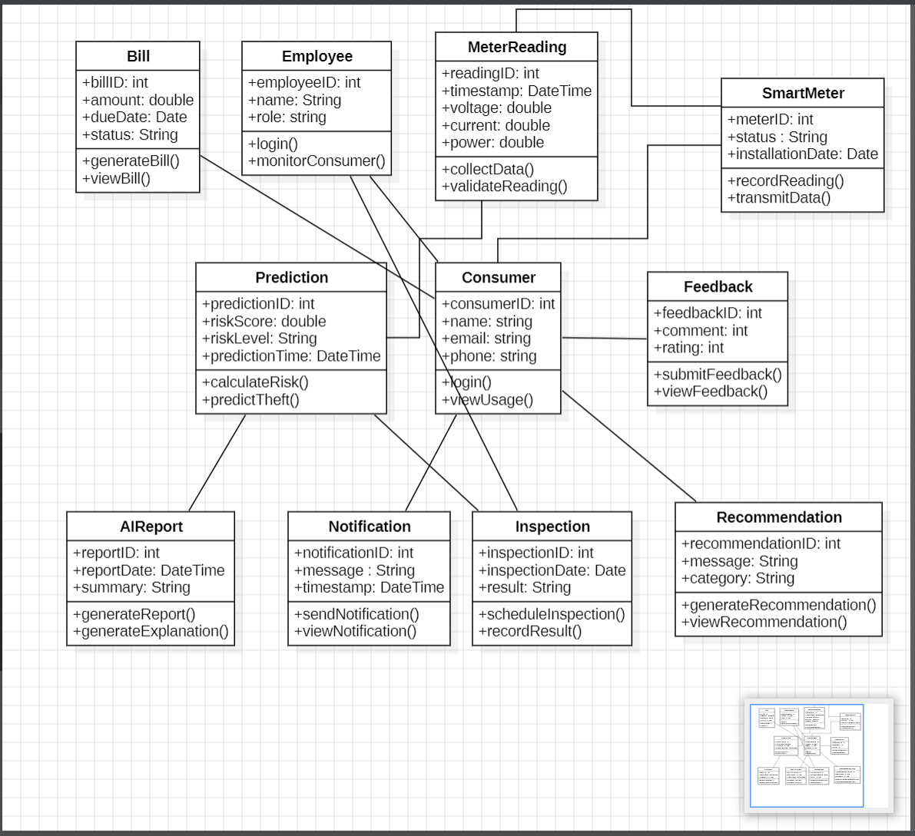
07 | PROJECT PHASES
Structure of the system

Slide 15
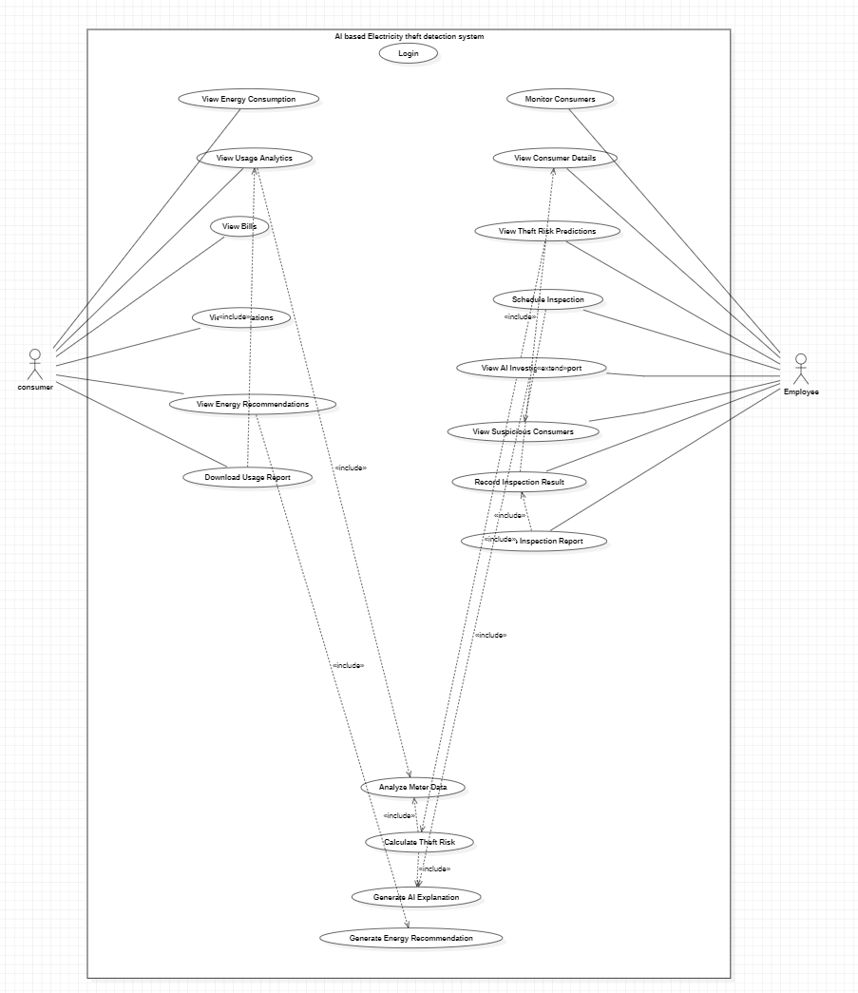
07 | PROJECT PHASES
Use Case Diagram

Slide 16
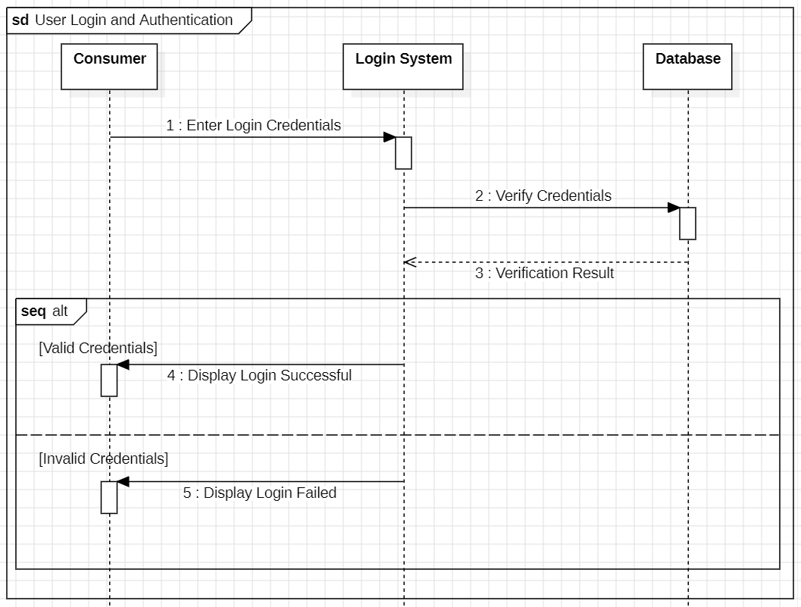
07 | PROJECT PHASES
Sequence Diagram

Slide 17
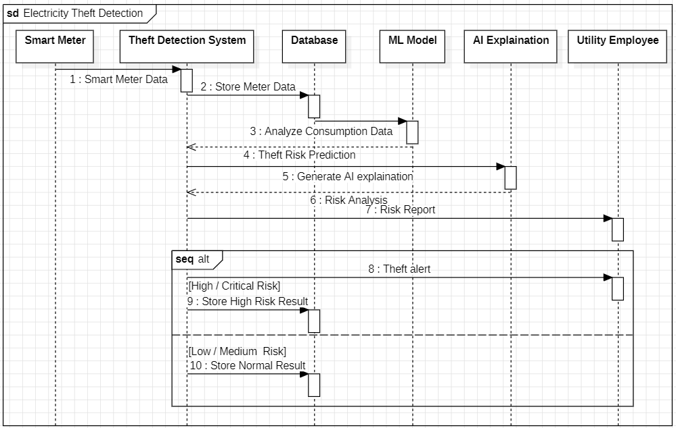
07 | PROJECT PHASES
Sequence Diagram

Slide 18
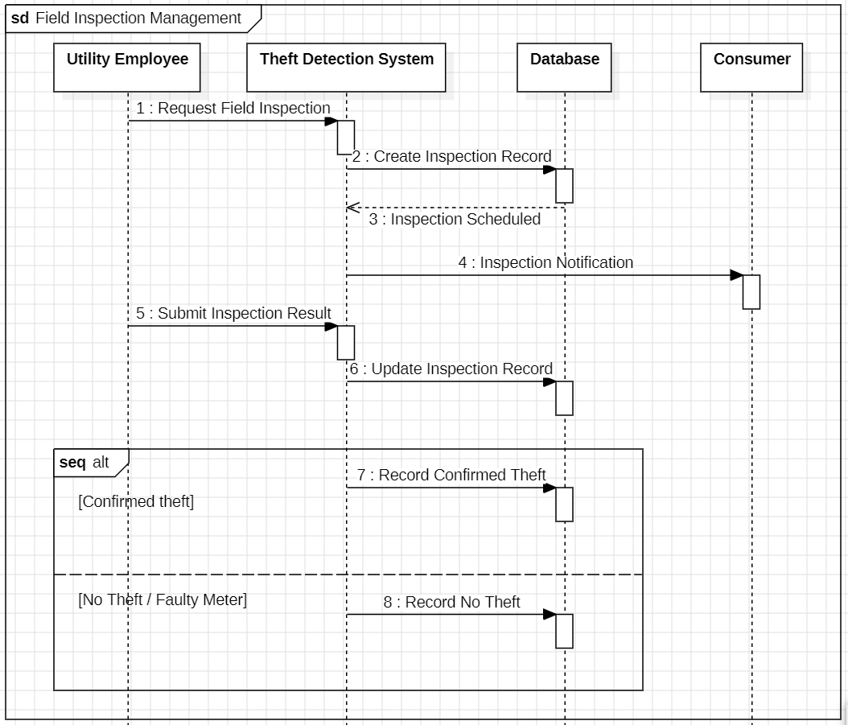
07 | PROJECT PHASES
Sequence Diagram

Slide 19
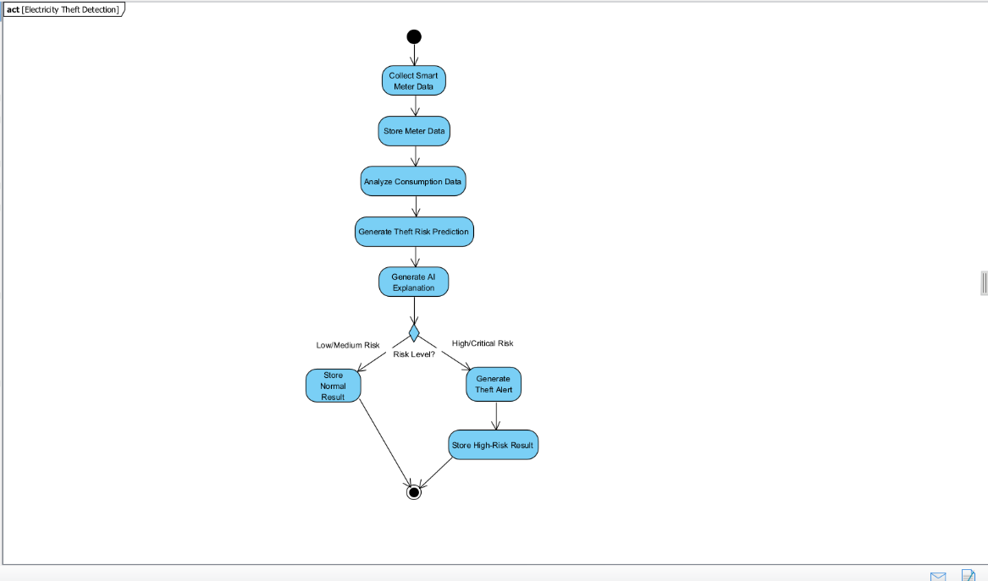
07 | PROJECT PHASES
Activity Diagram

Slide 20
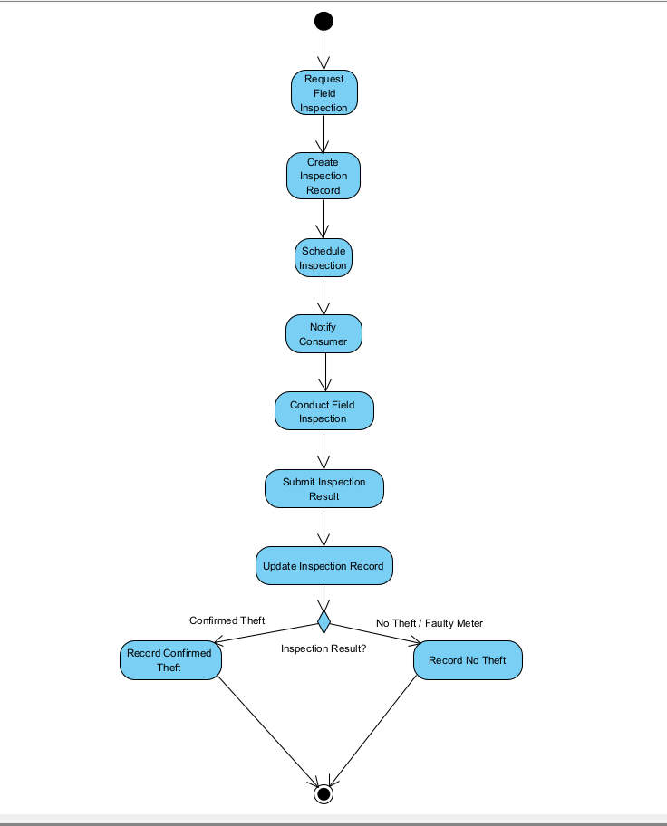
07 | PROJECT PHASES
Activity Diagram

Slide 21
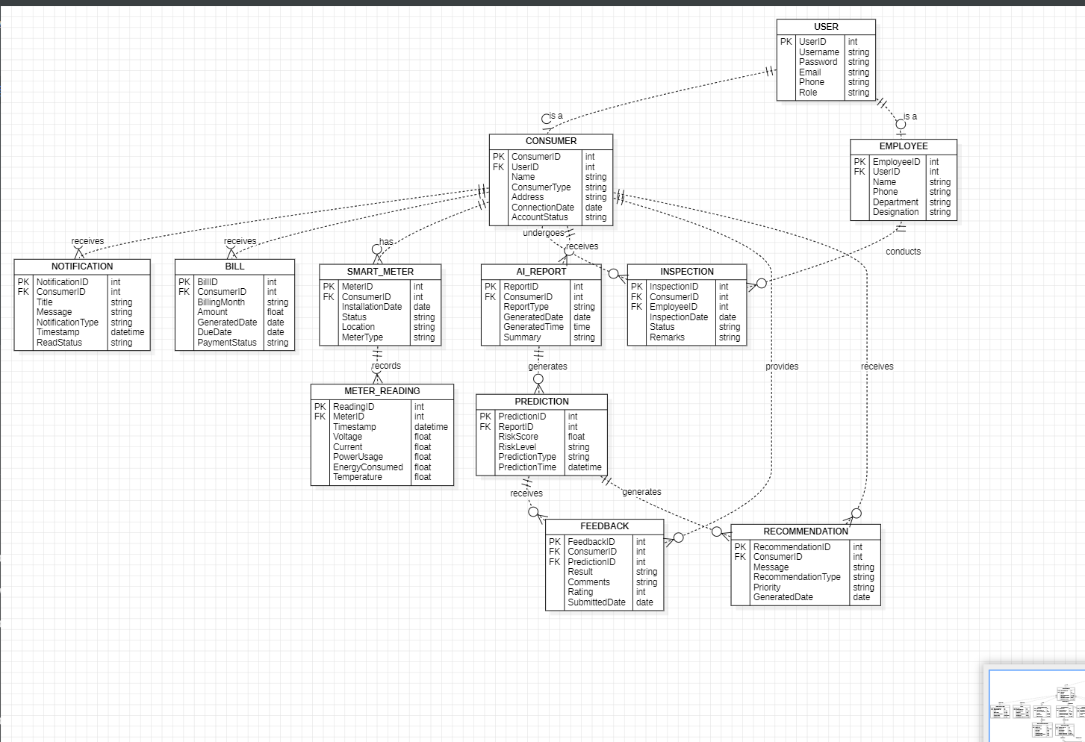
07 | PROJECT PHASES
Entity Relationship Diagram (ERD)

Slide 22
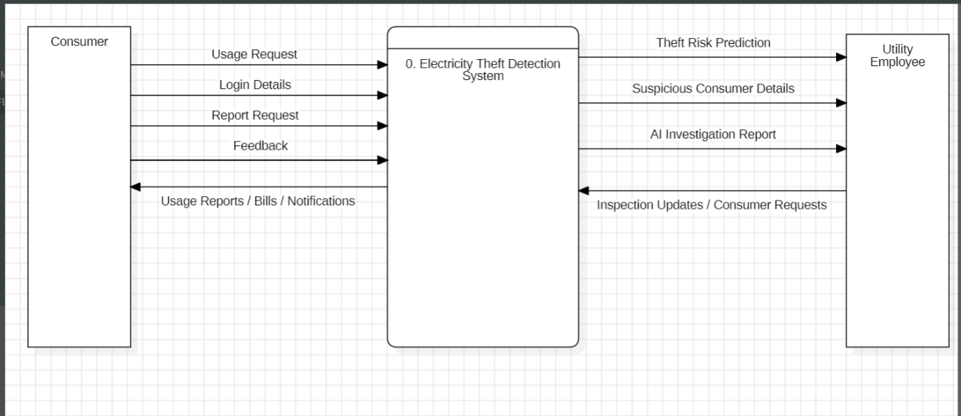
07 | PROJECT PHASES
Data Flow Diagram – Level 0

Slide 23
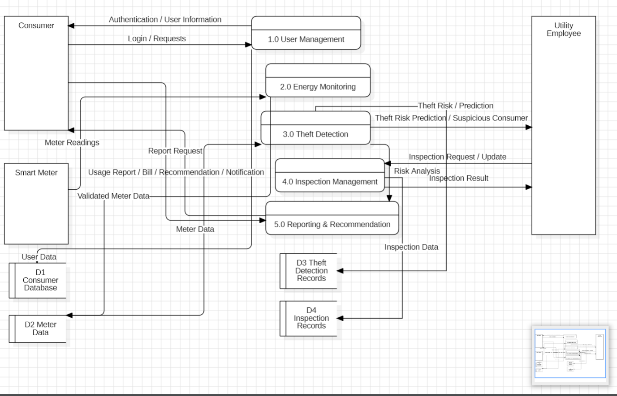
07 | PROJECT PHASES
Data Flow Diagram – Level 1

Slide 24
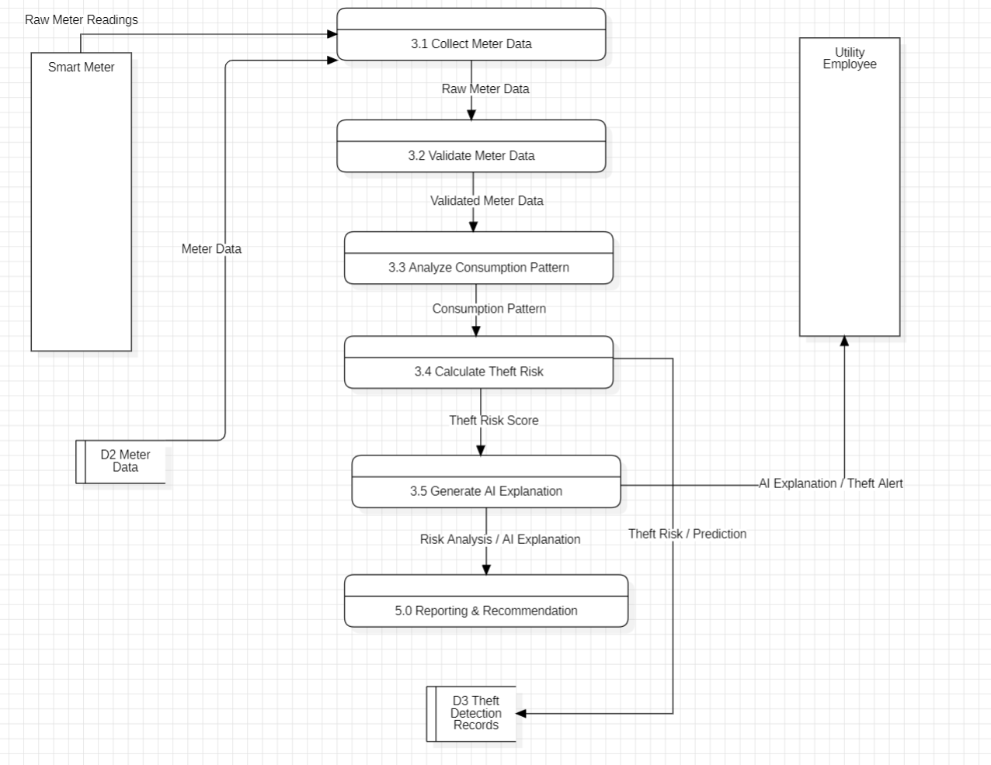
07 | PROJECT PHASES
Data Flow Diagram – Level 2

Slide 25
08 | CURRENT IMPLEMENTATION
Current Implementation: Progress Overview
Completed Work (Phases 1 to 4):
Phase 1: Requirements analysis and smart-meter dataset audit (SGCC data, 42,372 consumers).
Phase 2: Data preprocessing, feature engineering, XGBoost champion model, and SHAP explainability.
Phase 3: MySQL relational database (16 tables), FastAPI backend, JWT authentication, and role restrictions.
Phase 4: Inspection Intelligence Portal (Employee dashboard, queue, details, SHAP, map, assignment, outcomes, reports).
Work Underway (Phase 5):
• Phase 5: Consumer Portal and Board Communication Portal.
• Backend models and API foundations are established; user-facing screens and workflows are in active development.
Electricity Theft Intelligence & Inspection Platform | VIT Chennai
Swanand Siknis (24BRS1358) | Slide 22 of 35

Slide 26
08 | CURRENT IMPLEMENTATION
Testing and Verification Status
Automated Test Verification:
All 19 automated backend integration tests pass cleanly in pytest against the MySQL database.
Tests verify JWT authentication, role-based restrictions, inspection state transitions, and database integrity.
Frontend production build succeeds with zero TypeScript errors (tsc -b && vite build in 1.43s).
Testing Scope & Boundary Note:
Browser-level automated driver execution (Playwright) encountered an external upstream CDN network limitation for driver binaries.
System workflows were verified through comprehensive automated API tests and manual interface testing.
Electricity Theft Intelligence & Inspection Platform | VIT Chennai
Swanand Siknis (24BRS1358) | Slide 23 of 35

Slide 27
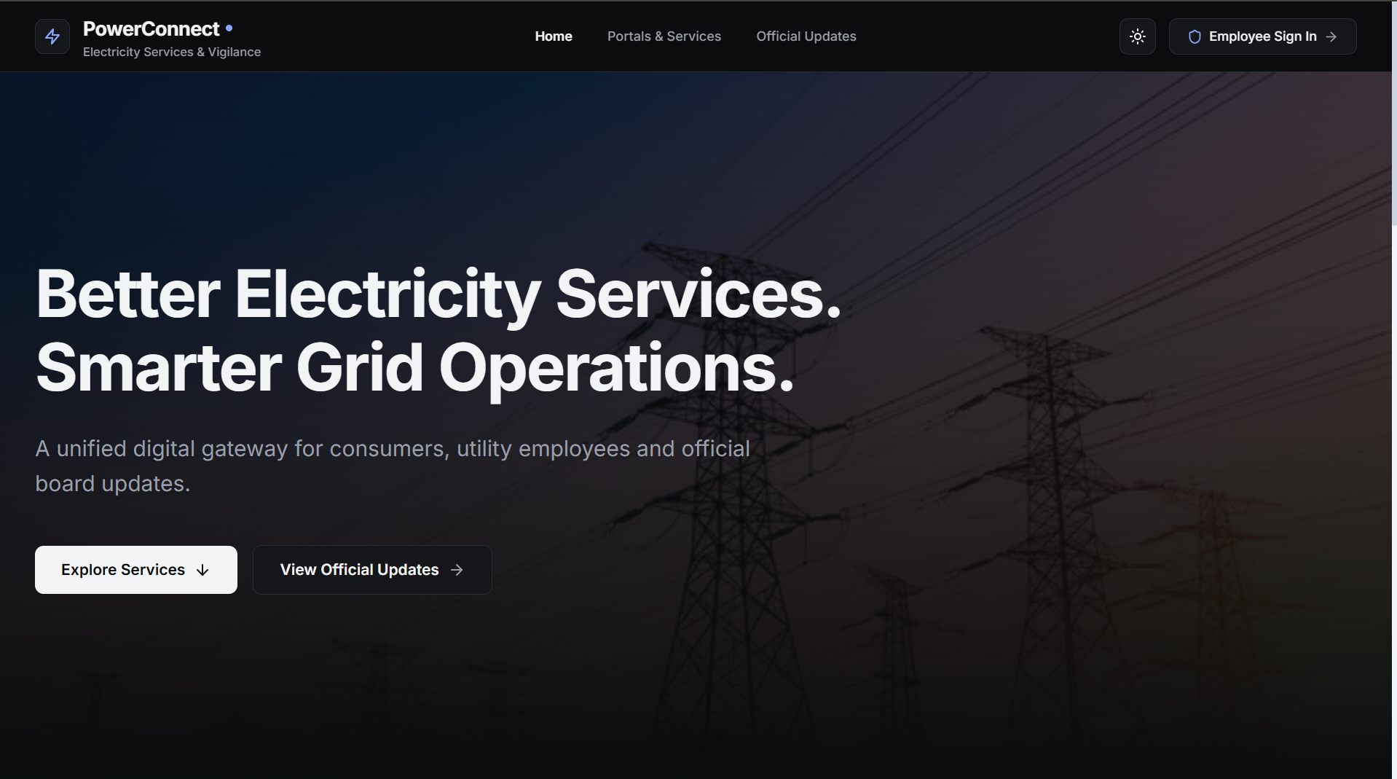
08 | CURRENT IMPLEMENTATION
Landing Page

Slide 28
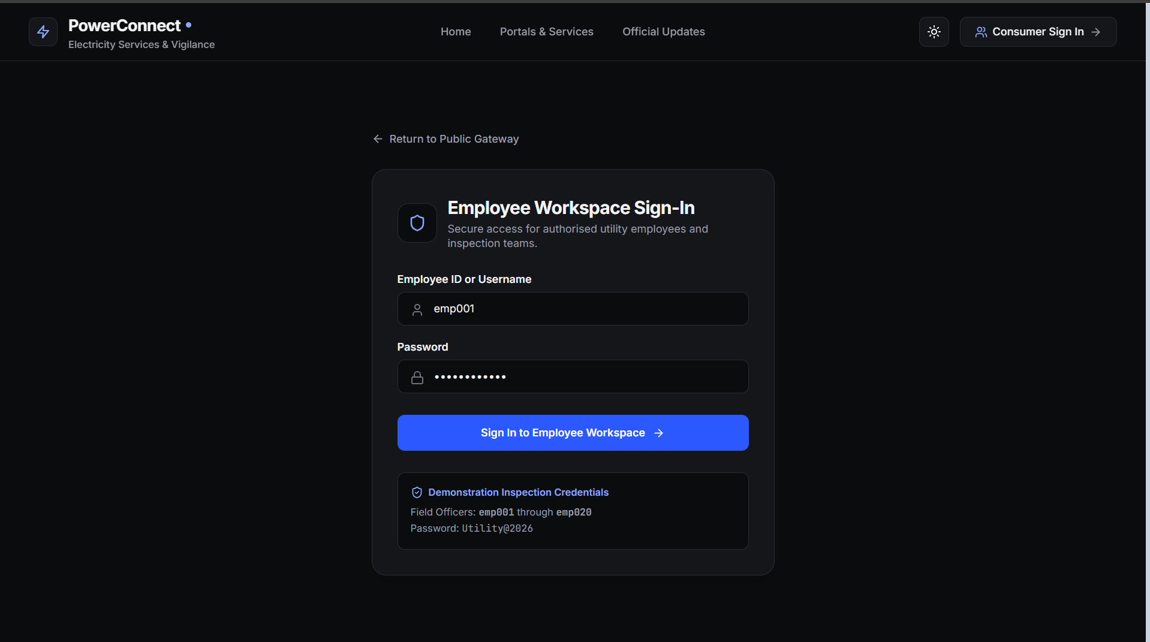
08 | CURRENT IMPLEMENTATION
Employee Dashboard

Slide 29
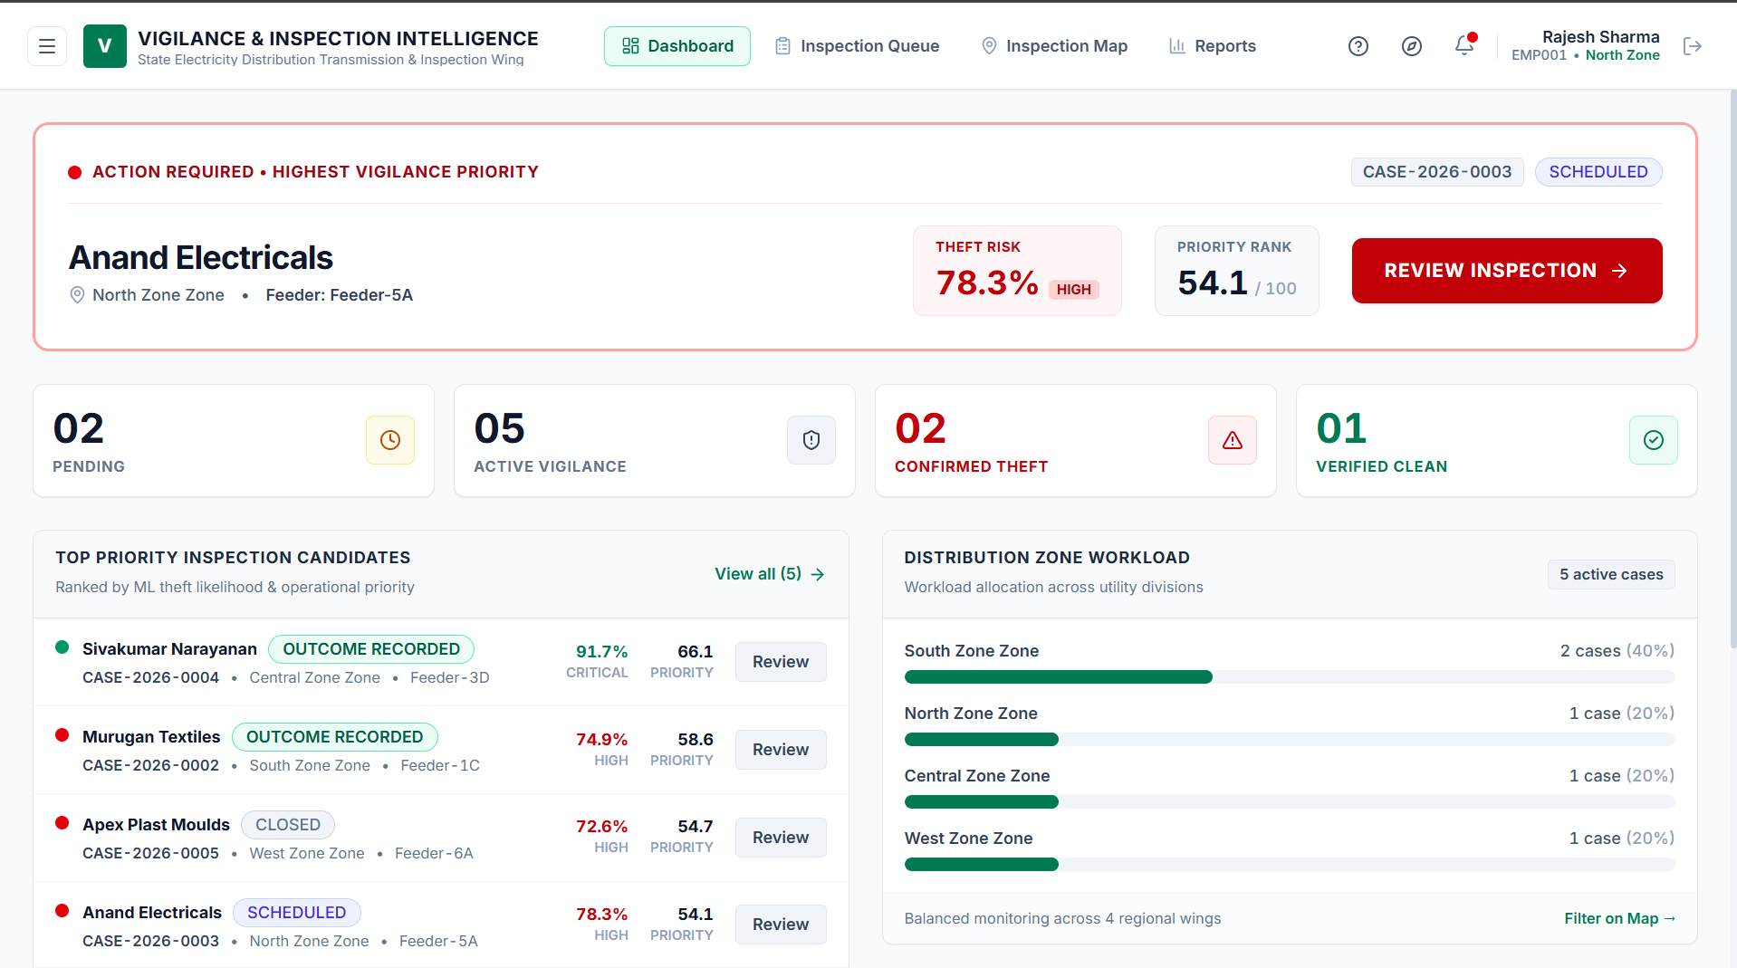
08 | CURRENT IMPLEMENTATION
Employee Dashboard

Slide 30
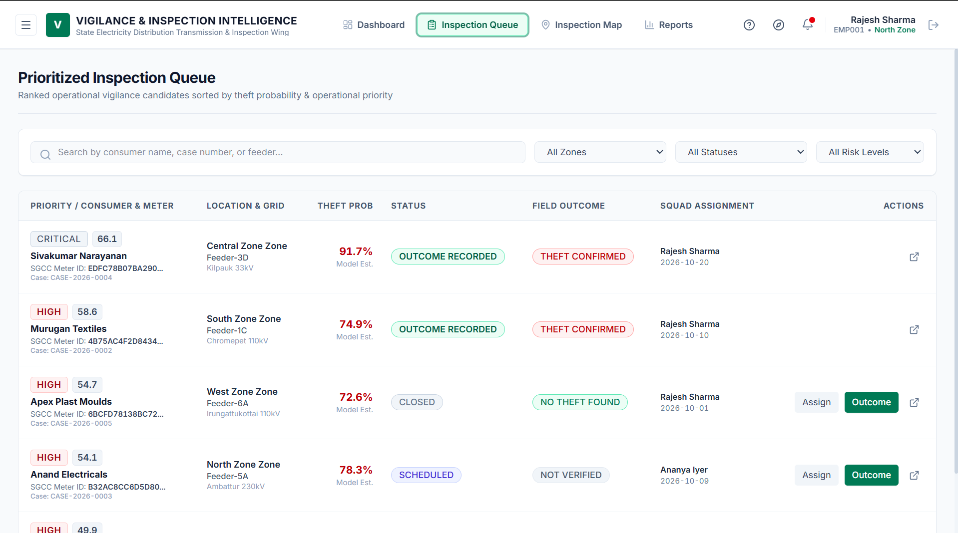
08 | CURRENT IMPLEMENTATION
Inspection Queue

Slide 31
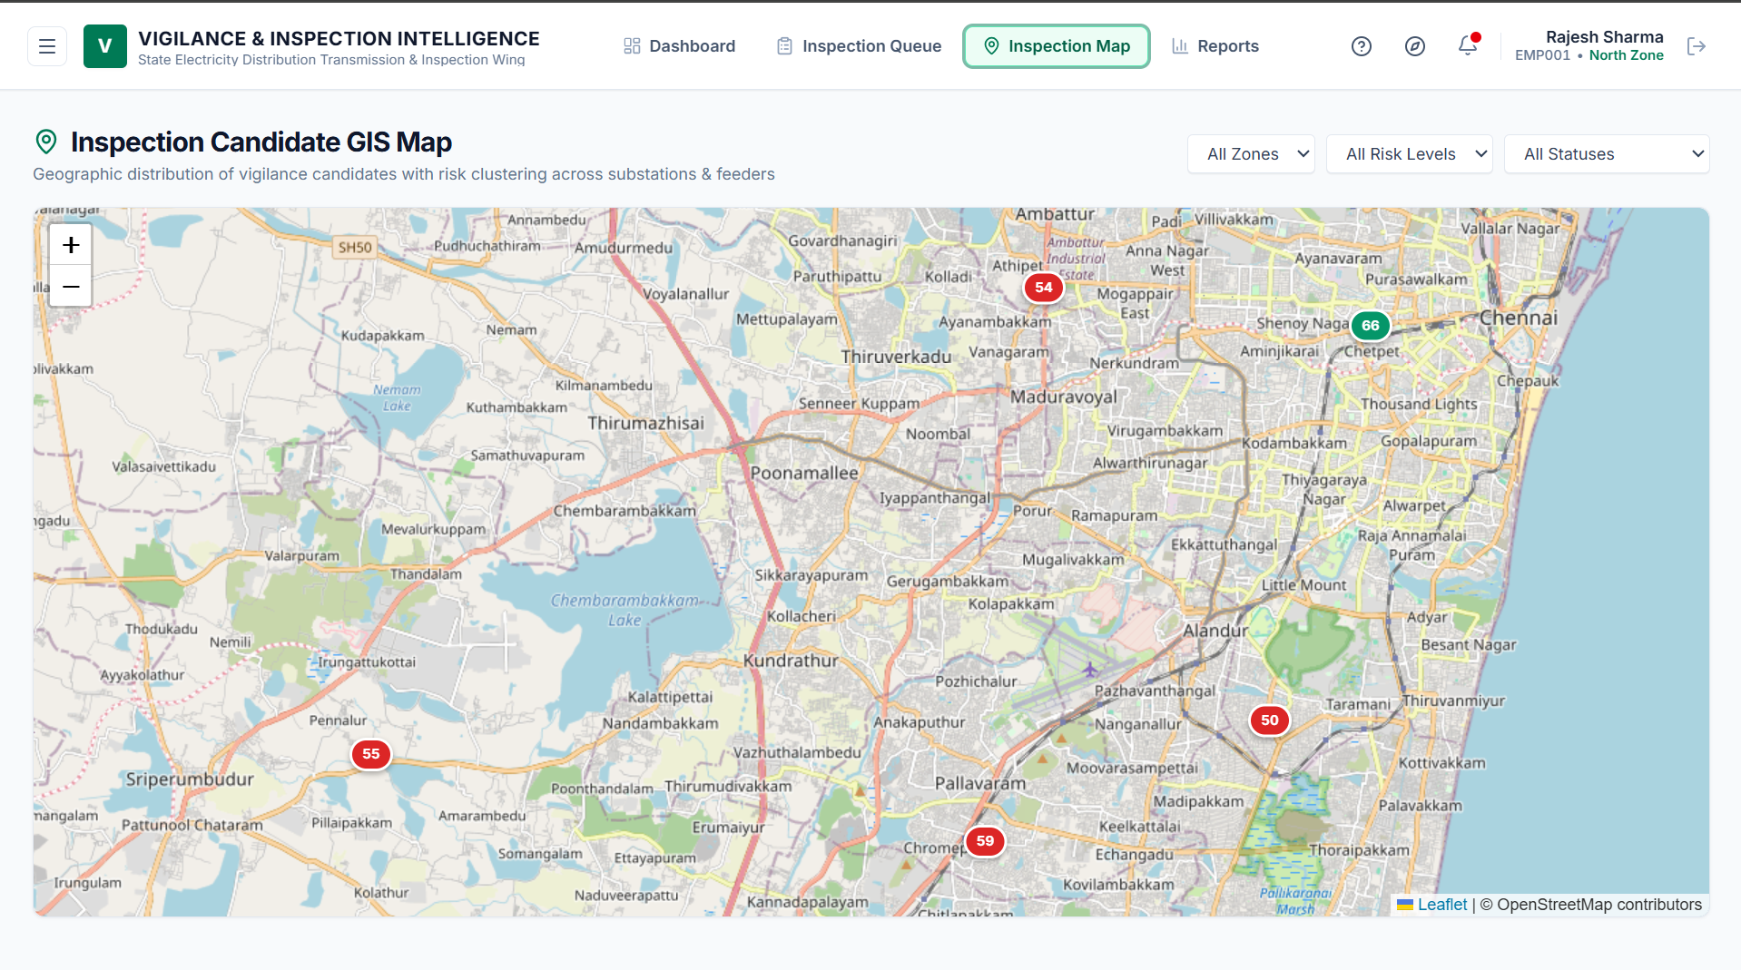
08 | CURRENT IMPLEMENTATION
Inspection Map

Slide 32
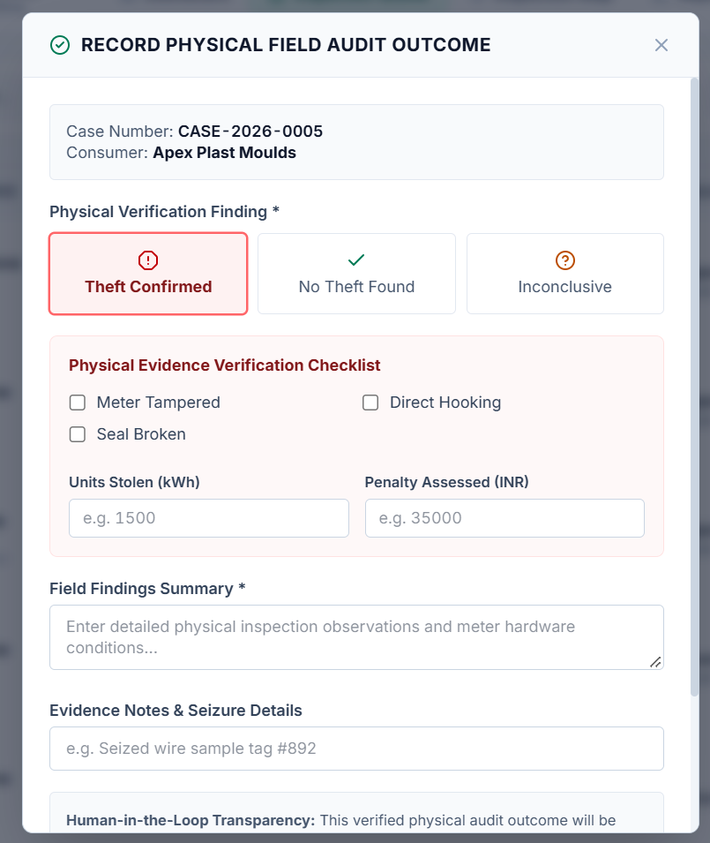
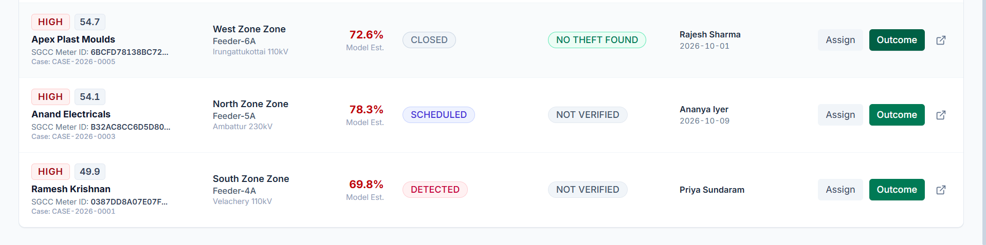
08 | CURRENT IMPLEMENTATION
Field Outcome Recording

Slide 33
09 | PENDING DELIVERABLES
Current Issues and Limitations
No proper dataset is available for Indian Consumption Patterns:
  This is because the onset of smart meters in India is pretty recent and its installation is still in progress.
Real world testing is needed in order to check the accuracy of the predictions:
  Testing of the theft detection on ground level is necessary in order to establish the credibility of the system.
Deployment Scope:
  Current performance is demonstrated using the SGCC dataset and a local development environment only.
Electricity Theft Intelligence & Inspection Platform | VIT Chennai
Swanand Siknis (24BRS1358) | Slide 33 of 35

Slide 34
10 | CONCLUSION
Conclusion
Integrated Operational System: The project combines smart-meter-based risk detection with inspection management, connecting machine learning predictions with verified field outcomes.
Structured Software Engineering Approach: The Incremental Model supports development in separate modules, ensuring that database, backend security, and inspection workflows are proven before adding further portals.
Delivery Status: The first four phases are complete and verified (ML engine, MySQL database, FastAPI backend, and Inspection Intelligence Portal).
Active Development: Phase 5 is underway, focusing on the Consumer Portal and Board Communication Portal.
Remaining Roadmap: Remaining work includes finishing user-facing portals, deeper feedback integration, documentation, and comprehensive system-wide testing.
Electricity Theft Intelligence & Inspection Platform | VIT Chennai
Swanand Siknis (24BRS1358) | Slide 35 of 35

Slide 35
10 | REFERENCES
References
1. Model Benchmarking Study:
Petrlik, J., Lezama, F., et al. (2022). "Electricity Theft Detection using Machine Learning." International Journal of Advanced Computer Science and Applications (IJACSA), Vol. 13, No. 12.
DOI: 10.14569/IJACSA.2022.0131251
2. Smart-Meter Anomaly Detection:
Tsao, Y.-C., Rahmalia, N., & Lu, J.-C. (2024). "Machine-Learning Techniques for Enhancing Electricity Theft Detection." Energy Reports, Vol. 12, pp. 3048–3064.
DOI: 10.1016/j.egyr.2024.08.067
3. Benchmark Smart-Meter Dataset:
State Grid Corporation of China (SGCC). Real-world smart-meter electricity consumption benchmark dataset comprising 42,372 consumers and 1,034 daily consumption readings.
4. Explainable Artificial Intelligence:
Lundberg, S. M., & Lee, S.-I. (2017). "A Unified Approach to Interpreting Model Predictions." Advances in Neural Information Processing Systems (NeurIPS 2017), Vol. 30.
Electricity Theft Intelligence & Inspection Platform | VIT Chennai
Swanand Siknis (24BRS1358) | Slide 34 of 35

