Slide 1
MoveWell
AI-Powered Computer Vision Workout & Rehabilitation
Real-time exercise posture assessment • quality-aware repetition counting • remote clinician monitoring
COMPUTER VISION
01

Slide 2
The Problem
Why home-based rehabilitation needs more than a repetition counter
Incorrect exercise form
Quantity over quality
Patients often perform prescribed movements without real-time posture correction.
Conventional workout apps can count movement but may not validate whether the repetition was performed correctly.
Limited clinician visibility
Manual follow-ups
Physiotherapists cannot continuously observe patients between in-person visits.
Progress tracking and follow-up can become time-consuming and inconsistent.
Goal: detect movement in real time → validate posture → give instant feedback → track rehabilitation remotely
02

Slide 3
The MoveWell Solution
One platform connecting the patient, computer vision engine and physiotherapist
AI ENGINE
Pose → angles → exercise state → form quality
PATIENT
Camera-based workout
CLINICIAN
Plans, reports & review
Real-time guidance
Quality-aware reps
Remote monitoring
The patient receives immediate visual and voice corrections.
Only repetitions satisfying configured movement criteria are counted as valid.
Session data becomes part of the patient's progress history.
03

Slide 4
How the AI Workout Works
The core MoveWell pipeline
1
2
3
4
5
6
Webcam
Live camera feed
Pose
33 body landmarks
Geometry
Joint angles
FSM
Movement phases
Quality
Correct / incorrect
Feedback
Reps + guidance
Key principle
The system does not ask only “Did the user move?” It asks whether the required movement was completed with the required biomechanical quality.
04

Slide 5
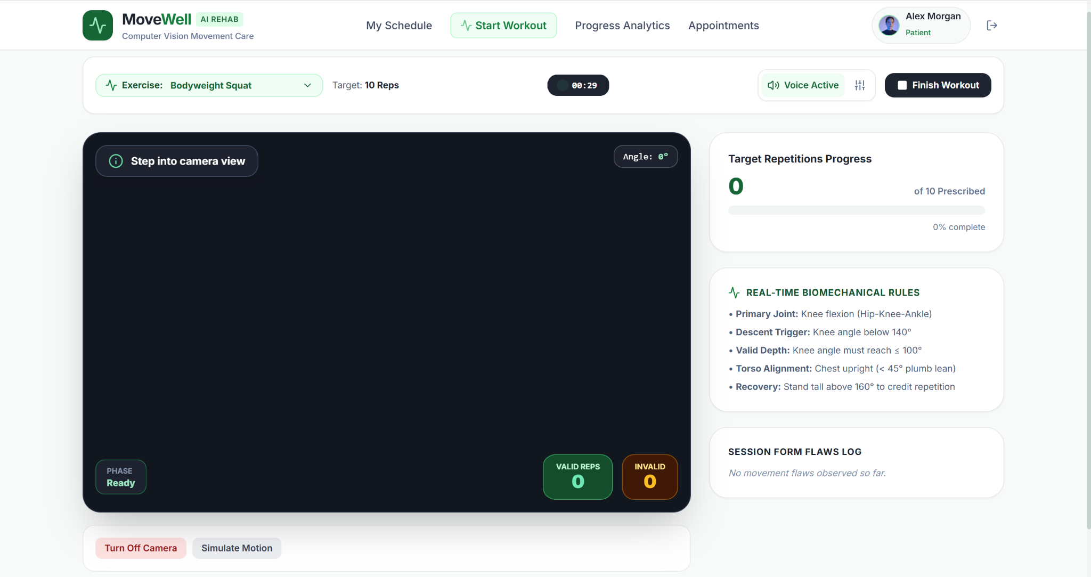
Real-Time Body Tracking
MediaPipe Pose Landmarker traces the user's movement through anatomical landmarks
33 body landmarks
The pose model extracts landmarks across the head, shoulders, elbows, wrists, hips, knees, ankles and feet.
Skeleton overlay
A transparent Canvas layer connects landmarks so the visual skeleton follows the user's body in real time.
Confidence-aware tracking
If key landmarks are not visible or confidence is too low, the system pauses assessment instead of producing misleading measurements.
05

Slide 6
Example: Intelligent Squat Assessment
A repetition is counted only after the required movement cycle and quality checks
STANDING
Ready
DESCENDING
Angle decreases
BOTTOM
≤ 100°
ASCENDING
Returning
VALID REP
+1
Quality checks
Depth must be reached, torso alignment must remain within the configured threshold, and the user must return to standing before the repetition is counted.
Knee angle → 96°
If correct
If incorrect
VALID REP +1
Feedback + invalid attempt
06

Slide 7
Real-Time Feedback
The system responds to actual movement quality, not pre-filled messages
Good movement
Insufficient depth
Excessive lean
✓ Correct depth
✓ Acceptable posture
→ Count repetition
⚠ “Squat lower for full depth.”
→ Do not count as valid
⚠ “Keep your chest upright.”
→ Record form issue
Session Form Flaws Log
Voice + visual guidance
The workout stores observable problems such as incomplete depth or excessive torso lean so the session summary can show where technique broke down.
Web Speech API can announce corrections, while the interface shows the current phase, angle, feedback state and repetition count.
07

Slide 8
Patient Experience
From assigned plan to measurable rehabilitation progress
PLAN
Clinician assigns exercises
WORKOUT
Live camera + AI
SUMMARY
Session metrics
PROGRESS
Trends
Dashboard
Session history
Analytics
Recovery stage, assigned exercises, valid reps, form accuracy, adherence and clinician recommendations.
Duration, valid/invalid repetitions, accuracy and review status.
Form-accuracy trends and valid vs. invalid repetition history.
Outcome
The patient gets immediate guidance during the exercise and longitudinal visibility after the session.
08

Slide 9
Physiotherapist Portal
Turning workout data into remote rehabilitation oversight
1. Patient roster
2. Prescription builder
3. Patient deep-dive
View supervised patients, rehabilitation stage, adherence and latest form accuracy.
Create plans with exercises, sets, reps, schedules and clinician instructions.
Review session history, movement flaws and performance trends.
Weekly report
Clinical interaction
Summarizes adherence, average form accuracy, valid/invalid repetitions and common flaws.
Recommendations and appointment/telehealth workflows keep the patient connected to the clinician.
Core benefit
Less reliance on manual follow-up, with structured evidence of home exercise performance.
09

Slide 10
System Architecture
The website combines a client-side CV engine with a clinical management backend
PATIENT / FRONTEND
BACKEND / DATA
ML / RESEARCH
React + TypeScript
Webcam
MediaPipe Pose Landmarker
Canvas skeleton
Joint-angle calculations
Exercise FSM
Live feedback
Recharts analytics
FastAPI
JWT authentication
Pydantic validation
SQLAlchemy ORM
SQLite for local development
PostgreSQL for production
Workout sessions
Plans
Appointments
Clinical notes
UI-PRMD dataset
Feature extraction
Subject-independent evaluation
Random Forest benchmark
Future extensions:
severity scoring
recovery prediction
wearables
EHR integration
Privacy principle
Process pose data client-side where practical; persist structured session metrics rather than raw webcam video.
10

Slide 11
Future Scope
Where the platform can evolve beyond the current prototype
01 Personalized AI plans
02 Severity & recovery prediction
Adapt rehabilitation plans based on observed progress.
Use ML to estimate progression from longitudinal movement data.
03 Wearable integration
04 Multilingual voice guidance
Combine camera-based assessment with sensor data.
Make spoken exercise guidance more accessible.
05 EHR integration
Connect structured rehabilitation information with electronic health records.
11

Slide 12
MoveWell: Quality Over Quantity
MoveWell combines computer vision, biomechanical movement assessment and rehabilitation management into one platform.
The core principle is simple: a repetition should be counted only when the required movement is completed correctly.
Patients receive immediate guidance while physiotherapists gain structured visibility into home-based rehabilitation progress.
REAL CAMERA
+
REAL POSE TRACKING
+
REAL FORM ASSESSMENT
+
REAL PROGRESS
AI-POWERED REHABILITATION
12

