Slide 1



VERSION CONTROL
Strategy for Git Workflow and Snowflake Folder Structure for DNA
Prepared by
Aditya Chobe (Technical Lead -Snowflake)
Swanand Khati (Sr. Content Developer)

Slide 2
Introduction
Version Control is an important part of any development process.
It helps
Revert changes
Track forward changes effectively
Keep the product afloat in risk events
Lets teams work on their own, collaborate, and maintain multiple versions.

Slide 3
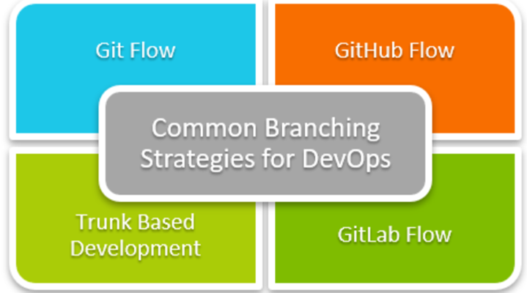
Overview
A Git branching strategy allows developers to collaborate on a project while also tracking changes and maintaining multiple versions of the codebase. There are several Git branching strategies available, each with its own set of advantages and disadvantages. The best strategy is determined by the project’s and team’s unique requirements.
Team Size | Recommended Strategies | Reasoning
Small team (1 - 5 members) | Trunk Based development, GitHub Flow | Simpler strategies minimize overhead and facilitate rapid integration.
Medium team (6 - 20 members) | Github Flow, Feature Branching | Structured branching to handle multiple features and tasks simultaneously.
Large team (20+) | Feature Branching, Git Flow | A structured approach to managing multiple parallel developments and releases.

Slide 4
Where We Are Now
Currently, snowflake code base is stored on Sharepoint. This is to be moved to GitHub remote repository managed by ATT, accessible only through HVD systems.

Slide 5

What’s To Be Achieved
Maintained History of Changes
Cross-Team Collaborative Development
Achieve Stable & Reliable Releases
Streamlined Review and Approval

Slide 6
Proposed Git Remote Repository Branches
Branch Name | Description | Naming Conventions
MASTER | Hosts last known stable code (typically from previous deployment) as backup till current deployment is tested for post-prod sanity. After sanity test and verification, prod is merged into master. | master
PROD | Production ready code will be pulled from here and deployed to production environment. | prod
DEVELOP | Collect all implemented features. Will host all features under development, irrespective of sign-off. | develop
RELEASE | Temporary Branch: Merge signed-off features for pre-prod testing. | release_{deployment_date in mm_dd_yyyy}
UAT / QA | Merge completed features for testing on UAT Environment. | qa
Feature Branch(es) | Feature branches created from and synced with master. Deleted after prod sync with master. | feature_{name_of_the_feature}
HOT_FIX | Temporary branch: Cloned from PROD to address post-prod issues. Deleted when current stable code is deployed. | hot_fix_{deployment_date in mm_dd_yyyy}

Slide 7
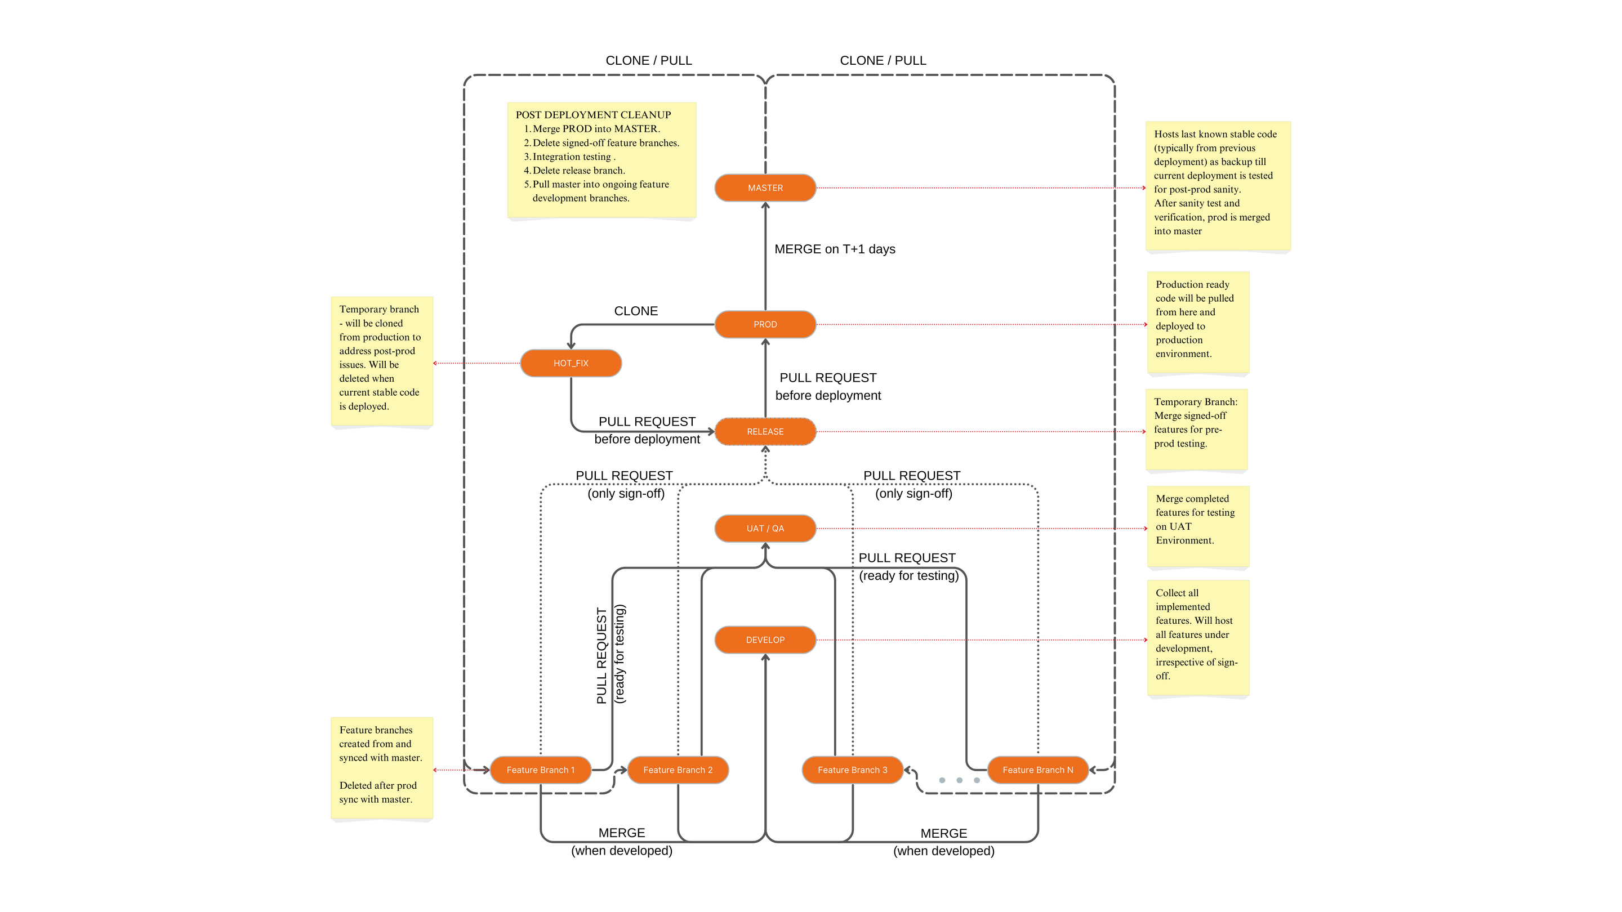
Branching and Merging Strategy

Slide 8

Branching & Merge Strategy
Development Begins | Developers clone the MASTER branch into individual FEATURE branches.
Feature Development | Features are worked on regardless of the status of other features.
Feature to Development Branch | FEATURE branch merges into DEVELOP branch for deployment to the development environment.
Unit Testing | Unit tests are performed on the DEVELOP environment.
Bug Fixes/Changes | Changes are committed back to the FEATURE branch and merged into DEVELOP again.

Slide 9
Branching & Merge Strategy
Feature to QA/UAT | FEATURE branches merge into UAT/QA for deployment to the UAT environment.
QA Testing and Approval | QA testing is completed, and sign-offs are received for approved features.
Release Preparation | Approved FEATURE branches merge into RELEASE. UAT already contains these features—no re-deployment to UAT.
Pre-Production Testing | Pre-PROD testing occurs on UAT for signed-off features.
Release to Production | RELEASE merges into PROD, and code is deployed to production.
Post-Production Testing | After sanity checks on production, PROD merges into MASTER on T+1.
MASTER branch now has the last known stable code.

Slide 10
Hot Fix Scenario
Data will be pulled from the MASTER branch and deployed temporarily while post-prod issues are being addressed.
A temporary branch, HOT_FIX will be cloned from the PROD branch. All hot fixes will be applied here, and the code will be pushed into RELEASE.
Development and QA teams will collaborate to resolve these post-production issues and push the codebase post-resolution to the PROD branch.
The fixed code in PROD is then deployed to the production environment.
Deployed code is tested for sanity and successful working.
When deemed at stable, this code will now be merged into MASTER.
MASTER branch now has the last known stable code.

Slide 11

Merge Protocol
PULL REQUESTS | CODE REVIEW | CONFLICT RESOLUTION
Use pull requests (PRs) or merge requests (MRs) for all merges. Developer has to create a pull request after completing their feature development. | Perform peer review before creating/approving any new merge requests. Respective sr. developers/team leads will review and then approve the merge request. | Resolve all merge conflicts before integration.

Slide 12
Access and Permissions
Developers | Reviewers | Admins
·Read/write access to `feature` and `develop` branches. | Approval rights for Pull Requests / Merge Requests. | Manage repository settings and permissions.
All developers will have this role by default. | Senior developers / Team Leads | Managers / Technical Leads

Slide 13

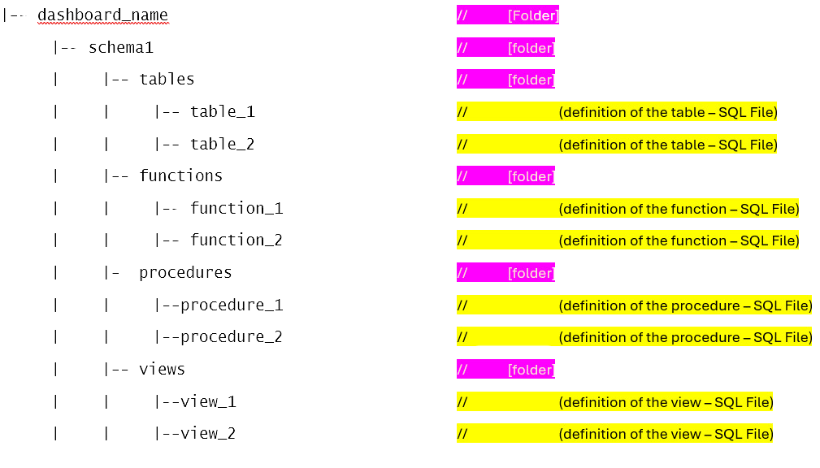
Folder
Structure

Slide 14
Tools /Platforms to be Used
VSCode
Supports Snowflake integration: Offers a very similar interface for all coding and development purposes.
Version Control: Has built-in Git integration for all git related activities.
ATT GitHub
All pull requests are to be created from here. Developers will push code to the remote branch, the create the pull request from the remote repository.

Slide 15


IMPLEMENTATION TO BEGIN IMMEDIATELY.

