Slide 1
Final Project
Sophia S

Slide 2
What do I want to know?
What are some unexpected patterns found in this dataset?
What attributes may effect population growth across the 12 islands sampled?
I chose to do these questions because I am curious about the population and environment of 12 tropical islands. Climate change is decimating these populations, so I would like to see if my questions can be answered based on the data and the algorithms collected.

Slide 3
Dataset
Had to change-not enough data
Culmination of data from https://ourworldindata.org/country/marshall-islands and https://climateknowledgeportal.worldbank.org/download-data
Changed to: Marshall Islands, Puerto Rico, Samoa, Bahamas, Kiribati, Barbados, Jamaica, Fiji, Tonga, Solomon Islands, New Zealand, and Madagascar
Based on Island size and tropical climate, not ocean location

Slide 4
Dataset (cont.)
12 islands
For each island, data on (from the ranges 1990-2016):
Precipitation
Temperature
Cancer Incidence
Deaths from Asthma
Prevalence of Mental Health disorders
Total Population
Asthma Prevalence
Chose health issues that are influenced by environment

Slide 5
Preprocessing
Temperature and rainfall converted to yearly averages from monthly
Needed a class value for population increase (0 for yes, 1 for no)
Created a program to achieve these needs
Converted island names to values between 1 and 12
Needed to give each tuple a “cluster code”, so abbreviated name and gave a number between 0 and 26 (exp: tuple 1 of Marshall Islands becomes MI1)

Slide 6
Algorithms
ID3 and Agglomerative Clustering-Single linkage
Why these?
AG Clustering gives unexpected patterns
ID3 classifies, would like to see what attributes are influencing population increase or decrease
Programs: ‘clusterstudent.py’ and ‘classification2.py’
I created clusterstudent.py in HW2, classification2.py provides a visual ID3 tree, handles continuous attributes better
classification2.py creates test/training set, testing set is 30%

Slide 7
Clustering
Ran twice, once with island code and once without island code
Results were both different:
Run 1 had 3 clusters, Run 2 had 2 clusters
Both took 322 iterations

Slide 8
Clustering (cont.)
Run 1: including island code
['MA22 MA3 NZ11 SI13 TO22 TO12 TO2 FI19 FI9 JA26 JA16 JA6 BR23 BR13 BR3 KI13 KI14 MA23 MA4 NZ12 SI14 SI15 MA24 MA5 NZ13 SI16 SI17 MA25 MA6 NZ14 SI18 TO23 TO13 TO3 FI20 FI10 FI0 JA17 JA7 BR24 BR14 BR4 KI15 KI16', 'MA26 MA7 NZ15 SI19 TO24 TO14 TO4 FI21 FI11 FI1 JA18 JA8 BR25 BR15 BR5 KI17 KI18 MA8 NZ16 SI20 TO25 TO15 TO5 FI22 FI12 FI2 JA19 JA9 BR26 BR16 BR6 KI19 KI20 MA9 NZ17 SI21 SI22 MA10 NZ18 SI23 SI24 MA11 NZ19 SI25 SI26NZ0 MA12 NZ20 NZ1 TO26 TO16 TO6 FI23 FI13 FI3 JA20 JA10 JA0 BR17 BR7 KI21 KI22 MA13 NZ21 NZ2 SI0 TO17 TO7 FI24 FI14 FI4 JA21 JA11 JA1 BR18 BR8 KI23 KI24', 'MA14 NZ22 NZ3 SI1 TO18 TO8 FI25 FI15 FI5 JA22 JA12 JA2 BR19 BR9 KI25 KI26 MA15 NZ23 NZ4 SI2 SI3 MA16 NZ24 NZ5 SI4 TO19 TO9 FI26 FI16 FI6 JA23 JA13 JA3 BR20 BR10 BR0 KI9 KI7 KI5 KI3 KI1 BA26 BA24 BA22 BA20 BA18 BA16 BA14 BA12 BA10 BA8 BA6 BA4 BA2 BA0 SA25 SA23 SA21 SA19 SA17 SA15 SA13 SA11 SA9 SA7 SA5 SA3 SA0 PR26 PR25 PR24 PR23 PR22 PR21 PR20 PR19 PR18 PR17 PR16 PR15 PR14 PR13 PR12 PR11 PR10 PR9 PR8 PR7 PR6 PR5 PR4 PR3 PR2 PR1 PR0 MI26 MI25 MI24 MI23 MI22 MI21 MI20 MI19 MI18 MI17 MI16 MI15 MI14 MI11 MI10 MI9 MI8 MI7 MI6 MI5 MI4 MI3 MI2 MI1 MI0 MI12 MI13 MA17 NZ25 NZ6 SI5 SI6 MA18 NZ26 NZ7 SI7 TO20 TO10 TO0 FI17 FI7 JA24 JA14 JA4 BR21 BR11 BR1 KI10 KI8 KI6 KI4 KI2 KI0 BA25 BA23 BA21 BA19 BA17 BA15 BA13 BA11 BA9 BA7 BA5 BA3 BA1 SA26 SA24 SA22 SA20 SA18 SA16 SA14 SA12 SA10 SA8 SA6 SA4 SA1 SA2 MA19 MA0 NZ8 SI8 SI9 MA20 MA1 NZ9 SI10 TO21 TO11 TO1 FI18 FI8 JA25 JA15 JA5 BR22 BR12 BR2 KI11 KI12 MA21 MA2 NZ10 SI11 SI12']

Slide 9
Clustering (cont.)
Run 2: excluding island code
['MA26', 'MA25 MA24 MA23 MA22 MA21 MA20 MA19 MA18 MA17 MA16 MA15 MA14 MA13 MA12 MA11 MA10 MA9 MA8 MA7 MA6 MA5 MA4 MA3 MA2 MA1 MA0 NZ26 NZ25 NZ24 NZ23 NZ22 NZ21 NZ20 NZ19 NZ18 NZ17 NZ16 NZ15 NZ14 NZ13 NZ12 NZ11 NZ10 NZ9 NZ8 NZ7 NZ6 NZ5 NZ4 NZ3 NZ2 NZ1 SI26NZ0 SI25 SI24 SI23 SI22 SI21 SI20 SI19 SI18 SI17 SI16 SI15 SI14 SI13 SI12 SI11 SI10 SI9 SI8 SI7 SI6 SI5 SI4 SI3 SI2 SI1 SI0 TO26 TO25 TO24 TO23 TO22 TO21 TO20 TO19 TO18 TO17 TO16 TO15 TO14 TO13 TO12 TO11 TO10 TO9 TO8 TO7 TO6 TO5 TO4 TO3 TO2 TO1 TO0 FI26 FI25 FI24 FI23 FI22 FI21 FI20 FI19 FI18 FI17 FI16 FI15 FI14 FI13 FI12 FI11 FI10 FI9 FI8 FI7 FI6 FI5 FI4 FI3 FI2 FI1 FI0 JA26 JA25 JA24 JA23 JA22 JA21 JA20 JA19 JA18 JA17 JA16 JA15 JA14 JA13 JA12 JA11 JA10 JA9 JA8 JA7 JA6 JA5 JA4 JA3 JA2 JA1 JA0 BR26 BR25 BR24 BR23 BR22 BR21 BR20 BR19 BR18 BR17 BR16 BR15 BR14 BR13 BR12 BR11 BR10 BR9 BR8 BR7 BR6 BR5 BR4 BR3 BR2 BR1 BR0 KI26 KI25 KI24 KI23 KI22 KI21 KI20 KI19 KI18 KI17 KI16 KI15 KI14 KI13 KI12 KI11 KI10 KI9 KI8 KI7 KI6 KI5 KI4 KI3 KI2 KI1 KI0 BA26 BA25 BA24 BA23 BA22 BA21 BA20 BA19 BA18 BA17 BA16 BA15 BA14 BA13 BA12 BA11 BA10 BA9 BA8 BA7 BA6 BA5 BA4 BA3 BA2 BA1 BA0 SA26 SA25 SA24 SA23 SA22 SA21 SA20 SA19 SA18 SA17 SA16 SA15 SA14 SA13 SA12 SA11 SA10 SA9 SA8 SA7 SA6 SA5 SA4 SA3 SA2 SA0 PR26 PR25 PR24 PR23 PR22 PR21 PR20 PR19 PR18 PR17 PR16 PR15 PR14 PR13 PR12 PR11 PR10 PR9 PR8 PR7 PR6 PR5 PR4 PR3 PR2 PR1 PR0 MI26 MI25 MI24 MI23 MI22 MI21 MI20 MI19 MI18 MI17 MI16 MI15 MI14 MI13 MI12 MI11 MI10 MI9 MI8 MI7 MI6 MI5 MI4 MI3 MI2 MI0 MI1 SA1']

Slide 10
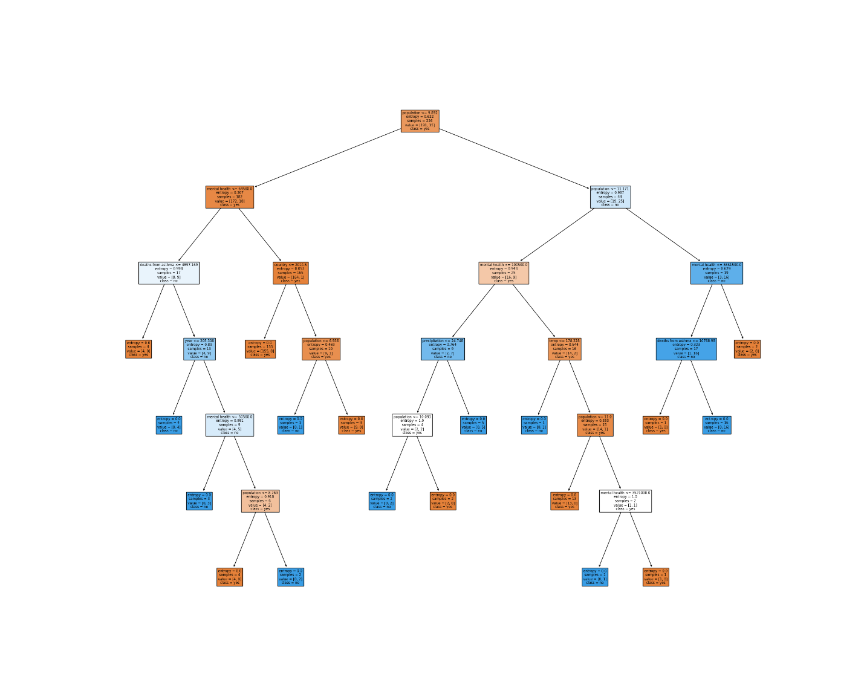
ID3
Ran 3 different times
Result of run 1:
No pruning
Bit difficult to read the output, also many paths

Slide 11
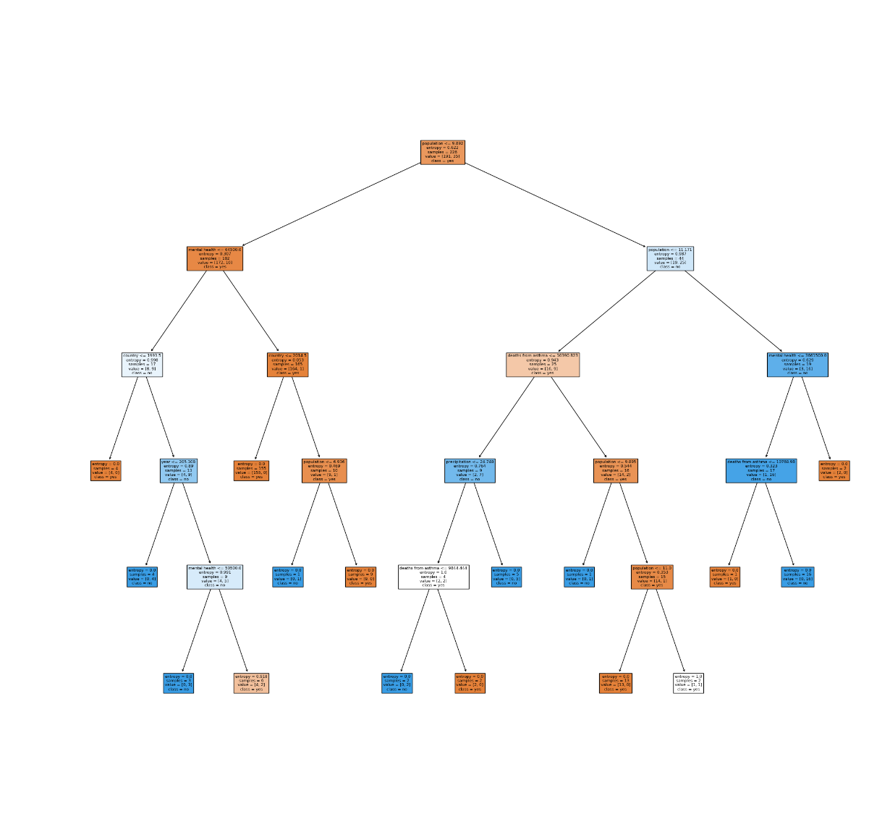
ID3 (cont.)
Run 2:
max_depth = 5
Bit easier to read, here are some rules:
Left side
IF population <= 9.982 and mental health incidence <= 64500.0 and country <= 1993.5 and year <= 205.308 and mental health incidence <= 50500.0 then N
IF population <= 9.982 and mental health incidence <= 64500.0 and country <= 2014.5 and population <= 6.936, then Y
Right side
IF population <= 9.982 and population <= 11.171 and deaths from asthma <= 10390.823 and precipitation <= 24.748 and deaths from asthma <= 9844.444, then Y
IF population <= 9.982 and population <= 11.171 and deaths from asthma <= 10390.823 and population <= 9.895 and population <= 11.0 then Y
IF population <= 9.982 and population <= 11.171 and mental health <= 3661500.0 and deaths from asthma <= 10768.90, then N.

Slide 12
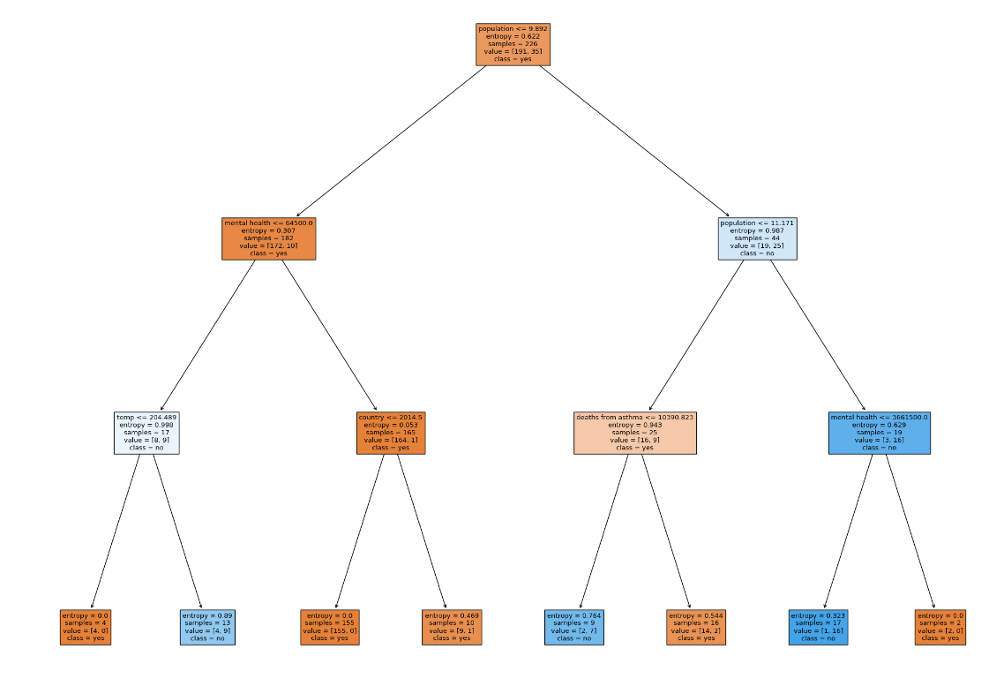
ID3 (cont.)
Run 3
max_depth = 3
Left side
IF population <= 9.982 and mental health incidence <= 64500 and temp <= 204.489 then N
IF population <= 9.982 and mental health incidence <= 64500 and country <= 2014.5 then Y
Right side
IF population <= 9.982 and population <= 11.171 and deaths from asthma is less than 10390.823, then Y
IF IF population <= 9.982 and population <= 11.171 and mental health incidence <= 3661500.0 then N

Slide 13
Conclusion
Issues with attribute choice
how are population and asthma prevalence related? I should have been asking those questions in the beginning and chose attributes that made more sense together.
How are they related to environment???
Clustering output is confusing
why those clusters; I cannot find many similarities.
I am thinking maybe the algorithm weighted the temperature more than anything, since some of the clusters seem close together based on their temperature, but I am unsure.
ID3 shows mental health indicators, deaths from asthma, and population levels affect whether the population increased or decreased

Slide 14
H.A.G.S ☺

